Slide 1
ANTICOAGULATION
Blake Wachter, MD, PhD
Monday Morning Conference
Oct 4, 2010

Slide 2
Classes
Vitamin K Antagonists
Coumarins
Factor Xa Inhibitors
Heparins
Direct factor Xa inhibitors
Direct thrombin inhibitors
Rivaroxaban
Dabigatran

Slide 3
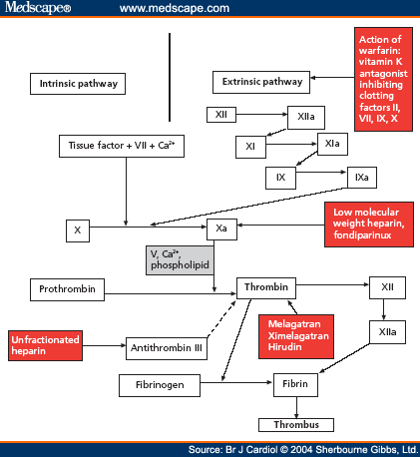
PT/INR
PTT
Unfractionated heparin
Extrinsic Pathway
Intrinsic Pathway
XIIa
Vitamin K antagonists, Inhibiting clotting factors: II, VII, IX, X
VII
XIa
IX
IXa
Low molecular weight heparins, fondiparinux
X
Xa
Prothrombin (II)
Thrombin (IIa)
Direct thrombin inhibitors
Antithrombin III

Slide 4
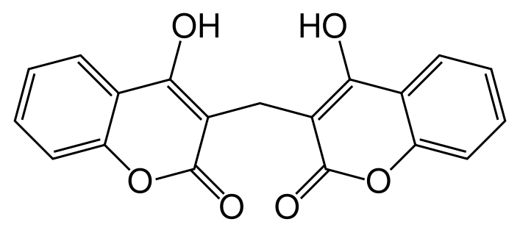
Vitamin K Antagonists
In 1940 an agent was discovered in wet sweet-clover hay which caused a bleeding disease in cattle. Many cattle died from hemorrhaging after minor procedures (castration, de-horning)
Dicoumarol
Prototype of the 4-hydroxycoumarin derivative anticoagulant drug class
University of Wisconsin
Coumarins are present in many plants
Produce the sweet smell of freshly cut grass or hay
Also present in lavender, licorice
Need to be metabolized by various fungi into the 4-dyroxycoumarin compound

Slide 5
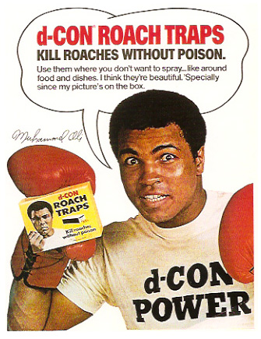
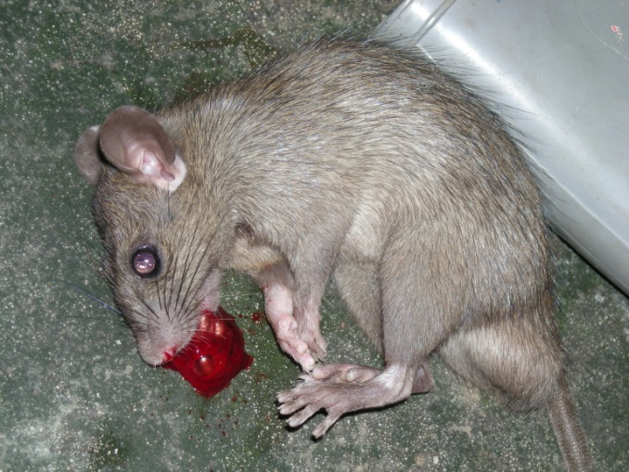
Vitamin K Antagonists
Coumatetralyl, brodificoum, diaphacinone, diaphacinone
A.k.a. Rat poison
Toxicity causes failure of extrinsic and intrinsic clotting pathway
Works best with repeated exposure
Kids and pets
Green dye for a characteristic appearance in the mouth
½ life of about 30 days

Slide 6
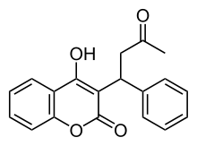
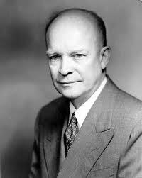
Vitamin K Antagonists
Warfarin
Originally used as rat poison
1951, US Army inductee ingested Warfarin, hospitalized, treated with vitamin K, and lived
University of Wisconsin (WARF – arin)
Wisconsin Alumni Research Foundation
Inhibits vitamin K epoxide reductase
½ life 1-2 days
Decrease clotting action by 30-50%
In 1954 approved for medical use in humans
Dwight Eisenhower prescribed Warfarin after heart attack in 1955
Rumor that Joseph Stalin was poisoned with warfarin

Slide 7
Other Vitamin K Antagonists
Phenprocoumon
Longer half life
Warfarin superior to phenprocoumon
Van Leeuwen Y. #LB-MO-001. Presented at: XXII Congress of the International Society on Thrombosis and Hemostasis; July 11-16, 2009; Boston.
Ximelagatran (Exanta)
The replacement for warfarin because of less drug and dietary interactions, less monitoring
AstraZeneca withdrew it from the market in 2006 because of hepatotoxicity

Slide 8
PT/INR
PTT
Extrinsic Pathway
Intrinsic Pathway
Vitamin K antagonists, Inhibiting clotting factors: II, VII, IX, X
VII
IX
X
Prothrombin (II)

Slide 9
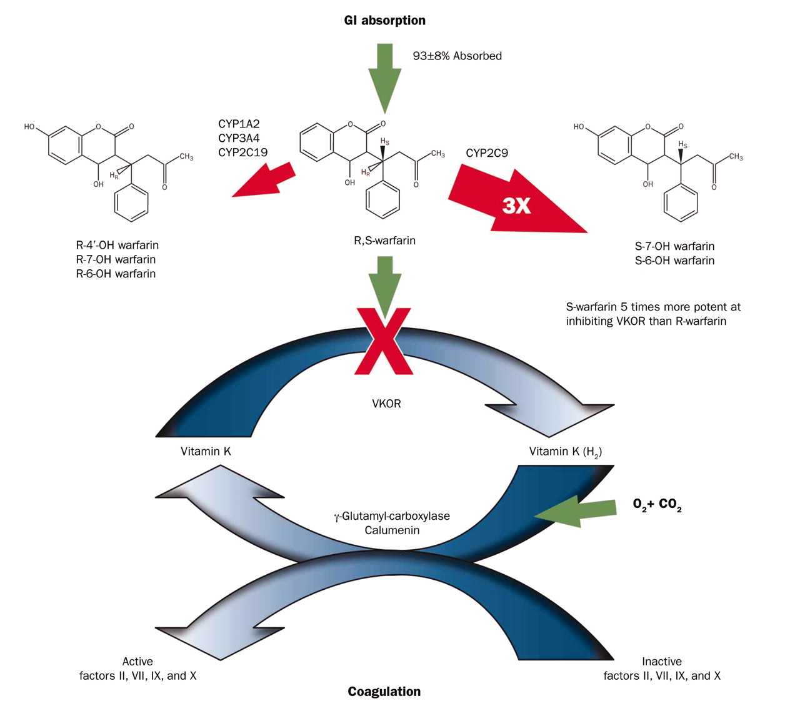
The coagulation cascade is inhibited by warfarin
Moyer T P et al. Mayo Clin Proc. 2009;84:1079-1094
© 2009 Mayo Foundation for Medical Education and Research
Notes:
The coagulation cascade is inhibited by warfarin (see Figure 1). Warfarin, an enantiomeric mixture of equal concentrations of R- and S-forms, is 93%±8% absorbed from the gastrointestinal (GI) tract. Hepatic enzymes metabolize warfarin. Cytochrome P450 isomer 2C9 (CYP2C9) selectively converts S-warfarin into inactive hydroxylated metabolites. Cytochrome P450 isomers 1A2, 3A4, and 2C19 (CYP1A2, CYP3A4, and CYP2C19) selectively metabolize R-warfarin into inactive hydroxylated metabolites. The pace of metabolism for S-warfarin is approximately 3 times (3×) faster than for R-warfarin. The potency of S-warfarin at inhibiting vitamin K epoxide reductase (VKOR) is approximately 5 times that of R-warfarin. CO2 = carbon dioxide; O2 = oxygen; OH = hydroxide.

Slide 10
Therapeutic Uses
Atrial fibrillation
Artificial heart valves
Deep venous thrombosis
Pulmonary embolism
Antiphospholipid syndrome
Not for thromboses in coronary arteries
Contraindications: pregnancy

Slide 11
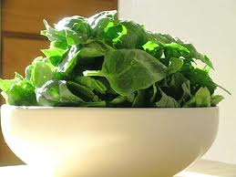
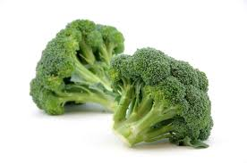
Drug/Food Interactions
Acetaminophen (Tylenol)
Alcohol
Amiodarone (Cordarone)
Adjustment per Amiodarone maintenance dose
Amiodarone 400 mg/day: Reduce Warfarin dose 40%
Amiodarone 300 mg/day: Reduce Warfarin dose 35%
Amiodarone 200 mg/day: Reduce Warfarin dose 30%
Amiodarone 100 mg/day: Reduce Warfarin dose 25%
Reference
Sanoski (2002) Chest 121:19
Anabolic Steroids
Antifungal Medications
Fluconazole (Diflucan)
Ketoconazole (Nizoral)
Itraconazole (Sporanox)
Miconazole (Monistat)
Aspirin and Salicylates
Cephalosporins
Cefoperazone (Cefobid)
Cefamandole (Mandol)
Cefotetan (Cefotan)
Cefmetazole (Zefazone)
Chloral Hydrate
Cimetidine (Tagamet)
Clofibrate
Cranberry Juice (CYP2C9 inhibitor)
Appears safe in at least one clinical trial
Greenblatt (2006) Clin Pharmacol Ther 79:125
Danazol (Danocrine)
Diflunisal (Dolobid)
Disulfiram (Antabuse)
Fluvoxamine (Luvox)
Ginkgo Biloba (independent effect due to antiplatelet activity)
Heparin
HMG CoA Reductase inhibitors
Isoniazid (INH)
Macrolides
Erythromycin
Clarithromycin
Metronidazole (Flagyl)
Nalidixic Acid
NSAIDs
Omeprazole (Prilosec)
Paroxetine (Paxil)
Penicillin
Propafenone (Rythmol)
Quinidine
Quinolones
Sulfinpyrazone (Anturane)
Tamoxifen
Tetracycline
Thyroid Hormone (Thyroxine or Synthroid)
Ticlopidine (Ticlid)
Trimethoprim-Sulfamethoxazole (Bactrim, Septra)
Vitamin E

Slide 12
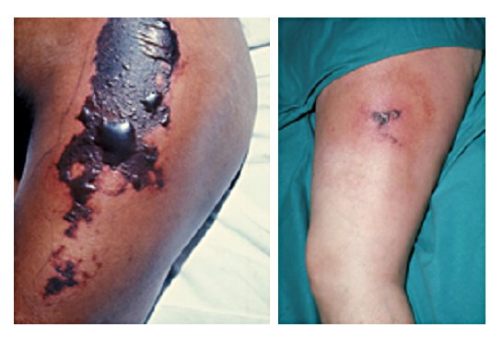
Adverse Effects
Risk of bleeding
0.9 – 2.7% within therapeutic range
Hemoptysis
Excessive bruising
Hematuria
Hematochesia
Increased risk of bleeding with clopidogrel, ASA, NSAIDS
Increased risk of bleeding in elderly and patients on hemodialysis
Necrosis – seen in patients with protein C deficiency
Osteoporosis

Slide 13
AFib Guidelines
Antithrombotic therapy is needed
Patients with high risk of stroke need vitamin K antagonists therapy (INR 2-3)
Prior stroke, TIA, systemic embolism, rheumatic MS, mechanical heart valve
Vitamin K antagonist if more than 1 moderate risk factor of stroke
> 75years old, hypertension, DM, heart failure
Aspirin (81-325mg daily), in low risk patients or contraindications to anticoagulation
Patients with AF and mechanical heart valve, INR at least 2.5
Antithrombotic therapy is recommended for patients with atrial flutter as for AF.
I
I
I
IIa
IIa
IIa
IIa
IIb
IIb
IIb
IIb
III
III
III
I
III
I
I
IIa
IIa
IIa
IIa
IIb
IIb
IIb
IIb
III
III
III
I
III
I
I
IIa
IIa
IIa
IIa
IIb
IIb
IIb
IIb
III
III
III
III
I
I
I
IIa
IIa
IIa
IIa
IIb
IIb
IIb
IIb
III
III
III
I
III
I
I
IIa
IIa
IIa
IIa
IIb
IIb
IIb
IIb
III
III
III
I
III
I
I
IIa
IIa
IIa
IIa
IIb
IIb
IIb
IIb
III
III
III
III
IIa
IIa
IIa
IIa
IIb
IIb
IIb
IIb
III
III
III
I
III
I
I
IIa
IIa
IIa
IIa
IIb
IIb
IIb
IIb
III
III
III
I
III
I
I
IIa
IIa
IIa
IIa
IIb
IIb
IIb
IIb
III
III
III
I
III
I
I

Slide 14
AFib Guidelines
For primary prevention of thromboembolism and non valvular AF with just 1 risk factor, recommend either ASA or vitamin K antagonist
> 75years old, hypertension, DM, heart failure
Nonvalvular AF with 1 or more less validated risks, recommend either ASA or vitamin K antagonist
Female, 65-74 years old, CAD
Anticoagulate paroxysmal, persistent, permanent the same
Nonvalvular AF, may stop therapy for 1 week if upcoming procedure
It is reasonable to re-evaluate the need for anticoagulation at regular intervals
IIa
IIa
IIa
IIa
IIb
IIb
IIb
IIb
III
III
III
I
III
I
I
IIa
IIa
IIa
IIa
IIb
IIb
IIb
IIb
III
III
III
I
III
I
I
IIa
IIa
IIa
IIa
IIb
IIb
IIb
IIb
III
III
III
I
III
I
I
A
IIa
IIa
IIa
IIa
IIb
IIb
IIb
IIb
III
III
III
I
III
I
I
IIa
IIa
IIa
IIa
IIb
IIb
IIb
IIb
III
III
III
I
III
I
I
IIa
IIa
IIa
IIa
IIb
IIb
IIb
IIb
III
III
III
I
III
I
I
B
IIa
IIa
IIa
IIa
IIa
IIa
IIa
IIa
IIb
IIb
IIb
IIb
IIb
IIb
IIb
IIb
III
III
III
III
III
III
III
I
III
I
I
I
I
I
IIa
IIa
IIa
IIa
IIa
IIa
IIa
IIa
IIb
IIb
IIb
IIb
IIb
IIb
IIb
IIb
III
III
III
III
III
III
III
I
III
I
I
I
I
I
IIa
IIa
IIa
IIa
IIa
IIa
IIa
IIa
IIb
IIb
IIb
IIb
IIb
IIb
IIb
IIb
III
III
III
III
III
III
III
I
III
I
I
I
I
I

Slide 15
AFib Guidelines
In older patients (>75) or unable to tolerate standard anticoagulation, lower INR target (1.6-2.0)
Bridge with LMWH or unfractionated heaparin in high risk patients off anticoagulation for > 1 week
After coronary revascularization and AF, add low dose ASA and/or clopidogrel concurrently with anticoagulation, but may have increased risk of bleeding
If undergoing PCI, then may stop anticoagulation but start back ASAP
Continue warfarin with the clopidogrel after PCI
If have stroke while on anticoagulation (INR 2-3), then increase intensity INR 3.0 – 3.5
Long-term anticoagulation is not recommended for primary stroke prevention in patients below age 60years without heart disease (lone AF)
IIa
IIa
IIa
IIa
IIb
IIb
IIb
IIb
III
III
III
I
III
I
I
IIa
IIa
IIa
IIa
IIb
IIb
IIb
IIb
III
III
III
I
III
I
I
IIa
IIa
IIa
IIa
IIb
IIb
IIb
IIb
III
III
III
I
III
I
I
IIa
IIa
IIa
IIa
IIb
IIb
IIb
IIb
III
III
III
I
III
I
I
IIa
IIa
IIa
IIa
IIb
IIb
IIb
IIb
III
III
III
I
III
I
I
IIa
IIa
IIa
IIa
IIb
IIb
IIb
IIb
III
III
III
I
III
I
I

Slide 16
Heparins
Unfractionated heparin
Low molecular weight heparin
Enoxaparin, Dalteparin, Tinzaparin
Oligosaccharides
Fondaparinux, Idraprinux
Heparinoids

Slide 17
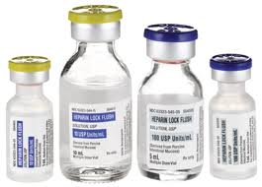
Heparin
Discovered in 1916
Originally isolated from canine liver cells
McLean and Howell
Discovered a fat soluble phosphotide anticoagulant in canine livers
Work derived from the Greek word liver
Jorpes, 1935, first human trials
Derived from porcine and bovine mucosal tissues
Physiologically present produced by basophils and stored by mast cells
Released in response to tissue injury
Given IV only b/c not absorbed by gut
½ life of 1 hour

Slide 18
Heparin Therapeutic Uses
Acute Coronary Syndrome
Atrial Fibrillation
Deep vein thrombosis
Pulmonary Embolism
Cardiopulmonary bypass
ECMO
Hemofiltration

Slide 19
Heparin Adverse Reactions
Heparin Induce Thrombocytopenia
immunological reaction against platelets
result in degradation of platelets
Elevation of serum aminotransferase
temporary and has no clinical significance
Hyperkalemia
heparin induced aldosterone suppression
Alopecia rare, osteoporosis rare
Contraindications
Severe liver disease, severe HTN, actively bleeding

Slide 20
PT/INR
PTT
Unfractionated heparin
Extrinsic Pathway
Intrinsic Pathway
XIIa
XIa
IXa
Xa
Antithrombin III

Slide 21
Heparins: Size matters
The formation of a ternary complex between AT, thrombin, and heparin results in the inactivation of thrombin. For this reason, heparin's activity against thrombin is size-dependent, the ternary complex requiring at least 18 saccharide units for efficient formation
In contrast, anti-factor Xa activity requires only the pentasaccharide binding site

Slide 22
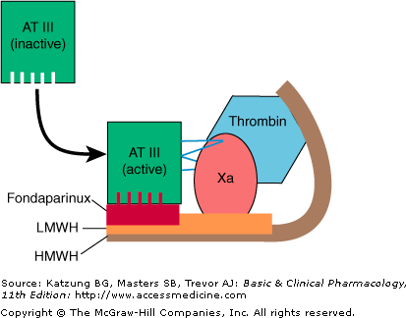
Notes:
Cartoon illustrating differences between fondaparinux, low-molecular-weight heparins (LMWH), and high-molecular-weight heparin (HMWH, unfractionated heparin). Activated antithrombin III (AT III) degrades thrombin, factor X, and several other factors. Binding of these drugs to AT III can increase the catalytic action of AT III 1000-fold. The combination of AT III with unfractionated heparin increases degradation of both factor Xa and thrombin. Combination with fondaparinux or LMWH more selectively increases degradation of Xa.

Slide 23
LMWH
Target anti-factor Xa rather than antithrombin
Reduced risk of osteoporosis and HIT
Do not need to monitor aPTT levels
Can measure factor Xa levels
Dalteparin, enoxaparin
CLOT trial 2003
Patients with malignancy and acute VTE, dalteparin was more effective than Coumadin to reduce the risk of recurrent embolic events

Slide 24
Fondaparinux
Unlike direct factor Xa inhibitors, fondaparinux mediates its effects indirectly through antithrombin III, but unlike heparin, it is selective for factor Xa
SQ injection daily

Slide 25
Comparison of Fondaparinux and Enoxaparin in Acute Coronary Syndromes (2006) – OASIS 5
Study Design
20,078 patients with ACS
fondaparinux (2.5mg SQ qday) or enoxaparin (1mg/kg SQ bid) for mean of 6 days
Primary outcome
refractory ischemia
Results
primary outcome events were similar
Rate of major bleed at 9 days significantly lower with fondaparinux compared to enoxaparin 2.2% vs 4.1% (p<0.001) and decreased number of deaths (p=0.02)
Conclusion
Similar in reducing risk of ischemic events at nine days but has significantly reduced major bleeding rate and improves long-term mortality and morbidity
Comparison of Fondaparinux and Enoxaparin in Acute Coronary Syndromes, The Fifth Organization to Assess Strategies in Acute Ischemic Syndromes Investigators, N Engl J Med 2006; 354:1464-1476April 6, 2006

Slide 26
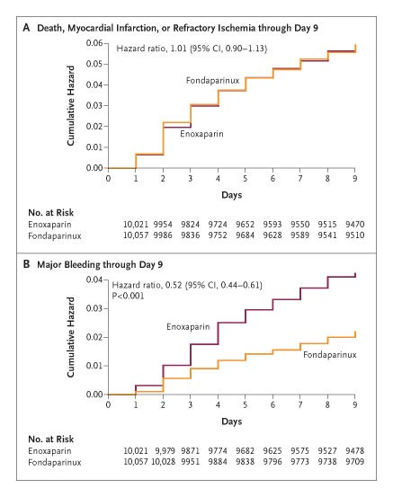
Cumulative Risks of Death, Myocardial Infarction, or Refractory Ischemia (Panel A) and of Major Bleeding (Panel B) through Day 9
The Fifth Organization to Assess Strategies in Acute Ischemic Syndromes Investigators N Engl J Med 2006;354:1464-1476

Slide 27
2009 Joint STEMI/PCI Focused Update Recommendations
Class 1
(Level of Evidence: C)
For prior treatment with fondaparinux, administer additional intravenous treatment with an anticoagulant possessing anti-IIa activity taking into account whether GP IIb/IIIa receptor antagonists have been administered.

Slide 28
Fondaparinux – 2010 ECS Update FUTURA/OASIS 8
Study Design
2026 patients with NSTEMI treated initially with fondaparinux to receive either low dose UFH (+/- GIIb/IIIa inhibitor) vs UFH + GIIb/IIIa inhibitor vs high dose UFH alone
At time of PCI, patients went on to receive clopidogrel and ASA daily
Results
With initial fondaparinux, low dose UFH had same frequency of bleeding events as standard dose UFH
Low dose UFH had marginally significantly increase in ischemic events

Slide 29
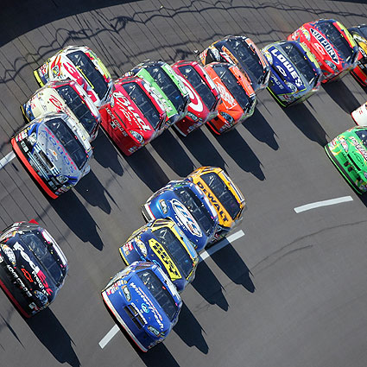

Slide 30
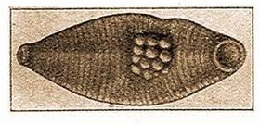
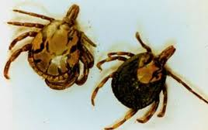
Direct Xa inhibitors (Xabans)
Direct on factor Xa, without antithrombin as a mediator
1987 isolated from extracts of Mexican Leach, Haementeria officinalis and tick, ornithodoros moubata

Slide 31
Xabans
Apixaban: phast II trials
2007: 1217 patients randomized to different doses of Apixaban vs enoxaparin vs warfarin showed it to be as safe following total knee
Edoxaban: phase II trials
2010: 903 patients with Edoxaban vs daltaparin with total hip replacement, incident of VTE was significantly lower in edoxaban group without significant increase in bleeding complications
2010: 1146 patients, compared different doses of edoxaban vs warfarin (INR 2-3) in patients with AF for stroke prevention and found it to be as safe as warfarin
Otamixaban: SEPIA-PCI trial – phase II trial
2007: 947 patients, comparing unfrac hep vs Otamixaban prior to non urgent PCI, found that Otamixaban had fewer prothrombin fragments but no difference in bleeding complications
Rivaroxaban – phase III trials
oral – VTE Studies with hip or knee replacement
Notes:
Raskob, G.; Cohen, A. T.; Eriksson, B. I.; Puskas, D.; Shi, M.; Bocanegra, T.; Weitz, J. I. (2010). "Oral direct factor Xa inhibition with edoxaban for thromboprophylaxis after elective total hip replacement". Thrombosis and Haemostasis.
Weitz, J. I.; Connolly, S. J.; Patel, I.; Salazar, D.; Rohatagi, S.; Mendell, J.; Kastrissios, H.; Jin, J. et al. (2010). "Randomised, parallel-group, multicentre, multinational phase 2 study comparing edoxaban, an oral factor Xa inhibitor, with warfarin for stroke prevention in patients with atrial fibrillation". Thrombosis and Haemostasis.
Lassen MR, Davidson BL, Gallus A, Pineo G, Ansell J, Deitchman D (2007). "The efficacy and safety of apixaban, an oral, direct factor Xa inhibitor, as thromboprophylaxis in patients following total knee replacement". J. Thromb. Haemost. 5 (12): 2368–75.
Turpie AG (2007). "Oral, direct factor Xa inhibitors in development for the prevention and treatment of thromboembolic diseases". Arterioscler. Thromb. Vasc. Biol. 27 (6): 1238–47.
Guertin KR, Choi YM (2007). "The discovery of the Factor Xa inhibitor otamixaban: from lead identification to clinical development". Curr. Med. Chem. 14 (23): 2471–81.

Slide 32
Rivaroxaban
Phase III trials, oral, no monitoring
Michael R. Lassen, M.D, Rivaroxaban versus Enoxaparin for Thromboprophylaxis after Total Knee Arthroplasty. N Engl J Med, Volume 358(26):2776-2786; June 26, 2008
This trial compared rivaroxaban with enoxaparin for thrombo-prophylaxis after total knee replacement
Rivaroxaban 10 mg PO qday vs Enoxaparin 40mg SQ qday, continued for 10-14 days, f/u at 30-35 days
Primary: composite of DVT, non fatal PE, or death from any cause
Rivaroxaban was superior to enoxaparin in the prevention of venous thrombosis, and the two drugs had similar safety profiles

Slide 33
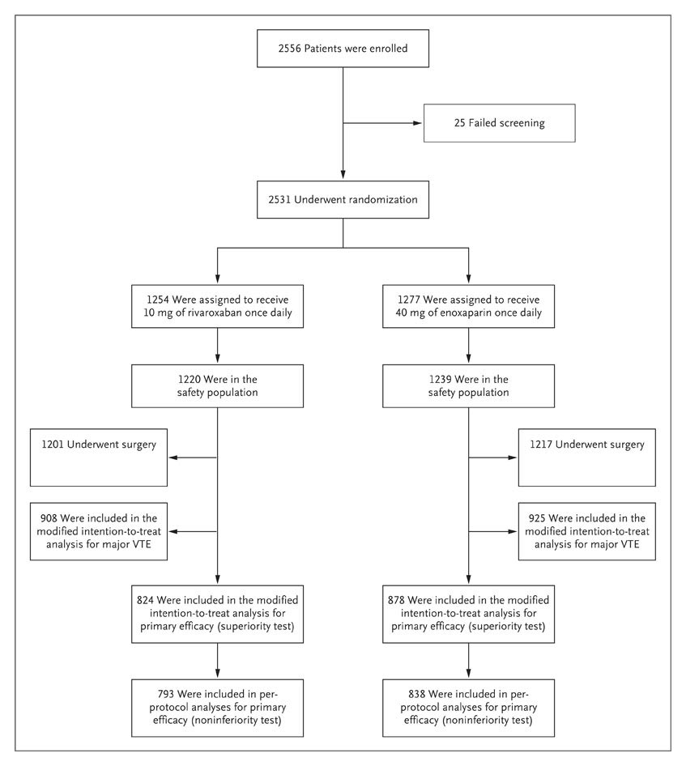
Enrollment, Randomization, and Follow-up of the Study Patients
Lassen MR et al. N Engl J Med 2008;358:2776-2786
Notes:
Figure 1. Enrollment, Randomization, and Follow-up of the Study Patients. Patients were included in the modified intention-to-treat population for major venous thromboembolism (VTE) if only the proximal veins were assessed.

Slide 34
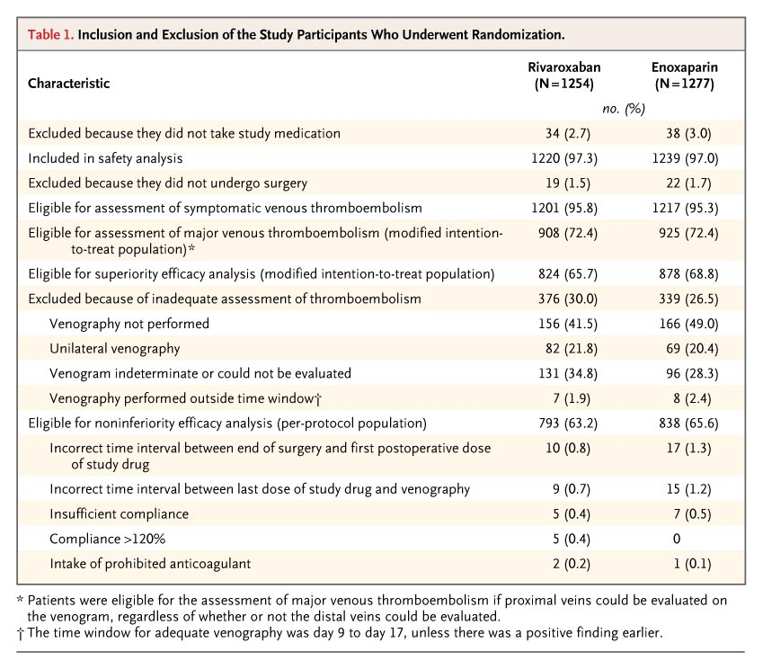
Inclusion and Exclusion of the Study Participants Who Underwent Randomization
Lassen MR et al. N Engl J Med 2008;358:2776-2786
Notes:
Table 1. Inclusion and Exclusion of the Study Participants Who Underwent Randomization.

Slide 35
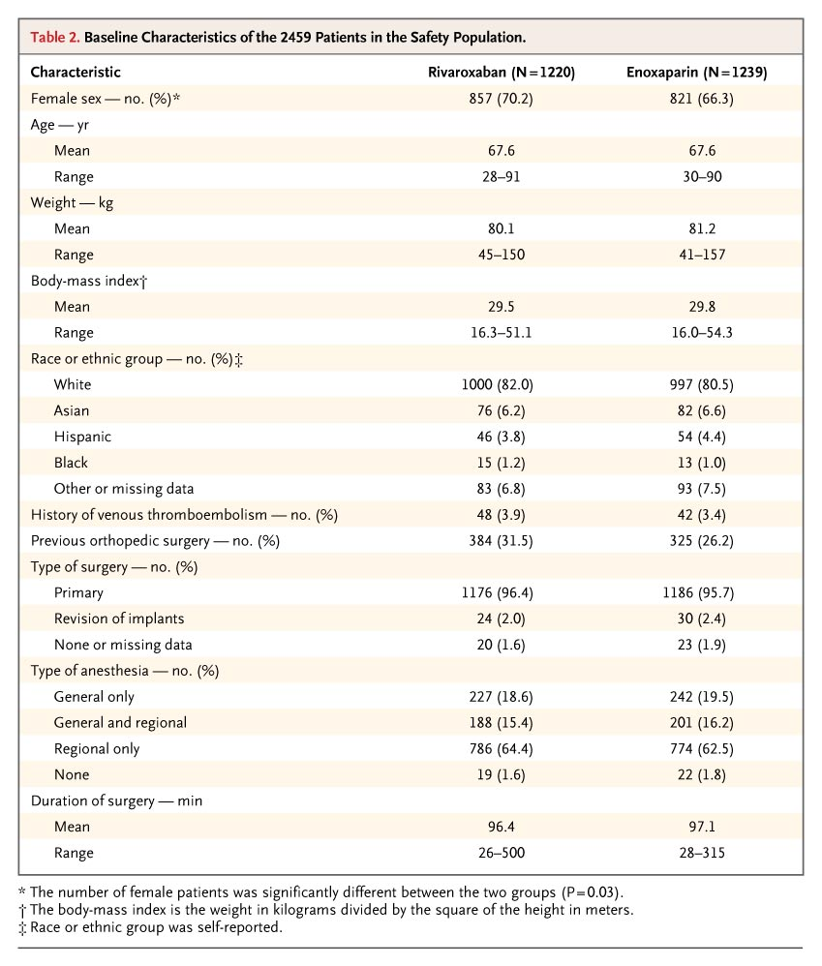
Baseline Characteristics of the 2459 Patients in the Safety Population
Lassen MR et al. N Engl J Med 2008;358:2776-2786
Notes:
Table 2. Baseline Characteristics of the 2459 Patients in the Safety Population.

Slide 36
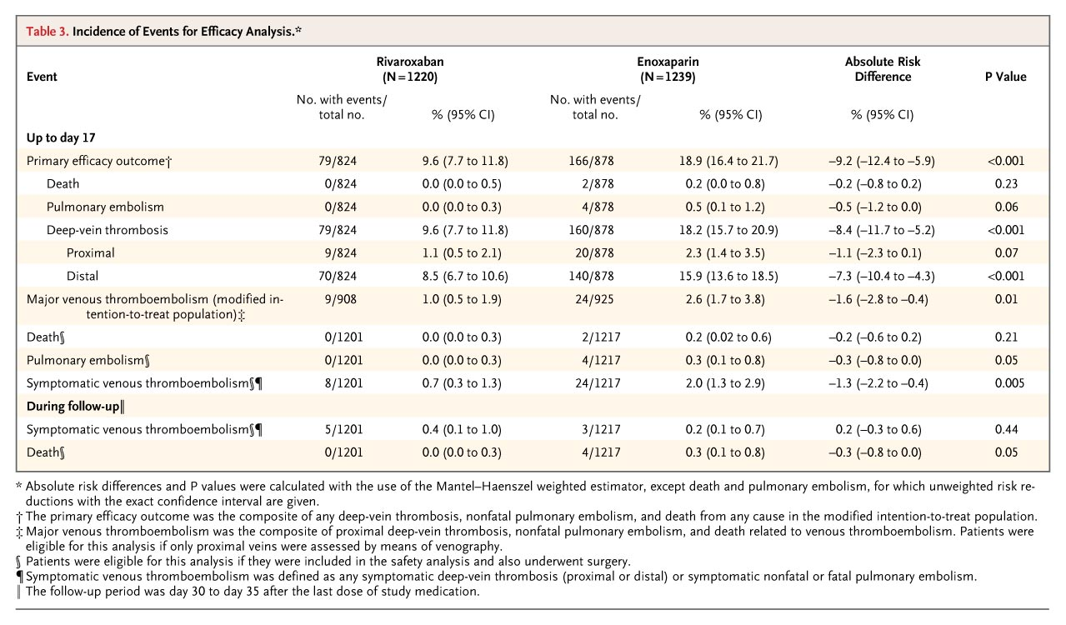
Incidence of Events for Efficacy Analysis
Lassen MR et al. N Engl J Med 2008;358:2776-2786
Notes:
Table 3. Incidence of Events for Efficacy Analysis.

Slide 37
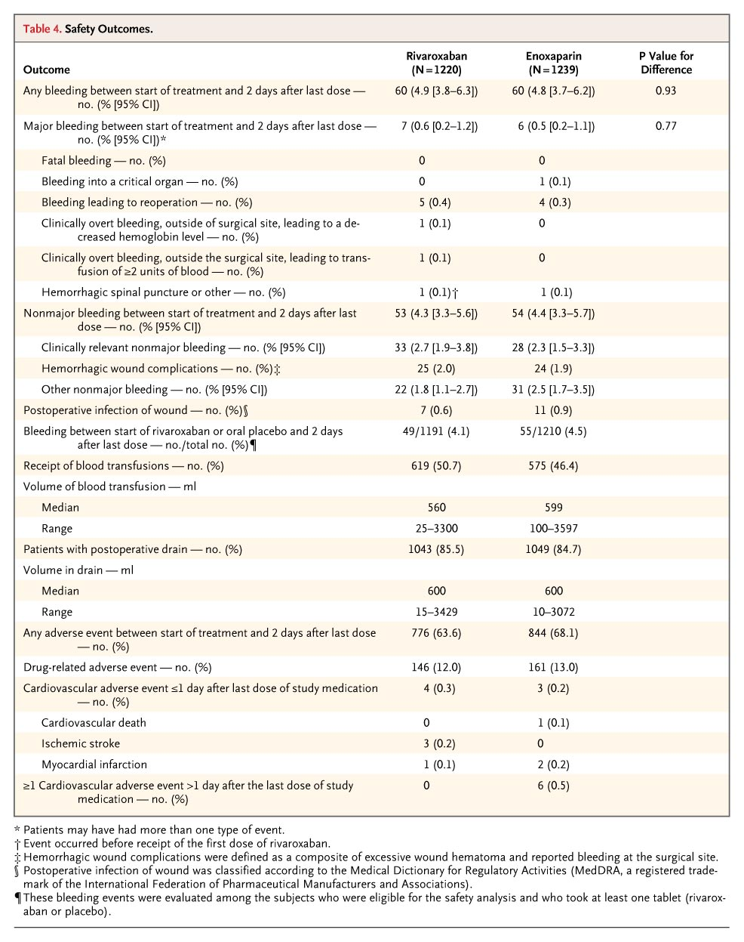
Safety Outcomes
Bleeding rate is consistent for both pharmaceuticals as reported in previous studies
Lassen MR et al. N Engl J Med 2008;358:2776-2786
Notes:
Table 4. Safety Outcomes.
Rivaroxaban was superior to enoxaparin for thromboprophylaxis after total knee arthroplasty, with similar rates of bleeding

Slide 38
EINSTEIN DVT
Trial design: Patients with acute deep venous thromboembolism were randomized to oral rivaroxaban 15 mg twice daily for 3 weeks, then 20 mg daily (n = 1,731) vs. enoxaparin 1 mg/kg twice daily ≥5 days, then warfarin with target INR 2-3 (n = 1,718).
Results
(p < 0.0001 for noninferiority)
Recurrent symptomatic venous thromboembolism: 2.1% of the rivaroxaban group vs. 3.0% of the enoxaparin group (p < 0.0001 for noninferiority, p = 0.076 for superiority)
Major and clinically relevant nonmajor bleeding: 8.1% of the rivaroxaban group vs. 8.1% of the enoxaparin group (p = 0.77)
3.0
%
2.1
Conclusions
Among patients with acute deep venous thromboembolism, the use of oral rivaroxaban was effective
This therapy was noninferior to subcutaneous enoxaparin with transition to warfarin in the prevention of recurrent symptomatic venous thromboembolism
Bleeding was similar between groups
Recurrent symptomatic venous thromboembolism
Rivaroxaban
Enoxaparin/warfarin
Presented by Dr. Harry Buller at ESC 2010

Slide 39
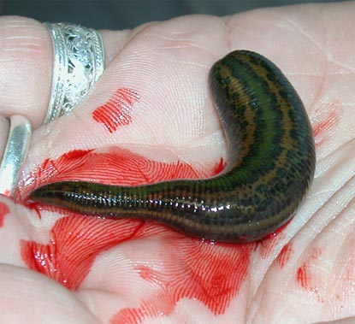
Direct Thrombin Inhibitors
Discovered in Hirudo medicinalis (leeches)
Bivalent: bind both to active site and exosite 1
Bivalirudin (good for renal failure patients)
Lepirudin
Desirudin
Univalent: bind to active site
Agatroban
Dabigatran
Ximelgatran
Melagatran

Slide 41
PT/INR
PTT
Extrinsic Pathway
Intrinsic Pathway
Thrombin (IIa)
Direct thrombin inhibitors

Slide 42
Antithrombotic Therapy Guidelines for PCI
IIa
IIa
IIa
IIa
IIb
IIb
IIb
IIb
III
III
III
I
III
I
I
IIa
IIa
IIa
IIa
IIb
IIb
IIb
IIb
III
III
III
I
III
I
I
IIa
IIa
IIa
IIa
IIb
IIb
IIb
IIb
III
III
III
I
III
I
I
Unfrac hep should be administered to pat undergoing PCI
For pat with HIT, it is recommended that bivalirudin or agatroban be used to replace heparin
It is reasonable to use bivalirudin as an alternative to unfrac heparin and glycoprotein IIb/IIIa antagonists in low risk patients undergoing elective PCI
REPLACE-2 trial, bivalirudin vs hep & gIIb/IIIa – no sig diff in major bleed, MI, revascularization
LMWH is reasonable alternative to unfract heparin in patients with UA/NSTEMI undergoing PCI
SYNERGY study: unfract hep to LMWH found them to be equal, but don’t cross over because higher bleeding risk
LMWH may be considered as an alternative to unfrac thep in patients with STEMI under going PCI (level B)
I
I
I
IIa
IIa
IIa
IIa
IIb
IIb
IIb
IIb
III
III
III
I
III
I
I
IIa
IIa
IIa
IIa
IIb
IIb
IIb
IIb
III
III
III
I
III
I
I
IIa
IIa
IIa
IIa
IIb
IIb
IIb
IIb
III
III
III
III
IIa
IIa
IIa
IIa
IIb
IIb
IIb
IIb
III
III
III
I
III
I
I
IIa
IIa
IIa
IIa
IIb
IIb
IIb
IIb
III
III
III
I
III
I
I
IIa
IIa
IIa
IIa
IIb
IIb
IIb
IIb
III
III
III
I
III
I
I
B
IIa
IIa
IIa
IIa
IIb
IIb
IIb
IIb
III
III
III
I
III
I
I
IIa
IIa
IIa
IIa
IIb
IIb
IIb
IIb
III
III
III
I
III
I
I
IIa
IIa
IIa
IIa
IIb
IIb
IIb
IIb
III
III
III
I
III
I
I
B
I
I
I
IIa
IIa
IIa
IIa
IIb
IIb
IIb
IIb
III
III
III
I
III
I
I
IIa
IIa
IIa
IIa
IIb
IIb
IIb
IIb
III
III
III
I
III
I
I
IIa
IIa
IIa
IIa
IIb
IIb
IIb
IIb
III
III
III
III
B
Notes:
2005

Slide 43
Dabigatran
Stuart J. Connolly. Dabigatran versus Warfarin in Patients with Atrial Fibrillation; N Engl J Med. Volume 361(12):1139-1151; September 17, 2009
In a large, randomized trial, two doses of the direct thrombin inhibitor dabigatran were compared with warfarin in patients who had atrial fibrillation and were at risk for stroke
At 2 years, the 110-mg dose of dabigatran was found to be noninferior, and the 150-mg dose superior, to warfarin with respect to the primary outcome of stroke or systemic embolism

Slide 44
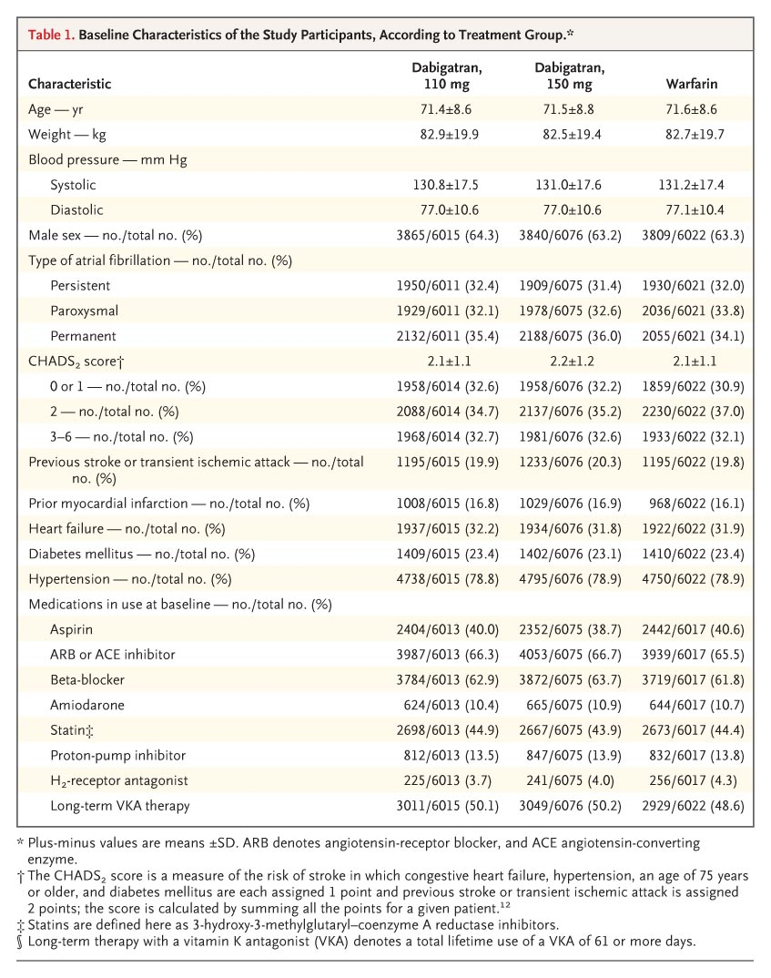
Baseline Characteristics of the Study Participants, According to Treatment Group
Connolly SJ et al. N Engl J Med 2009;361:1139-1151
Notes:
Table 1. Baseline Characteristics of the Study Participants, According to Treatment Group.

Slide 45
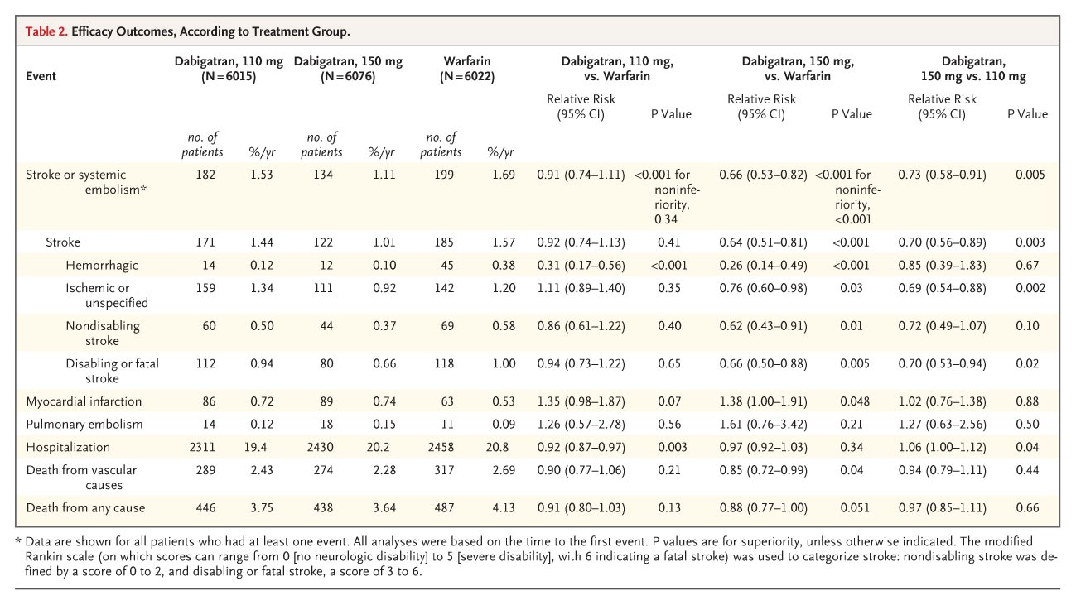
Efficacy Outcomes, According to Treatment Group
Connolly SJ et al. N Engl J Med 2009;361:1139-1151
Notes:
Table 2. Efficacy Outcomes, According to Treatment Group.

Slide 46
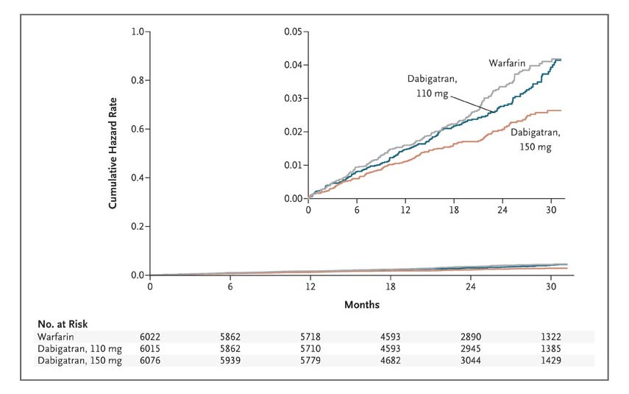
Cumulative Hazard Rates for the Primary Outcome of Stroke or Systemic Embolism, According to Treatment Group
Connolly SJ et al. N Engl J Med 2009;361:1139-1151
Notes:
Figure 1. Cumulative Hazard Rates for the Primary Outcome of Stroke or Systemic Embolism, According to Treatment Group.

Slide 47
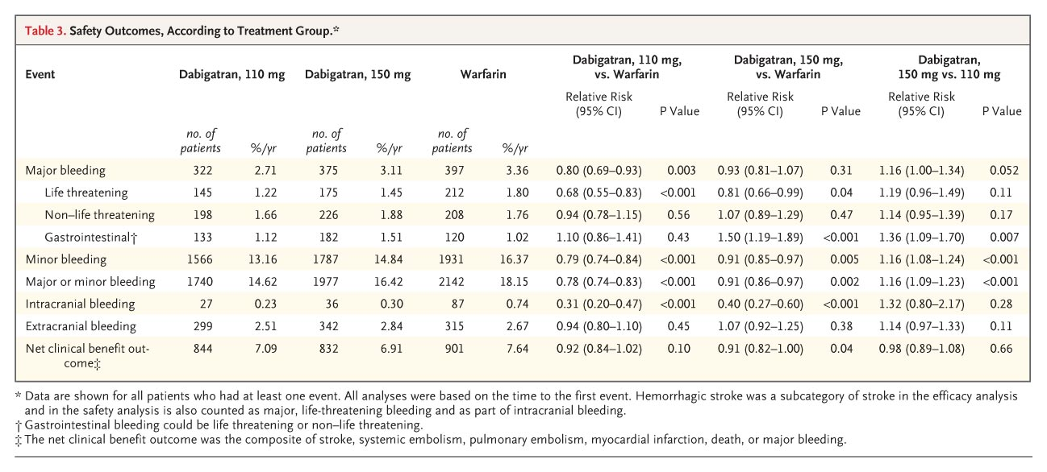
Safety Outcomes, According to Treatment Group
Connolly SJ et al. N Engl J Med 2009;361:1139-1151
Notes:
Table 3. Safety Outcomes, According to Treatment Group.

Slide 48
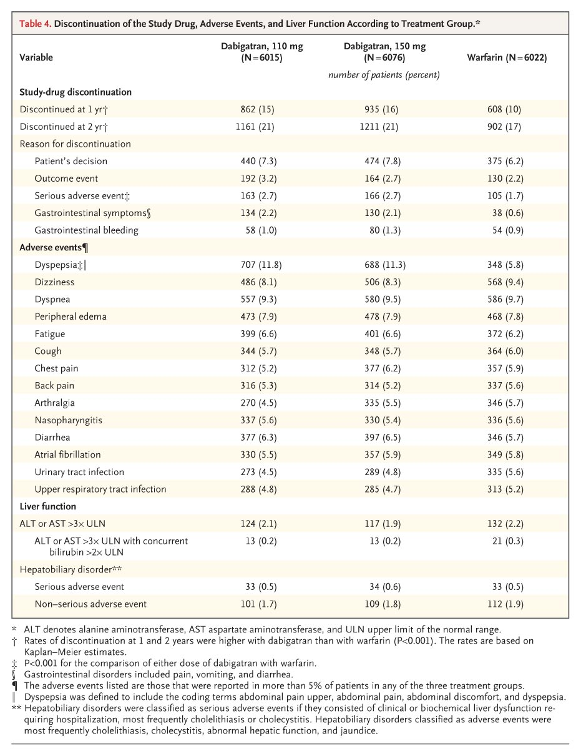
Discontinuation of the Study Drug, Adverse Events, and Liver Function According to Treatment Group
Connolly SJ et al. N Engl J Med 2009;361:1139-1151
Notes:
Table 4. Discontinuation of the Study Drug, Adverse Events, and Liver Function According to Treatment Group.

Slide 49
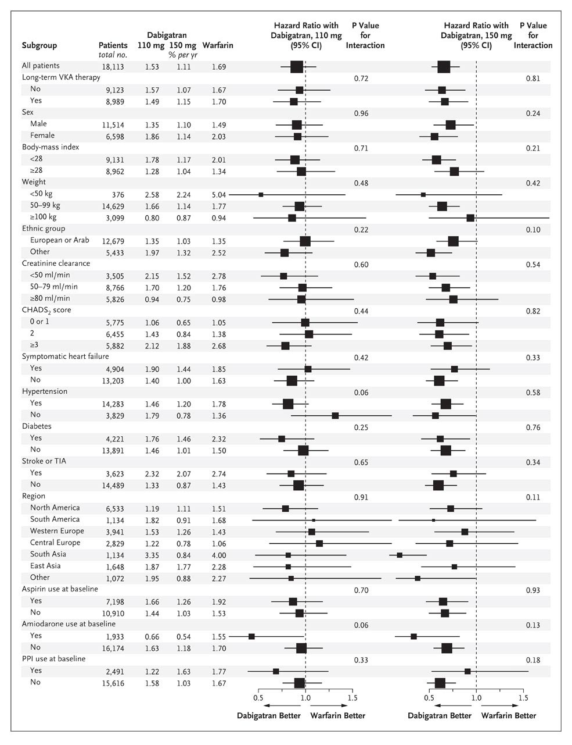
Relative Risk of the Primary Outcome of Stroke or Systemic Embolism with Dabigatran versus Warfarin, According to Subgroup
Connolly SJ et al. N Engl J Med 2009;361:1139-1151
Notes:
Figure 2. Relative Risk of the Primary Outcome of Stroke or Systemic Embolism with Dabigatran versus Warfarin, According to Subgroup. Ethnic group was self-reported. Long-term therapy with a vitamin K antagonist (VKA) denotes a total lifetime use of a VKA of 61 days or more. The body-mass index is the weight in kilograms divided by the square of the height in meters. The CHADS₂ score is a measure of the risk of stroke in which congestive heart failure, hypertension, an age of 75 years or older, and diabetes mellitus are each assigned 1 point and previous stroke or transient ischemic attack is assigned 2 points; the score is calculated by summing all the points for a given patient.12 Creatinine clearance was calculated according to the Cockcroft-Gault method. The squares with horizontal lines are hazard ratios and corresponding 95% confidence intervals; the sizes of squares are proportional to the sizes of the subgroups. PPI denotes proton-pump inhibitor.

Slide 50
Conclusion
In patients with atrial fibrillation, dabigatran given at a dose of 110 mg was associated with rates of stroke and systemic embolism that were similar to those associated with warfarin, as well as lower rates of major hemorrhage
Dabigatran administered at a dose of 150 mg, as compared with warfarin, was associated with lower rates of stroke and systemic embolism but similar rates of major hemorrhage

Slide 51
RE-COVER
Trial design: Evaluated the safety and efficacy of dabigatran 150 mg twice daily vs. warfarin for the treatment of acute VTE. Patients were followed for 6 months.
Results
(p < 0.001*)
(p = 0.38)
Primary outcome (recurrent VTE or death due to VTE): 2.4% vs. 2.1%
Mortality: 1.6% vs. 1.7% (p > 0.05)
Major bleeding: 1.6% vs. 1.9%; Major + clinically relevant bleeding: 5.6% vs. 8.8.% (p = 0.002)
* For noninferiority
5
5
4
4
3
3
%
2.4
%
Conclusions
2
2.1
2
1.9
1.6
Dabigatran 150 mg twice daily is noninferior to warfarin for the treatment of acute VTE, with a slightly better bleeding profile
Complements other studies showing safety and efficacy of dabigatran, as compared with warfarin in other settings, such as AF
1
1
0
0
Primary endpoint
Major bleeding
Dabigatran
(n = 1,274)
Warfarin
(n = 1,265)
Schulman S, et al. N Engl J Med 2009;361:2342-52

Slide 52
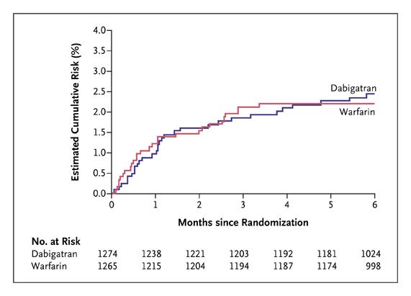
Cumulative Risk of Recurrent Venous Thromboembolism or Related Death during 6 Months of Treatment among Patients Randomly Assigned to Dabigatran or Warfarin
Schulman S et al. N Engl J Med 2009;361:2342-2352
Notes:
Figure 1. Cumulative Risk of Recurrent Venous Thromboembolism or Related Death during 6 Months of Treatment among Patients Randomly Assigned to Dabigatran or Warfarin.

Slide 53
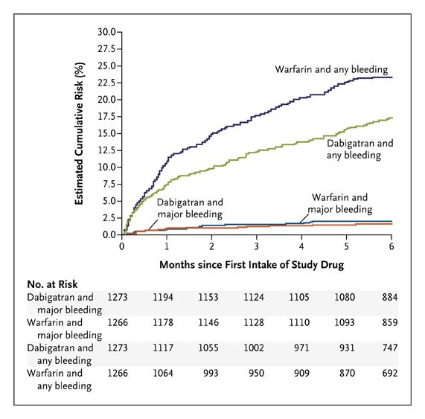
Cumulative Risks of a First Event of Major Bleeding and of Any Bleeding among Patients Randomly Assigned to Dabigatran or Warfarin
Schulman S et al. N Engl J Med 2009;361:2342-2352
Notes:
Figure 2. Cumulative Risks of a First Event of Major Bleeding and of Any Bleeding among Patients Randomly Assigned to Dabigatran or Warfarin. The hazard ratio with dabigatran for major bleeding at 6 months was 0.82 (95% CI, 0.45 to 1.48; P=0.38), and the hazard ratio with dabigatran for any bleeding at 6 months was 0.71 (95% CI, 0.59 to 0.85; P<0.001).

Slide 54
RE-DEEM
Trial design: After STEMI or NSTEMI, patients on dual antiplatelet therapy were randomized to dabigatran 50 mg twice daily (n = 372), 75 mg twice daily (n = 371), 110 mg twice daily (n = 411), 150 mg twice daily (n = 351), or placebo (n = 373). F/u was 6 months.
Results
(p < 0.001)
Major or clinically significant minor bleeding: 3.5% of the 50 mg group, 4.3% of the 75 mg group, 7.8% of the 110 mg group, 7.7% of the 150 mg group, and 2.4% with placebo
Major bleeding: 0.8%, 0.3%, 2.0%, 1.2%, 0.5%, respectively
Cardiovascular death, MI, or stroke: 4.6%, 4.8%, 3.0%, 3.4%, and 3.8% (p = NS), respectively
%
(p = NS)
Conclusions
Major or minor bleeding
Major bleeding
After STEMI or NSTEMI, the addition of dabigatran to dual antiplatelet therapy appeared to be safe
Bleeding was relatively low and it increased in a dose-dependent manner
50 mg
75 mg
110 mg
150 mg
Placebo
Presented by Dr. Jonas Oldgren at AHA 2009

Slide 55
RE−LY
Trial design: Patients with AF were randomized to either dabigatran 110 mg, 150 mg, or open-label warfarin. Patients were followed for a mean of 2 years.
*Dabigatran 150 mg vs. warfarin; †Dabigatran 110 mg vs. warfarin
Results
(p <0.001*, p = 0.34†)
(p = 0.31*, p = 0.03†)
Dabigatran 150 mg superior to warfarin for stroke/systemic embolism; dabigatran 110 mg was non-inferior
Stroke ↓ in dabigatran 150 mg arm (p < 0.001)
Major bleeding was higher in warfarin arm compared with dabigatran 110 mg, but was similar to dabigatran 150 mg
10
10
%/year
5
5
%/year
Conclusions
Dabigatran 150 mg superior to warfarin in reducing stroke or systemic embolism, with a similar bleeding profile. The 110 mg dose was non-inferior for efficacy, associated with lower bleeding compared with warfarin
Could prove to be alternative to warfarin for chronic anticoagulation; further data are awaited
1.53
1.11
1.69
2.71
3.11
3.36
0
0
Stroke/systemic embolism
Major bleeding
Dabigatran 110 mg
Dabigatran 150 mg
Warfarin
Connolly SJ, et al. N Engl J Med 2009;Aug 30:[Epub]

Slide 56
Summary
Old Friends
Unfractionated Heparin
LMWH
Warfarin
Agatraban
Bivalirubin
Fondaparinux
New Kids
Ravoroxaban
Dagatraban
No Shots!
No Monitoring!
No Worry?

Slide 57
I
I
I
IIa
IIa
IIa
IIa
IIb
IIb
IIb
IIb
III
III
III
I
III
I
I
IIa
IIa
IIa
IIa
IIb
IIb
IIb
IIb
III
III
III
I
III
I
I
IIa
IIa
IIa
IIa
IIb
IIb
IIb
IIb
III
III
III
I
III
I
I
IIa
IIa
IIa
IIa
IIb
IIb
IIb
IIb
III
III
III
I
III
I
I
IIa
IIa
IIa
IIa
IIb
IIb
IIb
IIb
III
III
III
I
III
I
I
IIa
IIa
IIa
IIa
IIb
IIb
IIb
IIb
III
III
III
III
A
I
I
I
I
I
I
IIa
IIa
IIa
IIb
IIb
IIb
III
III
IIa
III
IIa
IIa
IIa
IIb
IIb
IIb
IIb
III
III
III
IIa
III
IIa
IIa
IIa
IIb
IIb
IIb
IIb
III
III
III
III
I
I
I
IIa
IIa
IIa
IIb
IIb
IIb
III
III
I
III
I
I
I
I
I
I
I
I
IIa
IIa
IIa
IIa
IIb
IIb
IIb
IIb
III
III
III
III
IIa
IIa
IIa
IIa
IIb
IIb
IIb
IIb
III
III
III
I
III
I
I
IIa
IIa
IIa
IIb
IIb
IIb
III
III
I
III
I
IIa
I
IIa
IIa
IIa
IIb
IIb
IIb
IIb
III
III
III
III
IIa
IIa
IIa
IIa
IIb
IIb
IIb
IIb
III
III
III
III
I
I
I
IIa
IIa
IIa
IIa
IIb
IIb
IIb
IIb
III
III
III
I
III
I
I
IIa
IIa
IIa
IIa
IIb
IIb
IIb
IIb
III
III
III
I
III
I
I
IIa
IIa
IIa
IIa
IIb
IIb
IIb
IIb
III
III
III
I
III
I
I
B
B
IIa
IIa
IIa
IIa
IIb
IIb
IIb
IIb
III
III
III
I
III
I
I
IIa
IIa
IIa
IIa
IIb
IIb
IIb
IIb
III
III
III
I
III
I
I
IIa
IIa
IIa
IIa
IIb
IIb
IIb
IIb
III
III
III
III
IIa
IIa
IIa
IIa
IIb
IIb
IIb
IIb
III
III
III
I
III
I
I
I
I
I
IIa
IIa
IIa
IIa
IIb
IIb
IIb
IIb
III
III
III
I
III
I
IIa
I
IIa
IIa
IIa
IIb
IIb
IIb
IIb
III
III
III
III
IIa
IIa
IIa
IIa
IIb
IIb
IIb
IIb
III
III
III
I
III
I
I
I
I
IIa
I
IIa
IIa
IIa
IIb
IIb
IIb
IIb
III
III
III
I
III
I
I
IIa
IIa
IIa
IIa
IIb
IIb
IIb
IIb
III
III
III
I
III
I
I
IIa
IIa
IIa
IIa
IIa
IIa
IIa
IIa
IIb
IIb
IIb
IIb
IIb
IIb
IIb
IIb
III
III
III
III
III
III
III
I
III
I
I
I
I
I
IIa
IIa
IIa
IIa
IIa
IIa
IIa
IIa
IIb
IIb
IIb
IIb
IIb
IIb
IIb
IIb
III
III
III
III
III
III
III
I
III
I
I
I
I
I
IIa
IIa
IIa
IIa
IIa
IIa
IIa
IIa
IIb
IIb
IIb
IIb
IIb
IIb
IIb
IIb
III
III
III
III
III
III
III
I
III
I
I
I
I
I
IIa
IIa
IIa
IIa
IIb
IIb
IIb
IIb
III
III
III
I
III
I
I
IIa
IIa
IIa
IIa
IIb
IIb
IIb
IIb
III
III
III
I
III
I
I
IIa
IIa
IIa
IIa
IIb
IIb
IIb
IIb
III
III
III
I
III
I
I
A

