Slide 1
First Response to Cardiac Arrest
Blake Wachter, MD, PhD
April 2, 2016

Slide 2
The Victim
https://www.youtube.com/watch?v=S7P7NkYhNOc

Slide 3
AHA Statistical Update 2013
389,000 cardiac events (out of hospital)
Bystander CPR (40%)
Survival to hospital discharge (9%)

Slide 4
Morbidity Contributors of Patients with Cardiac Events
High blood pressure (40%)
Smoking (14%)
Student 9-12 grade smoke (18%)
Poor diet (13%)
Physical deconditioning (12%)
Diabetes (16%), pre-DM (38%)

Slide 5
The Sobering Facts
Rates of CV death has declined but the disease burden has increased
CV deaths (cardiac and stroke) account for 1 in 3 deaths
1 in 6 have a coronary death event
Each year 635,000 have a new MI event
Every 34 seconds 1 American will have a coronary event and every 1 minute 1 will die

Slide 6
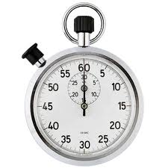
Every 34 seconds 1 American will have a coronary event
Every 60 seconds 1 American will die

Slide 8
Out of hospital cardiac arrest (OHCA) Surveillance Cardiac Arrest Registry to Enhance Survival (CARES) US 2005 – 2010
32,000 OHCA events (61% male)
22% were pronounced dead pre-hospital by EMS
Survival to hospital admission was 26%
Survival to hospital discharge 9.6%
37% were witnessed by bystander
33% of these got bystander CPR
Survival was 11.2% compared to those who did not get CPR 7%
3.7% were treated by an AED by bystander

Slide 9
Who wins?
Persons most likely to survive were ones found to be in a shockable rhythm (Vfib or pulseless Vtach) – survival to discharge was 30%

Slide 10
OHCA - Presenting Rhythm
VT / VF more likely to survive event
A shockable rhythm (37% survival rate)
PEA / Asystole (non shockable rhythm)
Less likely to survive (10%)

Slide 13
Heart Disease in Women
Heart disease is the #1 killer in women
Women less likely to ask for help
Women tend to shrug off the symptoms
I have the flu, I am just getting old, I have GERD
Go Red Campaign for Women

Slide 15
Women and CV Event
https://www.youtube.com/watch?v=t7wmPWTnDbE

Slide 16
Basic Life Support
Look / listen to see if patient is breathing
Check for pulse (10 seconds)
If no pulse (or not sure) begin chest compressions at rate of 100 bpm
Place AED on patient and follow prompts
If not breathing 1 breath every 6 seconds or 10 breaths per minute

Slide 17
Advanced Life Support The Cardiac Event
Bradycardia
Cardiac Pulmonary Edema
Tachycardia with a Pulse
Narrow vs Wide
Unstable Vtach / Vfib
Asystole/PEA
The STEMI
Hypothermia treatment
Cardiogenic Shock

Slide 18
Bradycardia - History
Medications (beta-blocker, calcium channel blockers, clonidine, digoxin)
Pacemaker
Insecticide exposure
Renal failure /dialysis

Slide 19
Bradycardia – Signs/Symptoms
Heart rate < 60 bpm
Hypotension
Altered mental status
Chest pain
Acute heart failure
Syncope
Respiratory distress
Right coronary artery occlusion

Slide 20
Bradycardia - Treatment
Normal saline or LR
Atropine (0.5mg IV) may repeat 3-5 minutes
0.02mg/kg pediatric
Dopamine 2-10mcg/kg/min IV
Epinephrine 2-10mcg/min IV
(0.01mg/kg IV pediatric)
Avoid NTG if hypotensive or Inferior MI

Slide 22
Cardiac Pulmonary Edema - History
History of heart failure
Hypertension
Myocardial infarction
Medications (lasix, digoxin)
Viagra, levitra, cialis

Slide 23
Cardiac Pulmonary Edema – Signs/Symptoms
Respiratory distress
Bilateral rales
Orthopnea
Jugular venous distention
Pink, frothy sputum
Peripheral edema
Diaphoresis
Hypotension/shock
Chest pain

Slide 24
Cardiac Pulmonary Edema - Treatment
Respiratory support (intubate?)
If systolic BP is > 110
NTG
Nitro-paste
Consider continuous positive airway pressure
Consider lasix

Slide 25
Tachycardia with a Pulse - History
Stimulant medications/street drugs
Previous MI/cardiac history
History of Afib, SVT, WPW syndrome
Pacemaker, ICD
Syncope or near syncope
Heart failure

Slide 26
Tachycardia with a Pulse – Signs/Symptoms
Heart rate > 150
ECG: QRS duration (wide or narrow)
Lightheadedness
Chest pain
Dyspnea

Slide 27
Narrow complex tachycardia

Slide 28
Tachycardia with a pulse
Patient is stable, QRS is narrow
Vagal maneuvers
Adenosine 6mg IV push FAST, may repeat with 12mg
May show underlying Afib/Flutter waves
May convert rhythm to normal sinus
Diltiazem 20mg IV push

Slide 29
BEWARE! WPW with Afib
NO ADENOSINE !

Slide 30
Tachycardia with a Pulse
Stable patient with wide QRS
Amiodarone 150mg IV
Patient is becoming unstable (low BP, altered, ect)
Consider paralytic / sedation (?)
Synchronized cardioversion
Amiodarone 150mg IV

Slide 31
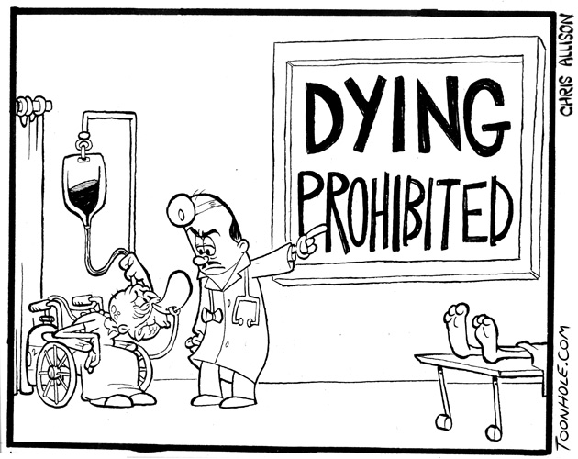
Vtach / Vfib - History
History of cardiac disease
Time of arrest
medications
Foreign body in airway
Hypothermia
Electrocution
Near drowning
DNR

Slide 32
Vtach / Vfib Unstable – Signs/Symptoms
The unresponsive patient with this strip…
Apneic
pulseless

Slide 34
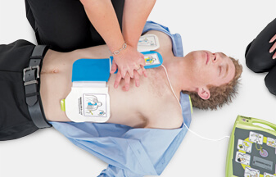
Vtach / Vfib - Treatment
Chest compressions
12 – lead ECG
Defibrillation as soon as possible
Resume CPR immediately for 2 minutes
Consider epi 1mg IV/IO, repeat 3-5 minutes
Shockable rhythm again?
Resume CPR for 2 minutes
Amiodarone 300mg IV/IO, may repeat 150mg IV
Lidocaine 1.5mg/kg IV, may repeat 1 x q 5 minutes

Slide 35
Asystole and PEA - History
Age
Past medical history
Medications
Events leading to arrest
End stage renal disease
Estimated downtime
Suspected hypothermia
Suspected Overdose
DNR or POST form

Slide 36
Asystole and PEA – History Cont
Differential
Trauma
Hypoxia
Potassium (hypo or hyper)
Drug overdose
Acidosis
Hypothermia
Device error
Death

Slide 37
Asystole and PEA
Pulseless
Apneic
ECG rhythm (electrical activity or asystole)
No auscultated heart tones

Slide 38
Asystole and PEA - Treatment
Chest compressions
Epinephrine (1mg IV/IO, repeat q 3-5 minutes)
Vasopressin 40 units IV/IO may replace 1st or 2nd dose of epi
Levophed 1-10mcg/min IV
Normal saline or LR (IL IV bolus)
Sodium bicarb (50mEq)
Calcium chloride 1gram
Chest compressions

Slide 39
Chest Pain (STEMI) - History
Age
History of cardiac disease
Quality of pain (dull, radiating, constant, not reproducible with palpation, non pleuritic)
Severity
Exacerbated by physical exertion
Time of onset, duration, frequency
Diabetic may have atypical pain

Slide 40
Chest Pain (STEMI) - Treatment
12 lead ECG
O2
ASA 325mg - chewable
NTG (if SBP > 90)
Careful of Inferior STEMI and bradycardia
Contraindicated if use of Viagra in past 24 hours or Cialis in past 36 hours
Morphine
AED / defibrillator pads

Slide 42
Hypothermia protocol
Return of spontaneous circulation with STABLE RHYTHM! Not IN SHOCK!
NOT following commands
Secure airway
Maintain BP (NS/LR, dobutamine, epi, levophed)
Begin hypothermia protocol by placing ice bags in arm pits and groins or infusing cold IV normal saline

Slide 43
Cardiac Hypotension/Shock – Signs/Symptoms
Altered mental status
Weak, rapid pulse
Cool, clammy skin (not just hands/feet)
Delayed capillary refill
Declining blood pressure

Slide 44
Cardiac Hypotension/Shock - Treatment
Treat underlying cause (STEMI, Vtach, ect)
Secure airway
IV access
Normal Saline / LR bolus
Dopamine 5-20 mcg/kg/min IV
Epinephrine 2-10 mcg/min IV

Slide 45
IOM Report, How Can We Do Better?
Institute of Medicine 2015 report declares that 8 out of 10 out of hospital cardiac arrest occur at home
46% of in home cardiac arrests are witnessed
Only 40% of the witnesses will begin CPR
90% of these people will die before getting medical care.
Only 6% -15% will survive hospital discharge.

Slide 46
Recognize and Initiate CPR Early!
Need more engagement of initial bystander recognition and treatment
Recognize need for CPR, Call 911, start CPR, get AED
Decrease time between initial event and beginning CPR
Likely hood of survival decreases by 10% for every passing minute.
< 3% of population receives CPR training

Slide 47
Initiatives
Educate the public
Teach CPR and proper use of AED in middle school and high school
Encourage dispatcher assisted high quality CPR

Slide 48
There’s an app for that!

Slide 49
Thinking outside the box
Animation assisted CPR vs dispatcher assisted CPR
More accurate hand placement
Better depth and speed of CPR
Video directed dispatcher assisted for CPR and/or AED use
More accurate, more confidence in provider, earlier CPR/AED
Needs more than 1 person, technical delays
Map apps for AED locations
Identify quicker where a AED is located
Mobile responders
Reached patient faster than EMS in 72% of the simulated events

Slide 50
Mobile CPR-Trained Bystanders
Mobile CPR-trained bystanders
Regular people trained in CPR and agree to receive mobile alerts and location of emergency
667 OHCA and randomized to alert or not to alert the mobile trained non EMS personal
62% in intervention group vs 48% in control group

Slide 51
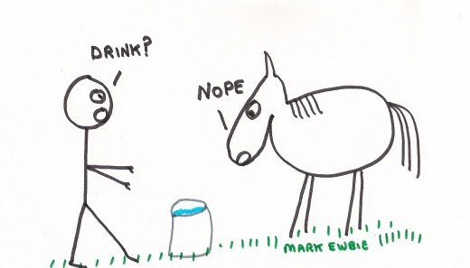
Bystanders…
Only 20-30% of CPR trained bystanders will use it
CPR quality deteriorates within months after training
Smart phone apps do not meet BLS standard guidelines and may do more harm than good.

Slide 52
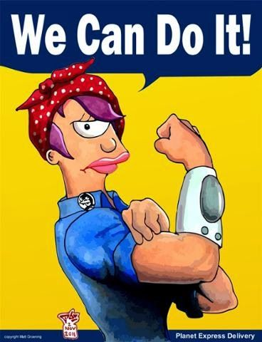
Increased rate of survival in 30 days post arrest if bystander CPR was initiated, a world wide trend

Slide 53
Thank you
https://www.youtube.com/watch?v=Bw5dN7hcu5s

