Slide 1
Heart Failure Management
(2013 Updated Guidelines)
Blake Wachter, MD, PhD
Idaho Heart Institute

Slide 2
Heart Failure: Significant Clinical and Economic Burden
Persons with HF in the US 5.1 million
  20% of Americans > 40yrs
Overall prevalence 2.7%
Incidence 650,000/year
Mortality in 2001 52,828
Cost $27.9 billion

Slide 3
What is heart failure?

Slide 4
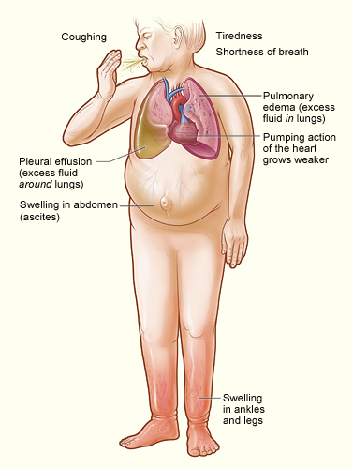
Heart Failure
Any structural or functional impairment of ventricular filling or ejection of blood
Symptoms
  Dyspnea
  Fatigue
  Decreased exercise tolerance
  Pulmonary congestion
  Splanchnic congestion
  Peripheral edema

Slide 5
Diagnosing heart failure
There is no single test or procedure to diagnosis heart failure
  Based on careful clinical history and physical exam
Heart failure is a catch all term
  Disorders of pericardium, myocardium, endocardium, heart valves, great vessels, metabolic abnormalities
  NOT synonymous for cardiomyopathy or LV dysfunction
Distinguish between reduced or normal ejection fraction
  Heart failure with reduced EF (HFrEF)
  Heart failure with preserved EF (HFpEF)

Slide 6
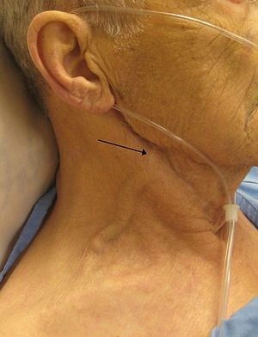
The History and Physical Exam
Thorough history
  Cardiac and non-cardiac disorders or behaviors
    Previous coronary disease/CABG, thyroid disorders, illegal drugs, excessive alcohol use
    Family history (3 generation), recent virus, toxic ingestions (i.e cobalt)
Volume status
  Peripheral edema
  Ascites
  Crackles at lung bases +/- decreased breath sounds
  S3 +/- S4
  Elevated JVP
  Displaced point of maximal impulse (PMI)
  Short of breath, orthopnea, paroxysmal nocturnal dyspnea
  Decreased appetite / fullness / abdominal pain

Slide 7
Diagnostic testing
Initial laboratory evaluation
  CBC
  U/A
  Basic metabolic panel with magnesium
  Fasting lipid profile
  Liver function tests
  TSH
Serial monitoring of electrolytes and renal function
ECG on first visit

Slide 8

Looking for Zebras…
Rheumatological diseases
Amyloidosis
Pheochromocytoma
Hemochromatosis
HIV

Slide 9
Biomarkers
BNP is useful to support HF diagnosis especially in the setting of clinical uncertainty
Measure of BNP useful for establishing prognosis or disease severity in chronic HF
Measurement of cardiac enzymes in acute decompensated patient
Can be used to guide therapy in select euvolemic patients in a well structured HF management program
Serial BNP measurements to reduce mortality or hospitalization has not been well established

Slide 10
Non-invasive Cardiac Imaging
New onset or change in condition
  CXR
  Echo with Doppler
Assess goal directed medical therapy (needing an ICD?)
  Repeat echo
In the patient with known CAD with new or worsening HF (+/- symptoms) (Class IIa, level B)
  Consider non invasive imaging
Consider MRI if need to assess myocardial infiltrative processes or scar burden (Class IIa, level B)

Slide 11
Don’t routinely repeat the echo
No Benefit
  Routine repeat measurement of LV function in absence of clinical status change or treatment intervention (Class III)

Slide 12
Invasive Evaluation
Invasive monitoring with pulmonary artery catheter
  Acute decompensating patient
  Guide therapy (inotropes, vasodilators, pressors)
  Volume status is unknown
  Worsening renal failure
  Low systolic pressures
  Evaluation for mechanical circulation support (MCS) or transplant
Coronary angiogram
  In select patient if eligible for revascularization
Endomyocardial biopsy
  Select patients looking for specific diagnosis

Slide 13
AHA Classification of Heart Failure
 | Stage | Patient Description
A | High risk for developing heart failure (HF) | Hypertension CAD Diabetes mellitus Family history of cardiomyopathy
B | Asymptomatic HF | Previous MI LV systolic dysfunction Asymptomatic valvular disease
C | Symptomatic HF | Known structural heart disease Shortness of breath and fatigue Reduced exercise tolerance
D | Refractory end-stage HF | Marked symptoms at rest despite maximal medical therapy (eg, those who are recurrently hospitalized or cannot be safely discharged from the hospital without specialized interventions)
Hunt SA et al. J Am Coll Cardiol 2001;38:2101–2113.
Notes:
Stages A through D show the progressive nature of cardiovascular disease into refractory end-stage heart failure.
These patient types, especially Stage A, B, and C patients, are commonly seen by primary care physicians.

Slide 14
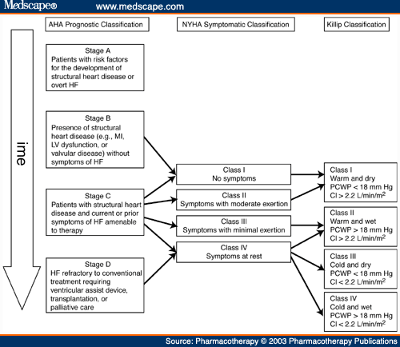

Slide 15
Treatment of chronic systolic heart failure
(HFrEF)

Slide 16
Stage A
Treat HTN
Treat lipid disorders
Address obesity
Control diabetes
Stop tobacco use
Avoid known cardiotoxic agents

Slide 17
Treatment of Stage B and C

Slide 18
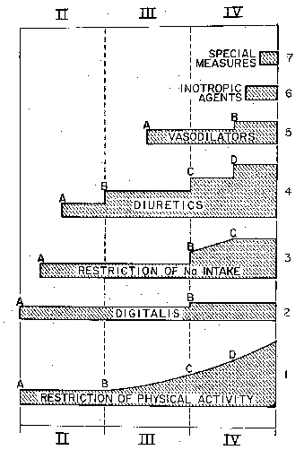
Medical Therapy of Heart Failure in 1984
Vasodilators
Diuretics
Digtalis
Restriction of Na⁺ Intake
Restriction of
Physical Activity
Functional Class
Brauwnwald E. Management of heart failure. Heart Disease 2nd ed. 1984; 503-550.

Slide 19
Diuretics

Slide 20
Diuretics and Heart Failure
No long-term studies of diuretic therapy for treatment of heart failure; its effects on morbidity and mortality are not known¹
Patients may become unresponsive to high doses of diuretic drugs if they
  consume large amounts of dietary sodium²
  Take agents that can block the effects of diuretics (e.g. NSAIDs)¹
  Have significant impairment of renal function or perfusion¹
Diuretic resistance can generally be overcome by
  IV administration of diuretics²
  using two or more diuretics in combination
¹Ravnan SL et al. Congest Heart Fail. 2002;8:80-85
² Brater DC. Drugs. 1985;30:427-443.
Notes:
Ravnan SL, Ravnan MC, Deedwania PC. Pharmacotherapy in congestive heart failure: diuretic resistance and strategies to overcome resistance in patients with congestive heart failure. Congest Heart Fail. 2002;8:80-85.
Brater DC. Resistance to loop diuretics. Why it happens and what to do about it. Drugs. 1985;30:427-443.

Slide 21
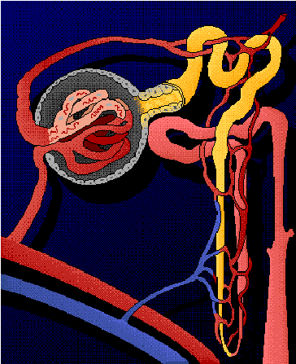
Location of Diuretic Action
Proximal Tubule
Carbonic anhydrase inhibitors
Distal Tubule
Thiazide diuretics
Collecting Duct
Vasopressin antagonists
Aldosterone antagonists
Ascending limb of Loop of Henle
Loop diuretics
Notes:
Diuretic resistance and refractoriness in heart failure patients is due to a number of factors
Avid sodium and water reabsorbtion in proximal tubule due to effects of angiotensin II (AII). Loop and thiazide diuretics work distal to proximal tubule, where majority of sodium and water has already been reabsorbed. Therefore, loop and thiazide diuretics have less substrate (tubular sodium and water) on which to exert their effects
Renal vasoconstriction mediated by norepinephrine, endothelin-1, and AII can lead to reduced GFR. As a result, ability of most diuretics to get to their site of action in renal tubules is reduced
High levels of aldosterone contribute (to a lesser extent) to sodium reabsorbtion
Weber KT. Aldosterone in congestive heart failure. N Engl J Med. 2001;345:1689-1697.
Francis GS, Goldsmith SR, Levine TB, Olivari MT, Cohn JN. The neurohumoral axis in congestive heart failure. Ann Intern Med. 1984;101:370-377.
Dzau VJ. Renal and circulatory mechanisms in congestive heart failure. Kidney Int. 1987;31:1402-1415.

Slide 22
Digoxin

Slide 23



Digitalis and the Treatment of Cardiac Dropsy
Dr. William Withering
1741 - 1799
17th Century patient
with severe dropsy
Foxglove
(Digitalis purpurea)
Withering W “An account of the foxglove and some of its medical uses;
with practical remarks on the dropsy, and some other diseases,” 1785

Slide 24
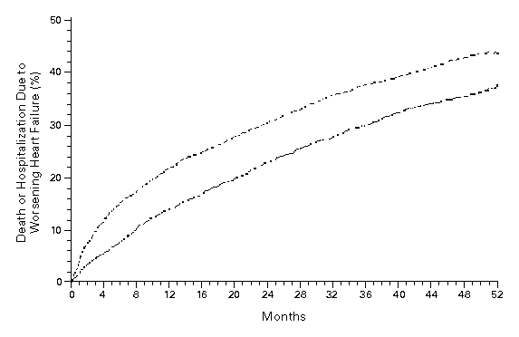
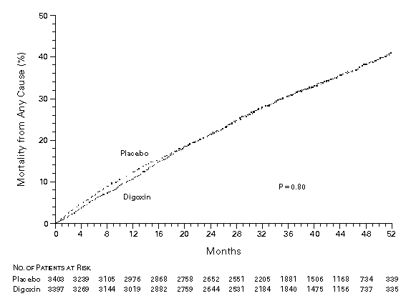
Effect of Digoxin Upon Clinical Outcomes in Subjects with Heart Failure
All Cause Mortality
Death or Hospitalization Due to HF
Placebo
Placebo
RR = 0.99
(0.91-1.07)
p = 0.80
RR = 0.85
(0.79-0.91)
p < 0.001
Digoxin
Digoxin
The Digitalis Investigator Group. N Eng J Med 1997; 336: 525-33.

Slide 25
ACE Inhibitors

Slide 26
ACE Inhibition Improves Survival
SOLVD Treatment Trial
SAVE
50
30
Chronic HF
NYLVEF<35%
HA II-III
Placebo
(n=1284)
Acute MI
Asymptomatic
LV dysfunction
Placebo
(n=1116)
40
20
30
% Mortality
Enalapril
(n=1285)
Captopril
(n=1115)
20
10
10
p=0.019
P=0.0036
0
0
0
12
24
36
48
0
1
2
3
4
Months
Years
SOLVD Investigators. N Engl J Med 1991;325:293-302.
Pfeffer MA et al. N Engl J Med 1992;327:669-77.

Slide 27
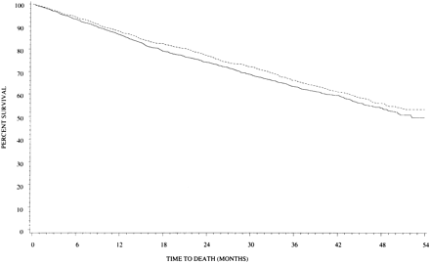
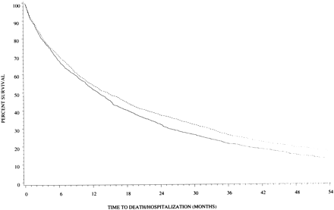
Effect of High Versus Low Dose
Lisinopril on Clinical Outcomes
ATLAS Trial
Low Dose (n = 1596): 2.5 to 5 mg daily (average = 4.5 + 1.1)
High Dose (n = 1568): 32.5 to 35 mg daily (average = 33.2 + 5.4)
All Cause Mortality
All Cause Mortality + Hospitalization
HR = 0.88 (0.82-0.96)
p = 0.002
High Dose
Low Dose
Survival (%)
Survival (%)
High Dose
HR = 0.92 (0.82-1.03)
p = 0.128
Low Dose
Follow-up (Months)
Follow-up (Months)
Follow-up (Months)
Follow-up (Months)
Packer M et al. Circulation 1999;100:2312-18.

Slide 28
ACEI is Superior to Vasodilator Therapy in Chronic Heart Failure
VHeFT II
0.75
0.54
Isosorbide +
Hydralazine
0.46
0.5
0.48
0.36
0.42
Enalapril
Mortality
0.25
0.31
0.25
0.13
RR = 28%
p = 0.016
0.18
0
0.09
0
0
0
12
24
36
48
60
Months
Cohn JN et al. N Engl J Med 1991;325:303-10.

Slide 29
ARB Improves Outcomes in ACEI Intolerant Patients
%
50
Placebo (n = 1013)
(40.0%)
40
(33.0%)
30
CV death or CHF hospitalisation
Candesartan (n = 1015)
20
10
HR 0.77 (95% CI 0.67-0.89), p=0.0004
Adjusted HR 0.70, p<0.0001
0
0
1
2
3
3.5
years
Granger CB et al. Lancet 2003;362:772-6.

Slide 30
Beta Blockers

Slide 31
Beta-Blockade Improves Survival
Advanced Heart Failure
Copernicus (n = 2289)
Post Myocardial Infarction
Capricorn (n= 1959)
100
1
90
0.95
RR=23%
P=.031
Carvedilol
0.9
80
% Survival
Placebo
0.85
Carvedilol
70
0.8
Placebo
35% ↓ in risk
P=.00013 (unadjusted)
P=.0014 (adjusted)
60
0.75
0
0.7
0
3
6
9
12
15
18
21
0
0.5
1
1.5
2
2.5
Months
Years
Packer M et al. N Engl J Med 2001;344:1651-8.
CAPRICORN Investigators. Lancet 2001;357:1385–90.

Slide 32
Major Trials of β-Blockade in Heart Failure
Trial Drug Mortality Reduction
US Carvedilol Program* carvedilol ↓ 65% (P<0.001)
1094 patients (Class II–IV)
CIBIS-II Trial HF² bisoprolol ↓ 34% (P<0.0001)
2647 patients (Class III–IV)
MERIT-HF metoprolol ↓ 34% (P=0.0062)
3991 patients (Class II–IV) succinate
BEST bucindolol ↓ 10% (P=0.109)
2708 patients (Class III–IV)
COPERNICUS carvediolol ↓ 35% (P=0.00014)
2289 patients (Class III-IV)
SENIORS* nebivolol ↓ 12% (P=0.21)
2128 patients (Class II-IV)
*Mortality not the primary efficacy endpoint in these trials

Slide 33
Effects of Metoprolol Tartrate and
Carvedilol on Mortality in Heart Failure
COMET
40
Metoprolol ( n = 1511)
30
Percent Mortality (%)
20
Carvedilol (n = 1518)
Hazard ratio 0.83,
95% CI 0.74-0.93, P = 0.0017
10
0
0
1
2
3
4
5
Time (years)
Poole-Wilson PA et al. Lancet 2003;362:7-13.

Slide 34
Impact of ACE Inhibition and β-Blockade on Annual Survival in Heart Failure
20
15.6%
Mortality
Reduced
50%!
12.4%
11.9%
Annual Mortality (%)
10
7.8%
Digoxin,
Diuretic
Digoxin,
Diuretic
+
ACEI
Digoxin,
Diuretic,
ACEI
Digoxin,
Diuretic,
ACEI
+
β-Blocker
Placebo
Active Treatment
0
SOLVD
Treatment
CIBIS-II +
MERIT-HF

Slide 35
Hydralizine and isosorbide dinitrate

Slide 36
Effect of Isosorbide and Hydralazine on Survival in Systolic Heart Failure
VHeFT (n =642)
HR = 0.66, p = 0.028 at 2 years
AAHeFT (n =1050)
HR = 0.57, p = 0.01
0.6
100
Placebo
0.5
Fixed-dose Hyd-Iso
Prazosin
0.4
Hyd-Iso
95
0.3
Survival (%)
Cumulative Mortality Rate
0.2
90
Placebo
0.1
0
85
0
6
12
18
24
30
36
42
0
100
200
300
400
500
600
Interval (months)
Interval (days)
Cohn J et al. N Engl J Med 1986;314:1547-52
Taylor AL et al. N Engl J Med. 2004;351:2049-57.

Slide 37
Aldosterone antagonist

Slide 38
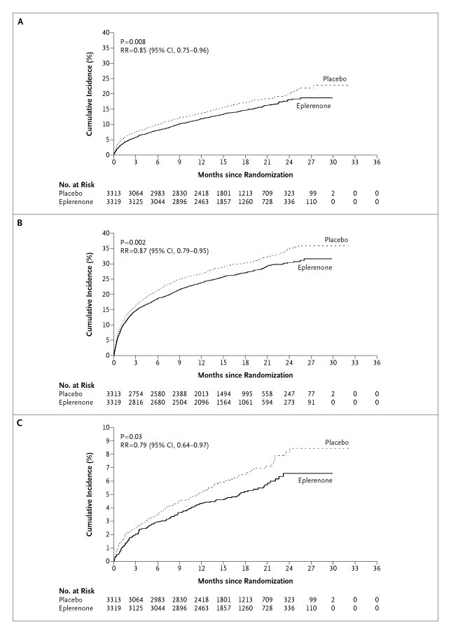
Aldosterone Antagonists Improve Survival
Advanced Heart Failure
RALES
Post Myocardial Infarction
EPHESUS
1.00
0.95
0.90
RR = 0.85 (0.75-0.96)
P = 0.008
RR = 0.85 (0.75-0.96)
P = 0.008
0.85
0.80
Placebo
0.75
Placebo
0.70
Spironolactone
0.65
0.60
Eplerenone
Eplerenone
0.55
Placebo
0.50
RR = 0.70 (0.60-0.82)
P < 0.001
0.45
0.00
0
3
6
9
12
15
18
21
24
27
30
33
36
Months Follow-up
Months Follow-up
Pitt B et al. N Engl J Med. 1999;341:709–717.
Pitt B et al. N Engl J Med 2003;348:1309-21.

Slide 39
Is there a role for aldosterone antagonists in chronic NYHA class II systolic heart failure?
Breaking News May, 2011:
EMPHASIS-HF (eplerenone verus placebo) terminated early by DSMB because of a significant reduction in the primary endpoint of cardiovascular death or heart failure hospitalization

Slide 40
When do I think about an ICD?

Slide 41
When do I need to think about an ICD
On good medical management
  Betablockers
  ACE-I or ARBs
  Spironolactone
At least 40 days post MI
LVEF < 30%
Reasonable expectation of survival of > 1 year

Slide 42
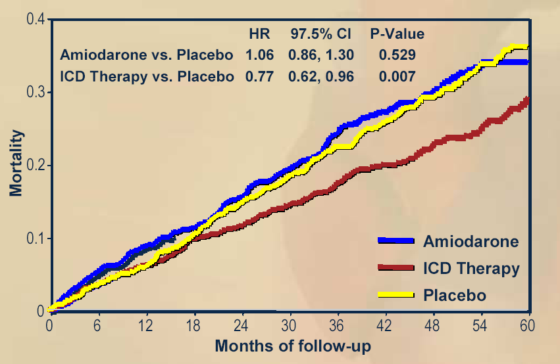
ICDs Improve Survival
MADIT II
SCDHeFT
1.0
0.9
ICD
0.8
0.7
Conventional
0.6
P = 0.007
0.0
0
1
2
3
4
Year
Moss AJ et al. N Engl J Med. 2002;346:877-83.
Bardy GH et al. N Engl J Med. 2005;352:225-37.

Slide 43
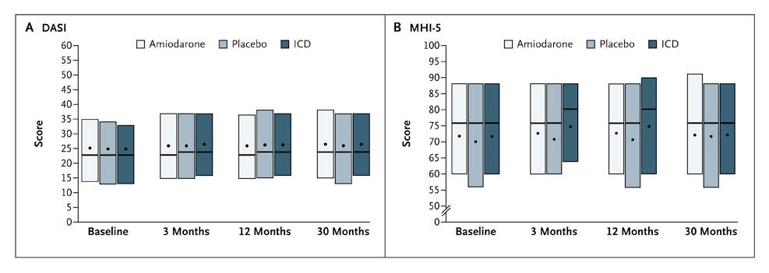
ICDs Do Not Improve Quality of Life
Duke Activity Status Index
Mental Health Inventory 5
Higher scores indicate better function
Mark DB et al. N Engl J Med 2008;359:999-1008.

Slide 44
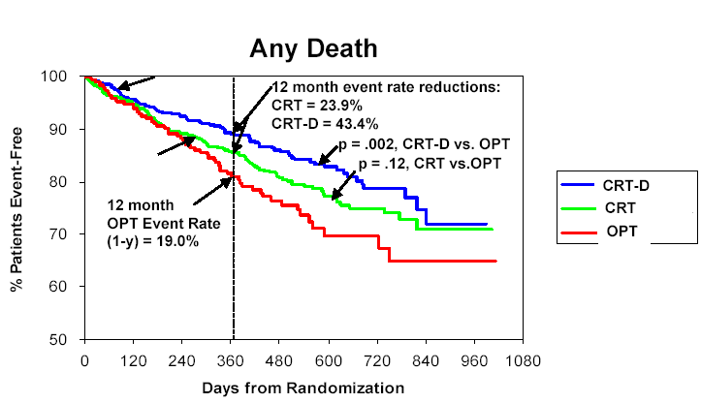
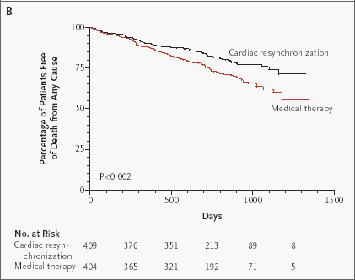
CRT Improves Survival
COMPANION
CARE-HF
Bristow MR et al. N Engl J Med. 2004; 350:2140-2150.
Cleland J et al. N Engl J Med 2005;353:1539-49.

Slide 45
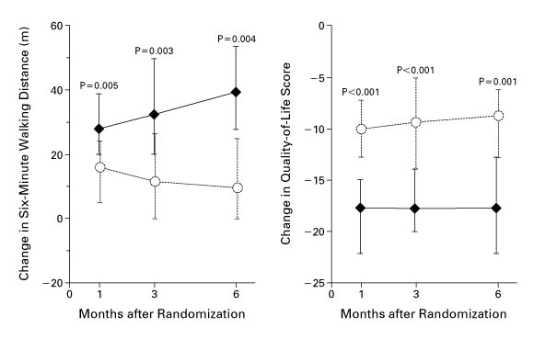
MIRACLE Study
CRT Improves Submaximal Exercise
and Quality of Life
Abraham WT et al. N Engl J Med, 2002; 346: 1845-1853.

Slide 46
Stage D Heart Failure

Slide 47
Features of Stage D Heart Failure
Marked symptoms at rest or with any activity.
Despite optimal medical and device therapy.
Experience recurrent hospitalization.
Can not be discharged from the hospital without specialized interventions.
Typically these patients are “cold and wet” (low cardiac output + high filling pressures).

Slide 48
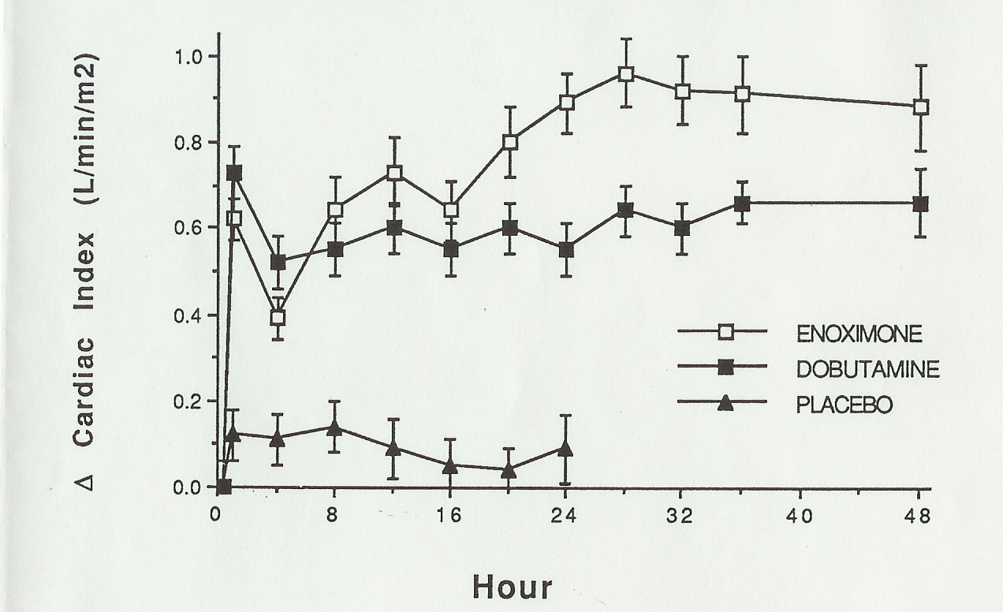
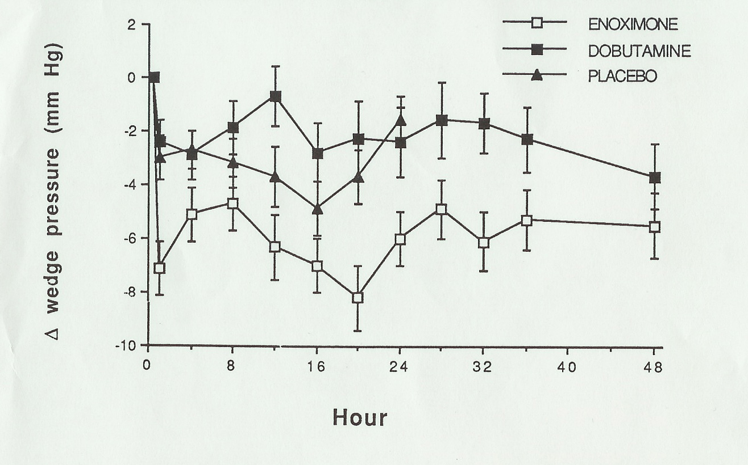
Inotropes Acutely Improve Hemodyamics
Dobutamine: β-Receptor Agonist
Enoximone: Phosdiesterase-3 Inhibitor
Bader FM, Gilbert EM et al. Congest Heart Failure, In Press.

Slide 49
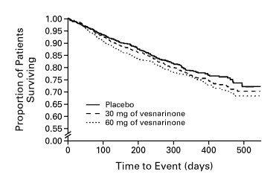
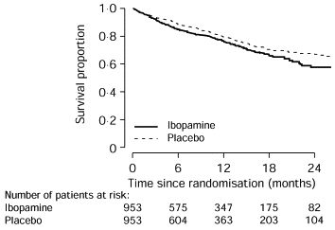
Chronic Inotrope Therapy Decreases Survival
VEST trial
PRIME II
RR = 1.21
p = 0.02
For 60 mg vs. placebo
RR = 1.26
p = 0.017
Cohn J et al. N Engl J Med 1998;339:1810-16.
Hampton JR et al. Lancet 1997;349:971-7.

Slide 50
If there is no current role for chronic inotrope therapy, then what can we do for patients with stage D heart failure?

Slide 51

NUMBER OF HEART TRANSPLANTS REPORTED BY YEAR
NOTE: This figure includes only the heart transplants that are reported to the ISHLT Transplant Registry. As such, the presented data may not mirror the changes in the number of heart transplants performed worldwide
ISHLT 2009 Update
Notes:
This figure includes only the heart transplants that are reported to the ISHLT Transplant Registry. As such, this should not be construed as evidence that the number of hearts transplanted worldwide has declined in recent years.

Slide 52
ADULT HEART TRANSPLANTATION
Kaplan-Meier Survival by Era (Transplants: 1/1982 – 6/2007)
100
All comparisons significant at p < 0.0001
80
60
Survival (%)
1982-1991 (N=18,846)
40
1992-2001 (N=35,238)
2002-6/2007 (N=15,620)
20
HALF-LIFE 1982-1991: 8.8 years; 1992-2001: 10.5 years; 2002-6/2007: NA
0
0
1
2
3
4
5
6
7
8
9
10
11
12
13
14
15
ISHLT 2009 Update
Years
Notes:
Survival was calculated using the Kaplan-Meier method, which incorporates information from all transplants for whom any follow-up has been provided. Since many patients are still alive and some patients have been lost to follow-up, the survival rates are estimates rather than exact rates because the time of death is not known for all patients. The half-life is the estimated time point at which 50% of all of the recipients have died.
Survival rates were compared using the log-rank test statistic.

Slide 53
Role of Heart Transplantation in Heart Failure Management
A great option for highly selected candidates.
The number of Stage D heart failure patients who are not ready for hospice far exceeds the number of donor hearts.
Many patients are not eligible for transplantation because of other medical conditions (e.g. recent malignancy) or age.

Slide 54
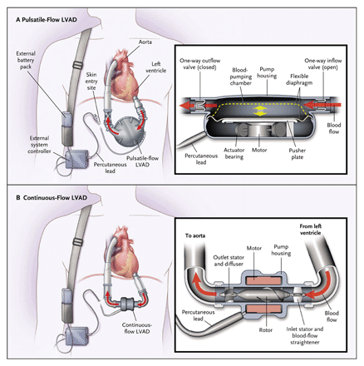
Heartmate Pulsatile-Flow and Continuous-Flow Left Ventricular Assist Devices

Slide 55
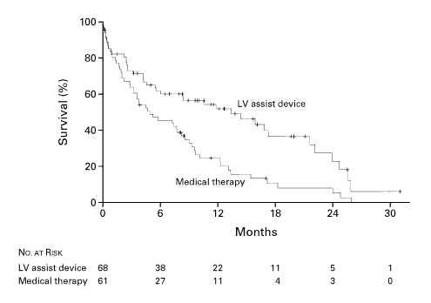
Survival in the REMATCH Trial
One Year Survival
LVAD: 52%
Medical therapy: 25%
(p = 0.002)
Two Year Survival
LVAD: 23%
Medical therapy: 8%
(p = 0.09)
LV assist device
Medical therapy
Rose EA et al. N Engl J Med 2001; 345: 1435-43.

Slide 56
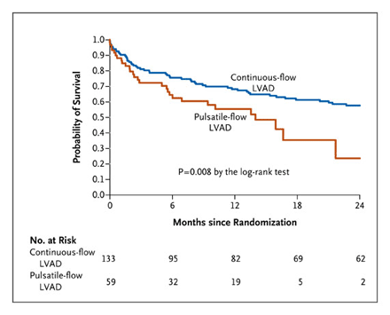
REMATCH 2 Survival
Slaughter MS et al. N Engl J Med 2009; 361:2241-51.

Slide 57
Summary: Evidenced-Based Treatment of Chronic Systolic Heart Failure
Many advances in the treatment of heart failure have occurred since 1984.
Evidence-based medications that improve survival include:
  ACEI or ARB
  b-Blocker
  Aldosterone antagonist
Evidence-based device therapy that improve survival include:
  ICD
  CRT
  LVAD

Slide 58
Limitations of the Current Medical
Management of Heart Failure
Many patients are still not receiving evidence based therapies.
Volume status is difficult to manage as an outpatient.
Clinically stable patients may die suddenly.
Some patients on optimal therapy will still progress to end-stage heart failure.

Slide 59
Multidisciplinary Heart Failure Management Program
Elements Crucial to a Successful Heart Failure Clinic
Specially trained heart failure nurse coordinators.
Education of patient and care givers:
  Nature of heart failure
  Adherence to medications
  Dietary counseling
Clinicians trained in heart failure diagnosis and management
Ready access of patients to the clinic providers
McAlister FA et al. J Am Coll Cardiol 2004;44:810-19.

Slide 60
Effects of Specialized Multidisciplinary Teams on Clinical Outcomes in Heart Failure.
Systemic Review of 14 Randomized Trials
Outcome | Relative Risk | 95% CI
All Cause Mortality | 0.75 | 0.59-0.96
Heart Failure Hospitalization | 0.74 | 0.63-0.87
All Cause Hospitalization | 0.81 | 0.71-0.92
McAlister FA et al. J Am Coll Cardiol 2004;44:810-19.

Slide 61
Heart Failure Clinic at EIRMC
Early phone call follow up (within 3 days)
Early follow up visit (within 7-10 days)
Continued close follow up for 6 weeks
Team Members:
  Douglas Blank, MD
  Blake Wachter, MD, PhD
  Lesli Christofferson, FNP-BC
  Call 208 403-3191 to schedule your patient
  Heart Failure Clinic follow up on discharge orders

