Slide 1
Heart Failure Management
(2013 Guidelines with 2016 and 2017 updates and 2016 ECS guidelines)
Blake Wachter, MD, PhD
Idaho Heart Institute
10/16/2019

Slide 2
Financial Disclosures
NOVARTIS, Entresto (sacubitril/valsartan), speaker

Slide 3
Understanding the Guidelines
2013 ACC/AHA Guidelines for Heart Failure
2016 ACC/AHA Update
  New therapies (valsartan/sucubitril and ivabradine)
2016 ECS Guidelines – similar to ACC/AHA 2013 + ACC/AHA 2016 updates
2017 ACC/AHA Update
  The scope of the focused update includes revision to the sections on biomarkers; new therapies indicated for stage C HF with reduced ejection fraction (HFrEF); updates on HF with preserved ejection fraction (HFpEF); new data on important comorbidities, including sleep apnea, anemia, and hypertension; and new insights into the prevention of HF.

Slide 4
Heart Failure – A Growing Global Concern
Prevalence and Incidence
  Overall 2.1% prevalence: 5.1M heart failure
  patients in 2010¹
  825,000 people ≥ 45 years of age are
  newly diagnosed each year with HF¹
  15M heart failure patients in the ESC
  51-member countries²
    Overall 2-3% prevalence²
Mortality
  For AHA/ACC stage C/D patients
  diagnosed with HF:
    30% will die in the first year.³⁻⁵
    60% will die within 5 years.⁵
HF prevalence in the US is projected to increase 46% from 2012 to 2030,
resulting in > 8M people ≥ 18 years of age with HF.⁶
AHA 2014 Statistics at a Glance, 2014
The European Society of Cardiology, ESC HF Guideline, 2008
Curtis et al, Arch Intern Med, 2008.
Roger et al. JAMA, 2004.
Cowie et al, EHJ, 2002.
Heidenreich PA et al. Circ Heart Failure 2013.
Notes:
Talking points included in this deck are for internal/speaker use only, and are not to be distributed.
Chronic heart failure affects more than 5 million people in the US, which is an overall prevalence of 2.1%. According to statistics reported by the AHA, approximately 825,000 new cases are diagnosed each year in patients 45 years of age and older. The significance of heart failure in Europe is similar to that of the US, where heart failure affects nearly 15 million people of the 900 million people from the 51-member countries of the ESC, amounting to an overall prevalence of 2-3%.
Despite advances in the treatment of heart failure over the past few decades, the prognosis remains poor for patients diagnosed with heart failure. Data from the US and from Europe suggest that approximately 30% of patients will die within the first year of HF diagnosis. An analysis of Medicare data by Curtis and colleagues showed that 60% of patients will die within the first 5 years of diagnosis.
References:
1. Go AS, et al. Heart Disease and Stroke Statistics – 2014 Update: A report from the American Heart Association. Circulation. 2014; 128: 1-268.
2. Dickstein K, et al. ESC Guidelines for the Diagnosis and Treatment of Acute and Chronic Heart Failure 2008. European Heart Journal. 2008; 29, 2388-2442.
3. Curtis LH, et al. Incidence and prevalence of heart failure in elderly persons, 1994-2003. Arch Intern Med. 2008 Feb 25;168(4):418-24.
4. Roger VL, et al. Trends in heart failure incidence and survival in a community-based population. JAMA 2004;292:344-50
5. Cowie MR, et al. Hospitalization of patients with heart failure: a population-based study. Eur Heart J. 2002 Jun;23(11):877-85.
6. Heidenreich PA, et al; on behalf of the American Heart Association Advocacy Coordinating Committee; Council on Arteriosclerosis,
Thrombosis and Vascular Biology; Council on Cardiovascular Radiology and Intervention; Council on Clinical Cardiology; Council on Epidemiology and Prevention; Stroke Council. Forecasting the impact of heart failure in the United States: a policy statement from the American Heart Association. Circ Heart Fail. 2013;6:606–619.

Slide 5

Economic Risks of HF Readmissions in the US
Medicare’s Hospital Readmissions Reduction program penalizes hospitals
that have above average all-cause readmissions within 30 days following
HF discharge.
Percent withholding of all inpatient Medicare payments will increase to up to 3% by 2015 and beyond.³
22.7%
national average 30-day
readmissions rate^{1,2}
Fiscal Year | 2013 | 2014 | 2015+
% payment withholding | up to 1% | up to 2% | up to 3%
1. Dharmarajan K, et al. JAMA. 2013;309(4):355-363.
2. Linden A, Adler-Milstein J. Health Care Finance Rev. 2008;29(3):1-11.
3. CMS Hospitals Readmissions Reductions Program of the Patient Protection and Affordable Care Act (PPACA), 2010.
Notes:
Talking points included in this deck are for internal/speaker use only, and are not to be distributed.
One of Medicare’s reform initiatives that has been introduced is the Hospital Readmissions Reduction program. This program penalizes hospitals with above national average all-cause 30-day readmission rate following HF discharge. Medicare is withholding up to 1% of all inpatient Medicare payments, this withholding will increase to up to 3 percent in fiscal year 2015 and beyond.¹⁸ A technology that can decrease the risk of hospitalization is much needed.
References:
Dharmarajan K, Hsieh AF, Lin Z, et al. Diagnoses and timing of 30-day readmissions after hospitalization for heart failure, acute myocardial infarction, or pneumonia. JAMA. 2013;309(4):355-363.
Linden A, Adler-Milstein J. Medicare disease management in policy context. Health Care Finance Rev. 2008;29(3):1-11.
3. CMS Hospitals Readmissions Reductions Program of the Patient Protection and Affordable Care Act (PPACA), 2010.

Slide 6
Heart Failure: Significant Clinical and Economic Burden
Persons with HF in the US 5.1 million
  20% of Americans > 40yrs
Overall prevalence 2.7%
Incidence 650,000/year
Mortality in 2001 52,828
Cost $27.9 billion

Slide 7
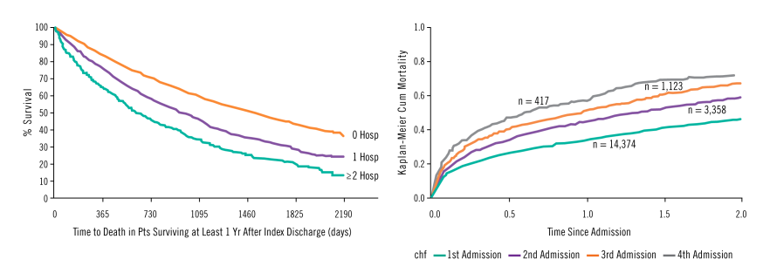
HF Hospitalizations are a Strong Predictor of Mortality^{1,2}
Data from the EFFECT study, n = 9138 patients¹
Among 1 year survivors after index EFFECT-HF discharge, the number of heart failure hospitalizations in the preceding year stratified the risk of death in crude analysis.¹
Data from Setoguchi et al., n = 14,374 patients²
KP cumulative mortality curve for all-cause mortality
after each subsequent hospitalization for HF.²
Studies show each admission decreases a patient’s chance of survival.
1. Lee DS, et al. Am J of Med, 2009.
2. Setoguchi S, et al. Am Heart J, 2007.
Notes:
Talking points included in this deck are for internal/speaker use only, and are not to be distributed.
In addition to further progression of heart failure, high HF-related hospitalizations have also been shown to be a strong predictor of mortality.
Lee and colleagues reported on data from the Enhanced Feedback For Effective Cardiac Treatment Study (EFFECT study), which included data from 9,138 patients. One of the findings was that the risk of death increases progressively and independently with each heart failure event. The graph on the left illustrates that patient survival decreases with increased number of hospitalizations. The data in the graph was from patients who survived at least 1 year after an index hospital discharge. On the right, Setoguchi and colleagues showed similar findings in their study. Among 14,374 patients with repeated HF hospitalizations, mortality increased with recurrent HF hospitalizations. The number of repeated HF hospitalizations remained a strong predictor of mortality even after adjusting for other major risk factors (i.e., age, sex, history of AF, hypertension, etc.) for mortality among HF patients.
These studies suggest that prevention of recurrent heart failure-related hospitalizations and cardiovascular disease events may improve survival in heart failure patients.
References:
1. Lee DS, et al. "Dose-dependent" impact of recurrent cardiac events on mortality in patients with heart failure. Am J Med. 2009 Feb;122(2):162-169.e1. Epub 2008 Dec 26.
2. Setoguchi S, et al. Repeated hospitalizations predict mortality in the community population with heart failure. Am Heart J. 2007 Aug;154(2):260-6.

Slide 8
What is heart failure?

Slide 9
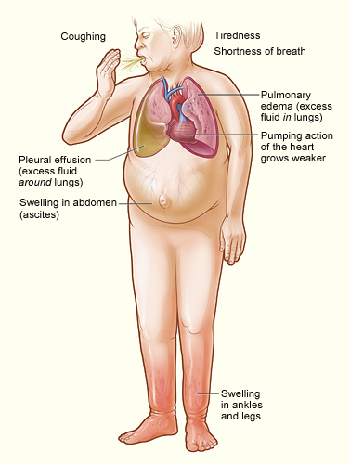
Heart Failure
Any structural or functional impairment of ventricular filling or ejection of blood
Symptoms
  Dyspnea
  Fatigue
  Decreased exercise tolerance
  Pulmonary congestion
  Splanchnic congestion
  Peripheral edema

Slide 10
Diagnosing heart failure
There is no single test or procedure to diagnosis heart failure
  Based on careful clinical history and physical exam
Heart failure is a catch all term
  Disorders of pericardium, myocardium, endocardium, heart valves, great vessels, metabolic abnormalities
  NOT synonymous for cardiomyopathy or LV dysfunction
Distinguish between reduced or normal ejection fraction
  Heart failure with reduced EF (HFrEF) < 45%
  Heart failure with preserved EF (HFpEF) > 55%

Slide 11
Diagnostic testing
Initial laboratory evaluation
  CBC
  U/A
  Basic metabolic panel with magnesium
  Fasting lipid profile
  Liver function tests
  TSH
  NT-Pro-BNP
Serial monitoring of electrolytes and renal function
ECG on first visit
Consider alcohol, drug, viral illness history

Slide 12

Looking for Zebras…
Rheumatological diseases
Amyloidosis
Pheochromocytoma
Hemochromatosis
Chagas
HIV

Slide 13
Biomarkers
*BNP/NT-Pro-BNP is useful to support HF diagnosis especially in the setting of clinical uncertainty
*Measure of BNP on admission is useful for establishing prognosis or disease severity in chronic HF
* Measure of BNP on hospital discharge can be useful for prognosis
Measurement of cardiac enzymes in acute decompensated patient
Can be used to guide therapy in select euvolemic patients in a well structured HF management program
* Can be useful to help identify people at risk of developing HF
Serial BNP measurements to reduce mortality or hospitalization has not been well established and is discouraged at EIRMC inpatient setting.

Slide 14
Non-invasive Cardiac Imaging
New onset or change in condition
  CXR
  Echo with Doppler
Assess goal directed medical therapy (needing an ICD?)
  Repeat echo
In the patient with known CAD with new or worsening HF (+/- symptoms) (Class IIa, level B)
  Consider non invasive imaging
Consider MRI if need to assess myocardial infiltrative processes or scar burden (Class IIa, level B)

Slide 15
Don’t routinely repeat the echo
No Benefit
  Routine repeat measurement of LV function in absence of clinical status change or treatment intervention (Class III)

Slide 16
Invasive Evaluation
Invasive monitoring with pulmonary artery catheter
  Acute decompensating patient
  Guide therapy (inotropes, vasodilators, pressors)
  Volume status is unknown
  Worsening renal failure
  Low systolic pressures
  Evaluation for mechanical circulation support (MCS) or transplant
Coronary angiogram
  In select patient if eligible for revascularization
Endomyocardial biopsy
  Select patients looking for specific diagnosis (Giant Cell Myocarditis)

Slide 17
AHA Classification of Heart Failure
 | Stage | Patient Description
A | High risk for developing heart failure (HF) | Hypertension CAD Diabetes mellitus Family history of cardiomyopathy
B | Asymptomatic HF | Previous MI LV systolic dysfunction Asymptomatic valvular disease
C | Symptomatic HF | Known structural heart disease Shortness of breath and fatigue Reduced exercise tolerance
D | Refractory end-stage HF | Marked symptoms at rest despite maximal medical therapy (eg, those who are recurrently hospitalized or cannot be safely discharged from the hospital without specialized interventions)
Hunt SA et al. J Am Coll Cardiol 2001;38:2101–2113.
Notes:
Stages A through D show the progressive nature of cardiovascular disease into refractory end-stage heart failure.
These patient types, especially Stage A, B, and C patients, are commonly seen by primary care physicians.

Slide 18
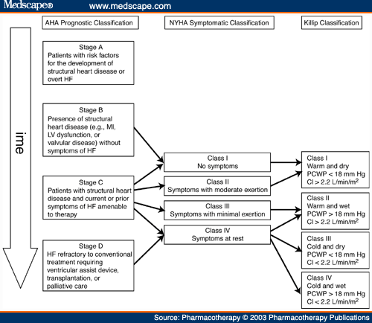

Slide 19

HF Morbidity and Mortality
Increasing frequency of acute events with disease progression leads to high rates of hospitalization and increased risk of mortality^{1,2}
With each acute event, myocardial injury may contribute to progressive left ventricular dysfunction^{1,2}
Chronic decline
Myocardial function
Mortality
Acute episodes
Disease progression
1. Gheorghiade M et al. Am J Cardiol. 2005;96:11G-17G. 2. Gheorghiade M, Pang PS. J Am Coll Cardiol. 2009;53:557-573.
Notes:
HF is a progressive condition with high morbidity and mortality. It is characterized by a progressive decline in cardiac function, interspersed with acute episodes of exacerbation. In chronic HF, a process of progressive ventricular remodeling leads to a gradual decline in clinical status, often punctuated with episodes of acute decompensation. With each acute event, there is a rapid drop in clinical status that may not be fully resolved following the event^{1,2}
The clinical course of HF tends to feature an increasing frequency of acute HF episodes as the disease progresses. Each acute episode is thought to contribute to further decline in cardiac and/or renal function, as a result of hemodynamic and neurohormonal changes and potential myocardial or renal injury incurred during these exacerbations. Thus, every rehospitalization for acute HF contributes to progressive left ventricular or renal dysfunction, leading to an inevitable downward spiral of increasing frequency of acute events, each causing further residual cardiac damage, high rates of hospitalization, and increased risk of death^{1,2}
References
Gheorghiade M, De Luca L, Fonarow GC, et al. Pathophysiologic targets in the early phase of acute heart failure syndromes. Am J Cardiol. 2005;96:11G-17G.
Gheorghiade M, Pang PS. Acute heart failure syndromes. J Am Coll Cardiol. 2009;53:557-573.
Figure, Gheorghiade 2005; p13G, Figure 2; Gheorghiade 2009; p557, col2, para3, lines1-3
Bullets, Gheorghiade 2005; p13G, Figure 2, legend; Gheorghiade 2009; p557, col2, para3, lines1-3; lines 10-13; p561, col1, para3, lines1-15
Bullets, Gheorghiade 2005; Figure 2, legend; Gheorghiade 2009; p557, col2, para3, lines1-3; lines 10-13; p561, col1, para3, lines1-15

Slide 20
Treatment of chronic systolic heart failure
(HFrEF)

Slide 21
Stage A
Treat HTN
Treat lipid disorders
Address obesity
Control diabetes
Stop tobacco use
Avoid known cardiotoxic agents
Treat sleep apnea

Slide 22
Treatment of Stage B and C

Slide 23
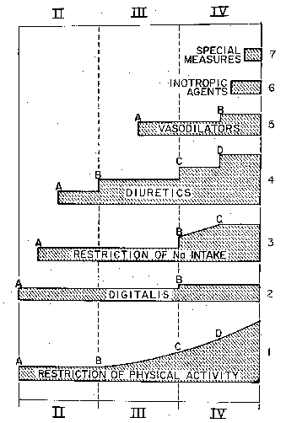
Medical Therapy of Heart Failure in 1984
Vasodilators
Diuretics
Digtalis
Restriction of Na⁺ Intake
Restriction of
Physical Activity
Functional Class
Brauwnwald E. Management of heart failure. Heart Disease 2nd ed. 1984; 503-550.

Slide 24

Diuretics

Slide 25
Diuretics and Heart Failure
No long-term studies of diuretic therapy for treatment of heart failure; its effects on morbidity and mortality are not known¹
Patients may become unresponsive to high doses of diuretic drugs if they
  consume large amounts of dietary sodium²
  Take agents that can block the effects of diuretics (e.g. NSAIDs)¹
  Have significant impairment of renal function or perfusion¹
Diuretic resistance can generally be overcome by
  IV administration of diuretics²
  using two or more diuretics in combination
¹Ravnan SL et al. Congest Heart Fail. 2002;8:80-85
² Brater DC. Drugs. 1985;30:427-443.
Notes:
Ravnan SL, Ravnan MC, Deedwania PC. Pharmacotherapy in congestive heart failure: diuretic resistance and strategies to overcome resistance in patients with congestive heart failure. Congest Heart Fail. 2002;8:80-85.
Brater DC. Resistance to loop diuretics. Why it happens and what to do about it. Drugs. 1985;30:427-443.

Slide 26
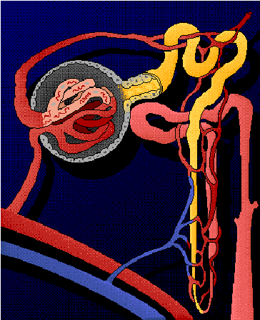
Location of Diuretic Action
Proximal Tubule
Carbonic anhydrase inhibitors
Distal Tubule
Thiazide diuretics
Collecting Duct
Vasopressin antagonists
Aldosterone antagonists
Ascending limb of Loop of Henle
Loop diuretics
Notes:
Diuretic resistance and refractoriness in heart failure patients is due to a number of factors
Avid sodium and water reabsorbtion in proximal tubule due to effects of angiotensin II (AII). Loop and thiazide diuretics work distal to proximal tubule, where majority of sodium and water has already been reabsorbed. Therefore, loop and thiazide diuretics have less substrate (tubular sodium and water) on which to exert their effects
Renal vasoconstriction mediated by norepinephrine, endothelin-1, and AII can lead to reduced GFR. As a result, ability of most diuretics to get to their site of action in renal tubules is reduced
High levels of aldosterone contribute (to a lesser extent) to sodium reabsorbtion
Weber KT. Aldosterone in congestive heart failure. N Engl J Med. 2001;345:1689-1697.
Francis GS, Goldsmith SR, Levine TB, Olivari MT, Cohn JN. The neurohumoral axis in congestive heart failure. Ann Intern Med. 1984;101:370-377.
Dzau VJ. Renal and circulatory mechanisms in congestive heart failure. Kidney Int. 1987;31:1402-1415.

Slide 27

Digoxin

Slide 28



Digitalis and the Treatment of Cardiac Dropsy
Dr. William Withering
1741 - 1799
17th Century patient
with severe dropsy
Foxglove
(Digitalis purpurea)
Withering W “An account of the foxglove and some of its medical uses;
with practical remarks on the dropsy, and some other diseases,” 1785

Slide 29
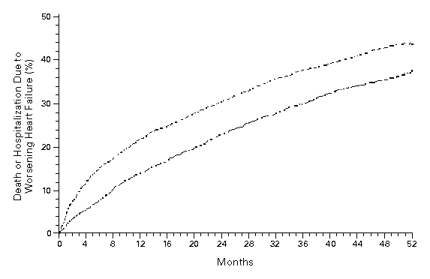
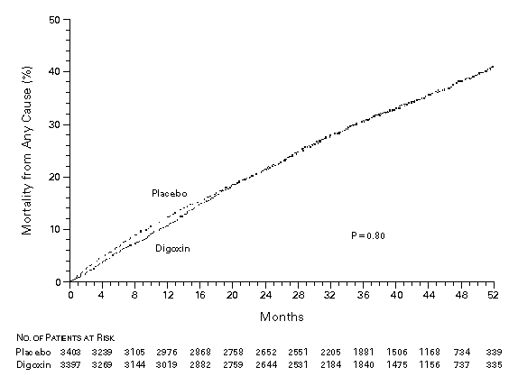
Effect of Digoxin Upon Clinical Outcomes in Subjects with Heart Failure
All Cause Mortality
Death or Hospitalization Due to HF
Placebo
Placebo
RR = 0.99
(0.91-1.07)
p = 0.80
RR = 0.85
(0.79-0.91)
p < 0.001
Digoxin
Digoxin
The Digitalis Investigator Group. N Eng J Med 1997; 336: 525-33.

Slide 30
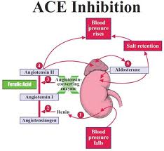
ACE Inhibitors

Slide 31
ACE Inhibition Improves Survival
SOLVD Treatment Trial
SAVE
50
30
Chronic HF
NYLVEF<35%
HA II-III
Placebo
(n=1284)
Acute MI
Asymptomatic
LV dysfunction
Placebo
(n=1116)
40
20
30
% Mortality
Enalapril
(n=1285)
Captopril
(n=1115)
20
10
10
p=0.019
P=0.0036
0
0
0
12
24
36
48
0
1
2
3
4
Months
Years
SOLVD Investigators. N Engl J Med 1991;325:293-302.
Pfeffer MA et al. N Engl J Med 1992;327:669-77.

Slide 32
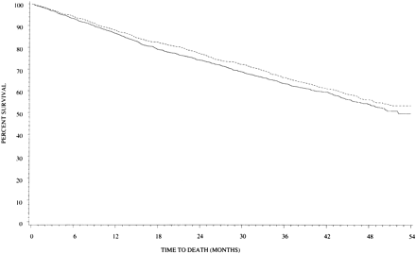
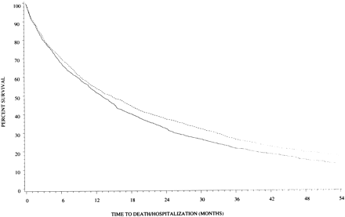
Effect of High Versus Low Dose
Lisinopril on Clinical Outcomes
ATLAS Trial
Low Dose (n = 1596): 2.5 to 5 mg daily (average = 4.5 + 1.1)
High Dose (n = 1568): 32.5 to 35 mg daily (average = 33.2 + 5.4)
All Cause Mortality
All Cause Mortality + Hospitalization
HR = 0.88 (0.82-0.96)
p = 0.002
High Dose
Low Dose
Survival (%)
Survival (%)
High Dose
HR = 0.92 (0.82-1.03)
p = 0.128
Low Dose
Follow-up (Months)
Follow-up (Months)
Follow-up (Months)
Follow-up (Months)
Packer M et al. Circulation 1999;100:2312-18.

Slide 33
ACEI is Superior to Vasodilator Therapy in Chronic Heart Failure
VHeFT II
0.75
0.54
Isosorbide +
Hydralazine
0.46
0.5
0.48
0.36
0.42
Enalapril
Mortality
0.25
0.31
0.25
0.13
RR = 28%
p = 0.016
0.18
0
0.09
0
0
0
12
24
36
48
60
Months
Cohn JN et al. N Engl J Med 1991;325:303-10.

Slide 34
ARB Improves Outcomes in ACEI Intolerant Patients
%
50
Placebo (n = 1013)
(40.0%)
40
(33.0%)
30
CV death or CHF hospitalisation
Candesartan (n = 1015)
20
10
HR 0.77 (95% CI 0.67-0.89), p=0.0004
Adjusted HR 0.70, p<0.0001
0
0
1
2
3
3.5
years
Granger CB et al. Lancet 2003;362:772-6.

Slide 35
Beta Blockers

Slide 36
Beta Blockers (BB)
B1→ negative chronotropy and inotropy
        → AV conduction delay
        → Reduced atrial and ventricular arrythmias
B2→ Bronchoconstriction
        → Peripheral unopposed alpha constriction
        → Decrease glycogenolysis
        (contribute to hypoglycemic events)
Other → antagonize release of renin
→ reduces intraocular pressures
36
Notes:
Alpha constriction, which at least initially increases peripheral resistance, but also of potential concern in cocaine users.
Glycogenolysis, particularly in Type I diabetics
Renin, thereby altering the renin-angiotensin pathway

Slide 37
Impact of BB
Acute MI
  Norwegian Multicenter Study Group Timolol
  CAPRICORN
  ISIS-1
CHF
  COPERNICUS
  MERIT-HF
37
Notes:
Norwegion: AMI, given Timilol for up to 33 months, showing reduced mortality in the Timolol group.
CAPRICORN, AMI and EF lower than 40%→ BB reduced all cause mortality
ISIS-1, Atenolol vs placebo during hospitalization for AMI (16,000 patients). Showed reduced in-hospital mortality.
COPPERNICUS, Carvedilol in patients with EF less than 25%, reduced severity of HF and hospitalizations
MERIT-HF: Metoprolol XL vs placebo, 4000 patients with Class II-IV HF, EF of less than 40%, stopped early due to mortality benefit with Metoprolol

Slide 38
Beta-Blockade Improves Survival
Advanced Heart Failure
Copernicus (n = 2289)
Post Myocardial Infarction
Capricorn (n= 1959)
100
1
90
0.95
RR=23%
P=.031
Carvedilol
0.9
80
% Survival
Placebo
0.85
Carvedilol
70
0.8
Placebo
35% ↓ in risk
P=.00013 (unadjusted)
P=.0014 (adjusted)
60
0.75
0
0.7
0
3
6
9
12
15
18
21
0
0.5
1
1.5
2
2.5
Months
Years
Packer M et al. N Engl J Med 2001;344:1651-8.
CAPRICORN Investigators. Lancet 2001;357:1385–90.

Slide 39
Major Trials of β-Blockade in Heart Failure
Trial Drug Mortality Reduction
US Carvedilol Program* carvedilol ↓ 65% (P<0.001)
1094 patients (Class II–IV)
CIBIS-II Trial HF² bisoprolol ↓ 34% (P<0.0001)
2647 patients (Class III–IV)
MERIT-HF metoprolol ↓ 34% (P=0.0062)
3991 patients (Class II–IV) succinate
BEST bucindolol ↓ 10% (P=0.109)
2708 patients (Class III–IV)
COPERNICUS carvediolol ↓ 35% (P=0.00014)
2289 patients (Class III-IV)
SENIORS* nebivolol ↓ 12% (P=0.21)
2128 patients (Class II-IV)
*Mortality not the primary efficacy endpoint in these trials

Slide 40
Effects of Metoprolol Tartrate and
Carvedilol on Mortality in Heart Failure
COMET
40
Metoprolol ( n = 1511)
30
Percent Mortality (%)
20
Carvedilol (n = 1518)
Hazard ratio 0.83,
95% CI 0.74-0.93, P = 0.0017
10
0
0
1
2
3
4
5
Time (years)
Poole-Wilson PA et al. Lancet 2003;362:7-13.

Slide 41
Impact of ACE Inhibition and β-Blockade on Annual Survival in Heart Failure
20
15.6%
Mortality
Reduced
50%!
12.4%
11.9%
Annual Mortality (%)
10
7.8%
Digoxin,
Diuretic
Digoxin,
Diuretic
+
ACEI
Digoxin,
Diuretic,
ACEI
Digoxin,
Diuretic,
ACEI
+
β-Blocker
Placebo
Active Treatment
0
SOLVD
Treatment
CIBIS-II +
MERIT-HF

Slide 42
Aldosterone antagonist

Slide 43
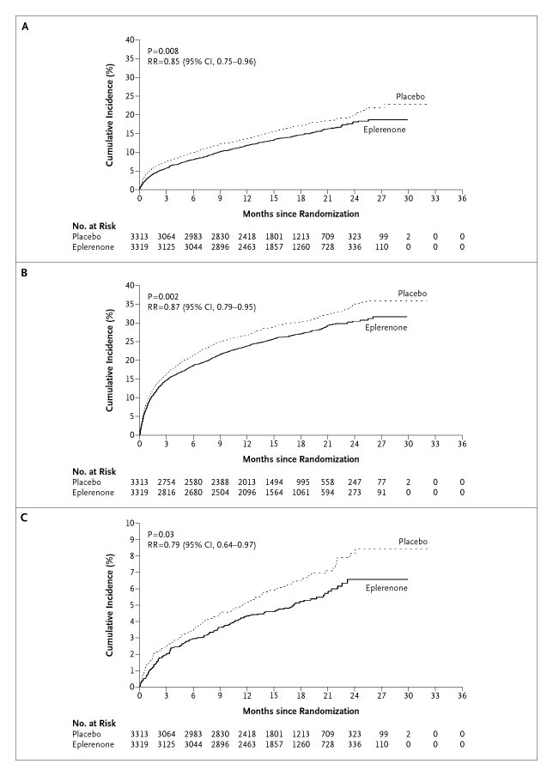
Aldosterone Antagonists Improve Survival
Advanced Heart Failure
RALES
Post Myocardial Infarction
EPHESUS
1.00
0.95
0.90
RR = 0.85 (0.75-0.96)
P = 0.008
RR = 0.85 (0.75-0.96)
P = 0.008
0.85
0.80
Placebo
0.75
Placebo
0.70
Spironolactone
0.65
0.60
Eplerenone
Eplerenone
0.55
Placebo
0.50
RR = 0.70 (0.60-0.82)
P < 0.001
0.45
0.00
0
3
6
9
12
15
18
21
24
27
30
33
36
Months Follow-up
Months Follow-up
Pitt B et al. N Engl J Med. 1999;341:709–717.
Pitt B et al. N Engl J Med 2003;348:1309-21.

Slide 44
Is there a role for aldosterone antagonists in chronic NYHA class II systolic heart failure?
Breaking News May, 2011:
EMPHASIS-HF (eplerenone verus placebo) terminated early by DSMB because of a significant reduction in the primary endpoint of cardiovascular death or heart failure hospitalization

Slide 45
IVABRADINE

Slide 46
Elevated Resting Heart Rate
Accelerates production of atherosclerosis (Int J Cardiol 2008;126:302-12)
Associated with coronary plaque disruption (Circulation 2001;126:1477-82)
Framingham Study
  progressive increase in all cause and cardiovascular mortality in relation
  to antecedent HR (Am Heart J 1987; 113:1489-94)
Continuous increase in death rates in survivors of Acute MI
starting at HR > 70 (J Am Coll Cardiol 2007;50:823-30)
Elevated HR (> 100 bpm) post heart transplant pts have worse outcomes with regard to 10-yr all cause mortality (WACHTER, et.al. Clin Transplant. 2015 Sep;29(9):829-34.)
46
Notes:
Circ journal: Heart rates greater than 80.

Slide 47
Ivabradine: First in class HCN channel blocker
Blocks the hyperpolarization-activated cyclic nucleotide-gated (HCN) channel responsible for the cardiac pacemaker (affects the If current)
Lowers heart rate with NO effect on ventricular repolarization or myocardial contractility
Indicated to reduce the risk of hospitalization for worsening heart failure in patients with stable, symptomatic chronic heart failure with left ventricular ejection fraction < = 35% who are in sinus rhythm with resting heart rates > = 70 beats per minute and on max tolerated doses of betablockers.

Slide 48
IVABRADINE: First in class HCN channel blocker
Blocks the hyperpolarization-activated cyclic nucleotide-gated (HCN) channel responsible for the cardiac pacemaker (affects the If current)
Inward flow of positively charged ions that initiates the spontaneous diastolic depolarization phase, modulating heart rate
Lowers heart rate with NO effect on ventricular repolarization or myocardial contractility
Size of effect of ivabradine is dependent on baseline heart rate.

Slide 49
I_{f} Current
The funny current is highly expressed in spontaneously active cardiac regions, such as the sinoatrial node (SAN, the natural pacemaker region), the atrio-ventricular node (AVN) and the Purkinje fibres of conduction tissue.
Particularly unusual, the funny current is a mixed sodium-potassium current, inward and slowly activating on hyperpolarization at voltages in the diastolic range (normally from -60/-70 mV to -40 mV).
When at the end of a sinoatrial action potential the membrane repolarizes below the If threshold (about -40/-50 mV), the funny current is activated and supplies inward current, which is responsible for starting the diastolic depolarization phase (DD);
By this mechanism, the funny current controls the rate of spontaneous activity of sinoatrial myocytes, hence the cardiac rate.

Slide 50
Ivabradine
Specifically binds the (If) Funny channel
  Reduces the slope for diastolic depolarization
    Prolongs diastolic duration
Does not alter…
    Ventricular repolarization
    Myocardial contractility
    Blood pressure
50
Notes:
Because it binds to the F channel in the open position, it has greatest activity when there is greater open-close cycling of the F channel.
Hence it exhibits is greatest effect when heart rates are highest.
In that sense it has a partial self limiting capability.

Slide 51
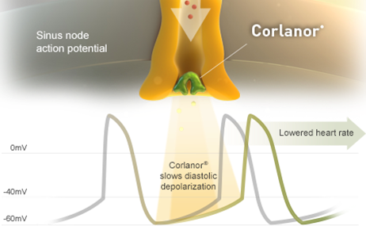
IVABRADINE
Ivabradine slows diastolic depolarization

Slide 52
MorBidity-mortality EvAlUation of The I _{f} inhibitor Ivabradine in patients with coronary disease and left ventricULar dysfunction
BEAUTIFUL Trial

Slide 53
BEAUTIFUL TRIAL
Clinical objective
To examine the effects of ivabradine on cardiovascular events in coronary patients with left ventricular dysfunction
Pathophysiological objective
To examine the effects of elevated HR (>70 bpm) on cardiovascular events in these coronary patients

Slide 54
Inclusion criteria
Male or female
Nondiabetic ≥55 years, diabetic ≥18 years
Documented coronary artery disease
Sinus rhythm and resting heart rate ≥60 bpm
Documented left ventricular systolic dysfunction (<40%)
Clinically stable for 3 months with regards to angina or
heart failure symptoms or both
Therapeutically stable for 1 month (appropriate or stable doses
of conventional medications)
K. Fox et al. Am Heart J. 2006;152:860-866.

Slide 55
Concomitant treatment
Placebo
Ivabradine
All
Antithrombotic agents (%)
94
94
94
Statins (%)
74
74
74
β-blockers (%)
87
87
87
Renin-angiotensin blockers (%)
90
90
90
Fox K et al. Lancet. 2008;372:807-816.

Slide 56
Heart rate above 70 bpm increases
risk of myocardial infarction by 46%
Prospective data from the BEAUTIFUL placebo arm
8
Hazard ratio = 1.46 (1.11 – 1.91)
P=0.0066
Heart rate ≥70 bpm
6
% with hospitalization for
fatal and nonfatal MI
4
Heart rate <70 bpm
2
0
0
0
0.5
1
1.5
2
Years
Fox K et al. Lancet. 2008;372:817-821.

Slide 57
Heart rate above 70 bpm increases
risk of coronary revascularization by 38%
% with coronary revascularization
6
Hazard ratio = 1.38 (1.02 – 1.86)
P=0.037
Heart rate ≥70 bpm
4
2
Heart rate <70 bpm
0
0
0.5
1
1.5
2
Years
Fox K et al. Lancet. 2008;372:817-821

Slide 58
Effect of ivabradine on primary endpoint (Overall population)
% with primary composite end point of CV death, hospitalization for acute MI, or for new-onset or worsening heart failure
25
Hazard ratio = 1.00 (0.91 – 1.10)
P=0.94
20
Ivabradine
15
Placebo
10
5
0
0
0.5
1
1.5
2
Years
Fox K et al. Lancet. 2008;372:807-816.

Slide 59
Ivabradine reduces fatal and nonfatal myocardial infarction (HR ≥70 bpm)
8
Hazard ratio = 0.64 (0.49 – 0.84)
P=0.001
Placebo
(HR >70 bpm)
RRR 36%
Hospitalization for
fatal or nonfatal MI (%)
4
Ivabradine
0
0
0.5
1
1.5
2
Years
RRR: relative risk reduction
Fox K et al. Lancet. 2008;372:807-816.

Slide 60
Ivabradine reduces the need for revascularization (HR ≥70 bpm)
8
Hazard ratio = 0.70 (0.52 – 0.93)
P=0.016
Placebo
(HR >70 bpm)
RRR 30%
Coronary revascularization (%)
4
Ivabradine
0
0
0.5
1
1.5
2
Years
RRR: relative risk reduction
Fox K et al. Lancet. 2008;372:807-816.

Slide 61
Ivabradine reduces primary end point in angina patients
Primary end point(PEP) : CV death + hospitalization for HF or MI
20
Placebo
-24%
n=1507
P=0.05
15
Cumulative incidence
for PEP* (%)
10
Ivabradine
5
0
0
0.5
1
1.5
2
Years
Fox K, Ford I, et al; BEAUTIFUL Investigators. Effect of ivabradine on cardiovascular outcomes in patients with stable coronary artery diseaseand left-ventricular systolic dysfunction with limiting angina: a subgroup analysis of the randomized, controlled BEAUTIFUL trial. Eur heart Jour On line.

Slide 62
Ivabradine reduces myocardial infarction in patients with angina
All patients with angina
Patients with angina and
heart rate >70 bpm
15
15
Hospitalization for fatal and nonfatal MI
HR (95% CI), 0.58 (0.37–0.92); P=0.021
Hospitalization for fatal and nonfatal MI
HR (95% CI), 0.27 (0.11–0.66); P=0.002
42%
73%
10
10
Event rate (%)
Placebo
Placebo
5
Event rate (%)
5
Ivabradine
Ivabradine
0
0
0
0.5
1
1.5
2
0
0.5
1
1.5
2
Years
Years
Fox K, Ford I, et al; BEAUTIFUL Investigators. Effect of ivabradine on cardiovascular outcomes in patients with stable coronary artery diseaseand left-ventricular systolic dysfunction with limiting angina: a subgroup analysis of the randomized, controlled BEAUTIFUL trial. Eur heart Jour On line.

Slide 63
BEAUTIFUL Summary
Ivabradine, the first selective and specific I_{f} inhibitor, has already demonstrated antianginal and anti-ischemic efficacy and improvement of cardiac performance
BEAUTIFUL, the first morbidity-mortality trial with ivabradine, includes 10 917 patients with documented stable coronary artery disease and left ventricular dysfunction receiving optimal guidelines-based therapy.
  In patients with coronary artery disease and left ventricular dysfunction, those with a heart rate >70 bpm have a higher risk of cardiovascular mortality, hospitalization for myocardial infarction, and heart failure.
  In patients with heart rate >70 bpm, ivabradine reduces the composite of fatal and nonfatal myocardial infarction and reduces the need for revascularisation.
  In angina patients, ivabradine reduces the primary end point of cardiovascular death, hospitalization for heart failure, or for myocardial infarction.

Slide 64
Systolic Heart failure treatment with
the If inhibitor ivabradine Trial
SHIFT Trial
http://www.lancet.com published online August 29, 2010 DOI:10.1016/S0140-6736(10)61198-1

Slide 65
Primary objective
To evaluate whether the I_{f} inhibitor ivabradine improves cardiovascular outcomes in patients with
1. Moderate to severe chronic heart failure
2. Left ventricular ejection fraction ≤35%
3. Heart rate ≥70 bpm and
4. Recommended therapy

Slide 66
Inclusion criteria
≥18 years
Class II to IV NYHA heart failure
Ischemic/non-ischemic etiology
LV systolic dysfunction (EF ≤35%)
Heart rate ≥70 bpm
Sinus rhythm
Documented hospital admission for worsening heart failure ≤12 months
Swedberg K, et al. Eur J Heart Fail. 2010;12:75-81.
Notes:
66

Slide 67
Study endpoints
Primary composite endpoint
Cardiovascular death
Hospitalization for worsening heart failure
Other endpoints
All-cause / CV / HF death
All-cause / CV / HF hospitalization
Composite of CV death, hospitalization for HF or non-fatal MI
NYHA class / Patient & Physician Global Assessment
In total population and in patients with at least 50% target dose of beta-blockers
Swedberg K, et al. Eur J Heart Fail. 2010;12:75-81.
Notes:
67

Slide 68
STUDY DESIGN
7411 screened
6558 randomized
3268 to ivabradine
3290 to placebo
5mg BID
Excluded: 27
Excluded: 26
3241 analyzed
2 lost to follow-up
3264 analyzed
1 lost to follow-up
Median study duration: 22.9 months; maximum: 41.7 months

Slide 69
Chronic HF background treatment
Patients (%)
100
91
91
89
90
90
84
83
Ivabradine
80
Placebo
70
61
59
60
50
40
30
22
22
20
10
3
4
0
Beta-blockers
ACEIs and/or
Diuretics
Aldosterone
Digitalis
ICD/CRT
ARBs
antagonists

Slide 70
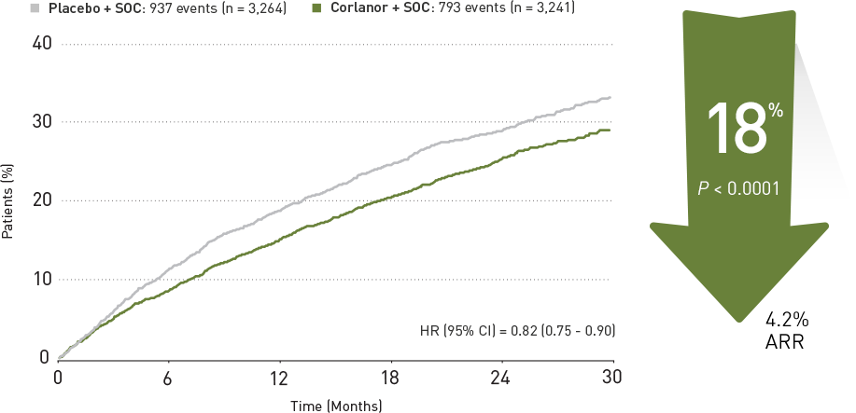
Time to first event of primary composite end point
Ivabradine
placebo
Ivabradine

Slide 71
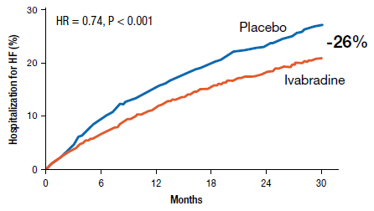
Hospitalization for heart failure
Ivabradine n=514 (9.4%PY) Placebo n=672 (12.7%PY)

Slide 72
Effect of ivabradine on outcomes
Endpoints | Hazard ratio | 95% CI | p value
Primary composite endpoint | 0.82 | [0.75;0.90] | p<0.0001
All-cause death | 0.90 | [0.80;1.02] | p=0.092
Death from HF | 0.74 | [0.58;0.94] | p=0.014
Hospital for any cause | 0.89 | [0.82;0.96] | p=0.003
Hospital for CV reason | 0.85 | [0.78;0.92] | p=0.0002
CV death/hospital for HF or non-fatal MI | 0.82 | [0.74;0.89] | p<0.0001

Slide 73
Incidence of selected adverse events (N = 6492)
 | Patients with an event
 | Ivabradine N=3232, % (n) | Placebo N=3260, % (n) | p value
All serious adverse events | 45% (1450) | 48% (1553) | 0.025
All adverse events | 75% (2439) | 74% (2423) | 0.303
Heart failure | 25% (804) | 29% (937) | 0.0005
Symptomatic bradycardia | 5% (150) | 1% (32) | <0.0001
Asymptomatic bradycardia | 6% (184) | 1% (48) | <0.0001
Atrial fibrillation | 9% (306) | 8% (251) | 0.012
Phosphenes | 3% (89) | 1% (17) | <0.0001
Blurred vision | 1% (17) | <1% (7) | 0.042

Slide 74
Conclusion
Heart failure with systolic dysfunction and elevated heart rate is associated with poor outcomes (primary composite endpoint in the placebo group is 18%/year)
Ivabradine reduced CV mortality or heart failure hospitalization by 18% (p<0.0001). The absolute risk reduction was 4.2%
This beneficial effect was mainly driven by a favourable effect on heart failure death/hospital admission (RRR 26%)
Overall, treatment with ivabradine was safe and well tolerated

Slide 75
Contraindicated in patients with…
Acute decompensated HF
Blood pressure < 90/50
Sick sinus syndrome, AV block without the protection of a PM
Resting heart rate < 60
Severe hepatic impairment
PM set to HR > 70
Concomitant use of strong P450 3A4 (CYP3A4) inhibitors

Slide 76

2016 ACC/AHA/HFSA Guideline Update: Updated Recommendations Around Ivabradine
Recommendations for Ivabradine
COR | LOE | Recommendations
IIa | B-R | Ivabradine can be beneficial to reduce HF hospitalization for patients with symptomatic (NYHA class II-III) stable chronic HFrEF (LVEF ≤35%) who are receiving GDEM, including a β-blocker at maximum tolerated dose, and who are in sinus rhythm with a heart rate of ≥70 bpm at rest
GDEM, guideline-directed evaluation and management.
Yancy CW et al. Circulation. 2016;134:e282-e293.
Notes:
The SHIFT clinical trial provides evidence in support of this recommendation
Yancy 2016; p11, Table

Slide 77
Neprilysin inhibitor (sucubitril)

Slide 78
PARADIGM-HF: A Randomized, Controlled Trial Examining the Efficacy of Sacubitril/Valsartan vs Enalapril in Patients With HF
PARADIGM-HF 2014
Study Design¹
Key inclusion criteria¹
Age ≥18 years
NYHA class II-IV HF
LVEF ≤40%
BNP ≥150 pg/mL
Double-Blind Randomized Treatment Period
Randomization
Single-blind run-in period
Sac/val 97/103 mg BID (n=4187)
Primary Endpoint
Enalapril*
10 mg BID
Sac/val†
49/51 mg BID
Sac/val†
97/103 mg BID
Composite of death from CV causes or first hospitalization for HF
Key exclusion criteria¹
Symptomatic hypotension
Systolic BP <100 mmHg at screening
eGFR<30 mL/min/
1.73 m²
History of angioedema
Enalapril 10 mg BID (n=4212)
Testing tolerability to target doses of enalapril and sac/val
On top of standard HF therapy,
excluding ACEIs and ARBs
2 weeks
1–2 weeks
2–4 weeks
Median duration of follow-up: 27 months
Data from this study support the ACC/AHA/HFSA guideline recommendation of ARNIs
for the treatment of patients with chronic HFrEF (Class I, Level B-R evidence)²
ARNIs, angiotensin receptor-neprilysin inhibitors; BNP, B-type natriuretic peptide; Sac, sacubitril; Val, valsartan.
*Enalapril 5 mg BID for 1-2 weeks followed by enalapril 10 mg BID was an optional starting run-in dose for patients treated with ARBs or with a low-dose ACEI.
†Dosing in clinical trials was based on the total amount of both components of sac/val; 24/26 mg, 49/51 mg, and 97/103 mg were
referred to as 50 mg, 100 mg, and 200 mg, respectively. Sac/val was formerly known as LCZ696 in clinical trials.
1. McMurray JJV et al. N Engl J Med. 2014;371:993-1004. 2. Yancy CW et al. Circulation. 2016;134:e282-e293.
Notes:
The Prospective Comparison of ARNI (Angiotensin Receptor-Neprilysin Inhibitor) with ACEI (Angiotensin-Converting Enzyme Inhibitor) to Determine Impact on Global Mortality and Morbidity in Heart Failure Trial (PARADIGM-HF) was designed to compare whether the combination of the angiotensin receptor-neprilysin inhibitor (ARNI) sacubitril and the ARB valsartan (sac/val) improved morbidity and mortality compared with enalapril¹
Patients were eligible if they had NYHA class II-IV HF, an LVEF≤40%, and a plasma B-type natriuretic peptide ≥150 pg/mL¹
Exclusion criteria included symptomatic hypotension, systolic BP <100 mmHg at screening (or <95 mmHg at randomization), eGFR<30 mL/min/1.73 m², a decrease in eGFR >25% (later amended to >35%) between screening and randomization, serum potassium >5.2 mmol/L at screening (or >5.4 mmol/L at randomization), and a history of angioedema or unacceptable side effects during the treatment with ACE inhibitors or ARBs¹
Eligible patients underwent a single-blind run-in period prior to randomization, during which time they received enalapril followed by increasing doses of sacl/val to determine tolerability to target doses of study agents¹
After completion of the run-in period, 8442 patients were randomized to receive sac/val (n=4187) or enalapril (n=4212)¹
The primary outcome was a composite of death from CV causes or first hospitalization for HF. Secondary endpoints were the time to death from any cause, the change from baseline to 8 months in Kansas City Cardiomyopathy Questionnaire (KCCQ) score, time to a new onset of atrial fibrillation, and time to the first occurrence of a decline in renal function¹
Data from this study support the ACC/AHA/HFSA Guideline recommendation of ARNIs for the treatment of patients with chronic HFrEF (Class I, Level B-R evidence)²
References
McMurray JJV, Packer M, Desai AS, et al; for the PARADIGM-HF Investigators and Committees. Angiotensin–neprilysin inhibition versus enalapril in heart failure. N Engl J Med. 2014;371:993-1004.
Yancy CW, Jessup M, Bozkirt B, et al. 2016 ACC/AHA/HFSA focused update on new pharmacological therapy for heart failure: an update of the 2013 ACCF/AHA guideline for the management of heart failure. A report of the American College of Cardiology/American Heart Association Task Force on Clinical Practice Guidelines and the Heart Failure Society of America. Circulation. 2016;134:e282-e293.
Key inclusion criteria, McMurray 2014; p994, col2, para 4, lines1-13
Key exclusion criteria, McMurray 2014; p994, col2, para5, lines1-2; p995, col1, para1, lines1-9; col2, para2, lines1-2
Study design, McMurray 2014; p994, col2, para3, lines2-7; p995, Figure 1; col2, para2; p996, col1, para1; pp997, col1, para2, lines1-8; para3, lines1-3; p999, col2, para2, lines11-12
Callout, Yancy 2016; p10, Table; p14, Reference 19
Bullet 1, McMurray 2014; p993, asterisk; p994, col1, para3, lines8-13
Bullet 2, McMurray 2014; p994, col2, para 4, lines1-13
Bullet 3, McMurray 2014; p994, col2, para5, lines1-2; p995, col1, para1, lines1-9; col2, para2, lines1-2
Bullet 4, McMurray 2014; p994, col2, para3, lines2-7
Bullet 5, McMurray 2014; p995, Figure 1
Bullet 6, McMurray 2014; p997, col1, para3, lines1-10; col2, para1, lines1-6
Bullet 7, Yancy 2016; p10, Table; p14, Reference 19

Slide 79
PARADIGM-HF: Efficacy and Safety of Sacubitril/Valsartan vs Enalapril in Patients With HF
PARADIGM-HF 2014
Hospitalization for HF or Death from Cardiovascular Causes
1.0
0.5
HR 0.80 (95% Cl 0.73-0.87), P<0.001
20% relative risk reduction
0.4
Combined Endpoint of CV Death
Cumulative Probability of the
or HR Hospitalization
Enalapril (
11
17 events)
0.2
Sac/val (914 events)
0
0
180
360
540
720
900
1080
1260
No. at Risk
Days Since Randomization
Sac/val
4187
3922
3663
3018
2257
1544
896
249
Enalapril
4212
3883
3579
2922
2123
1488
853
236
Death from CV causes or first hospitalization for worsening HF occurred in 914 (21.8%) of sac/val patients and 1117 (26.5%) of enalapril patients (HR 0.80 [95% CI, 0.73-0.87]; P<0.001)
Sac/val treatment was associated with significant improvements in each component of the composite endpoint
Patients in the sac/val group were more likely to have symptomatic hypotension than patients in the enalapril group (P<0.001)
McMurray JJV et al. N Engl J Med. 2014;371:993-1004.
Notes:
Death from CV causes or hospitalization for HF occurred in 914 (21.7%) patients in the sac/val group and 1117 (26.5%) patients in the enalapril group (P<0.001)
Differences in primary outcome were observed early in the trial and was retained at each interim analysis
558 (13.3%) deaths due to CV causes occurred in the sac/val group compared with 693 (16.5%) deaths in the enalapril group
(P<0.001)
Hospitalization for HF was observed in 537 (12.8%) patients in the sac/val group vs 658 (15.6%) patients in the enalapril group (P<0.001)
Sac/val treatment was also associated with significant improvements in death from any cause (17.0% vs 19.8% with enalapril; P<0.001) and change in KCCQ clinical summary score at 8 months (−2.99 vs − 4.63, P=0.001)
Patients in the sac/val group were more likely to have symptomatic hypotension than patients in the enalapril group
Termination of study medication due to AEs occurred more frequently in the enalapril group than in the sac/val group (12.3% vs 10.7%, P=0.03)
Reference
McMurray JJV, Packer M, Desai AS, et al; for the PARADIGM-HF Investigators and Committees. Angiotensin–neprilysin inhibition versus enalapril in heart failure. N Engl J Med. 2014;371:993-1004.
Figure, McMurray 2014; p998, Figure 1A; p999, Table 2
Bullets 1 and 2, McMurray 2014; p999, Table 2
Bullet 3, McMurray 2014; p1002, Table 3
Bullet 1, McMurray 2014; p999, Table 2
Bullet 2, McMurray 2014; p1001, col1, para1, lines7-9
Bullets 3-5, McMurray 2014; p999, Table 2
Bullet 6, McMurray 2014; p1002, Table 3
Bullet 7, McMurray 2014; p1001, col2, para3, lines19-23

Slide 80

HFrEF Pathophysiology
Slide has animation
SNS and RAAS
Neurohormonal activation via SNS and RAAS signaling may exacerbate the failing heart and trigger lethal ventricular arrhythmias^{1,2}
SNS^{2,4}
Epinephrine Norepinephrine
α₁, β₁, β₂ receptors
Vasoconstriction ↑
RAAS activity ↑
Heart rate ↑
Contractility ↑
HF SYMPTOMS & PROGRESSION
RAAS^{2,3,4}
Ang II
AT1R
Vasoconstriction ↑
Blood pressure ↑
Sympathetic tone ↑
Vasopressin ↑
Aldosterone ↑
Hypertrophy ↑
Fibrosis ↑
Ang II, angiotensin II; AT1R, angiotensin II type 1 receptor; HF, heart failure; NPs, natriuretic peptides; SNS, sympathetic nervous system;
RAAS, renin-angiotensin-aldosterone system.
1. Tomaselli GF, Zipes DP. Circ Res. 2004;95(8):754-763. 2. Kemp CD, Conte JV. Cardiovasc Pathol. 2012;21(5):365-371. 3. Mangiafico S et al. Eur Heart J. 2013;34:886-893. 4. Hasenfuss G, Mann DL. Pathophysiology of heart failure. In: Mann DL et al, eds. Braunwald's Heart Disease: A Textbook of Cardiovascular Medicine. 10th ed. Philadelphia, PA: Elsevier; 2015

Slide 81
HFrEF Pathophysiology
Slide has animation
The SNS and RAAS Are Overexpressed
Neurohormonal activation via SNS and RAAS signaling may exacerbate the failing heart and trigger lethal ventricular arrhythmias^{1,2}
The RAAS and SNS are overexpressed^{1,2,4}
SNS^{2,4}
Epinephrine Norepinephrine
α₁, β₁, β₂ receptors
Vasoconstriction ↑
RAAS activity ↑
Heart rate ↑
Contractility ↑
HF SYMPTOMS & PROGRESSION
RAAS^{2,3,4}
Ang II
AT1R
Vasoconstriction ↑
Blood pressure ↑
Sympathetic tone ↑
Vasopressin ↑
Aldosterone ↑
Hypertrophy ↑
Fibrosis ↑
Ang II, angiotensin II; AT1R, angiotensin II type 1 receptor; HF, heart failure; NPs, natriuretic peptides; SNS, sympathetic nervous system;
RAAS, renin-angiotensin-aldosterone system.
1. Tomaselli GF, Zipes DP. Circ Res. 2004;95(8):754-763. 2. Kemp CD, Conte JV. Cardiovasc Pathol. 2012;21(5):365-371. 3. Mangiafico S et al. Eur Heart J. 2013;34:886-893. 4. Hasenfuss G, Mann DL. Pathophysiology of heart failure. In: Mann DL et al, eds. Braunwald's Heart Disease: A Textbook of Cardiovascular Medicine. 10th ed. Philadelphia, PA: Elsevier; 2015

Slide 82
HFrEF Pathophysiology
Slide has animation
Role of Endogenous Compensatory Peptides
Endogenous Compensatory Peptides (ECPs)²⁻⁴
SNS^{1,4}
Epinephrine Norepinephrine
α₁, β₁, β₂ receptors
NPR-A, NPR-B, B2, calcitonin receptor-like receptor
NPs, Bradykinin, ADM
Vasoconstriction ↑
RAAS activity ↑
Heart rate ↑
Contractility ↑
↓ Vasodilation
↓ Blood pressure
↓ Sympathetic tone
↑ Natriuresis/diuresis
↓ Vasopressin
↓ Aldosterone
↓ Fibrosis
↓ Hypertrophy
HF SYMPTOMS & PROGRESSION
RAAS^{1,2,4}
Ang II
AT1R
Vasoconstriction ↑
Blood pressure ↑
Sympathetic tone ↑
Vasopressin ↑
Aldosterone ↑
Hypertrophy ↑
Fibrosis ↑
The effects of RAAS and SNS are balanced by the counterregulatory effects of ECPs, including NPs, bradykinin, and adrenomedullin²⁻⁴
ADM, adrenomedulin; Ang II, angiotensin II; AT1R, angiotensin II type 1 receptor; ECPs, endogenous compensatory peptides; HF, heart failure;
NPs, natriuretic peptides; SNS, sympathetic nervous system; RAAS, renin-angiotensin-aldosterone system.
1. Kemp CD, Conte JV. Cardiovasc Pathol. 2012;21(5):365-371. 2. Mangiafico S et al. Eur Heart J. 2013;34:886-893. 3. Nathisuwan S, Talbert RL. Pharmacotherapy. 2002;22:27-42. 4. Hasenfuss G, Mann DL. Pathophysiology of heart failure. In: Mann DL et al, eds. Braunwald's Heart Disease: A Textbook of Cardiovascular Medicine. 10th ed. Philadelphia, PA: Elsevier; 2015.

Slide 83
HFrEF Pathophysiology
Slide has animation
Existing Therapies
β-blockers⁵
β-blockers⁵
SNS^{1,4}
Endogenous Compensatory Peptides²⁻⁴
SNS^{1,4}
Epinephrine Norepinephrine
Epinephrine Norepinephrine
α₁, β₁, β₂ receptors
NPR-A, NPR-B, B2, calcitonin receptor-like receptor
α₁, β₁, β₂ receptors
NPs, Bradykinin, ADM
Vasoconstriction ↑
RAAS activity ↑
Heart rate ↑
Contractility ↑
Vasoconstriction ↑
RAAS activity ↑
Heart rate ↑
Contractility ↑
↓ Vasodilation
↓ Blood pressure
↓ Sympathetic tone
↑ Natriuresis/diuresis
↓ Vasopressin
↓ Aldosterone
↓ Fibrosis
↓ Hypertrophy
HF SYMPTOMS & PROGRESSION
RAAS inhibitors (ACEI, ARB, MRA)⁵
RAAS inhibitors (ACEI, ARB, MRA)⁵
RAAS^{1,2,4}
RAAS^{1,2,4}
Ang II
Ang II
AT1R
AT1R
Vasoconstriction ↑
Blood pressure ↑
Sympathetic tone ↑
Vasopressin ↑
Aldosterone ↑
Hypertrophy ↑
Fibrosis ↑
Vasoconstriction ↑
Blood pressure ↑
Sympathetic tone ↑
Vasopressin ↑
Aldosterone ↑
Hypertrophy ↑
Fibrosis ↑
ACEI, angiotensin-converting enzyme inhibitor; ADM, adrenomedulin; Ang II, angiotensin II; ARB, angiotensin II receptor blocker; AT1R, angiotensin II type 1 receptor; ECPs, endogenous compensatory peptides; HF, heart failure; MRA, mineralocorticoid receptor antagonists; NPs, natriuretic peptides; SNS, sympathetic nervous system; RAAS, renin-angiotensin-aldosterone system.
1. Kemp CD, Conte JV. Cardiovasc Pathol. 2012;21(5):365-371. 2. Mangiafico S et al. Eur Heart J. 2013;34:886-893. 3. Nathisuwan S, Talbert RL. Pharmacotherapy. 2002;22:27-42. 4. Hasenfuss G, Mann DL. Pathophysiology of heart failure. In: Mann DL et al, eds. Braunwald's Heart Disease: A Textbook of Cardiovascular Medicine. 10th ed. Philadelphia, PA: Elsevier; 2015. 5. Mann DL. Management of Patients with Heart Failure with Reduced Ejection Fraction. In: Mann DL et al, eds. Braunwald's Heart Disease: A Textbook of Cardiovascular Medicine. 10th ed. Philadelphia, PA: Elsevier; 2015

Slide 84
Sacubitril/Valsartan
Slide has animation
Effects of Sacubitril/valsartan in HFrEF
Endogenous Compensatory Peptides²⁻⁴
SNS^{1,4}
Endogenous Compensatory Peptides²⁻⁴
Epinephrine Norepinephrine
α₁, β₁, β₂ receptors
NPR-A, NPR-B, B2, calcitonin receptor-like receptor
NPR-A, NPR-B, B2, calcitonin receptor-like receptor
NPs, Bradykinin, ADM
NPs, Bradykinin, ADM
Vasoconstriction ↑
RAAS activity ↑
Heart rate ↑
Contractility ↑
↓ Vasodilation
↓ Blood pressure
↓ Sympathetic tone
↑ Natriuresis/diuresis
↓ Vasopressin
↓ Aldosterone
↓ Fibrosis
↓ Hypertrophy
↓ Vasodilation
↓ Blood pressure
↓ Sympathetic tone
↑ Natriuresis/diuresis
↓ Vasopressin
↓ Aldosterone
↓ Fibrosis
↓ Hypertrophy
HF SYMPTOMS & PROGRESSION
RAAS^{1,2,4}
RAAS^{1,2,4}
Ang II
Ang II
AT1R
Enhance the beneficial effects of endogenous compensatory peptides
AT1R
+
Vasoconstriction ↑
Blood pressure ↑
Sympathetic tone ↑
Vasopressin ↑
Aldosterone ↑
Hypertrophy ↑
Fibrosis ↑
Vasoconstriction ↑
Blood pressure ↑
Sympathetic tone ↑
Vasopressin ↑
Aldosterone ↑
Hypertrophy ↑
Fibrosis ↑
Neprilysin
Inhibitor
Suppress deleterious effects of RAAS
Sacubitril/
valsartan⁵
ARB
Link to effects of NEP inhibition
1. Kemp CD, Conte JV. Cardiovasc Pathol. 2012;21(5):365-371. 2. Mangiafico S et al. Eur Heart J. 2013;34:886-893. 3. Nathisuwan S, Talbert RL. Pharmacotherapy. 2002;22:27-42. 4. Hasenfuss G, Mann DL. Pathophysiology of heart failure. In: Mann DL et al, eds. Braunwald's Heart Disease: A Textbook of Cardiovascular Medicine. 10th ed. Philadelphia, PA: Elsevier; 2015. 5. Entresto (sacubitril/valsartan) [package insert].
East Hanover, NJ: Novartis Pharmaceuticals Corp; August 2015.
ADM, adrenomedulin; Ang II, angiotensin II; AT1R, angiotensin II type 1 receptor; ECPs, endogenous compensatory peptides; HF, heart failure;
NPs, natriuretic peptides; SNS, sympathetic nervous system; RAAS, renin-angiotensin-aldosterone system.

Slide 85
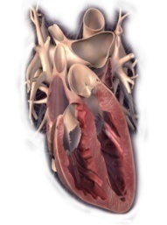
Sacubitril/Valsartan
Slide has animation
Effect on BNP and NT-proBNP
⬆ proBNP secretion
Heart Failure with LV Stretch
Vasoactive peptideª with cardioprotective effects
BNP
NT-proBNP
Inactive
(inert) marker
of HF
Sacubitril/
Valsartan
Neprilysin inhibition has
no effect on NT-proBNP
Neprilysin
Sacubitril/Valsartan Increases BNP Levels
Link to BNP and NT-proBNP Reductions
Inactive
fragments
BNPs, brain natriuretic peptides; NT-proBNP, N-terminal of the prohormone brain natriuretic peptide.
ªVasoactive peptides include the NPs (atrial NPs, BNPs, C-type NPs), adrenomedullin, and bradykinin.
Modified from Vardeny O et al. Clin Pharmacol Ther. 2013;94:445-448.

Slide 86
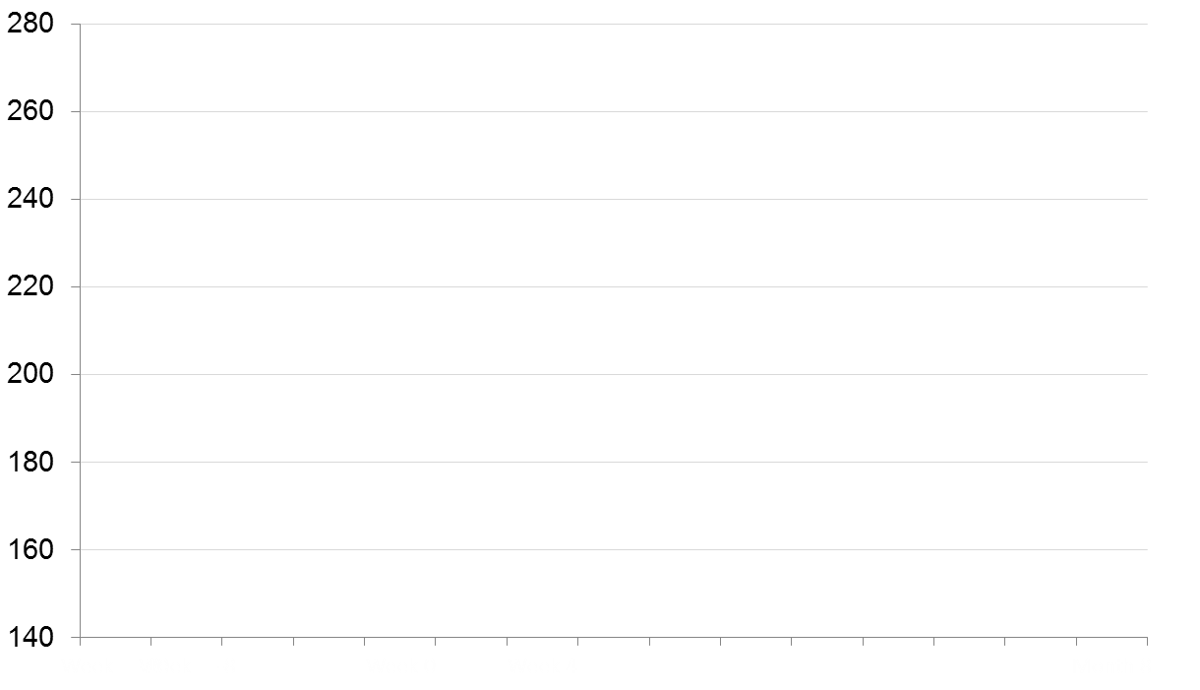
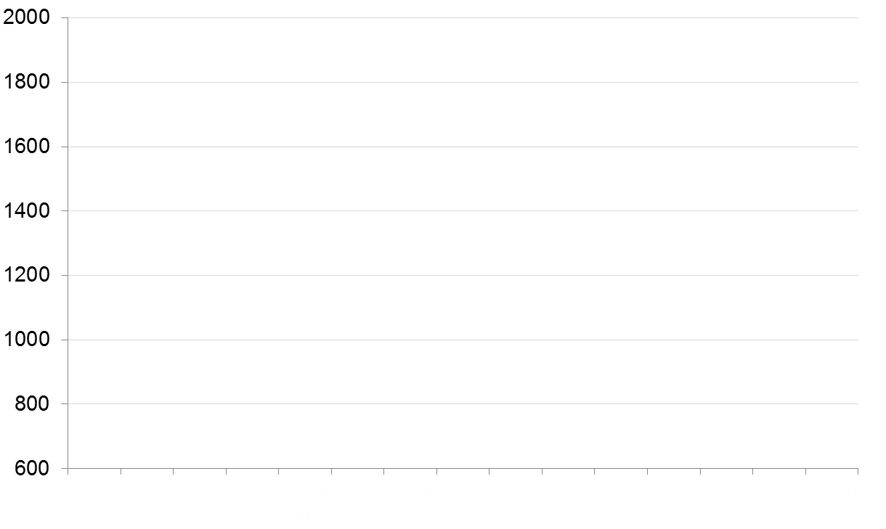
Effects of Sacubitril/Valsartan on BNP & NT- proBNP
BNP
NT- proBNP
Enalapril
Run-in*
Entresto
Run-in*
Enalapril
Run-in*
Entresto
Run-in*
Enalapril
Enalapril
Sac/Val
Sac/Val
Geometric Mean (nmol/L)
Geometric Mean (nmol/L)
W
-10
W
-8
W
0
W
4
M
8
W
-10
W
-8
W
0
W
4
M
8
*Patients in both groups received the same single-blind treatment
"BNP, but not NT-proBNP, is a neprilysin substrate, and therefore BNP levels will increase as levels of active drug increase; whereas levels of NT-proBNP will show the effects of the drug on the heart"
Post hoc analysis
BNP, B-type natriuretic peptide; M, month; NT pro-BNP, N-terminal pro-B-type natriuretic peptide; W, week
Packer M et al. Circulation. 2014;131:54–61
Entresto (sacubitril/valsartan) [package insert]. East Hanover, NJ: Novartis Pharmaceuticals Corp; August 2015
Notes:
LCZ696 significantly reduced levels of NT-proBNP, a marker of cardiac wall stress
A pre-specified exploratory analysis assessed various measures in the PARADIGM-HF study, including biomarkers reflective of cardiac injury, wall stress and effects of neprilysin inhibition.
Entresto treatment was associated with an early and sustained reduction in N-terminal pro-BNP (a biomarker of myocardial wall-stress) versus enalapril. The difference between groups was apparent within 4 weeks and was sustained at 8 months, p<0.0001 for the difference between groups at both time points.
Abbreviations
BNP=B-type natriuretic peptide; NT-proBNP=N-terminal pro B-type natriuretic peptide
Reference
Packer M et al. Circulation. 2014;131:54–61

Slide 87

Sacubitril/Valsartan
Required 36-Hour Washout from ACEi
Potential for the Risk of Angioedema
Neprilysin inhibition may increase levels of bradykinin, a potent vasodilator, thereby raising the risk of angioedema¹
However, neprilysin contributes only modestly to the breakdown of bradykinin, while ACE and APP are major enzymes for bradykinin breakdown¹
LBQ657-the active neprilysin inhibitor moiety of sacubitril- inhibits neprilysin without inhibiting ACE or APP. The incidence of angioedema was 0.5% in patients treated with sacubitril/valsartan and 0.2% with enalapril²⁻⁴
Sacubitril/valsartan inhibits neprilysin³
Active bradykinin¹
ACE
APP
Neprilysin
DPP-4
Inactive bradykinin¹
Without ACEi washout, risk for angioedema would be greater due to possible inhibition of multiple enzymes
The incidence of angioedema in Black patients was 2.4% with ENTRESTO and 0.5% with enalapril
ACEi, angiotensin-converting enzyme inhibitor; APP, aminopeptidase P; DPP-4, dipeptidyl peptidase-4.
1. Fryer RM et al. Br J Pharmacol. 2008;153:947-955. 2. Entresto (sacubitril/valsartan) [package insert]. East Hanover, NJ: Novartis Pharmaceuticals Corp; August 2015. 3. McMurray JJ. Eur J Heart Fail. 2015;17(3):242-247. 4. Gu J et al. J Clin Pharmacol. 2010;50:401-414.
Notes:
87

Slide 88
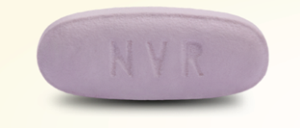

Sacubitril/Valsartan
Available Dosages for BID Administration
24 mg of sacubitril and
26 mg of valsartan†
49 mg of sacubitril and
51 mg of valsartan†
97 mg of sacubitril and
103 mg of valsartan†
24/26 mg
49/51 mg
97/103 mg
Stop ACEi
36 hours before starting sac/val*
Not currently taking ACEIs or ARBs; or low doses
Severe renal impairment††
Moderate Hepatic Impairment‡
Recommended starting dose
Target dose
Double the dose of sac/val after 2 to 4 weeks, as tolerated by the patient, to reach the target maintenance dose of 97/103 mg BID
In clinical studies sacubitril/valsartan doses were referred to as 50mg, 100mg and 200mg (24/26mg, 49/51mg and 97/103mg), respectively
*If stopping sacubitril/valsartan and switching to ACEi ,36 hour washout before starting ace inhibitor is also required
† The 26 mg, 51 mg, and 103 mg dose of valsartan in Entresto is equivalent to 40 mg, 80 mg, and 160 mg of Diovan, respectively.
†† eGFR<30 mL/min/1.73m²
‡ Child-Pugh B classification
Entresto (sacubitril/valsartan) [package insert]. East Hanover, NJ: Novartis Pharmaceuticals Corp; August 2015.

Slide 89
Sacubitril/Valsartan
Adverse Reactions Occurring at an Incidence of ≥5% in the Double-Blind Period
Adverse Reactions Occurring ≥5% | Sac/Val N=4203 n (%) | Enalapril N=4229 n (%)
Hypotension | 18 | 12
Hyperkalemia | 12 | 14
Cough | 9 | 13
Dizziness | 6 | 5
Renal failure/acute renal failure | 5 | 5
In the PARADIGM-HF trial, the incidence of angioedema was 0.1% in both the enalapril and sacubitril/valsartan run-in periods. In the double-blind period, the incidence of angioedema was higher in patients treated with sacubitril/valsartan than enalapril (0.5% and 0.2%, respectively). The incidence of angioedema in Black patients was 2.4% with sacubitril/valsartan and 0.5% with enalapril
Orthostasis was reported in 2.1% of patients treated with sacubitril/valsartan compared to 1.1% of patients treated with enalapril during the double-blind period of PARADIGM-HF. Falls were reported in 1.9% of patients treated with sacubitril/valsartan compared to 1.3% of patients treated with enalapril
Entresto (sacubitril/valsartan) [package insert]. East Hanover, NJ: Novartis Pharmaceuticals Corp; August 2015.

Slide 90
PARADIGM-HF
Primary Endpoint: Time to First Occurrence of CV Death or HF Hospitalization
Sacubitril/Valsartan Reduced the Risk of CV Death or
First HF Hospitalization by 20% vs Enalapril^{1,2}
1.0
Enalapril
Sacubitril/valsartan
4.7% ARR
NNT²=21
over a median duration of 27 months
Total Patients = 8442
0.6
Hazard ratio = 0.80 (95% CI: 0.73-0.87)
P<0.0001
0.4
Cumulative probability of event
1117 events
914 events
0.2
0
0
180
360
540
720
900
1080
1260
Days since randomization
Trial stopped early after median follow-up of 27 months²
ARR, absolute risk reduction; CI, confidence interval; HR, hazard ratio; NNT, number needed to treat; RRR, relative risk reduction.
1. ENTRESTO [prescribing information]. East Hanover, NJ: Novartis Pharmaceuticals Corp; August 2015. 2. McMurray JJ, et al. N Engl J Med. 2014;371(11):993-1004.

Slide 91
Sacubitril/Valsartan
Warnings and Precautions
Click on any of the warnings and precautions for more information
Fetal Toxicity
Sacubitril/valsartan can cause fetal harm when administered to a pregnant woman
Angioedema
Sacubitril/valsartan may cause angioedema. In the double-blind period of PARADIGM-HF, 0.5% of patients on sacubitril/valsartan and 0.2% of patients on enalapril had angioedema
Hypotension
Sacubitril/valsartan lowers blood pressure and may cause symptomatic hypotension
Impaired Renal Function
As a consequence of inhibiting the renin-angiotensin-aldosterone system (RAAS), decreases in renal function may be anticipated in susceptible individuals treated with sacubitril/valsartan
Hyperkalemia
Through its actions on the RAAS, hyperkalemia may occur with sacubitril/valsartan
Entresto (sacubitril/valsartan) [package insert]. East Hanover, NJ: Novartis Pharmaceuticals Corp; August 2015.

Slide 92

Angiotensin Receptor-Neprilysin Inhibition in Patients Hospitalized With Acute Decompensated Heart Failure
Eric J Velazquez,¹ David A Morrow,² Adam D DeVore,³ Carol I Duffy,⁴ Andrew P
Ambrosy,³ Kevin McCague,⁴ Ricardo Rocha,⁴ Eugene Braunwald²
¹Yale Univ Sch of Med, New Haven, CT; ²Harvard Univ/Brigham and Women's Hosp, Boston, MA;
³Duke Univ/Duke Clinical Res Inst, Durham, NC; ⁴Novartis Pharmaceuticals Corp, East Hanover, NJ; ⁵

Slide 93

Study Design
Hospitalized with ADHF (HFrEF)
Stabilized
sacubitril/valsartan
enalapril
vs
In-hospital initiation
Titration algorithm over 8 weeks
Evaluate biomarker surrogates of efficacy
Evaluate safety and tolerability
Explore clinical outcomes
4

Slide 94
2017 ACC/AHA/HFSA Focused Update
Recommendations for Renin-Angiotensin System Inhibition With ACE Inhibitor or ARB or ARNI (angiotensin receptor neprilysin inhibitor)
COR | LOE | Recommendations
I | ACE: A | The clinical strategy of inhibition of the renin-angiotensin system with ACE inhibitors (Level of Evidence: A), OR ARBs (Level of Evidence: A), OR ARNI (Level of Evidence: B-R) in conjunction with evidence-based beta blockers, and aldosterone antagonists in selected patients, is recommended for patients with chronic HFrEF to reduce morbidity and mortality.
 | ARB: A
 | ARNI: B-R
COR | LOE | Recommendations
I | ARNI: B-R | In patients with chronic symptomatic HFrEF NYHA class II or III who tolerate an ACE inhibitor or ARB, replacement by an ARNI is recommended to further reduce morbidity and mortality.
COR | LOE | Recommendations
III: Harm | B-R | ARNI should not be administered concomitantly with ACE inhibitors or within 36 hours of the last dose of an ACE inhibitor.
III: Harm | C-EO | ARNI should not be administered to patients with a history of angioedema.
ACE, angiotensin-converting enzyme; ARB, angiotensin II receptor blocker; CV, cardiovascular; HFrEF, heart failure with reduced ejection fraction; NYHA, New York Heart Association
Yancy CW, Jessup M, Bozkurt B, et al. 2017 ACC/AHA/HFSA Focused Update of the 2013 ACCF/AHA Guideline for the Management of Heart Failure: A Report of the American College of Cardiology/American Heart Association Task Force on Clinical Practice Guidelines and the Heart Failure Society of America. J Am Coll Cardiol 2017;Apr 28:[Epub ahead of print].

Slide 95
Serious Composite Clinical Endpoint
Death, HF re-hosp, LVAD, Transplant listing
20
HR = 0.54; 95% CI 0.37, 0.79
enalapril
16.8%
P = 0.001
N = 441
Event Rate (%)
NNT = 13
10
9.3%
sacubitril/valsartan
N = 440
0
0
7
14
24 28 35 42
Days since Randomization
49
56
11

Slide 96
These results support the in-hospital initiation of sacubitril/valsartan in stabilized patients with
acute decompensated heart failure and reduced
Clinical Implications
EF, irrespective of prior ACEi/ARB use, or prior HF diagnosis.
15

Slide 97
New trials with Entresto
Entresto Improved Measures of Heart Structure and Function in Heart Failure Patients
Results from PROVE-HF trial show significant improvements in measures of cardiac structure and function at six months and one year in heart failure with reduced ejection fraction patients
EVALUATE-HF results complement findings

Slide 98
HFpEF Treatment
Novartis PARAGON-HF trial suggests Entresto® benefit in HFpEF patients but narrowly misses primary endpoint

Slide 99
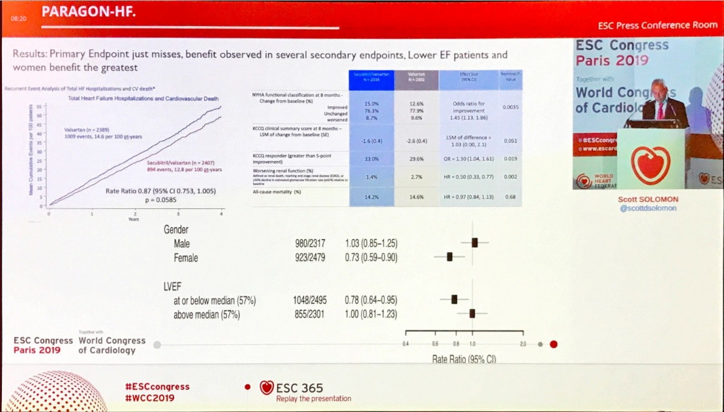

Slide 100
When do I think about an ICD?

Slide 101
When do I need to think about an ICD
On good medical management
  Betablockers
  ACE-I or ARBs
  Spironolactone
At least 90 days post medical management/PCI/CABG
LVEF < 35%
Reasonable expectation of survival of > 1 year

Slide 102
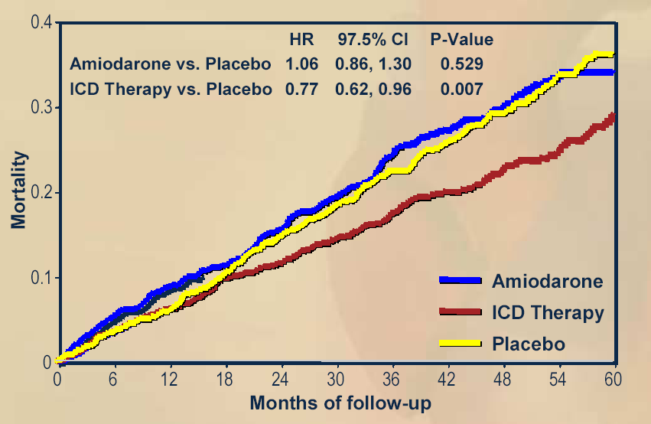
ICDs Improve Survival
MADIT II
SCDHeFT
1.0
0.9
ICD
0.8
0.7
Conventional
0.6
P = 0.007
0.0
0
1
2
3
4
Year
Moss AJ et al. N Engl J Med. 2002;346:877-83.
Bardy GH et al. N Engl J Med. 2005;352:225-37.

Slide 103
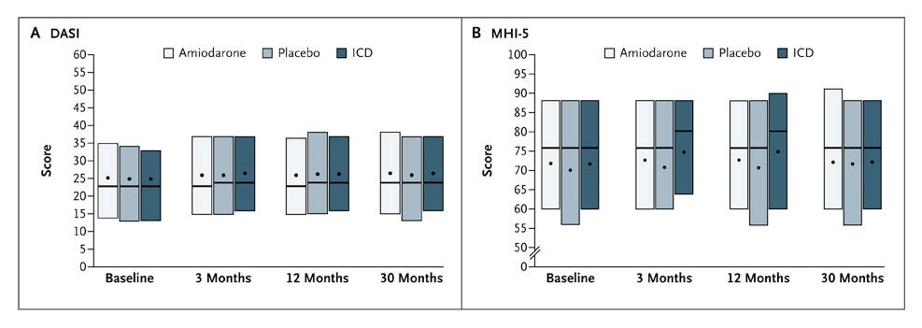
ICDs Do Not Improve Quality of Life
Duke Activity Status Index
Mental Health Inventory 5
Higher scores indicate better function
Mark DB et al. N Engl J Med 2008;359:999-1008.

Slide 104
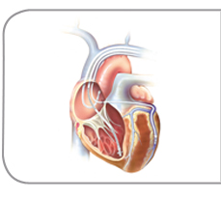
CRT (cardiac resynchronization therapy)
On good medical management
Reasonable expectation of survival of > 1 year
EF < 35% and QRS > 120 ms, LBBB
  PCI/CABG > 3 months
  No NYHA Class IV symptoms

Slide 105
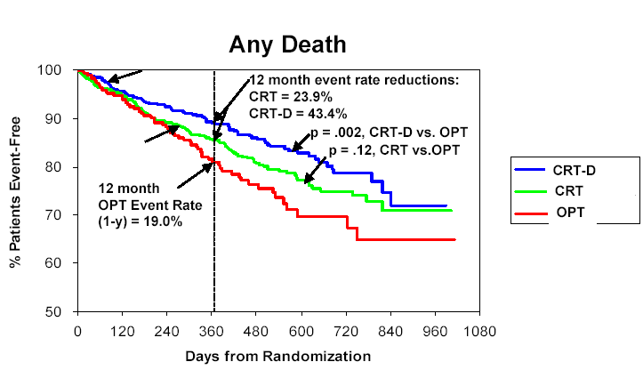
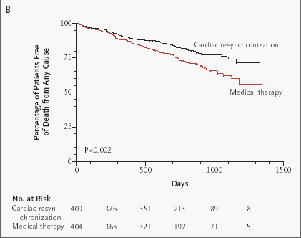
CRT Improves Survival
COMPANION
CARE-HF
Bristow MR et al. N Engl J Med. 2004; 350:2140-2150.
Cleland J et al. N Engl J Med 2005;353:1539-49.

Slide 106
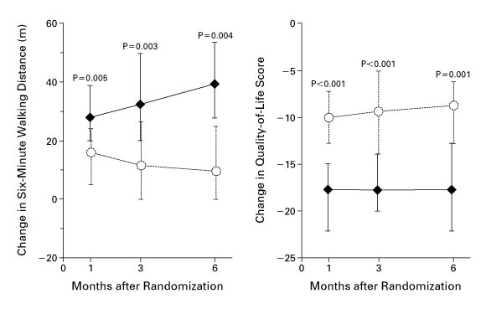
MIRACLE Study
CRT Improves Submaximal Exercise
and Quality of Life
Abraham WT et al. N Engl J Med, 2002; 346: 1845-1853.

Slide 107
Stage D Heart Failure

Slide 108
Features of Stage D Heart Failure
Marked symptoms at rest or with any activity.
Despite optimal medical and device therapy.
Experience recurrent hospitalization.
Can not be discharged from the hospital without specialized interventions.
Typically these patients are “cold and wet” (low cardiac output + high filling pressures).

Slide 109
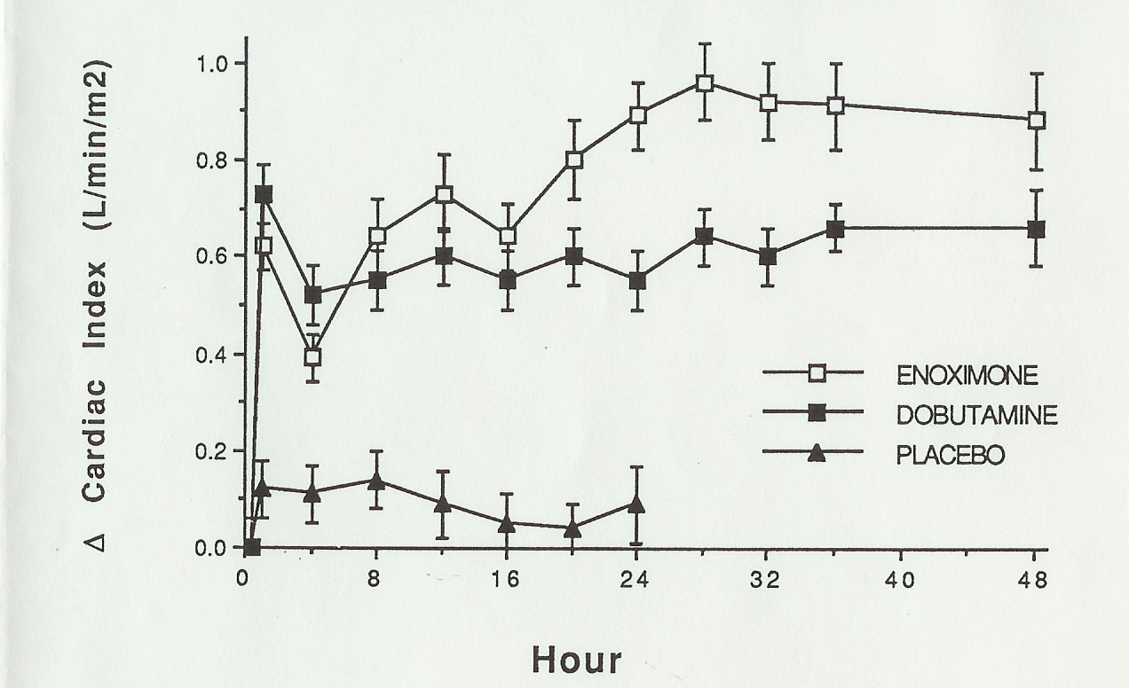
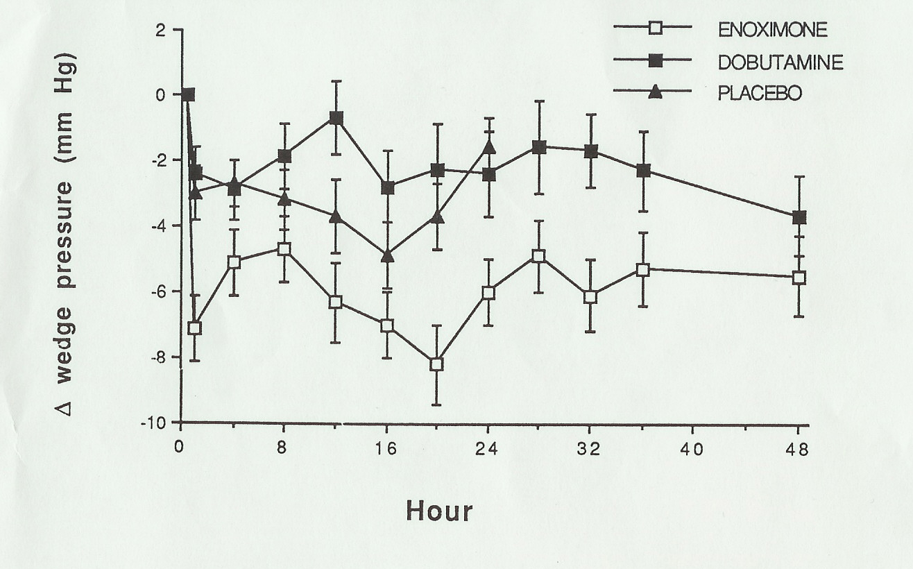
Inotropes Acutely Improve Hemodyamics
Dobutamine: β-Receptor Agonist
Enoximone: Phosdiesterase-3 Inhibitor
Bader FM, Gilbert EM et al. Congest Heart Failure, In Press.

Slide 110
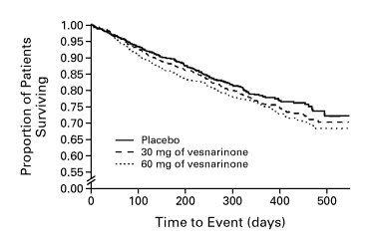
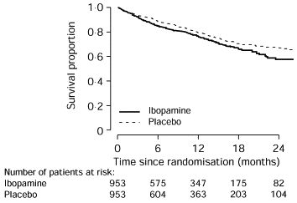
Chronic Inotrope Therapy Decreases Survival
VEST trial
PRIME II
RR = 1.21
p = 0.02
For 60 mg vs. placebo
RR = 1.26
p = 0.017
Cohn J et al. N Engl J Med 1998;339:1810-16.
Hampton JR et al. Lancet 1997;349:971-7.

Slide 111
If there is no current role for chronic inotrope therapy, then what can we do for patients with stage D heart failure?

Slide 112
Does everyone with low EF need a heart transplant?

Slide 113
Case 1
52 yo male with long standing idiopathic cardiomyopathy with EF of 25%
On good max medical management and ICD
Cardiopulmonary stress test: VO2 Max of 11 (normal for him would be about 20 or greater)
Presents to clinic with continued worsening shortness of breath
https://youtu.be/ie_Ojh7FNbY

Slide 114
Case 2
32 yo male with newly diagnosed heart failure with reduced EF. His presenting symptoms to ER was “my abdomen is bloated’. Denies shortness of breath, chest pain, palpitations, syncope.
Workup negative for known etiologies (thyroid, HIV, drugs, alcohol, CAD, Chagas, hemochromotosis, viral illness)
Echo shows EF of 5-10%, no significant vavle abnormalites, no significant RV findings, no congenital defects

Slide 115
Features of Stage D Heart Failure
Marked symptoms at rest or with any activity.
Despite optimal medical and device therapy.
Experience recurrent hospitalization.
Can not be discharged from the hospital without specialized interventions.
Typically these patients are “cold and wet” (low cardiac output + high filling pressures).
Inotropes help short term but not long term

Slide 116
What else can we do for stage D heart failure?

Slide 117
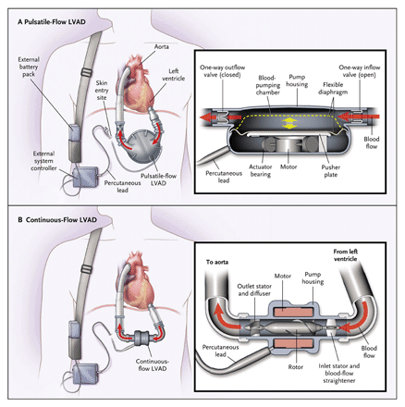
Left Ventricular Assist Devices

Slide 118
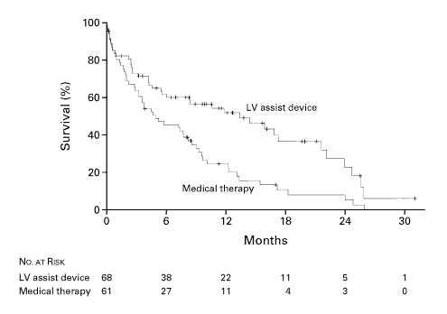
Survival in the REMATCH Trial
One Year Survival
LVAD: 52%
Medical therapy: 25%
(p = 0.002)
Two Year Survival
LVAD: 23%
Medical therapy: 8%
(p = 0.09)
LV assist device
Medical therapy
Rose EA et al. N Engl J Med 2001; 345: 1435-43.

Slide 119
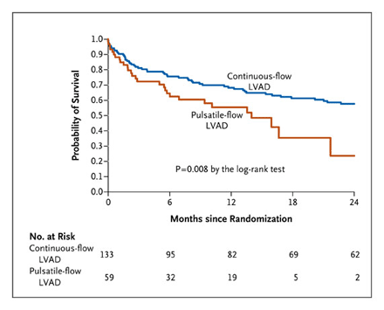
REMATCH 2 Survival
Slaughter MS et al. N Engl J Med 2009; 361:2241-51.

Slide 120
Role of Heart Transplantation in Heart Failure Management
A great option for highly selected candidates.
The number of Stage D heart failure patients who are not ready for hospice far exceeds the number of donor hearts.
Many patients are not eligible for transplantation because of other medical conditions (e.g. recent malignancy) or age.

Slide 121

NUMBER OF HEART TRANSPLANTS REPORTED BY YEAR
NOTE: This figure includes only the heart transplants that are reported to the ISHLT Transplant Registry. As such, the presented data may not mirror the changes in the number of heart transplants performed worldwide
ISHLT 2009 Update
Notes:
This figure includes only the heart transplants that are reported to the ISHLT Transplant Registry. As such, this should not be construed as evidence that the number of hearts transplanted worldwide has declined in recent years.

Slide 122
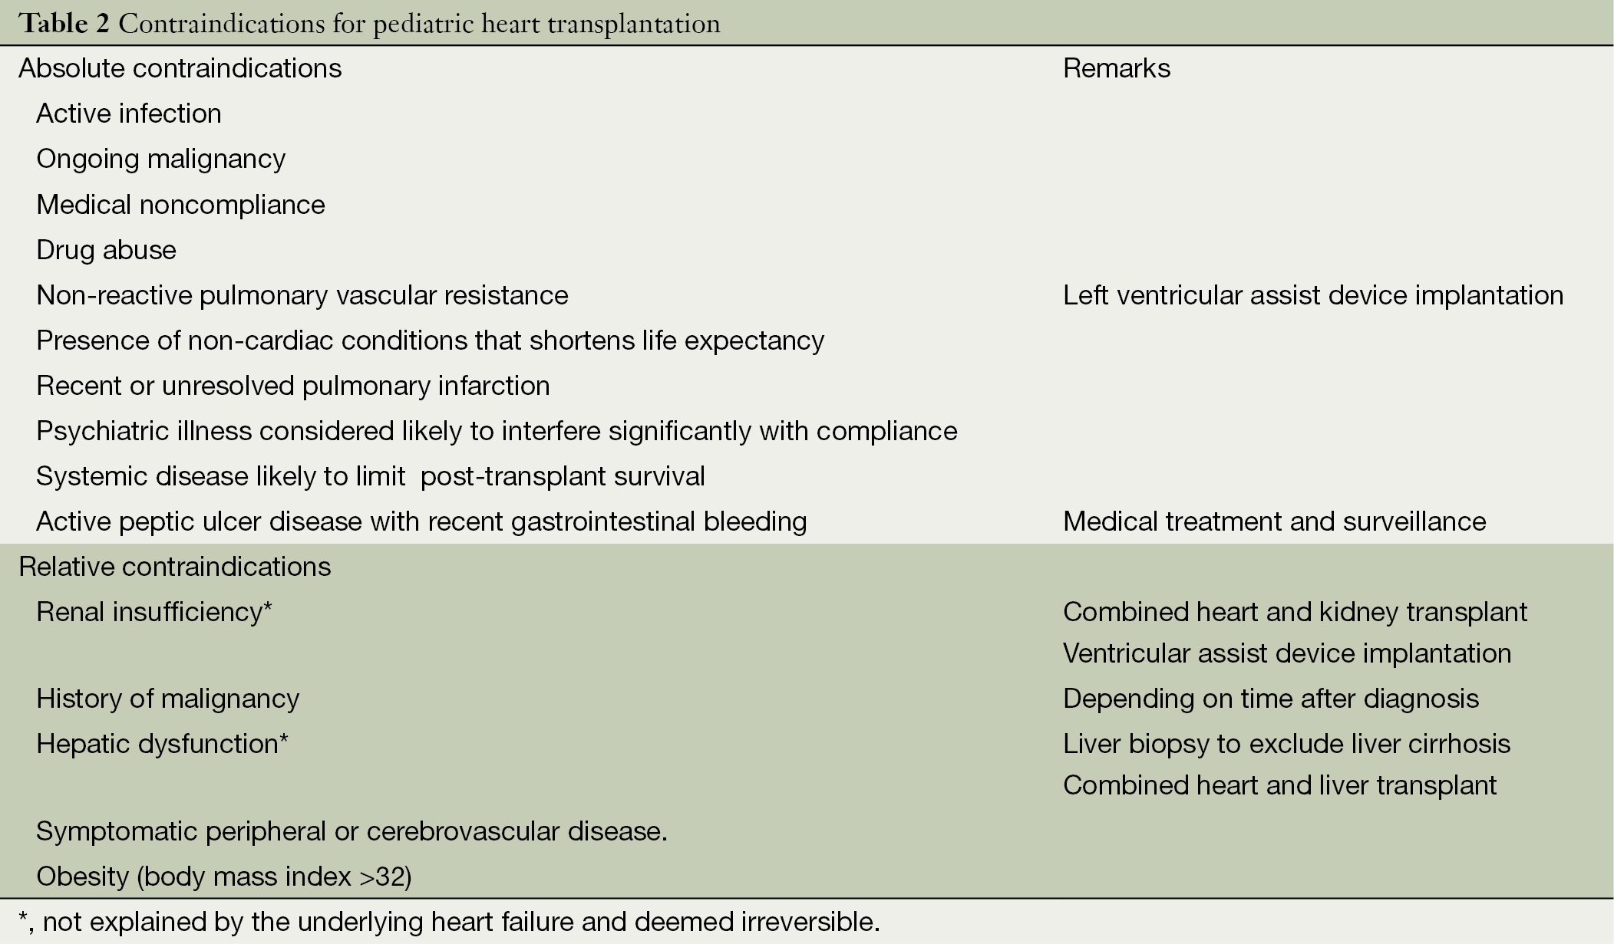

Slide 123
Proposed Statuses 1-3
Status Criteria
ECMO
Continuous Mechanical ventilation
Non-dischargeable (surgically implanted) VAD
MCSD with life-threatening ventricular arrhythmia
1
Intra-aortic balloon pump
Ventricular tachycardia/ventricular fibrillation, mechanical support not required
MCSD with device malfunction/mechanical failure
Total artificial heart
Dischargeable BiVAD or RVAD
Acute circulatory support
2
Dischargeable LVAD for up to 30 days
Multiple inotropes or single high-dose inotropes with continuous hemodynamic monitoring
MCSD with device infection
MCSD with hemolysis
MCSD with pump thrombosis
MCSD with right heart failure
MCSD with mucosal bleeding
MCSD with aortic insufficiency
3

Slide 124
Proposed Statuses 4-6
Status Criteria
Stable LVAD candidates not using 30 day discretionary period
Inotropes without hemodynamic monitoring
Diagnosis of congenital heart disease (CHD)
Diagnosis of ischemic heart disease with intractable angina
Diagnosis of hypertrophic cardiomyopathy
Diagnosis of restrictive cardiomyopathy
Diagnosis of amyloidosis
Retransplant
4
5 Combined organ transplants
6 All remaining active candidates

Slide 125
Limitations of the Current Medical
Management of Heart Failure
Many patients are still not receiving evidence based therapies.
Volume status is difficult to manage as an outpatient.
Clinically stable patients may die suddenly.
Some patients on optimal therapy will still progress to end-stage heart failure.

Slide 126
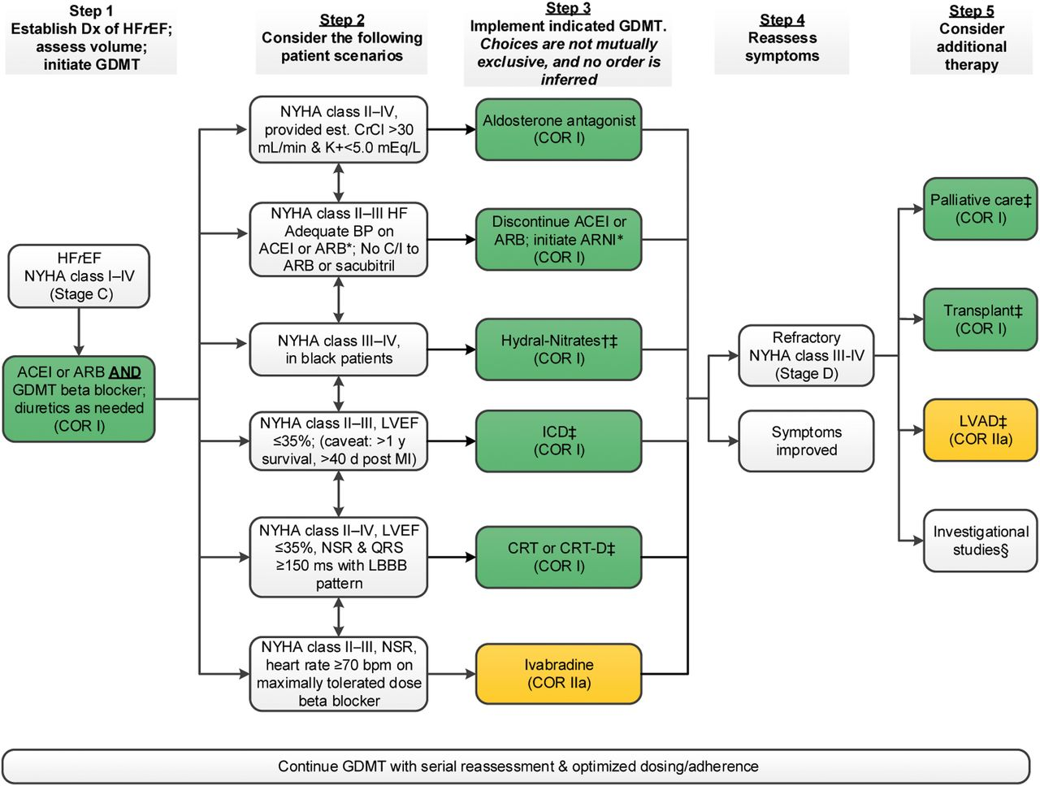

Clyde W. Yancy et al. JACC 2017;70:776-803
2017 American College of Cardiology Foundation, the American Heart Association, Inc., and the Heart Failure Society of America
Notes:
Treatment of HFrEF Stage C and D Colors correspond to COR in Table 1. For all medical therapies, dosing should be optimized and serial assessment exercised. *See text for important treatment directions. †Hydral-Nitrates green box: The combination of ISDN/HYD with ARNI has not been robustly tested. BP response should be carefully monitored. ‡See 2013 HF guideline (9). §Participation in investigational studies is also appropriate for stage C, NYHA class II and III HF. ACEI indicates angiotensin-converting enzyme inhibitor; ARB, angiotensin receptor-blocker; ARNI, angiotensin receptor-neprilysin inhibitor; BP, blood pressure; bpm, beats per minute; C/I, contraindication; COR, Class of Recommendation; CrCl, creatinine clearance; CRT-D, cardiac resynchronization therapy–device; Dx, diagnosis; GDMT, guideline-directed management and therapy; HF, heart failure; HFrEF, heart failure with reduced ejection fraction; ICD, implantable cardioverter-defibrillator; ISDN/HYD, isosorbide dinitrate hydral-nitrates; K+, potassium; LBBB, left bundle-branch block; LVAD, left ventricular assist device; LVEF, left ventricular ejection fraction; MI, myocardial infarction; NSR, normal sinus rhythm; and NYHA, New York Heart Association.

Slide 127
THANK YOU
QUESTIONS?

