Slide 1

Heart Failure Management
(2022 Guidelines)
Blake Wachter, MD, PhD
Idaho Heart Institute
August 2023

Slide 2
Understanding the Guidelines
2022 ACC/AHA Guidelines for Heart Failure
Areas of focus include:
Prevention of HF.
Management strategies in stage C HF, including:
  ◦ New treatment strategies in HF, including sodium-glucose cotransporter-2 inhibitors (SGLT2i) and angiotensin receptor-neprilysin inhibitors (ARNi).
  ◦ Management of HF and atrial fibrillation (AF), including ablation of AF.
  ◦ Management of HF and secondary MR, including MV transcatheter edge-to-edge repair.
Specific management strategies, including:
  ◦ Cardiac amyloidosis.
  ◦ Cardio-oncology.
Implantable devices.
Left ventricular assist device (LVAD) use in stage D HF.

Slide 3
What is in this Slide Set
Part 1: What is Heart Failure
Part 2: Baseline Treatment of Heart Failure
Part 3: New Therapies of Heart Failure
Part 4: Nonmedical therapies of heart failure (ICD, CRT-D)
Part 5: Advanced therapies

Slide 4
Heart Failure – A Growing Global Concern
Prevalence and Incidence
  Overall 2.1% prevalence: 5.1M heart failure
  patients in 2010¹
  825,000 people ≥ 45 years of age are
  newly diagnosed each year with HF¹
  15M heart failure patients in the ESC
  51-member countries²
    Overall 2-3% prevalence²
Mortality
  For AHA/ACC stage C/D patients
  diagnosed with HF:
    30% will die in the first year.³⁻⁵
    60% will die within 5 years.⁵
HF prevalence in the US is projected to increase 46% from 2012 to 2030,
resulting in > 8M people ≥ 18 years of age with HF.⁶
AHA 2014 Statistics at a Glance, 2014
The European Society of Cardiology, ESC HF Guideline, 2008
Curtis et al, Arch Intern Med, 2008.
Roger et al. JAMA, 2004.
Cowie et al, EHJ, 2002.
Heidenreich PA et al. Circ Heart Failure 2013.
Notes:
Talking points included in this deck are for internal/speaker use only, and are not to be distributed.
Chronic heart failure affects more than 5 million people in the US, which is an overall prevalence of 2.1%. According to statistics reported by the AHA, approximately 825,000 new cases are diagnosed each year in patients 45 years of age and older. The significance of heart failure in Europe is similar to that of the US, where heart failure affects nearly 15 million people of the 900 million people from the 51-member countries of the ESC, amounting to an overall prevalence of 2-3%.
Despite advances in the treatment of heart failure over the past few decades, the prognosis remains poor for patients diagnosed with heart failure. Data from the US and from Europe suggest that approximately 30% of patients will die within the first year of HF diagnosis. An analysis of Medicare data by Curtis and colleagues showed that 60% of patients will die within the first 5 years of diagnosis.
References:
1. Go AS, et al. Heart Disease and Stroke Statistics – 2014 Update: A report from the American Heart Association. Circulation. 2014; 128: 1-268.
2. Dickstein K, et al. ESC Guidelines for the Diagnosis and Treatment of Acute and Chronic Heart Failure 2008. European Heart Journal. 2008; 29, 2388-2442.
3. Curtis LH, et al. Incidence and prevalence of heart failure in elderly persons, 1994-2003. Arch Intern Med. 2008 Feb 25;168(4):418-24.
4. Roger VL, et al. Trends in heart failure incidence and survival in a community-based population. JAMA 2004;292:344-50
5. Cowie MR, et al. Hospitalization of patients with heart failure: a population-based study. Eur Heart J. 2002 Jun;23(11):877-85.
6. Heidenreich PA, et al; on behalf of the American Heart Association Advocacy Coordinating Committee; Council on Arteriosclerosis,
Thrombosis and Vascular Biology; Council on Cardiovascular Radiology and Intervention; Council on Clinical Cardiology; Council on Epidemiology and Prevention; Stroke Council. Forecasting the impact of heart failure in the United States: a policy statement from the American Heart Association. Circ Heart Fail. 2013;6:606–619.

Slide 5

Economic Risks of HF Readmissions in the US
Medicare’s Hospital Readmissions Reduction program penalizes hospitals
that have above average all-cause readmissions within 30 days following
HF discharge.
Percent withholding of all inpatient Medicare payments will increase to up to 3% by 2015 and beyond.³
22.7%
national average 30-day
readmissions rate^{1,2}
Fiscal Year | 2013 | 2014 | 2015+
% payment withholding | up to 1% | up to 2% | up to 3%
1. Dharmarajan K, et al. JAMA. 2013;309(4):355-363.
2. Linden A, Adler-Milstein J. Health Care Finance Rev. 2008;29(3):1-11.
3. CMS Hospitals Readmissions Reductions Program of the Patient Protection and Affordable Care Act (PPACA), 2010.
Notes:
Talking points included in this deck are for internal/speaker use only, and are not to be distributed.
One of Medicare’s reform initiatives that has been introduced is the Hospital Readmissions Reduction program. This program penalizes hospitals with above national average all-cause 30-day readmission rate following HF discharge. Medicare is withholding up to 1% of all inpatient Medicare payments, this withholding will increase to up to 3 percent in fiscal year 2015 and beyond.¹⁸ A technology that can decrease the risk of hospitalization is much needed.
References:
Dharmarajan K, Hsieh AF, Lin Z, et al. Diagnoses and timing of 30-day readmissions after hospitalization for heart failure, acute myocardial infarction, or pneumonia. JAMA. 2013;309(4):355-363.
Linden A, Adler-Milstein J. Medicare disease management in policy context. Health Care Finance Rev. 2008;29(3):1-11.
3. CMS Hospitals Readmissions Reductions Program of the Patient Protection and Affordable Care Act (PPACA), 2010.

Slide 6
Heart Failure: Significant Clinical and Economic Burden
Persons with HF in the US 5.1 million
  20% of Americans > 40yrs
Overall prevalence 2.7%
Incidence 650,000/year
Mortality in 2001 52,828
Cost $27.9 billion

Slide 7
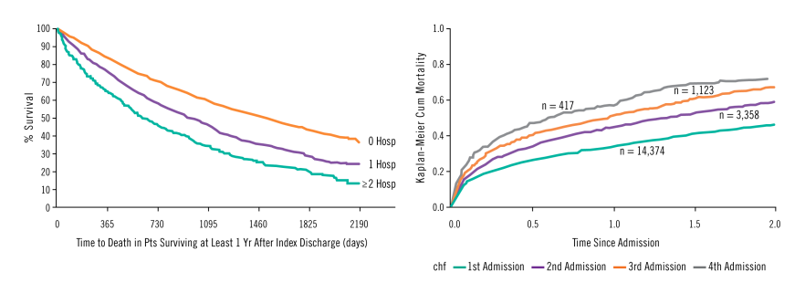
HF Hospitalizations are a Strong Predictor of Mortality^{1,2}
Data from the EFFECT study, n = 9138 patients¹
Among 1 year survivors after index EFFECT-HF discharge, the number of heart failure hospitalizations in the preceding year stratified the risk of death in crude analysis.¹
Data from Setoguchi et al., n = 14,374 patients²
KP cumulative mortality curve for all-cause mortality
after each subsequent hospitalization for HF.²
Studies show each admission decreases a patient’s chance of survival.
1. Lee DS, et al. Am J of Med, 2009.
2. Setoguchi S, et al. Am Heart J, 2007.
Notes:
Talking points included in this deck are for internal/speaker use only, and are not to be distributed.
In addition to further progression of heart failure, high HF-related hospitalizations have also been shown to be a strong predictor of mortality.
Lee and colleagues reported on data from the Enhanced Feedback For Effective Cardiac Treatment Study (EFFECT study), which included data from 9,138 patients. One of the findings was that the risk of death increases progressively and independently with each heart failure event. The graph on the left illustrates that patient survival decreases with increased number of hospitalizations. The data in the graph was from patients who survived at least 1 year after an index hospital discharge. On the right, Setoguchi and colleagues showed similar findings in their study. Among 14,374 patients with repeated HF hospitalizations, mortality increased with recurrent HF hospitalizations. The number of repeated HF hospitalizations remained a strong predictor of mortality even after adjusting for other major risk factors (i.e., age, sex, history of AF, hypertension, etc.) for mortality among HF patients.
These studies suggest that prevention of recurrent heart failure-related hospitalizations and cardiovascular disease events may improve survival in heart failure patients.
References:
1. Lee DS, et al. "Dose-dependent" impact of recurrent cardiac events on mortality in patients with heart failure. Am J Med. 2009 Feb;122(2):162-169.e1. Epub 2008 Dec 26.
2. Setoguchi S, et al. Repeated hospitalizations predict mortality in the community population with heart failure. Am Heart J. 2007 Aug;154(2):260-6.

Slide 8
Part 1: What is heart failure?

Slide 9
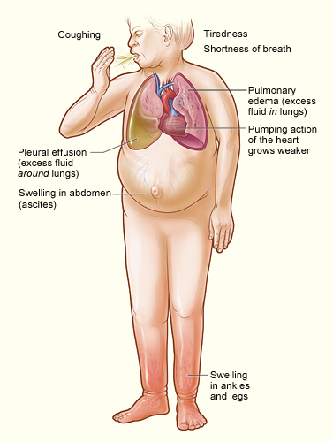
Heart Failure
Any structural or functional impairment of ventricular filling or ejection of blood
Symptoms
  Dyspnea
  Fatigue
  Decreased exercise tolerance
  Pulmonary congestion
  Splanchnic congestion
  Peripheral edema

Slide 10
Diagnosing heart failure
There is no single test or procedure to diagnosis heart failure
  Based on careful clinical history and physical exam
Heart failure is a catch all term
  Disorders of pericardium, myocardium, endocardium, heart valves, great vessels, metabolic abnormalities
  NOT synonymous for cardiomyopathy or LV dysfunction
New Terms To Learn
  Heart failure with reduced EF (HFrEF) < 40%
  Heart failure with mildly reduced EF (HFmrEF) 41% <EF <49%
  Heart failure with preserved EF (HFpEF) > 50%
  Heart Failure with improved EF (HFimpEF)

Slide 11

Call IT what it is

Slide 12
Diagnostic testing
Initial laboratory evaluation
  CBC
  U/A
  Basic metabolic panel with magnesium
  Fasting lipid profile
  Liver function tests
  TSH
  NT-Pro-BNP
Serial monitoring of electrolytes and renal function
ECG on first visit
Consider alcohol, drug, viral illness history

Slide 13

Looking for Zebras…
Rheumatological diseases
Amyloidosis
Pheochromocytoma
Hemochromatosis
Chagas
HIV

Slide 14
Biomarkers
*BNP/NT-Pro-BNP is useful to support HF diagnosis especially in the setting of clinical uncertainty
*Measure of BNP on admission is useful for establishing prognosis or disease severity in chronic HF
* Measure of BNP on hospital discharge can be useful for prognosis
Measurement of cardiac enzymes in acute decompensated patient
Can be used to guide therapy in select euvolemic patients in a well structured HF management program
* Can be useful to help identify people at risk of developing HF
Serial BNP measurements to reduce mortality or hospitalization has not been well established and is discouraged at EIRMC inpatient setting.

Slide 15
What can cause an elevated BNP besides HF?
Noncardiac
Advancing age
Anemia
Renal failure
Pulmonary
Obstructive sleep apnea
severe pneumonia
Pulmonary embolism
pulmonary arterial hypertension
Critical illness
Bacterial sepsis
Severe burns
Cardiac
ACS
Heart muscle disease, including LVH
VHD
Pericardial disease
AFib
Myocarditis
Cardiac surgery
Cardioversion
Toxic-metabolic myocardial insults, including cancer chemotherapy

Slide 16
Non-invasive Cardiac Imaging
New onset or change in condition
  CXR
  Echo with Doppler
Assess goal directed medical therapy (needing an ICD?)
  Repeat echo
In the patient with known CAD with new or worsening HF (+/- symptoms) (Class IIa, level B)
  Consider non invasive imaging
Consider MRI if need to assess myocardial infiltrative processes or scar burden (Class IIa, level B)

Slide 17
Recommendations for Evaluation With Cardiac Imaging (Continued)
COR | LOE | Recommendations
1 | C-LD | 3. In patients with HF who have had a significant clinical change, or who have received GDMT and are being considered for invasive procedures or device therapy, repeat measurement of EF, degree of structural remodeling, and valvular function are useful to inform therapeutic interven- tions.^{4–7}
1 | C-LD | 4. In patients for whom echocardiography is inadequate, alternative imaging (eg, cardiac magnetic resonance [CMR], cardiac computed tomography [CT], radionuclide imaging) is recommended for assessment of LVEF.^{8–15}
2a | B-NR | 5. In patients with HF or cardiomyopathy, CMR can be useful for diagnosis or manage- _{ment.}16–23
2a | B-NR | 6. In patients with HF, an evaluation for possible ischemic heart disease can be useful to identify the cause and guide management.^{24–27}
2b | B-NR | 7. In patients with HF and coronary artery disease (CAD) who are candidates for coronary revas- cularization, noninvasive stress imaging (stress echocardiography, single-photon emission CT [SPECT], CMR, or positron emission tomog- raphy [PET]) may be considered for detection of myocardial ischemia to help guide coronary revascularization.^{28–32}
3: No Benefit | C-EO | 8. In patients with HF in the absence of: 1) clinical status change, 2) treatment interventions that might have had a significant effect on cardiac function, or 3) candidacy for invasive procedures or device therapy, routine repeat assess- ment of LV function is not indicated.
CLINICAL STATEENTS AND GUIDELINES
4.4. Evaluation With Cardiac Imaging
Recommendations for Evaluation With Cardiac Imaging Referenced studies that support the recommendations are summa- rized in the Online Data Supplements.
COR | LOE | Recommendations
1 | C-LD | 1. In patients with suspected or new-onset HF, or those presenting with acute decompensated HF, a chest x-ray should be performed to assess heart size and pulmonary congestion and to detect alternative cardiac, pulmonary, and other diseases that may cause or contribute to the patient’s symptoms.^{1,2}
1 | C-LD | 2. In patients with suspected or newly diagnosed HF, transthoracic echocardiography (TTE) should be performed during initial evaluation to assess cardiac structure and function.³

Slide 18
Don’t routinely repeat the echo
No Benefit
  Routine repeat measurement of LV function in absence of clinical status change or treatment intervention (Class III)

Slide 19
Invasive Evaluation
Invasive monitoring with pulmonary artery catheter
  Acute decompensating patient
  Guide therapy (inotropes, vasodilators, pressors)
  Volume status is unknown
  Worsening renal failure
  Low systolic pressures
  Evaluation for mechanical circulation support (MCS) or transplant
Coronary angiogram
  In select patient if eligible for revascularization
Endomyocardial biopsy
  Select patients looking for specific diagnosis (Giant Cell Myocarditis)

Slide 20
AHA Classification of Heart Failure
 | Stage | Patient Description
A | High risk for developing heart failure (HF) | Hypertension CAD Diabetes mellitus Family history of cardiomyopathy
B | Asymptomatic HF | Previous MI LV systolic dysfunction Asymptomatic valvular disease
C | Symptomatic HF | Known structural heart disease Shortness of breath and fatigue Reduced exercise tolerance
D | Refractory end-stage HF | Marked symptoms at rest despite maximal medical therapy (eg, those who are recurrently hospitalized or cannot be safely discharged from the hospital without specialized interventions)
Hunt SA et al. J Am Coll Cardiol 2001;38:2101–2113.
Notes:
Stages A through D show the progressive nature of cardiovascular disease into refractory end-stage heart failure.
These patient types, especially Stage A, B, and C patients, are commonly seen by primary care physicians.

Slide 21
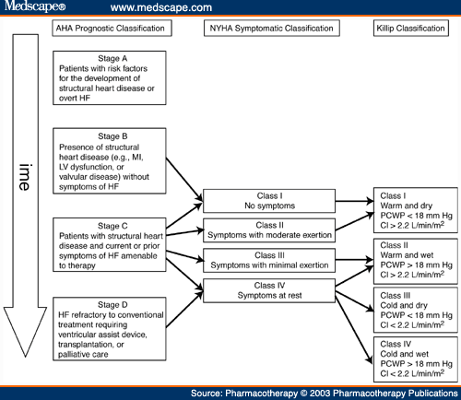

Slide 22

HF Morbidity and Mortality
Increasing frequency of acute events with disease progression leads to high rates of hospitalization and increased risk of mortality^{1,2}
With each acute event, myocardial injury may contribute to progressive left ventricular dysfunction^{1,2}
Chronic decline
Myocardial function
Mortality
Acute episodes
Disease progression
1. Gheorghiade M et al. Am J Cardiol. 2005;96:11G-17G. 2. Gheorghiade M, Pang PS. J Am Coll Cardiol. 2009;53:557-573.
Notes:
HF is a progressive condition with high morbidity and mortality. It is characterized by a progressive decline in cardiac function, interspersed with acute episodes of exacerbation. In chronic HF, a process of progressive ventricular remodeling leads to a gradual decline in clinical status, often punctuated with episodes of acute decompensation. With each acute event, there is a rapid drop in clinical status that may not be fully resolved following the event^{1,2}
The clinical course of HF tends to feature an increasing frequency of acute HF episodes as the disease progresses. Each acute episode is thought to contribute to further decline in cardiac and/or renal function, as a result of hemodynamic and neurohormonal changes and potential myocardial or renal injury incurred during these exacerbations. Thus, every rehospitalization for acute HF contributes to progressive left ventricular or renal dysfunction, leading to an inevitable downward spiral of increasing frequency of acute events, each causing further residual cardiac damage, high rates of hospitalization, and increased risk of death^{1,2}
References
Gheorghiade M, De Luca L, Fonarow GC, et al. Pathophysiologic targets in the early phase of acute heart failure syndromes. Am J Cardiol. 2005;96:11G-17G.
Gheorghiade M, Pang PS. Acute heart failure syndromes. J Am Coll Cardiol. 2009;53:557-573.
Figure, Gheorghiade 2005; p13G, Figure 2; Gheorghiade 2009; p557, col2, para3, lines1-3
Bullets, Gheorghiade 2005; p13G, Figure 2, legend; Gheorghiade 2009; p557, col2, para3, lines1-3; lines 10-13; p561, col1, para3, lines1-15
Bullets, Gheorghiade 2005; Figure 2, legend; Gheorghiade 2009; p557, col2, para3, lines1-3; lines 10-13; p561, col1, para3, lines1-15

Slide 23
Part 2: Baseline Treatment of chronic systolic heart failure
(HFrEF)

Slide 24
Stage A
Treat HTN
Treat lipid disorders
Address obesity
Control diabetes
Stop tobacco use
Avoid known cardiotoxic agents
Treat sleep apnea

Slide 25
Treatment of Stage B and C

Slide 26
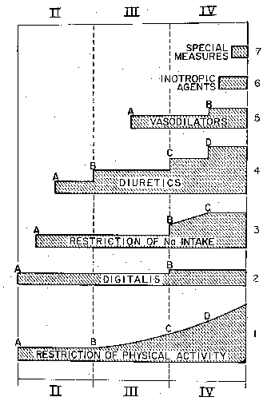
Medical Therapy of Heart Failure in 1984
Vasodilators
Diuretics
Digtalis
Restriction of Na⁺ Intake
Restriction of
Physical Activity
Functional Class
Brauwnwald E. Management of heart failure. Heart Disease 2nd ed. 1984; 503-550.

Slide 27

Diuretics

Slide 28
Diuretics and Heart Failure
No long-term studies of diuretic therapy for treatment of heart failure; its effects on morbidity and mortality are not known¹
Patients may become unresponsive to high doses of diuretic drugs if they
  consume large amounts of dietary sodium²
  Take agents that can block the effects of diuretics (e.g. NSAIDs)¹
  Have significant impairment of renal function or perfusion¹
Diuretic resistance can generally be overcome by
  IV administration of diuretics²
  using two or more diuretics in combination
¹Ravnan SL et al. Congest Heart Fail. 2002;8:80-85
² Brater DC. Drugs. 1985;30:427-443.
Notes:
Ravnan SL, Ravnan MC, Deedwania PC. Pharmacotherapy in congestive heart failure: diuretic resistance and strategies to overcome resistance in patients with congestive heart failure. Congest Heart Fail. 2002;8:80-85.
Brater DC. Resistance to loop diuretics. Why it happens and what to do about it. Drugs. 1985;30:427-443.

Slide 29
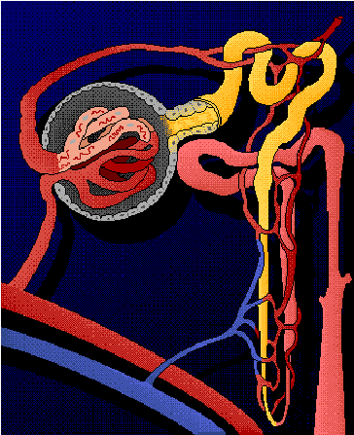
Location of Diuretic Action
Proximal Tubule
Carbonic anhydrase inhibitors
Distal Tubule
Thiazide diuretics
Collecting Duct
Vasopressin antagonists
Aldosterone antagonists
Ascending limb of Loop of Henle
Loop diuretics
Notes:
Diuretic resistance and refractoriness in heart failure patients is due to a number of factors
Avid sodium and water reabsorbtion in proximal tubule due to effects of angiotensin II (AII). Loop and thiazide diuretics work distal to proximal tubule, where majority of sodium and water has already been reabsorbed. Therefore, loop and thiazide diuretics have less substrate (tubular sodium and water) on which to exert their effects
Renal vasoconstriction mediated by norepinephrine, endothelin-1, and AII can lead to reduced GFR. As a result, ability of most diuretics to get to their site of action in renal tubules is reduced
High levels of aldosterone contribute (to a lesser extent) to sodium reabsorbtion
Weber KT. Aldosterone in congestive heart failure. N Engl J Med. 2001;345:1689-1697.
Francis GS, Goldsmith SR, Levine TB, Olivari MT, Cohn JN. The neurohumoral axis in congestive heart failure. Ann Intern Med. 1984;101:370-377.
Dzau VJ. Renal and circulatory mechanisms in congestive heart failure. Kidney Int. 1987;31:1402-1415.

Slide 30

Digoxin

Slide 31



Digitalis and the Treatment of Cardiac Dropsy
Dr. William Withering
1741 - 1799
17th Century patient
with severe dropsy
Foxglove
(Digitalis purpurea)
Withering W “An account of the foxglove and some of its medical uses;
with practical remarks on the dropsy, and some other diseases,” 1785

Slide 32
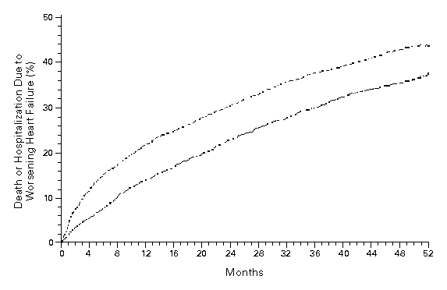
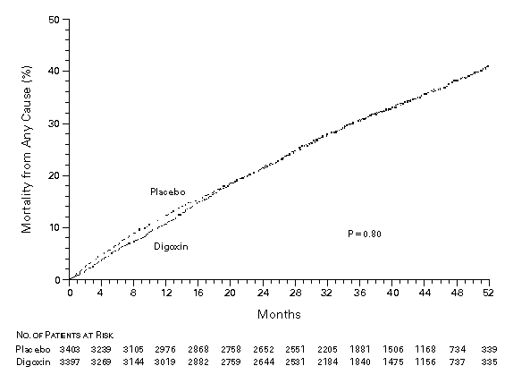
Effect of Digoxin Upon Clinical Outcomes in Subjects with Heart Failure
All Cause Mortality
Death or Hospitalization Due to HF
Placebo
Placebo
RR = 0.99
(0.91-1.07)
p = 0.80
RR = 0.85
(0.79-0.91)
p < 0.001
Digoxin
Digoxin
The Digitalis Investigator Group. N Eng J Med 1997; 336: 525-33.

Slide 33
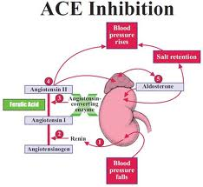
ACE Inhibitors

Slide 34
ACE Inhibition Improves Survival
SOLVD Treatment Trial
SAVE
50
30
Chronic HF
NYLVEF<35%
HA II-III
Placebo
(n=1284)
Acute MI
Asymptomatic
LV dysfunction
Placebo
(n=1116)
40
20
30
% Mortality
Enalapril
(n=1285)
Captopril
(n=1115)
20
10
10
p=0.019
P=0.0036
0
0
0
12
24
36
48
0
1
2
3
4
Months
Years
SOLVD Investigators. N Engl J Med 1991;325:293-302.
Pfeffer MA et al. N Engl J Med 1992;327:669-77.

Slide 35
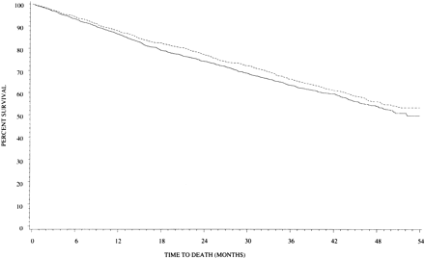
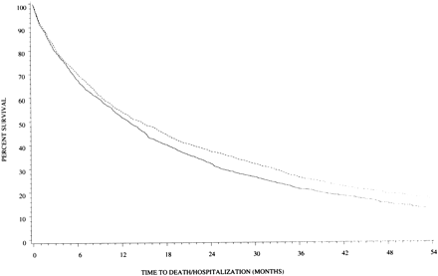
Effect of High Versus Low Dose
Lisinopril on Clinical Outcomes
Low Dose (n = 1596): 2.5 to 5 mg daily (average = 4.5 + 1.1)
High Dose (n = 1568): 32.5 to 35 mg daily (average = 33.2 + 5.4)
All Cause Mortality
All Cause Mortality + Hospitalization
HR = 0.88 (0.82-0.96)
p = 0.002
High Dose
Low Dose
Survival (%)
Survival (%)
High Dose
HR = 0.92 (0.82-1.03)
p = 0.128
Low Dose
Follow-up (Months)
Follow-up (Months)
Follow-up (Months)
ATLAS Trial
Follow-up (Months)
Packer M et al. Circulation 1999;100:2312-18.

Slide 36
ACEI is Superior to Vasodilator Therapy in Chronic Heart Failure
0.75
0.54
Isosorbide +
Hydralazine
0.46
0.5
0.48
0.36
0.42
Enalapril
Mortality
0.25
0.31
0.25
0.13
RR = 28%
p = 0.016
0.18
0
0.09
0
0
0
12
24
36
48
60
Months
VHeFT II
Cohn JN et al. N Engl J Med 1991;325:303-10.

Slide 37
ARB Improves Outcomes in ACEI Intolerant Patients
%
50
Placebo (n = 1013)
(40.0%)
40
(33.0%)
30
CV death or CHF hospitalisation
Candesartan (n = 1015)
20
10
HR 0.77 (95% CI 0.67-0.89), p=0.0004
Adjusted HR 0.70, p<0.0001
0
0
1
2
3
3.5
years
Granger CB et al. Lancet 2003;362:772-6.

Slide 38
Beta Blockers

Slide 39
Beta Blockers (BB)
B1→ negative chronotropy and inotropy
        → AV conduction delay
        → Reduced atrial and ventricular arrythmias
B2→ Bronchoconstriction
        → Peripheral unopposed alpha constriction
        → Decrease glycogenolysis
        (contribute to hypoglycemic events)
Other → antagonize release of renin
→ reduces intraocular pressures
39
Notes:
Alpha constriction, which at least initially increases peripheral resistance, but also of potential concern in cocaine users.
Glycogenolysis, particularly in Type I diabetics
Renin, thereby altering the renin-angiotensin pathway

Slide 40
Impact of BB
Acute MI
  Norwegian Multicenter Study Group Timolol
  CAPRICORN
  ISIS-1
CHF
  COPERNICUS
  MERIT-HF
40
Notes:
Norwegion: AMI, given Timilol for up to 33 months, showing reduced mortality in the Timolol group.
CAPRICORN, AMI and EF lower than 40%→ BB reduced all cause mortality
ISIS-1, Atenolol vs placebo during hospitalization for AMI (16,000 patients). Showed reduced in-hospital mortality.
COPPERNICUS, Carvedilol in patients with EF less than 25%, reduced severity of HF and hospitalizations
MERIT-HF: Metoprolol XL vs placebo, 4000 patients with Class II-IV HF, EF of less than 40%, stopped early due to mortality benefit with Metoprolol

Slide 41
Beta-Blockade Improves Survival
Advanced Heart Failure
Copernicus (n = 2289)
Post Myocardial Infarction
Capricorn (n= 1959)
100
1
90
0.95
RR=23%
P=.031
Carvedilol
0.9
80
% Survival
Placebo
0.85
Carvedilol
70
0.8
Placebo
35% ↓ in risk
P=.00013 (unadjusted)
P=.0014 (adjusted)
60
0.75
0
0.7
0
3
6
9
12
15
18
21
0
0.5
1
1.5
2
2.5
Months
Years
Packer M et al. N Engl J Med 2001;344:1651-8.
CAPRICORN Investigators. Lancet 2001;357:1385–90.

Slide 42
Major Trials of β-Blockade in Heart Failure
Trial Drug Mortality Reduction
US Carvedilol Program* carvedilol ↓ 65% (P<0.001)
1094 patients (Class II–IV)
CIBIS-II Trial HF² bisoprolol ↓ 34% (P<0.0001)
2647 patients (Class III–IV)
MERIT-HF metoprolol ↓ 34% (P=0.0062)
3991 patients (Class II–IV) succinate
BEST bucindolol ↓ 10% (P=0.109)
2708 patients (Class III–IV)
COPERNICUS carvediolol ↓ 35% (P=0.00014)
2289 patients (Class III-IV)
SENIORS* nebivolol ↓ 12% (P=0.21)
2128 patients (Class II-IV)
*Mortality not the primary efficacy endpoint in these trials

Slide 43
Effects of Metoprolol Tartrate and
Carvedilol on Mortality in Heart Failure
40
Metoprolol ( n = 1511)
30
Percent Mortality (%)
20
Carvedilol (n = 1518)
Hazard ratio 0.83,
95% CI 0.74-0.93, P = 0.0017
10
0
0
1
2
3
4
5
Time (years)
COMET
Poole-Wilson PA et al. Lancet 2003;362:7-13.

Slide 44
Impact of ACE Inhibition and β-Blockade on Annual Survival in Heart Failure
20
15.6%
Mortality
Reduced
50%!
12.4%
11.9%
Annual Mortality (%)
10
7.8%
Digoxin,
Diuretic
Digoxin,
Diuretic
+
ACEI
Digoxin,
Diuretic,
ACEI
Digoxin,
Diuretic,
ACEI
+
β-Blocker
Placebo
Active Treatment
0
SOLVD
Treatment
CIBIS-II +
MERIT-HF

Slide 45
Aldosterone antagonist

Slide 46
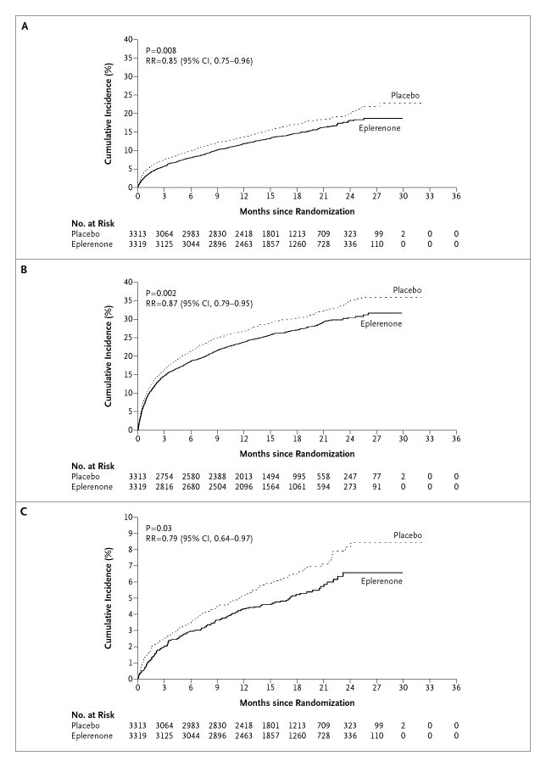
Aldosterone Antagonists Improve Survival
Advanced Heart Failure
RALES
Post Myocardial Infarction
EPHESUS
1.00
0.95
0.90
RR = 0.85 (0.75-0.96)
P = 0.008
RR = 0.85 (0.75-0.96)
P = 0.008
0.85
0.80
Placebo
0.75
Placebo
0.70
Spironolactone
0.65
0.60
Eplerenone
Eplerenone
0.55
Placebo
0.50
RR = 0.70 (0.60-0.82)
P < 0.001
0.45
0.00
0
3
6
9
12
15
18
21
24
27
30
33
36
Months Follow-up
Months Follow-up
Pitt B et al. N Engl J Med. 1999;341:709–717.
Pitt B et al. N Engl J Med 2003;348:1309-21.

Slide 47
Is there a role for aldosterone antagonists in chronic NYHA class II systolic heart failure?
Breaking News May, 2011:
EMPHASIS-HF (eplerenone verus placebo) terminated early by DSMB because of a significant reduction in the primary endpoint of cardiovascular death or heart failure hospitalization

Slide 48
Part 3: New Medical Therapies for Heart Failure

Slide 49
What have we learned so far?
2022 HF Guidelines

Slide 50
Bb AND mraS
Recommendation for Beta Blockers
COR | LOE | Recommendation
1 | A | 1. In patients with HFrEF, with current or previous symptoms, use of 1 of the 3 beta blockers proven to reduce mortality (eg, bisoprolol, carvedilol, sustained-release metoprolol succi- nate) is recommended to reduce mortality and hospitalizations.^{1–3}
Value Statement: High Value (A) |  | 2. In patients with HFrEF, with current or previous symptoms, beta-blocker therapy provides high economic value.^{4–8}
Recommendations for Mineralocorticoid Receptor Antagonists (MRAs)
COR | LOE | Recommendations
1 | A | 1. In patients with HFrEF and NYHA class II to IV symptoms, an MRA (spironolactone or eplerenone) is recommended to reduce morbidity and mortality, if eGFR is >30 mL/min/1.73 m² and serum potassium is <5.0 mEq/L. Careful monitoring of potassium, renal function, and diuretic dosing should be performed at initiation and closely monitored thereafter to minimize risk of hyperkalemia and renal insufficiency.^{1–3}
Value Statement: High Value (A) |  | 2. In patients with HFrEF and NYHA class II to IV symptoms, MRA therapy provides high economic value.^{4–7}
3: Harm | B-NR | 3. In patients taking MRA whose serum potas- sium cannot be maintained at <5.5 mEq/L, MRA should be discontinued to avoid life- threatening hyperkalemia.^{8,9}

Slide 51
iSOSORBIDE
Recommendations for Hydralazine and Isosorbide Dinitrate
COR | LOE | Recommendations
1 | A | 1. For patients self-identified as African American with NYHA class III-IV HFrEF who are receiving optimal medical therapy, the combination of hydralazine and isosorbide dinitrate is recommended to improve symptoms and reduce morbidity and mortality.^{1,2}
Value Statement: High Value (B-NR) |  | 2. For patients self-identified as African American with NYHA class III to IV HFrEF who are receiving optimal medical therapy with ACEi or ARB, beta blockers, and MRA, the combination of hydralazine and isosorbide dinitrate provides high economic value.³
2b | C-LD | 3. In patients with current or previous symptomatic HFrEF who cannot be given first-line agents, such as ARNi, ACEi, or ARB, because of drug intolerance or renal insufficiency, a combination of hydralazine and isosorbide dinitrate might be considered to reduce morbidity and mortality.^{4,5}

Slide 52
Digoxin
Recommendation for the Pharmacological Treatment for Stage C HFrEF: Digoxin
COR | LOE | Recommendation
2b | B-R | 1. In patients with symptomatic HFrEF despite GDMT (or who are unable to tolerate GDMT), digoxin might be considered to decrease hospitalizations for HF.^{1,2}

Slide 53
IVABRADINE

Slide 54
Elevated Resting Heart Rate
Accelerates production of atherosclerosis (Int J Cardiol 2008;126:302-12)
Associated with coronary plaque disruption (Circulation 2001;126:1477-82)
Framingham Study
  progressive increase in all cause and cardiovascular mortality in relation
  to antecedent HR (Am Heart J 1987; 113:1489-94)
Continuous increase in death rates in survivors of Acute MI
starting at HR > 70 (J Am Coll Cardiol 2007;50:823-30)
Elevated HR (> 100 bpm) post heart transplant pts have worse outcomes with regard to 10-yr all cause mortality (WACHTER, et.al. Clin Transplant. 2015 Sep;29(9):829-34.)
54
Notes:
Circ journal: Heart rates greater than 80.

Slide 55
Ivabradine: First in class HCN channel blocker
Blocks the hyperpolarization-activated cyclic nucleotide-gated (HCN) channel responsible for the cardiac pacemaker (affects the If current)
Lowers heart rate with NO effect on ventricular repolarization or myocardial contractility
Indicated to reduce the risk of hospitalization for worsening heart failure in patients with stable, symptomatic chronic heart failure with left ventricular ejection fraction < = 35% who are in sinus rhythm with resting heart rates > = 70 beats per minute and on max tolerated doses of betablockers.

Slide 56
IVABRADINE: First in class HCN channel blocker
Blocks the hyperpolarization-activated cyclic nucleotide-gated (HCN) channel responsible for the cardiac pacemaker (affects the If current)
Inward flow of positively charged ions that initiates the spontaneous diastolic depolarization phase, modulating heart rate
Lowers heart rate with NO effect on ventricular repolarization or myocardial contractility
Size of effect of ivabradine is dependent on baseline heart rate.

Slide 57
I_{f} Current
The funny current is highly expressed in spontaneously active cardiac regions, such as the sinoatrial node (SAN, the natural pacemaker region), the atrio-ventricular node (AVN) and the Purkinje fibers of conduction tissue.
Particularly unusual, the funny current is a mixed sodium-potassium current, inward and slowly activating on hyperpolarization at voltages in the diastolic range (normally from -60/-70 mV to -40 mV).
When at the end of a sinoatrial action potential the membrane repolarizes below the If threshold (about -40/-50 mV), the funny current is activated and supplies inward current, which is responsible for starting the diastolic depolarization phase (DD);
By this mechanism, the funny current controls the rate of spontaneous activity of sinoatrial myocytes, hence the cardiac rate.

Slide 58
Ivabradine
Specifically binds the (If) Funny channel
  Reduces the slope for diastolic depolarization
    Prolongs diastolic duration
Does not alter…
    Ventricular repolarization
    Myocardial contractility
    Blood pressure
58
Notes:
Because it binds to the F channel in the open position, it has greatest activity when there is greater open-close cycling of the F channel.
Hence it exhibits is greatest effect when heart rates are highest.
In that sense it has a partial self limiting capability.

Slide 59
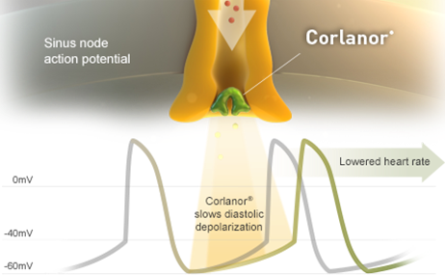
IVABRADINE
Ivabradine slows diastolic depolarization

Slide 60
MorBidity-mortality EvAlUation of The I _{f} inhibitor Ivabradine in patients with coronary disease and left ventricULar dysfunction
BEAUTIFUL Trial
2010

Slide 61
Ivabradine reduces primary end point in angina patients
Primary end point(PEP) : CV death + hospitalization for HF or MI
20
Placebo
-24%
n=1507
P=0.05
15
Cumulative incidence
for PEP* (%)
10
Ivabradine
5
0
0
0.5
1
1.5
2
Years
Fox K, Ford I, et al; BEAUTIFUL Investigators. Effect of ivabradine on cardiovascular outcomes in patients with stable coronary artery diseaseand left-ventricular systolic dysfunction with limiting angina: a subgroup analysis of the randomized, controlled BEAUTIFUL trial. Eur heart Jour On line.

Slide 62
Systolic Heart failure treatment with
the If inhibitor ivabradine Trial
SHIFT Trial
http://www.lancet.com published online August 29, 2010 DOI:10.1016/S0140-6736(10)61198-1

Slide 63
Chronic HF background treatment
Patients (%)
100
91
91
89
90
90
84
83
Ivabradine
80
Placebo
70
61
59
60
50
40
30
22
22
20
10
3
4
0
Beta-blockers
ACEIs and/or
Diuretics
Aldosterone
Digitalis
ICD/CRT
ARBs
antagonists

Slide 64
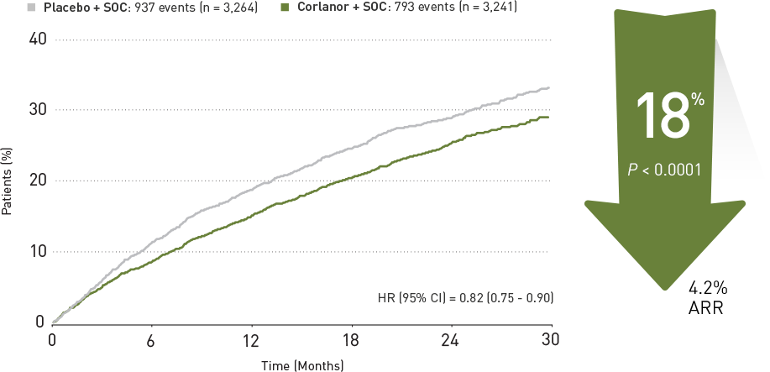
Time to first event of primary composite end point
Cardiovascular death & Hospitalization for worsening heart failure
placebo
Ivabradine

Slide 65
Incidence of selected adverse events (N = 6492)
 | Patients with an event
 | Ivabradine N=3232, % (n) | Placebo N=3260, % (n) | p value
All serious adverse events | 45% (1450) | 48% (1553) | 0.025
All adverse events | 75% (2439) | 74% (2423) | 0.303
Heart failure | 25% (804) | 29% (937) | 0.0005
Symptomatic bradycardia | 5% (150) | 1% (32) | <0.0001
Asymptomatic bradycardia | 6% (184) | 1% (48) | <0.0001
Atrial fibrillation | 9% (306) | 8% (251) | 0.012
Phosphenes | 3% (89) | 1% (17) | <0.0001
Blurred vision | 1% (17) | <1% (7) | 0.042

Slide 66


Slide 67

Ivabradine
Recommendation for the Management of Stage C HF: Ivabradine
COR | LOE | Recommendation
2a | B-R | 1. For patients with symptomatic (NYHA class II to III) stable chronic HFrEF (LVEF ≤35%) who are receiving GDMT, including a beta blocker at maximum tolerated dose, and who are in sinus rhythm with a heart rate of ≥70 bpm at rest, ivabradine can be beneficial to reduce HF hospitalizations and cardiovascular death.^{1,2}
GDEM, guideline-directed evaluation and management.
Yancy CW et al. Circulation. 2016;134:e282-e293.
Notes:
The SHIFT clinical trial provides evidence in support of this recommendation
Yancy 2016; p11, Table

Slide 68
Neprilysin inhibitor (sucubitril) eNTRESTO

Slide 69
PARADIGM-HF: A Randomized, Controlled Trial Examining the Efficacy of Sacubitril/Valsartan vs Enalapril in Patients With HF
PARADIGM-HF 2014
Study Design¹
Key inclusion criteria¹
Age ≥18 years
NYHA class II-IV HF
LVEF ≤40%
BNP ≥150 pg/mL
Double-Blind Randomized Treatment Period
Randomization
Single-blind run-in period
Sac/val 97/103 mg BID (n=4187)
Primary Endpoint
Enalapril*
10 mg BID
Sac/val†
49/51 mg BID
Sac/val†
97/103 mg BID
Composite of death from CV causes or first hospitalization for HF
Key exclusion criteria¹
Symptomatic hypotension
Systolic BP <100 mmHg at screening
eGFR<30 mL/min/
1.73 m²
History of angioedema
Enalapril 10 mg BID (n=4212)
Testing tolerability to target doses of enalapril and sac/val
On top of standard HF therapy,
excluding ACEIs and ARBs
2 weeks
1–2 weeks
2–4 weeks
Median duration of follow-up: 27 months
ARNIs, angiotensin receptor-neprilysin inhibitors; BNP, B-type natriuretic peptide; Sac, sacubitril; Val, valsartan.
*Enalapril 5 mg BID for 1-2 weeks followed by enalapril 10 mg BID was an optional starting run-in dose for patients treated with ARBs or with a low-dose ACEI.
†Dosing in clinical trials was based on the total amount of both components of sac/val; 24/26 mg, 49/51 mg, and 97/103 mg were
referred to as 50 mg, 100 mg, and 200 mg, respectively. Sac/val was formerly known as LCZ696 in clinical trials.
1. McMurray JJV et al. N Engl J Med. 2014;371:993-1004. 2. Yancy CW et al. Circulation. 2016;134:e282-e293.
Notes:
The Prospective Comparison of ARNI (Angiotensin Receptor-Neprilysin Inhibitor) with ACEI (Angiotensin-Converting Enzyme Inhibitor) to Determine Impact on Global Mortality and Morbidity in Heart Failure Trial (PARADIGM-HF) was designed to compare whether the combination of the angiotensin receptor-neprilysin inhibitor (ARNI) sacubitril and the ARB valsartan (sac/val) improved morbidity and mortality compared with enalapril¹
Patients were eligible if they had NYHA class II-IV HF, an LVEF≤40%, and a plasma B-type natriuretic peptide ≥150 pg/mL¹
Exclusion criteria included symptomatic hypotension, systolic BP <100 mmHg at screening (or <95 mmHg at randomization), eGFR<30 mL/min/1.73 m², a decrease in eGFR >25% (later amended to >35%) between screening and randomization, serum potassium >5.2 mmol/L at screening (or >5.4 mmol/L at randomization), and a history of angioedema or unacceptable side effects during the treatment with ACE inhibitors or ARBs¹
Eligible patients underwent a single-blind run-in period prior to randomization, during which time they received enalapril followed by increasing doses of sacl/val to determine tolerability to target doses of study agents¹
After completion of the run-in period, 8442 patients were randomized to receive sac/val (n=4187) or enalapril (n=4212)¹
The primary outcome was a composite of death from CV causes or first hospitalization for HF. Secondary endpoints were the time to death from any cause, the change from baseline to 8 months in Kansas City Cardiomyopathy Questionnaire (KCCQ) score, time to a new onset of atrial fibrillation, and time to the first occurrence of a decline in renal function¹
Data from this study support the ACC/AHA/HFSA Guideline recommendation of ARNIs for the treatment of patients with chronic HFrEF (Class I, Level B-R evidence)²
References
McMurray JJV, Packer M, Desai AS, et al; for the PARADIGM-HF Investigators and Committees. Angiotensin–neprilysin inhibition versus enalapril in heart failure. N Engl J Med. 2014;371:993-1004.
Yancy CW, Jessup M, Bozkirt B, et al. 2016 ACC/AHA/HFSA focused update on new pharmacological therapy for heart failure: an update of the 2013 ACCF/AHA guideline for the management of heart failure. A report of the American College of Cardiology/American Heart Association Task Force on Clinical Practice Guidelines and the Heart Failure Society of America. Circulation. 2016;134:e282-e293.
Key inclusion criteria, McMurray 2014; p994, col2, para 4, lines1-13
Key exclusion criteria, McMurray 2014; p994, col2, para5, lines1-2; p995, col1, para1, lines1-9; col2, para2, lines1-2
Study design, McMurray 2014; p994, col2, para3, lines2-7; p995, Figure 1; col2, para2; p996, col1, para1; pp997, col1, para2, lines1-8; para3, lines1-3; p999, col2, para2, lines11-12
Callout, Yancy 2016; p10, Table; p14, Reference 19
Bullet 1, McMurray 2014; p993, asterisk; p994, col1, para3, lines8-13
Bullet 2, McMurray 2014; p994, col2, para 4, lines1-13
Bullet 3, McMurray 2014; p994, col2, para5, lines1-2; p995, col1, para1, lines1-9; col2, para2, lines1-2
Bullet 4, McMurray 2014; p994, col2, para3, lines2-7
Bullet 5, McMurray 2014; p995, Figure 1
Bullet 6, McMurray 2014; p997, col1, para3, lines1-10; col2, para1, lines1-6
Bullet 7, Yancy 2016; p10, Table; p14, Reference 19

Slide 70
PARADIGM-HF: Efficacy and Safety of Sacubitril/Valsartan vs Enalapril in Patients With HF
PARADIGM-HF 2014
1.0
0.5
HR 0.80 (95% Cl 0.73-0.87), P<0.001
20% relative risk reduction
Hospitalization for HF or Death from Cardiovascular Causes
0.4
Combined Endpoint of CV Death
Cumulative Probability of the
or HR Hospitalization
Enalapril (
11
17 events)
0.2
Sac/val (914 events)
0
0
180
360
540
720
900
1080
1260
No. at Risk
Days Since Randomization
Sac/val
4187
3922
3663
3018
2257
1544
896
249
Enalapril
4212
3883
3579
2922
2123
1488
853
236
Death from CV causes or first hospitalization for worsening HF occurred in 914 (21.8%) of sac/val patients and 1117 (26.5%) of enalapril patients (HR 0.80 [95% CI, 0.73-0.87]; P<0.001)
Sac/val treatment was associated with significant improvements in each component of the composite endpoint
Patients in the sac/val group were more likely to have symptomatic hypotension than patients in the enalapril group (P<0.001)
McMurray JJV et al. N Engl J Med. 2014;371:993-1004.
Notes:
Death from CV causes or hospitalization for HF occurred in 914 (21.7%) patients in the sac/val group and 1117 (26.5%) patients in the enalapril group (P<0.001)
Differences in primary outcome were observed early in the trial and was retained at each interim analysis
558 (13.3%) deaths due to CV causes occurred in the sac/val group compared with 693 (16.5%) deaths in the enalapril group
(P<0.001)
Hospitalization for HF was observed in 537 (12.8%) patients in the sac/val group vs 658 (15.6%) patients in the enalapril group (P<0.001)
Sac/val treatment was also associated with significant improvements in death from any cause (17.0% vs 19.8% with enalapril; P<0.001) and change in KCCQ clinical summary score at 8 months (−2.99 vs − 4.63, P=0.001)
Patients in the sac/val group were more likely to have symptomatic hypotension than patients in the enalapril group
Termination of study medication due to AEs occurred more frequently in the enalapril group than in the sac/val group (12.3% vs 10.7%, P=0.03)
Reference
McMurray JJV, Packer M, Desai AS, et al; for the PARADIGM-HF Investigators and Committees. Angiotensin–neprilysin inhibition versus enalapril in heart failure. N Engl J Med. 2014;371:993-1004.
Figure, McMurray 2014; p998, Figure 1A; p999, Table 2
Bullets 1 and 2, McMurray 2014; p999, Table 2
Bullet 3, McMurray 2014; p1002, Table 3
Bullet 1, McMurray 2014; p999, Table 2
Bullet 2, McMurray 2014; p1001, col1, para1, lines7-9
Bullets 3-5, McMurray 2014; p999, Table 2
Bullet 6, McMurray 2014; p1002, Table 3
Bullet 7, McMurray 2014; p1001, col2, para3, lines19-23

Slide 71

HFrEF Pathophysiology
Slide has animation
SNS and RAAS
Neurohormonal activation via SNS and RAAS signaling may exacerbate the failing heart and trigger lethal ventricular arrhythmias^{1,2}
SNS^{2,4}
Epinephrine Norepinephrine
α₁, β₁, β₂ receptors
Vasoconstriction ↑
RAAS activity ↑
Heart rate ↑
Contractility ↑
HF SYMPTOMS & PROGRESSION
RAAS^{2,3,4}
Ang II
AT1R
Vasoconstriction ↑
Blood pressure ↑
Sympathetic tone ↑
Vasopressin ↑
Aldosterone ↑
Hypertrophy ↑
Fibrosis ↑
Ang II, angiotensin II; AT1R, angiotensin II type 1 receptor; HF, heart failure; NPs, natriuretic peptides; SNS, sympathetic nervous system;
RAAS, renin-angiotensin-aldosterone system.
1. Tomaselli GF, Zipes DP. Circ Res. 2004;95(8):754-763. 2. Kemp CD, Conte JV. Cardiovasc Pathol. 2012;21(5):365-371. 3. Mangiafico S et al. Eur Heart J. 2013;34:886-893. 4. Hasenfuss G, Mann DL. Pathophysiology of heart failure. In: Mann DL et al, eds. Braunwald's Heart Disease: A Textbook of Cardiovascular Medicine. 10th ed. Philadelphia, PA: Elsevier; 2015

Slide 72
HFrEF Pathophysiology
Slide has animation
The SNS and RAAS Are Overexpressed
Neurohormonal activation via SNS and RAAS signaling may exacerbate the failing heart and trigger lethal ventricular arrhythmias^{1,2}
The RAAS and SNS are overexpressed^{1,2,4}
SNS^{2,4}
Epinephrine Norepinephrine
α₁, β₁, β₂ receptors
Vasoconstriction ↑
RAAS activity ↑
Heart rate ↑
Contractility ↑
HF SYMPTOMS & PROGRESSION
RAAS^{2,3,4}
Ang II
AT1R
Vasoconstriction ↑
Blood pressure ↑
Sympathetic tone ↑
Vasopressin ↑
Aldosterone ↑
Hypertrophy ↑
Fibrosis ↑
Ang II, angiotensin II; AT1R, angiotensin II type 1 receptor; HF, heart failure; NPs, natriuretic peptides; SNS, sympathetic nervous system;
RAAS, renin-angiotensin-aldosterone system.
1. Tomaselli GF, Zipes DP. Circ Res. 2004;95(8):754-763. 2. Kemp CD, Conte JV. Cardiovasc Pathol. 2012;21(5):365-371. 3. Mangiafico S et al. Eur Heart J. 2013;34:886-893. 4. Hasenfuss G, Mann DL. Pathophysiology of heart failure. In: Mann DL et al, eds. Braunwald's Heart Disease: A Textbook of Cardiovascular Medicine. 10th ed. Philadelphia, PA: Elsevier; 2015

Slide 73
HFrEF Pathophysiology
Slide has animation
Role of Endogenous Compensatory Peptides
Endogenous Compensatory Peptides (ECPs)²⁻⁴
SNS^{1,4}
Epinephrine Norepinephrine
α₁, β₁, β₂ receptors
NPR-A, NPR-B, B2, calcitonin receptor-like receptor
NPs, Bradykinin, ADM
Vasoconstriction ↑
RAAS activity ↑
Heart rate ↑
Contractility ↑
↓ Vasodilation
↓ Blood pressure
↓ Sympathetic tone
↑ Natriuresis/diuresis
↓ Vasopressin
↓ Aldosterone
↓ Fibrosis
↓ Hypertrophy
HF SYMPTOMS & PROGRESSION
RAAS^{1,2,4}
Ang II
AT1R
Vasoconstriction ↑
Blood pressure ↑
Sympathetic tone ↑
Vasopressin ↑
Aldosterone ↑
Hypertrophy ↑
Fibrosis ↑
The effects of RAAS and SNS are balanced by the counterregulatory effects of ECPs, including NPs, bradykinin, and adrenomedullin²⁻⁴
ADM, adrenomedulin; Ang II, angiotensin II; AT1R, angiotensin II type 1 receptor; ECPs, endogenous compensatory peptides; HF, heart failure;
NPs, natriuretic peptides; SNS, sympathetic nervous system; RAAS, renin-angiotensin-aldosterone system.
1. Kemp CD, Conte JV. Cardiovasc Pathol. 2012;21(5):365-371. 2. Mangiafico S et al. Eur Heart J. 2013;34:886-893. 3. Nathisuwan S, Talbert RL. Pharmacotherapy. 2002;22:27-42. 4. Hasenfuss G, Mann DL. Pathophysiology of heart failure. In: Mann DL et al, eds. Braunwald's Heart Disease: A Textbook of Cardiovascular Medicine. 10th ed. Philadelphia, PA: Elsevier; 2015.

Slide 74
HFrEF Pathophysiology
Slide has animation
Existing Therapies
β-blockers⁵
β-blockers⁵
SNS^{1,4}
Endogenous Compensatory Peptides²⁻⁴
SNS^{1,4}
Epinephrine Norepinephrine
Epinephrine Norepinephrine
α₁, β₁, β₂ receptors
NPR-A, NPR-B, B2, calcitonin receptor-like receptor
α₁, β₁, β₂ receptors
NPs, Bradykinin, ADM
Vasoconstriction ↑
RAAS activity ↑
Heart rate ↑
Contractility ↑
Vasoconstriction ↑
RAAS activity ↑
Heart rate ↑
Contractility ↑
↓ Vasodilation
↓ Blood pressure
↓ Sympathetic tone
↑ Natriuresis/diuresis
↓ Vasopressin
↓ Aldosterone
↓ Fibrosis
↓ Hypertrophy
HF SYMPTOMS & PROGRESSION
RAAS inhibitors (ACEI, ARB, MRA)⁵
RAAS inhibitors (ACEI, ARB, MRA)⁵
RAAS^{1,2,4}
RAAS^{1,2,4}
Ang II
Ang II
AT1R
AT1R
Vasoconstriction ↑
Blood pressure ↑
Sympathetic tone ↑
Vasopressin ↑
Aldosterone ↑
Hypertrophy ↑
Fibrosis ↑
Vasoconstriction ↑
Blood pressure ↑
Sympathetic tone ↑
Vasopressin ↑
Aldosterone ↑
Hypertrophy ↑
Fibrosis ↑
ACEI, angiotensin-converting enzyme inhibitor; ADM, adrenomedulin; Ang II, angiotensin II; ARB, angiotensin II receptor blocker; AT1R, angiotensin II type 1 receptor; ECPs, endogenous compensatory peptides; HF, heart failure; MRA, mineralocorticoid receptor antagonists; NPs, natriuretic peptides; SNS, sympathetic nervous system; RAAS, renin-angiotensin-aldosterone system.
1. Kemp CD, Conte JV. Cardiovasc Pathol. 2012;21(5):365-371. 2. Mangiafico S et al. Eur Heart J. 2013;34:886-893. 3. Nathisuwan S, Talbert RL. Pharmacotherapy. 2002;22:27-42. 4. Hasenfuss G, Mann DL. Pathophysiology of heart failure. In: Mann DL et al, eds. Braunwald's Heart Disease: A Textbook of Cardiovascular Medicine. 10th ed. Philadelphia, PA: Elsevier; 2015. 5. Mann DL. Management of Patients with Heart Failure with Reduced Ejection Fraction. In: Mann DL et al, eds. Braunwald's Heart Disease: A Textbook of Cardiovascular Medicine. 10th ed. Philadelphia, PA: Elsevier; 2015

Slide 75
Sacubitril/Valsartan
Slide has animation
Effects of Sacubitril/valsartan in HFrEF
Endogenous Compensatory Peptides²⁻⁴
SNS^{1,4}
Endogenous Compensatory Peptides²⁻⁴
Epinephrine Norepinephrine
α₁, β₁, β₂ receptors
NPR-A, NPR-B, B2, calcitonin receptor-like receptor
NPR-A, NPR-B, B2, calcitonin receptor-like receptor
NPs, Bradykinin, ADM
NPs, Bradykinin, ADM
Vasoconstriction ↑
RAAS activity ↑
Heart rate ↑
Contractility ↑
↓ Vasodilation
↓ Blood pressure
↓ Sympathetic tone
↑ Natriuresis/diuresis
↓ Vasopressin
↓ Aldosterone
↓ Fibrosis
↓ Hypertrophy
↓ Vasodilation
↓ Blood pressure
↓ Sympathetic tone
↑ Natriuresis/diuresis
↓ Vasopressin
↓ Aldosterone
↓ Fibrosis
↓ Hypertrophy
HF SYMPTOMS & PROGRESSION
RAAS^{1,2,4}
RAAS^{1,2,4}
Ang II
Ang II
AT1R
Enhance the beneficial effects of endogenous compensatory peptides
AT1R
+
Vasoconstriction ↑
Blood pressure ↑
Sympathetic tone ↑
Vasopressin ↑
Aldosterone ↑
Hypertrophy ↑
Fibrosis ↑
Vasoconstriction ↑
Blood pressure ↑
Sympathetic tone ↑
Vasopressin ↑
Aldosterone ↑
Hypertrophy ↑
Fibrosis ↑
Neprilysin
Inhibitor
Suppress deleterious effects of RAAS
Sacubitril/
valsartan⁵
ARB
Link to effects of NEP inhibition
1. Kemp CD, Conte JV. Cardiovasc Pathol. 2012;21(5):365-371. 2. Mangiafico S et al. Eur Heart J. 2013;34:886-893. 3. Nathisuwan S, Talbert RL. Pharmacotherapy. 2002;22:27-42. 4. Hasenfuss G, Mann DL. Pathophysiology of heart failure. In: Mann DL et al, eds. Braunwald's Heart Disease: A Textbook of Cardiovascular Medicine. 10th ed. Philadelphia, PA: Elsevier; 2015. 5. Entresto (sacubitril/valsartan) [package insert].
East Hanover, NJ: Novartis Pharmaceuticals Corp; August 2015.
ADM, adrenomedulin; Ang II, angiotensin II; AT1R, angiotensin II type 1 receptor; ECPs, endogenous compensatory peptides; HF, heart failure;
NPs, natriuretic peptides; SNS, sympathetic nervous system; RAAS, renin-angiotensin-aldosterone system.

Slide 76
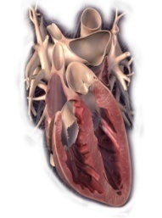
Sacubitril/Valsartan
Slide has animation
Effect on BNP and NT-proBNP
⬆ proBNP secretion
Heart Failure with LV Stretch
Vasoactive peptideª with cardioprotective effects
BNP
NT-proBNP
Inactive
(inert) marker
of HF
Sacubitril/
Valsartan
Neprilysin inhibition has
no effect on NT-proBNP
Neprilysin
Sacubitril/Valsartan Increases BNP Levels
Link to BNP and NT-proBNP Reductions
Inactive
fragments
BNPs, brain natriuretic peptides; NT-proBNP, N-terminal of the prohormone brain natriuretic peptide.
ªVasoactive peptides include the NPs (atrial NPs, BNPs, C-type NPs), adrenomedullin, and bradykinin.
Modified from Vardeny O et al. Clin Pharmacol Ther. 2013;94:445-448.

Slide 77
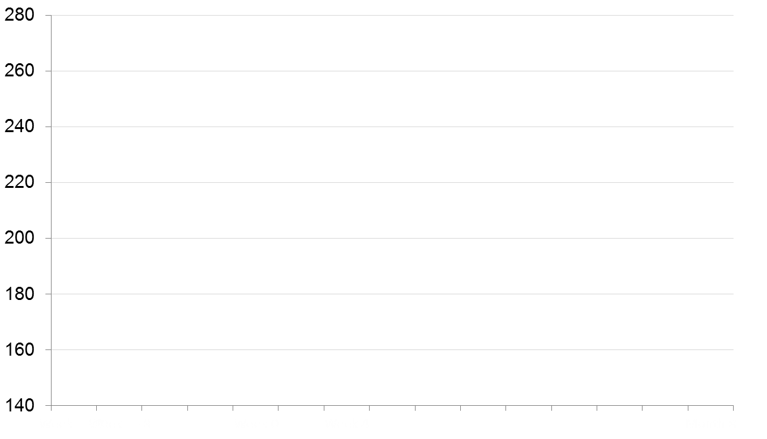
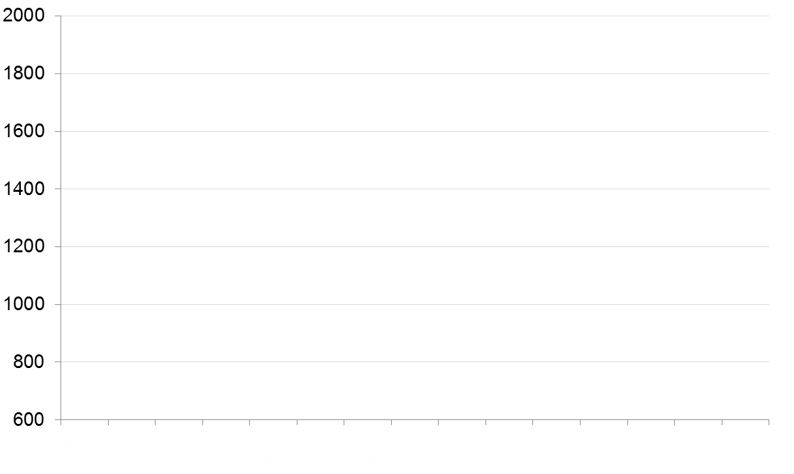
Effects of Sacubitril/Valsartan on BNP & NT- proBNP
BNP
NT- proBNP
Enalapril
Run-in*
Entresto
Run-in*
Enalapril
Run-in*
Entresto
Run-in*
Enalapril
Enalapril
Sac/Val
Sac/Val
Geometric Mean (nmol/L)
Geometric Mean (nmol/L)
W
-10
W
-8
W
0
W
4
M
8
W
-10
W
-8
W
0
W
4
M
8
*Patients in both groups received the same single-blind treatment
"BNP, but not NT-proBNP, is a neprilysin substrate, and therefore BNP levels will increase as levels of active drug increase; whereas levels of NT-proBNP will show the effects of the drug on the heart"
Notes:
LCZ696 significantly reduced levels of NT-proBNP, a marker of cardiac wall stress
A pre-specified exploratory analysis assessed various measures in the PARADIGM-HF study, including biomarkers reflective of cardiac injury, wall stress and effects of neprilysin inhibition.
Entresto treatment was associated with an early and sustained reduction in N-terminal pro-BNP (a biomarker of myocardial wall-stress) versus enalapril. The difference between groups was apparent within 4 weeks and was sustained at 8 months, p<0.0001 for the difference between groups at both time points.
Abbreviations
BNP=B-type natriuretic peptide; NT-proBNP=N-terminal pro B-type natriuretic peptide
Reference
Packer M et al. Circulation. 2014;131:54–61

Slide 78
PARADIGM-HF
Primary Endpoint: Time to First Occurrence of CV Death or HF Hospitalization
Sacubitril/Valsartan Reduced the Risk of CV Death or
First HF Hospitalization by 20% vs Enalapril^{1,2}
1.0
Enalapril
Sacubitril/valsartan
4.7% ARR
NNT²=21
over a median duration of 27 months
Total Patients = 8442
0.6
Hazard ratio = 0.80 (95% CI: 0.73-0.87)
P<0.0001
0.4
Cumulative probability of event
1117 events
914 events
0.2
0
0
180
360
540
720
900
1080
1260
Days since randomization
Trial stopped early after median follow-up of 27 months²
ARR, absolute risk reduction; CI, confidence interval; HR, hazard ratio; NNT, number needed to treat; RRR, relative risk reduction.
1. ENTRESTO [prescribing information]. East Hanover, NJ: Novartis Pharmaceuticals Corp; August 2015. 2. McMurray JJ, et al. N Engl J Med. 2014;371(11):993-1004.

Slide 79

Angiotensin Receptor-Neprilysin Inhibition in Patients Hospitalized With Acute Decompensated Heart Failure
Eric J Velazquez,¹ David A Morrow,² Adam D DeVore,³ Carol I Duffy,⁴ Andrew P
Ambrosy,³ Kevin McCague,⁴ Ricardo Rocha,⁴ Eugene Braunwald²
¹Yale Univ Sch of Med, New Haven, CT; ²Harvard Univ/Brigham and Women's Hosp, Boston, MA;
³Duke Univ/Duke Clinical Res Inst, Durham, NC; ⁴Novartis Pharmaceuticals Corp, East Hanover, NJ; ⁵

Slide 80

Composite Clinical Endpoint
Death, HF re-hosp, LVAD, Transplant listing
20
HR = 0.54; 95% CI 0.37, 0.79
enalapril
16.8%
P = 0.001
N = 441
Event Rate (%)
NNT = 13
10
9.3%
sacubitril/valsartan
N = 440
0
0
7
14
24 28 35 42
Days since Randomization
49
56
11

Slide 81
Recommendations for Renin-Angiotensin System Inhibition With ACEi or ARB or ARNI
COR | LOE | Recommendations
1 | A | 1. In patients with HFrEF and NYHA class II to III symptoms, the use of ARNi is recommended to reduce morbidity and mortality.^{1–5}
1 | A | 2. In patients with previous or current symptoms of chronic HFrEF, the use of ACEi is beneficial to reduce morbidity and mortality when the use of ARNi is not feasible.^{6–13}
1 | A | 3. In patients with previous or current symptoms of chronic HFrEF who are intolerant to ACEi because of cough or angioedema and when the use of ARNi is not feasible, the use of ARB is recommended to reduce morbidity and mortality.^{14–18}
Value Statement: High Value (A) |  | 4. In patients with previous or current symptoms of chronic HFrEF, in whom ARNi is not feasible, treatment with an ACEi or ARB provides high economic value.^{19–25}
1 | B-R | 5. In patients with chronic symptomatic HFrEF NYHA class II or III who tolerate an ACEi or ARB, replacement by an ARNi is recommended to further reduce morbidity and mortality.^{1–5}
Value Statement: High Value (A) |  | 6. In patients with chronic symptomatic HFrEF, treatment with an ARNi instead of an ACEi provides high economic value.^{26–29}
3: Harm | B-R | 7. ARNi should not be administered concomi- tantly with ACEi or within 36 hours of the last dose of an ACEi.^{30,31}
3: Harm | C-LD | 8. ARNi should not be administered to patients with any history of angioedema.^{32–35}
3: Harm | C-LD | 9. ACEi should not be administered to patients with any history of angioedema.^{36–39}

Slide 82
SGLT2 inhibitors
The action of sodium-glucose cotransporter 2 (SGLT2) inhibitors to promote natriuresis and osmotic diuresis has been proposed as a central mechanism by which these drugs reduce heart failure hospitalizations in large-scale trials.
Sodium retention in patients with heart failure is related to increased sodium reabsorption in the proximal tubule, and by attenuating the sodium reabsorption at this site, SGLT2 inhibitors may potentiate the effect of diuretic agents acting at the loop of Henle.

Slide 83
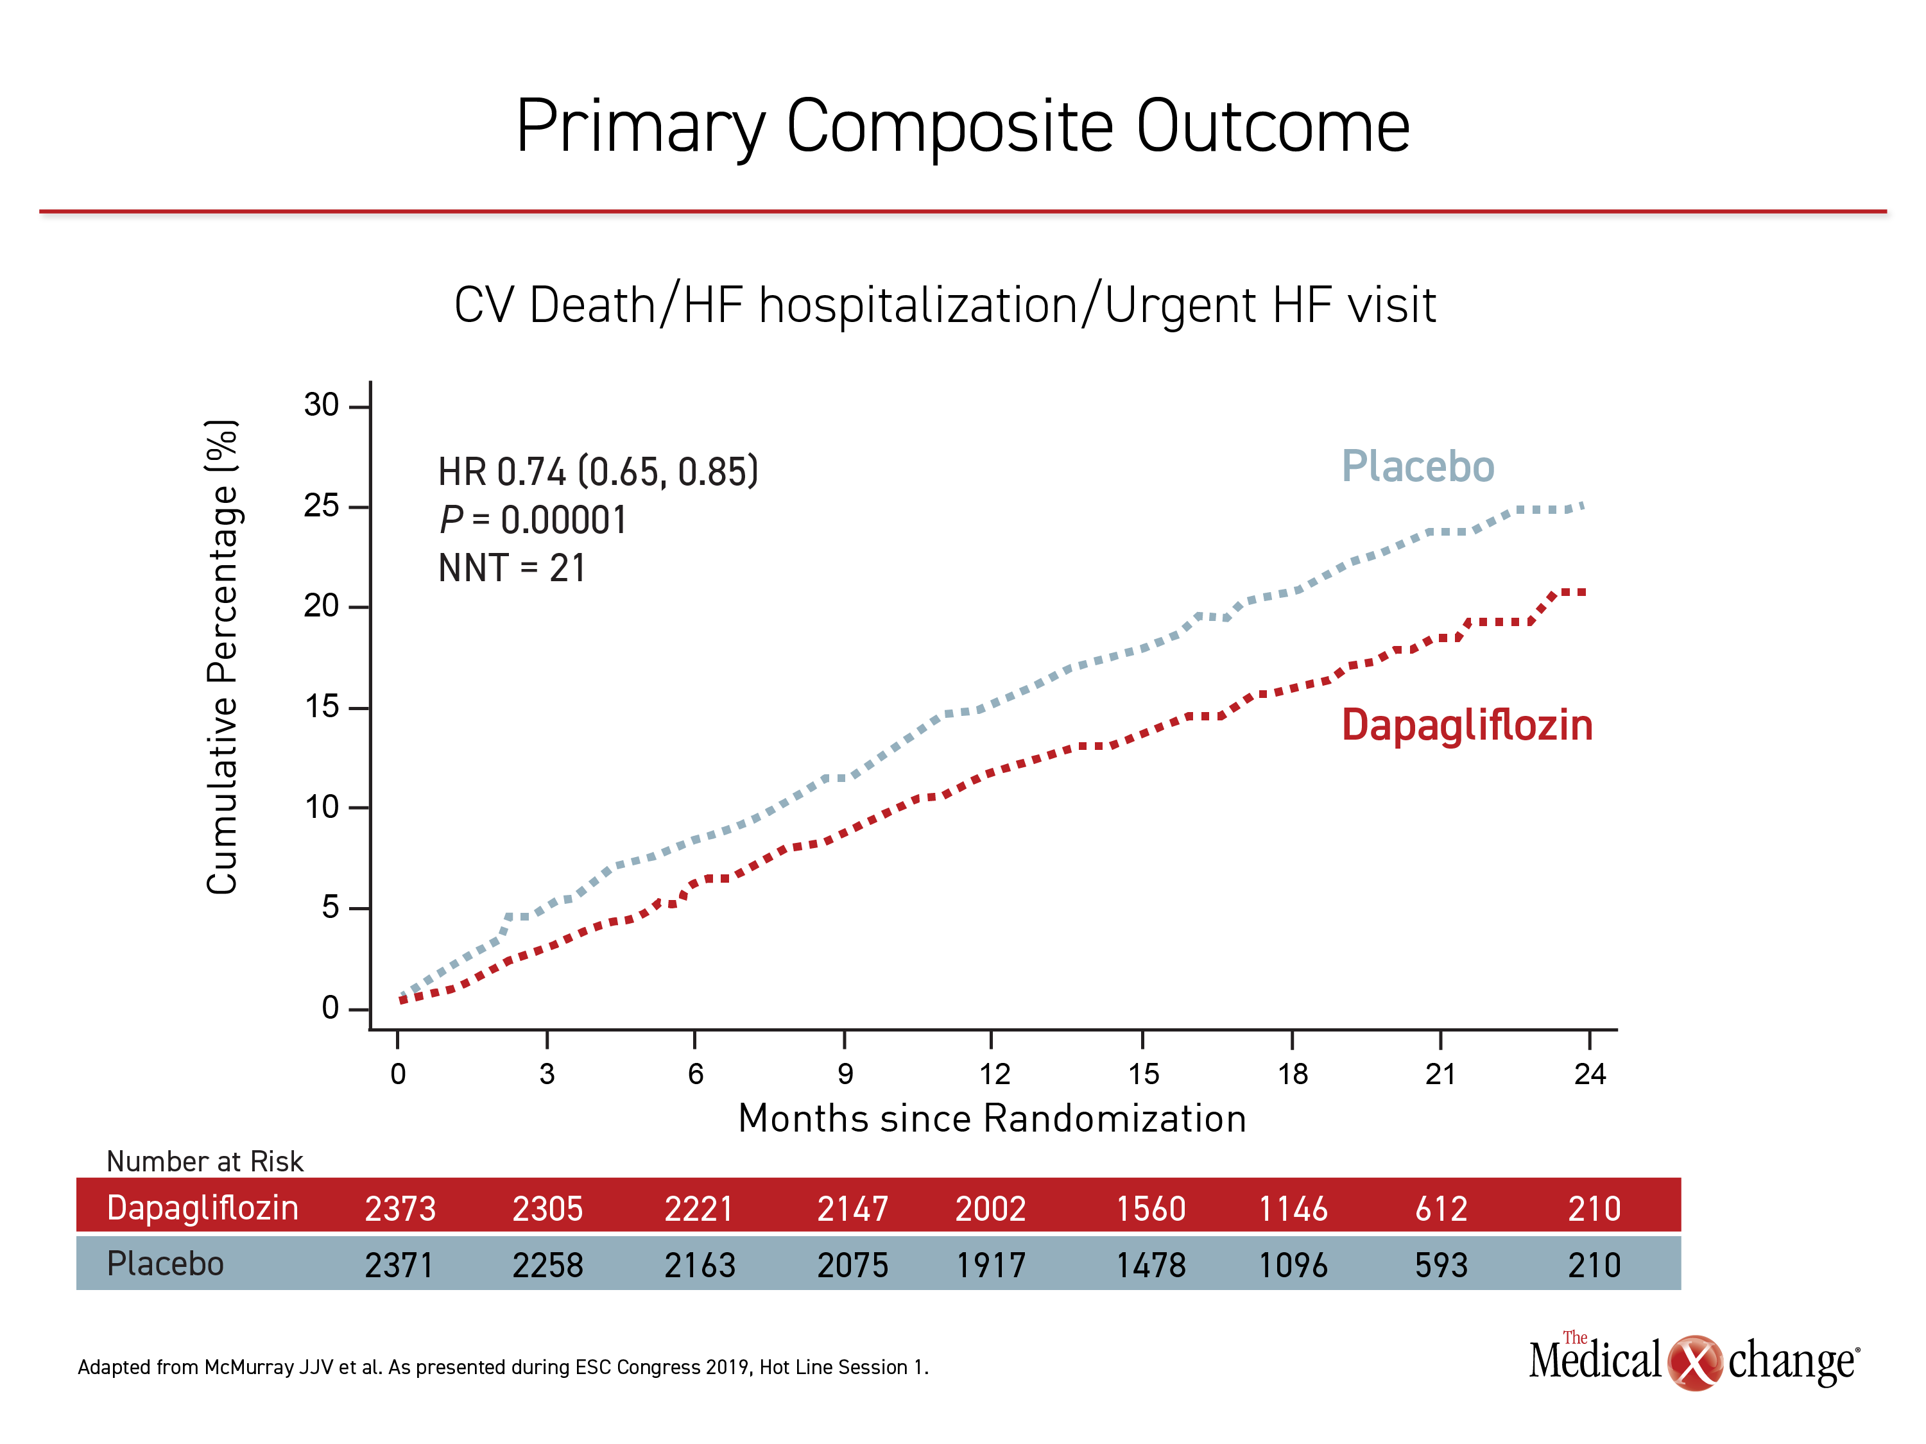
DAPA-HF
2019

Slide 84
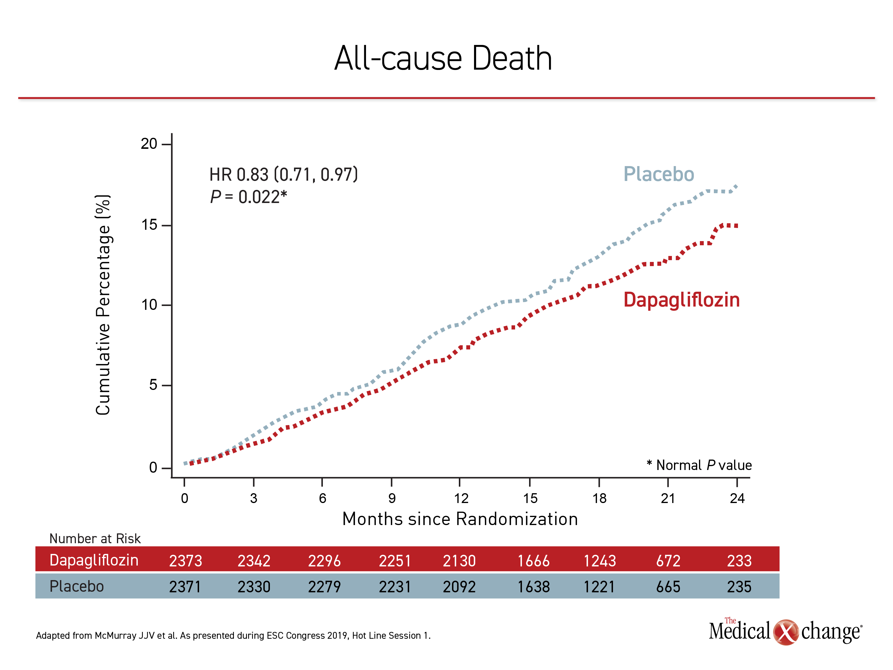

Slide 85
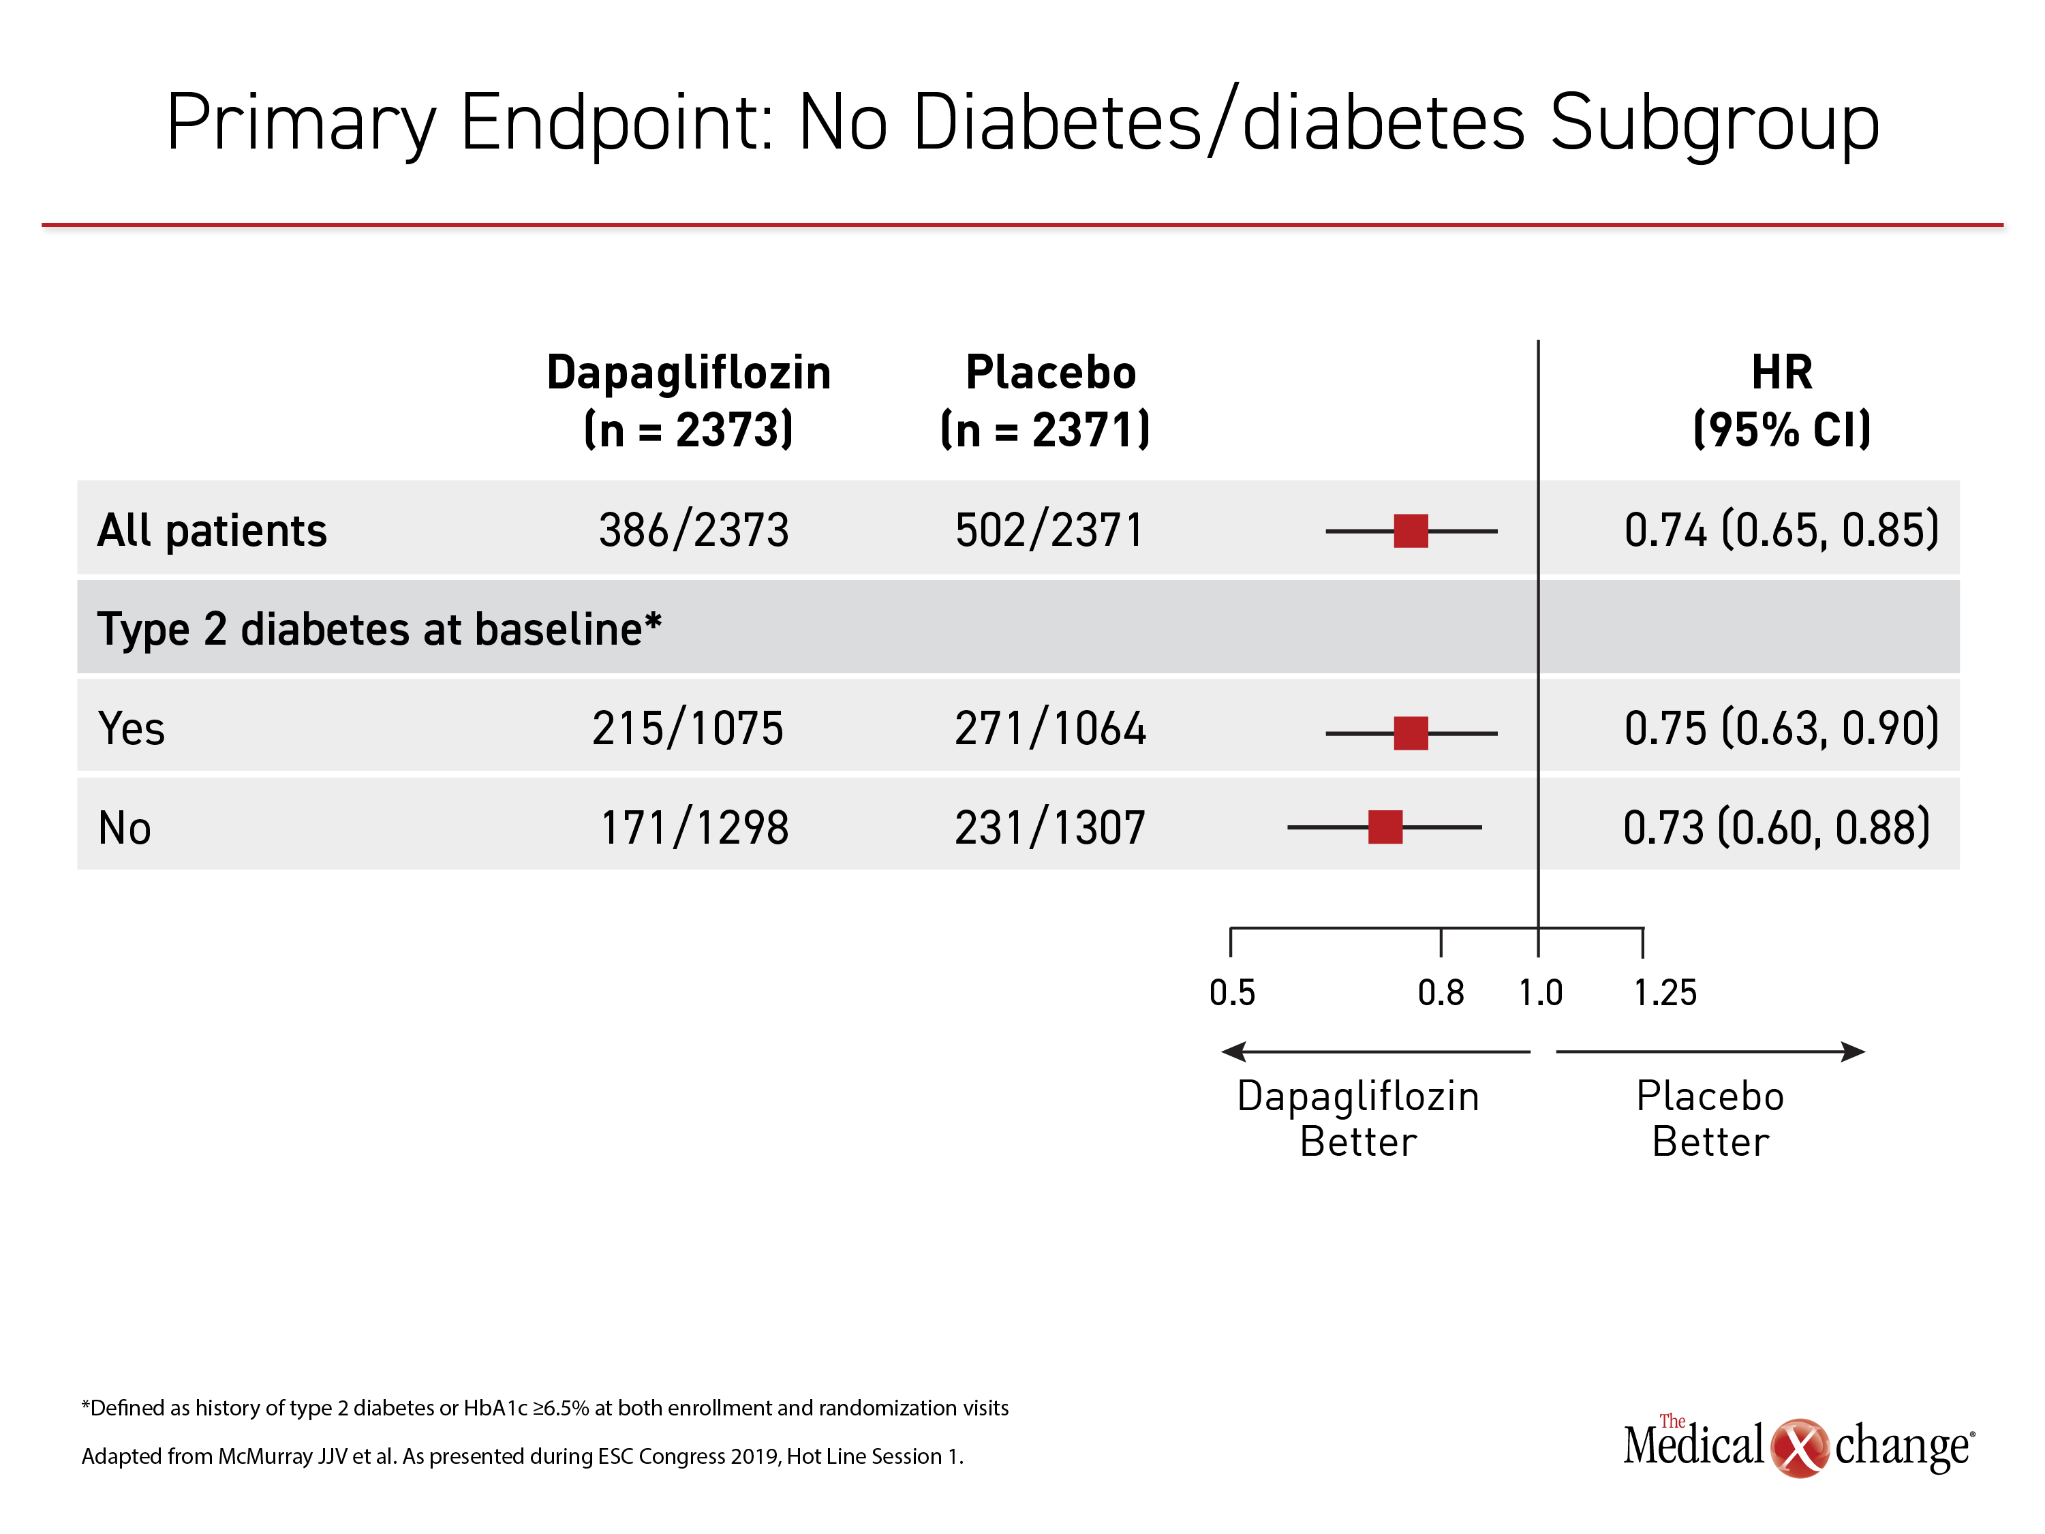

Slide 86
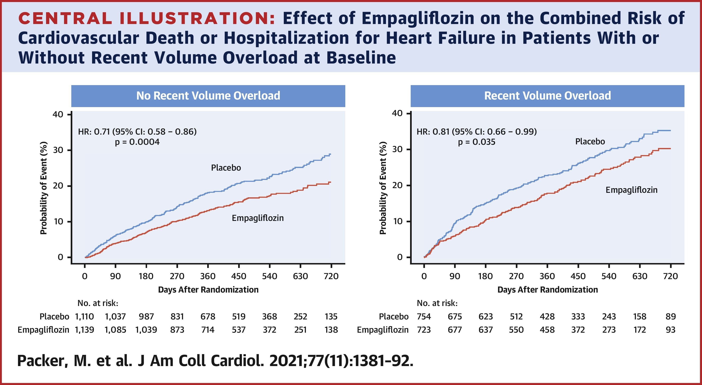
Emperor reduced
Possible effects of SGLT2 inhibitor on left ventricular remodeling

Slide 87
Sglt2 inhibitors
Recommendation for SGLT2i
COR | LOE | Recommendation
1 | A | 1. In patients with symptomatic chronic HFrEF, SGLT2i are recommended to reduce hospitalization for HF and cardiovascular mortality, irrespective of the presence of type 2 diabetes.^{1,2}
Value Statement: Intermediate Value (A) |  | 2. In patients with symptomatic chronic HFrEF, SGLT2i therapy provides intermediate economic value.^{3,4}

Slide 88
Vericiguat
In patients with progression of HFrEF despite GDMT, there may be a role for novel therapeutic agents. Oral soluble guanylyl cyclase stimulator (eg, vericiguat) directly binds and stimulates sGC and increases cGMP production.
cGMP has several potentially beneficial effects in patients with HF, including vasodilation, improvement in endothelial function, as well as decrease in fibrosis and remodeling of the heart.^{2–7}
The VICTORIA (Vericiguat Global Study in Subjects with Heart Failure with Reduced Ejection Fraction) trial randomized 5050 higher-risk patients with worsening HFrEF to vericiguat versus placebo.

Slide 89
vericiguat
Recommendation for Pharmacological Treatment for Stage C HFrEF: Soluble Guanylyl Cyclase Stimulators
COR | LOE | Recommendation
2b | B-R | 1. In selected high-risk patients with HFrEF and recent worsening of HF already on GDMT, an oral soluble guanylate cyclase stimulator (vericiguat) may be considered to reduce HF hospitalization and cardiovascular death.¹

Slide 90
PUFA and Potassium Binders
Recommendations for Other Drug Treatment
COR | LOE | Recommendations
2b | B-R | 1. In patients with HF class II to IV symptoms, omega-3 polyunsaturated fatty acid (PUFA) supplementation may be reasonable to use as adjunctive therapy to reduce mortality and car- diovascular hospitalizations.^{1–4}
2b | B-R | 2. In patients with HF who experience hyperkale- mia (serum potassium level ≥5.5 mEq/L) while taking a renin-angiotensin-aldosterone system inhibitor (RAASi), the effectiveness of potassium binders (patiromer, sodium zirconium cyclosilicate) to improve outcomes by facilitat- ing continuation of RAASi therapy is uncer- tain.^{5,6}
3: No Benefit | B-R | 3. In patients with chronic HFrEF without a spe- cific indication (eg, venous thromboembolism [VTE], AF, a previous thromboembolic event, or a cardioembolic source), anticoagulation is not recommended.^{7–9}
Omega-3 PUFA supplementation results in a 10% to 20% risk reduction in fatal and nonfatal cardiovascular events when used with other evidence-based therapies.^{2,3,10}
Two newer gastrointestinal potassium-binding agents—patiromer and sodium zirconium cyclosilicate—have been shown to lower potassium levels and enable treatment with a RAASi in patients with HF

Slide 91
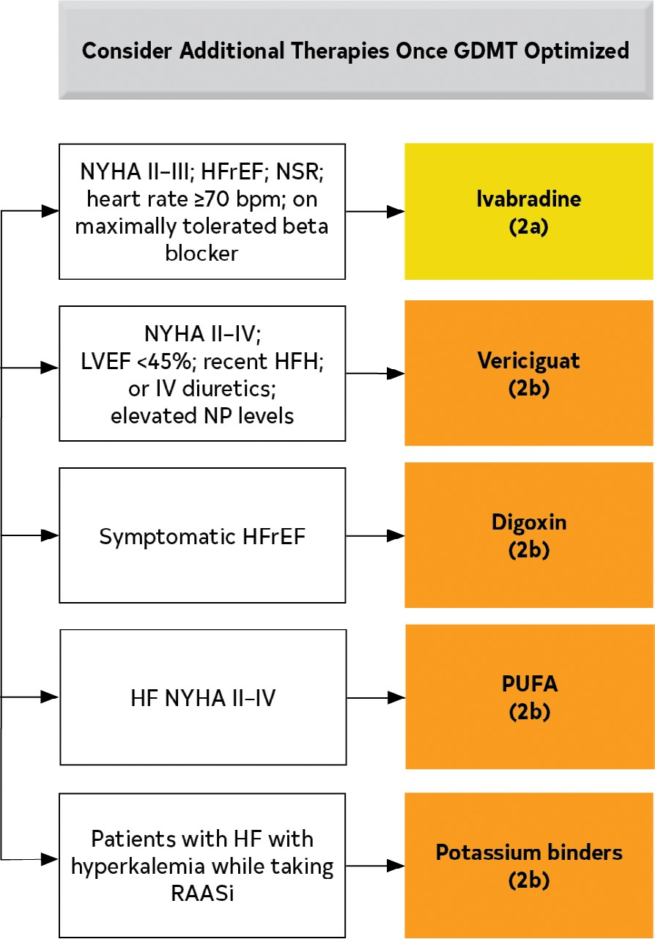

Slide 92
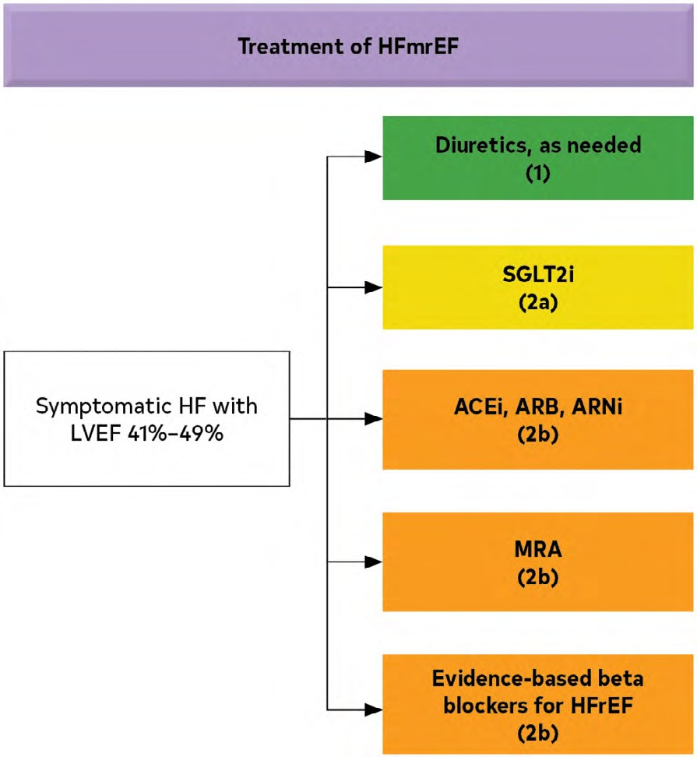
hfmref

Slide 93
HFimpEF
Recommendation for HF With Improved Ejection Fraction
COR | LOE | Recommendation
1 | B-R | 1. In patients with HFimpEF after treatment, GDMT should be continued to prevent relapse of HF and LV dysfunction, even in patients who may become asymptomatic.¹

Slide 94
Drugs to avoid in HF
Recommendations for Drugs of Unproven Value or Drugs That May Worsen H
COR | LOE | Recommendations
3: No Benefit | A | 1. In patients with HFrEF, dihydropyridine calcium channel-blocking drugs are not recommended treatment for HF.^{1,2}
3: No Benefit | B-R | 2. In patients with HFrEF, vitamins, nutritional supplements, and hormonal therapy are not recommended other than to correct specific deficiencies.^{3–9}
3: Harm | A | 3. In patients with HFrEF, nondihydropyridine calcium channel-blocking drugs are not recommended.^{10–13}
3: Harm | A | 4. In patients with HFrEF, class IC antiarrhythmic medications and dronedarone may increase the risk of mortality.^{14–16}
3: Harm | A | 5. In patients with HFrEF, thiazolidinediones increase the risk of worsening HF symptoms and hospitalizations.^{17–21}
3: Harm | B-R | 6. In patients with type 2 diabetes and high cardiovascular risk, the dipeptidyl pepti- dase-4 (DPP-4) inhibitors saxagliptin and alogliptin increase the risk of HF hospitaliza- tion and should be avoided in patients with HF_{HF.}22–24
3: Harm | B-NR | 7. In patients with HFrEF, NSAIDs worsen HF symptoms and should be avoided or withdrawn whenever possible.^{25–28}

Slide 95
HFpEF Treatment
Novartis PARAGON-HF trial suggests Entresto® benefit in HFpEF patients but narrowly misses primary endpoint

Slide 96
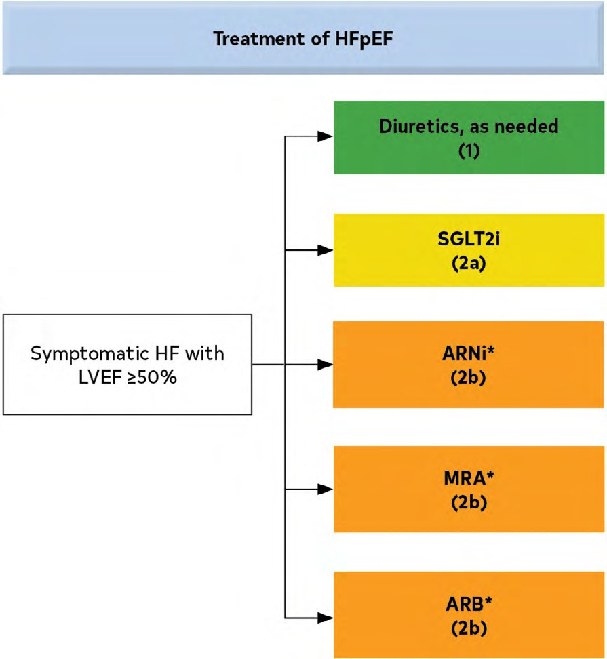
HFPEF
What do we know?
Don’t forget to treat what we can: HTN, DM, Obesity, OSA, ect.

Slide 97
Recommendations for HF With Preserved Ejection Fraction*
COR | LOE | Recommendations
1 | C-LD | 1. Patients with HFpEF and hypertension should have medication titrated to attain blood pressure targets in accordance with published clinical practice guidelines to prevent morbidity.^{1–3}
2a | B-R | 2. In patients with HFpEF, SGLT2i can be beneficial in decreasing HF hospitalizations and cardiovascular mortality.⁴
2a | C-EO | 3. In patients with HFpEF, management of AF can be useful to improve symptoms.
2b | B-R | 4. In selected patients with HFpEF, MRAs may be considered to decrease hospitalizations, particularly among patients with LVEF on the lower end of this spectrum.^{5–7}
2b | B-R | 5. In selected patients with HFpEF, the use of ARB may be considered to decrease hospitalizations, particularly among patients with LVEF on the lower end of this spectrum.^{8,9}
2b | B-R | 6. In selected patients with HFpEF, ARNi may be considered to decrease hospitalizations, particularly among patients with LVEF on the lower end of this spectrum.^{10,11}
3: No- Benefit | B-R | 7. In patients with HFpEF, routine use of nitrates or phosphodiesterase-5 inhibitors to increase activity or QOL is ineffective.^{12,13}

Slide 98
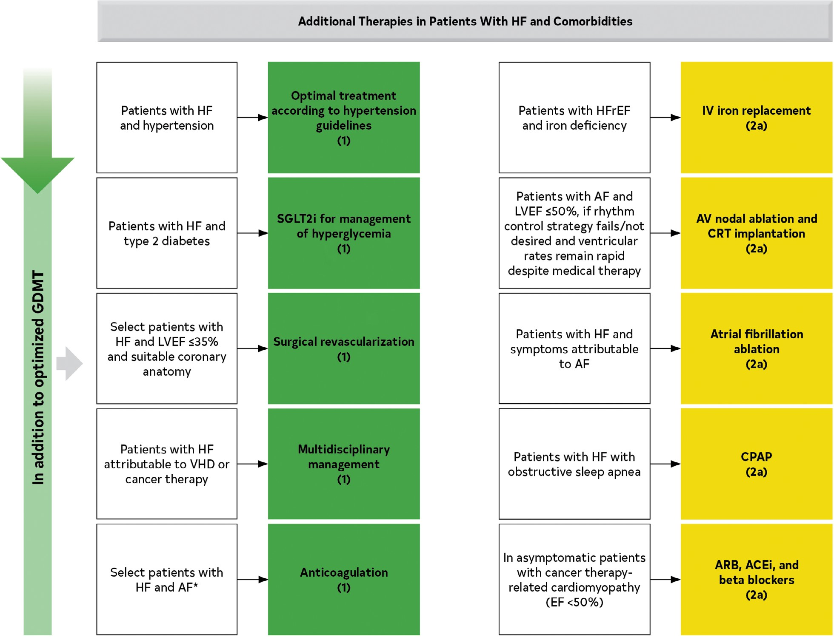

Slide 99


Slide 100

Advanced Heart failure management
2022 ACC/HFSA Guidelines
Douglas Blank, MD, FACC
Idaho Heart Institute

Slide 101
Part 4: ICD or CRT-D?

Slide 102
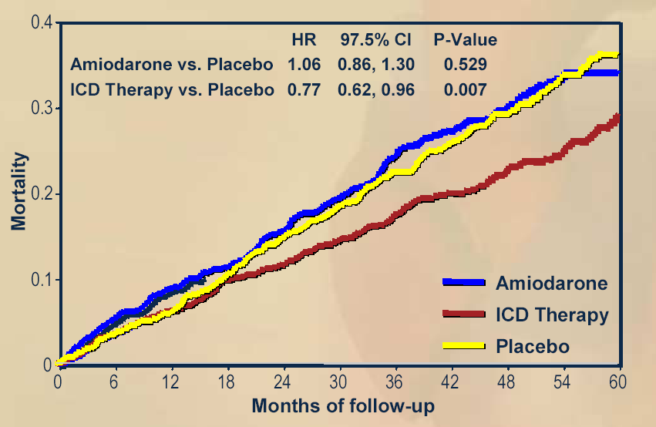
ICDs Improve Survival
MADIT II
SCDHeFT
1.0
0.9
ICD
0.8
0.7
Conventional
0.6
P = 0.007
0.0
0
1
2
3
4
Year
Moss AJ et al. N Engl J Med. 2002;346:877-83.
Bardy GH et al. N Engl J Med. 2005;352:225-37.

Slide 103
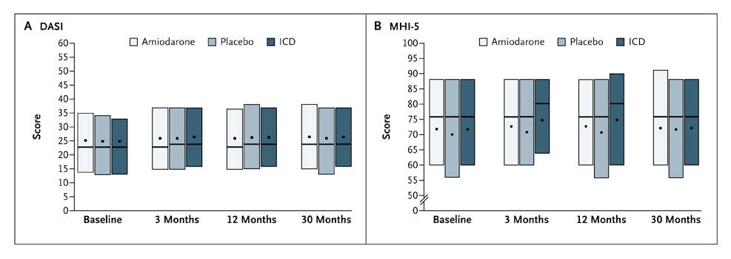
ICDs Do Not Improve Quality of Life
Duke Activity Status Index
Mental Health Inventory 5
Higher scores indicate better function
Mark DB et al. N Engl J Med 2008;359:999-1008.

Slide 104
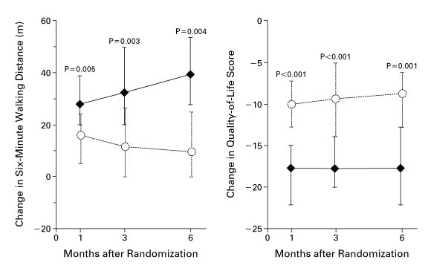
MIRACLE Study
CRT Improves Submaximal Exercise
and Quality of Life
Abraham WT et al. N Engl J Med, 2002; 346: 1845-1853.

Slide 105
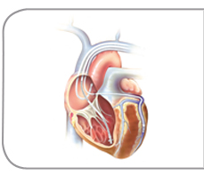
CRT (cardiac resynchronization therapy)
On good medical management
Reasonable expectation of survival of > 1 year
EF < 35% and QRS > 120 ms, LBBB
  PCI/CABG > 3 months
  No NYHA Class IV symptoms

Slide 106
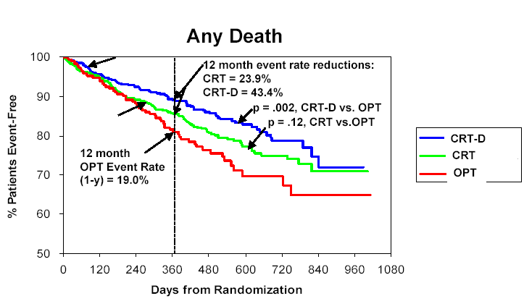
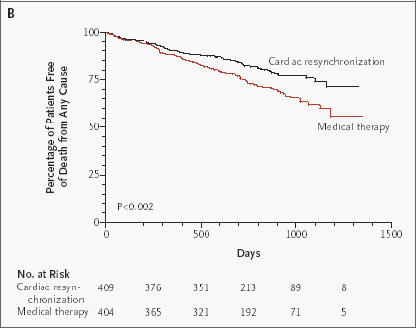
CRT Improves Survival
COMPANION
CARE-HF
Bristow MR et al. N Engl J Med. 2004; 350:2140-2150.
Cleland J et al. N Engl J Med 2005;353:1539-49.

Slide 107
When do I need to think about an ICD
On good medical management
  Betablockers
  ACE-I or ARBs
  Spironolactone
At least 90 days post medical management/PCI/CABG
LVEF < 35%
Reasonable expectation of survival of > 1 year

Slide 108
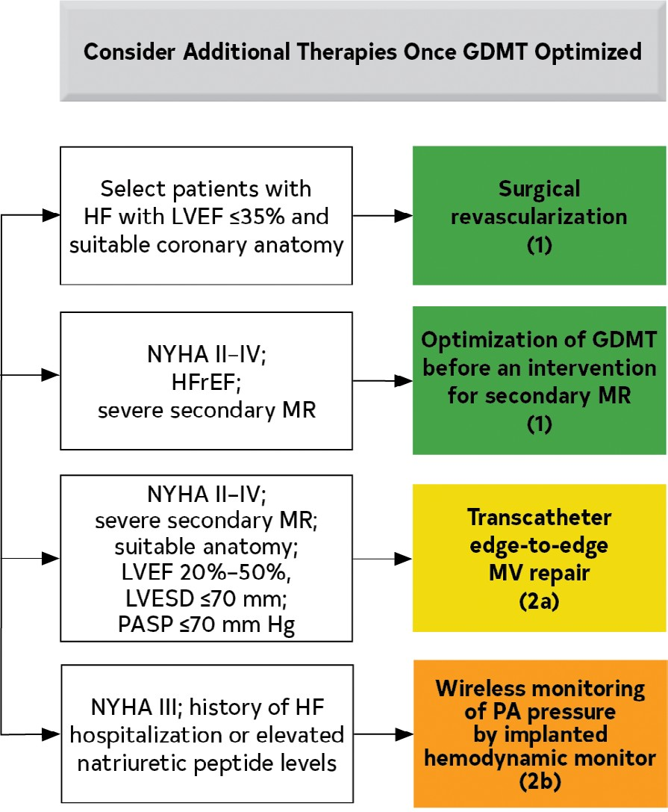

Slide 109
MV and HF
Recommendations for Valvular Heart Disease Referenced studies that support the recommendations are summa- rized in the Online Data Supplements.
COR | LOE | Recommendations
1 | B-R | 1. In patients with HF, VHD should be managed in a multidisciplinary manner in accordance with clini- cal practice guidelines for VHD to prevent wors- ening of HF and adverse clinical outcomes.^{1–11}
1 | C-LD | 2. In patients with chronic severe secondary MR and HFrEF, optimization of GDMT is recom- mended before any intervention for secondary MR related to LV dysfunction.^{3–5,12–14}

Slide 110
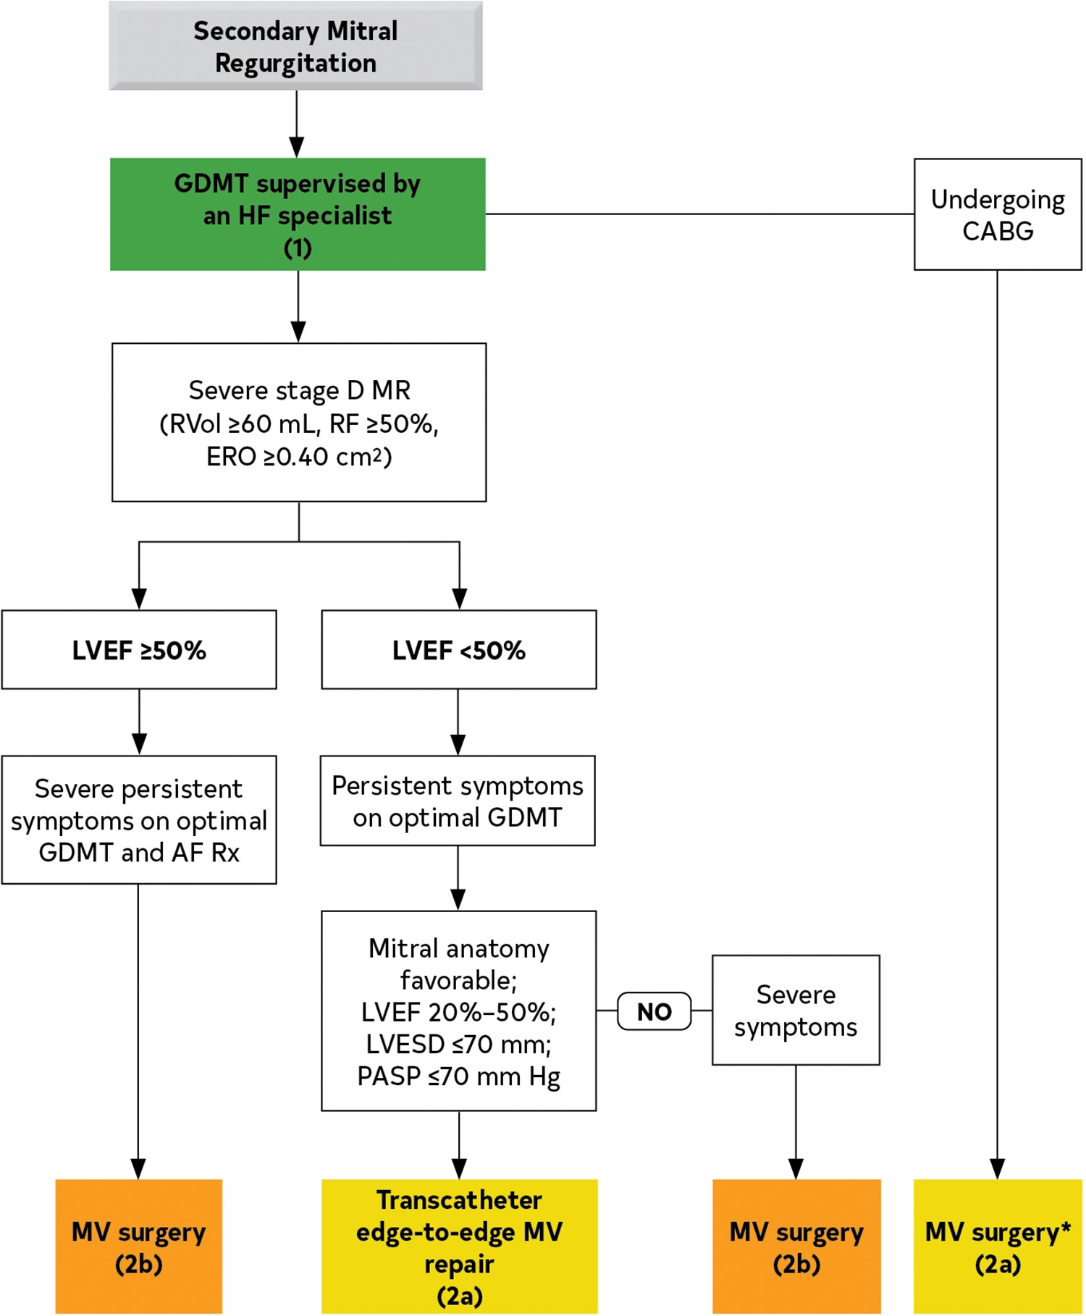

Slide 111
Part 5: Monitoring heart failure

Slide 112
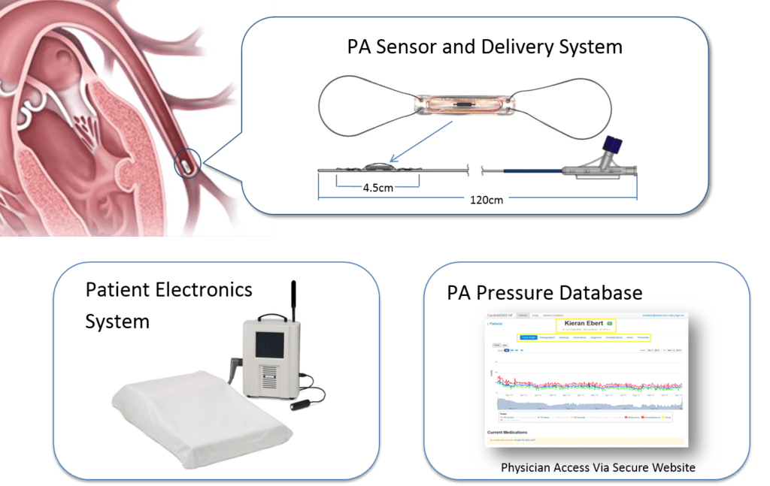
Cardiomems

Slide 113
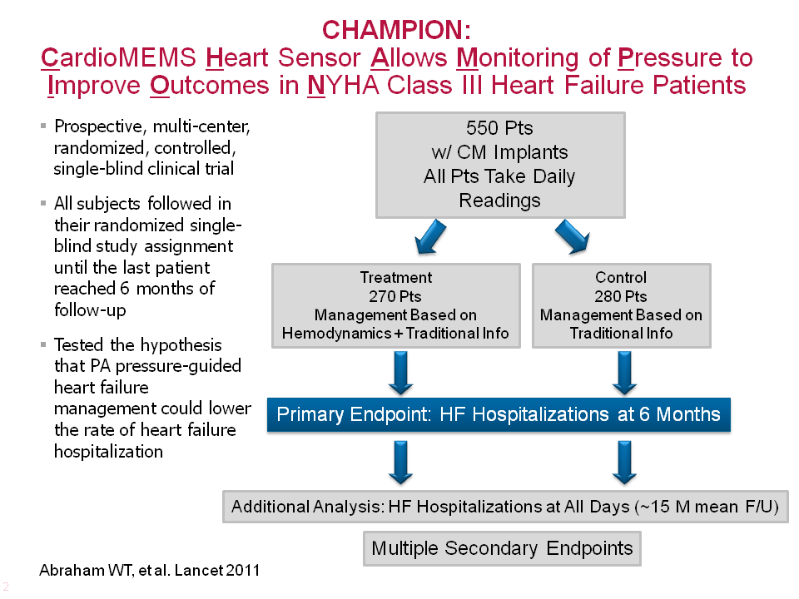

Slide 114
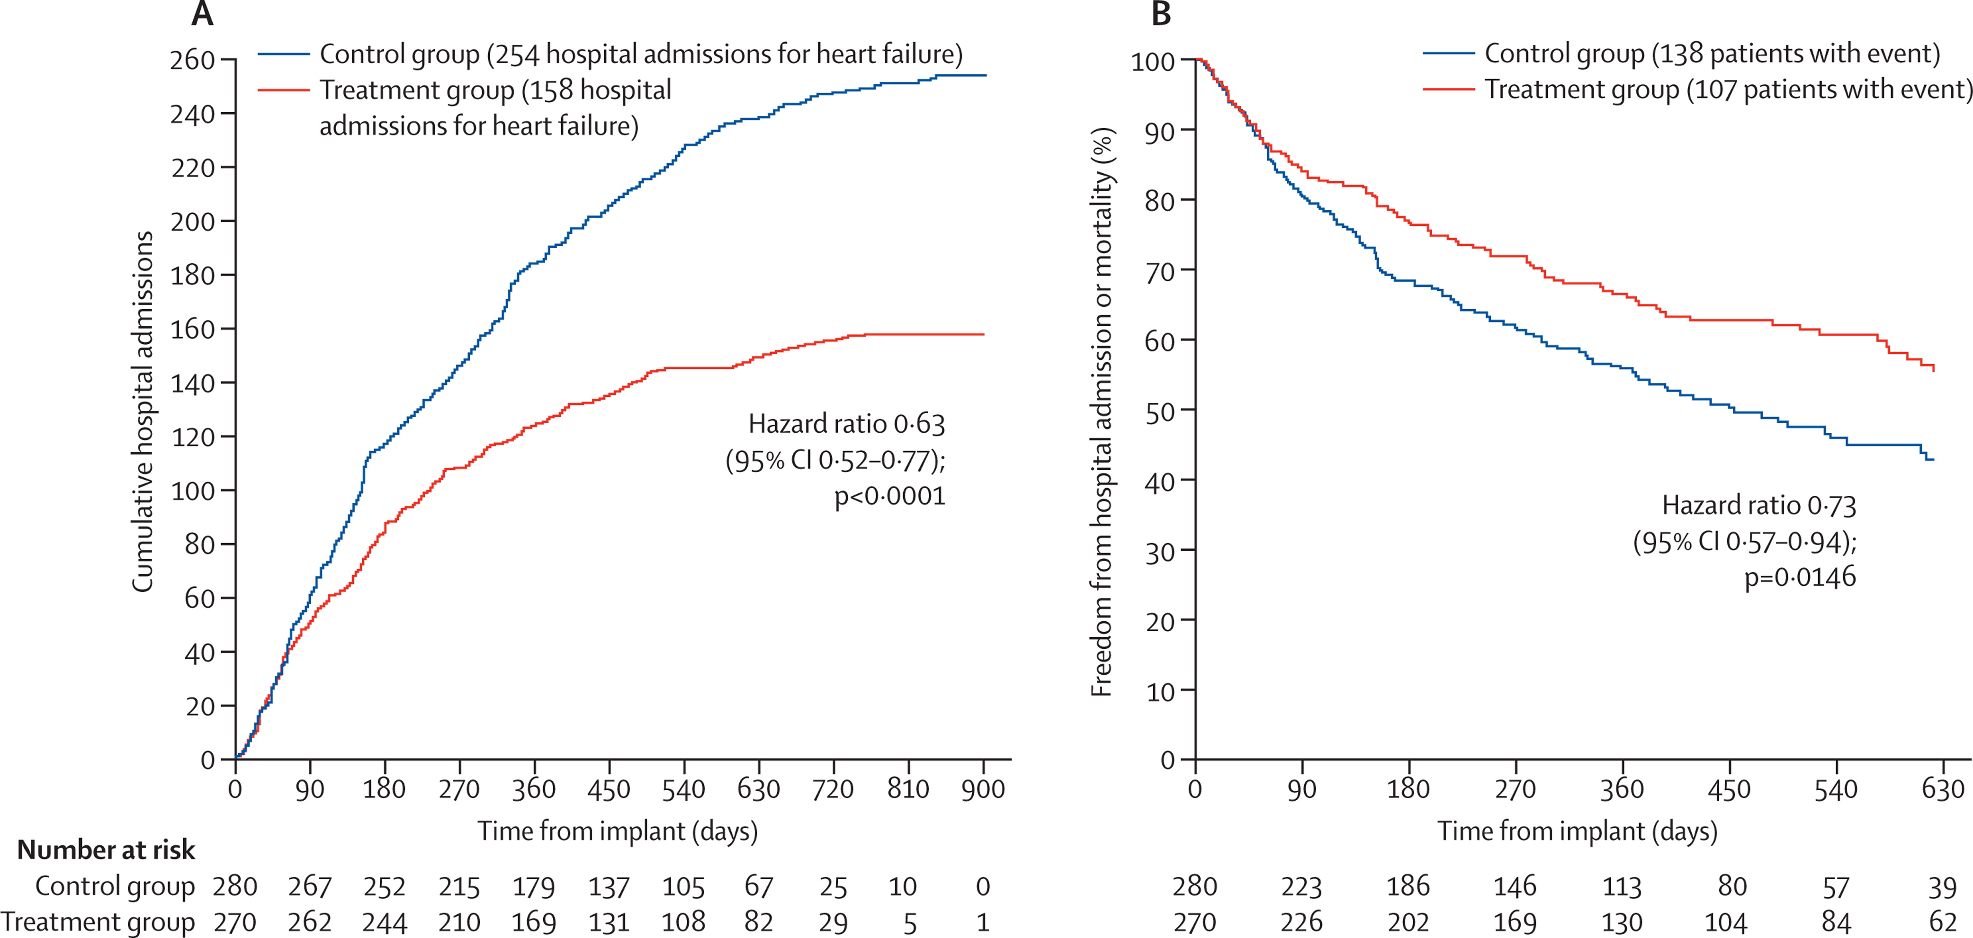
CHAMPION

Slide 115
4.6. Wearables and Remote Monitoring (Including Telemonitoring and Device Monitoring)
Recommendation for Wearables and Remote Monitoring (Including Telemonitoring and Device Monitoring) CARDIOMEMS
COR | LOE | Recommendation
2b | B-R | 1. In selected adult patients with NYHA class III HF and history of a HF hospitalization in the past year or elevated natriuretic peptide levels, on maximally tolerated stable doses of GDMT with optimal device therapy, the usefulness of wireless monitoring of PA pressure by an implanted hemodynamic monitor to reduce the risk of subsequent HF hospitalizations is uncertain.^{1–4}

Slide 116
Recommendations for Exercise and Functional Capacity Testing
COR | LOE | Recommendations
1 | C-LD | 1. In patients with HF, assessment and documentation of NYHA functional classification are recommended to determine eligibility for treatments.^{1–3}
1 | C-LD | 2. In selected ambulatory patients with HF, cardiopulmonary exercise testing (CPET) is recommended to determine appropriateness of advanced treatments (eg, LVAD, heart transplant).^{4–8}
2a | C-LD | 3. In ambulatory patients with HF, performing a CPET or 6-minute walk test is reasonable to assess functional capacity.^{4,5,9–16}
2a | C-LD | 4. In ambulatory patients with unexplained dyspnea, CPET is reasonable to evaluate the cause of dyspnea.^{17,18}

Slide 117
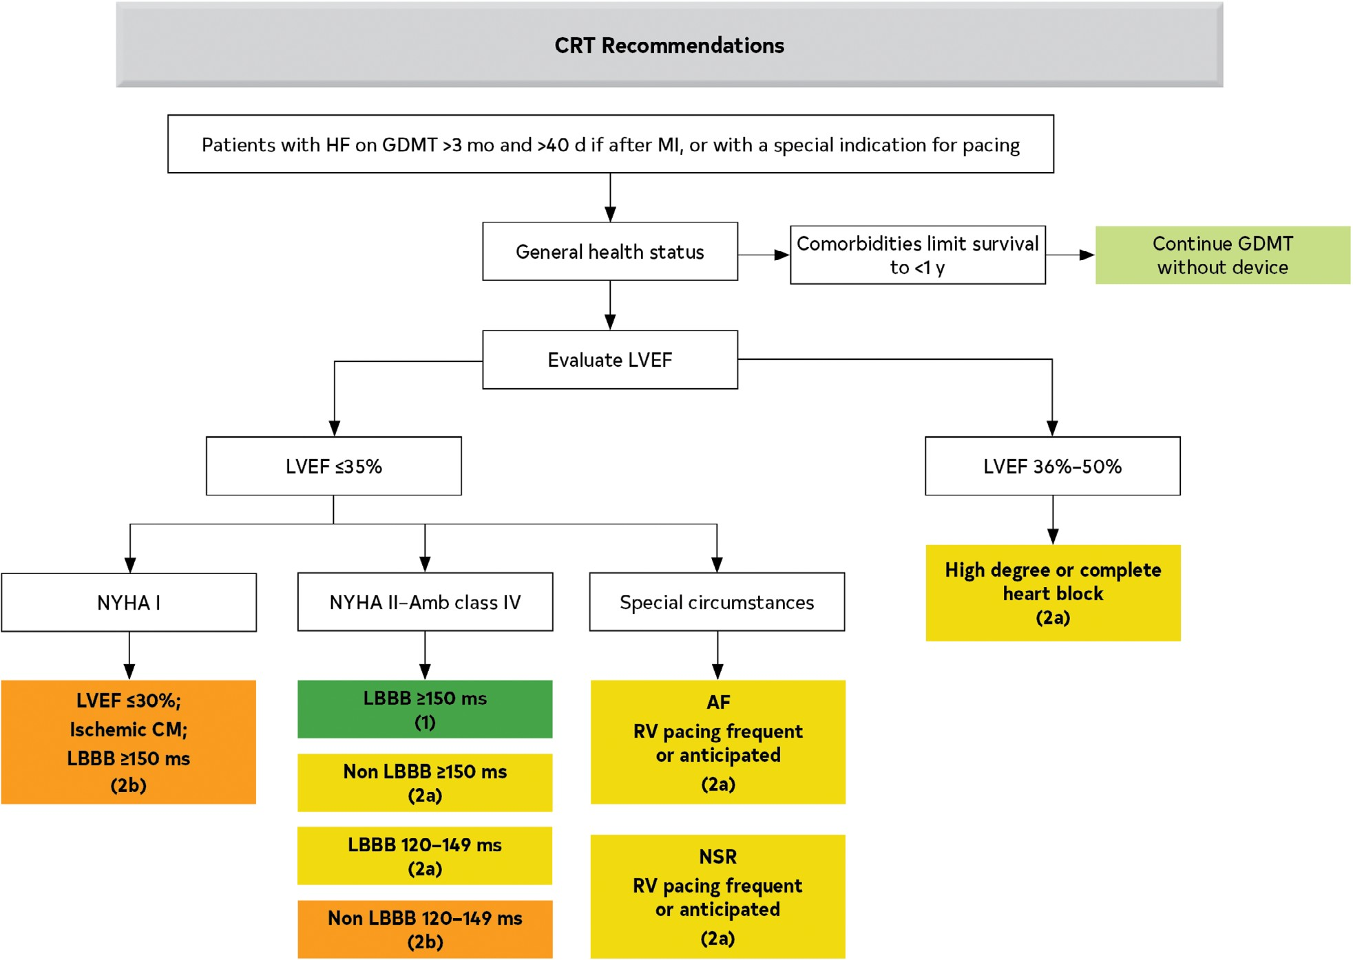

Slide 118


Slide 119
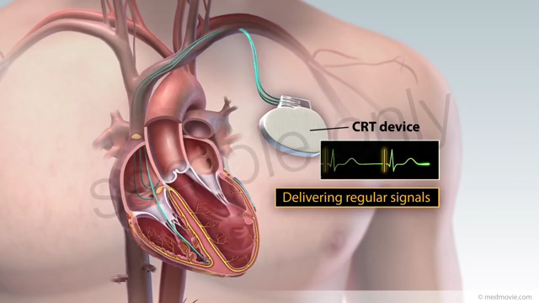
CRT-D

Slide 120
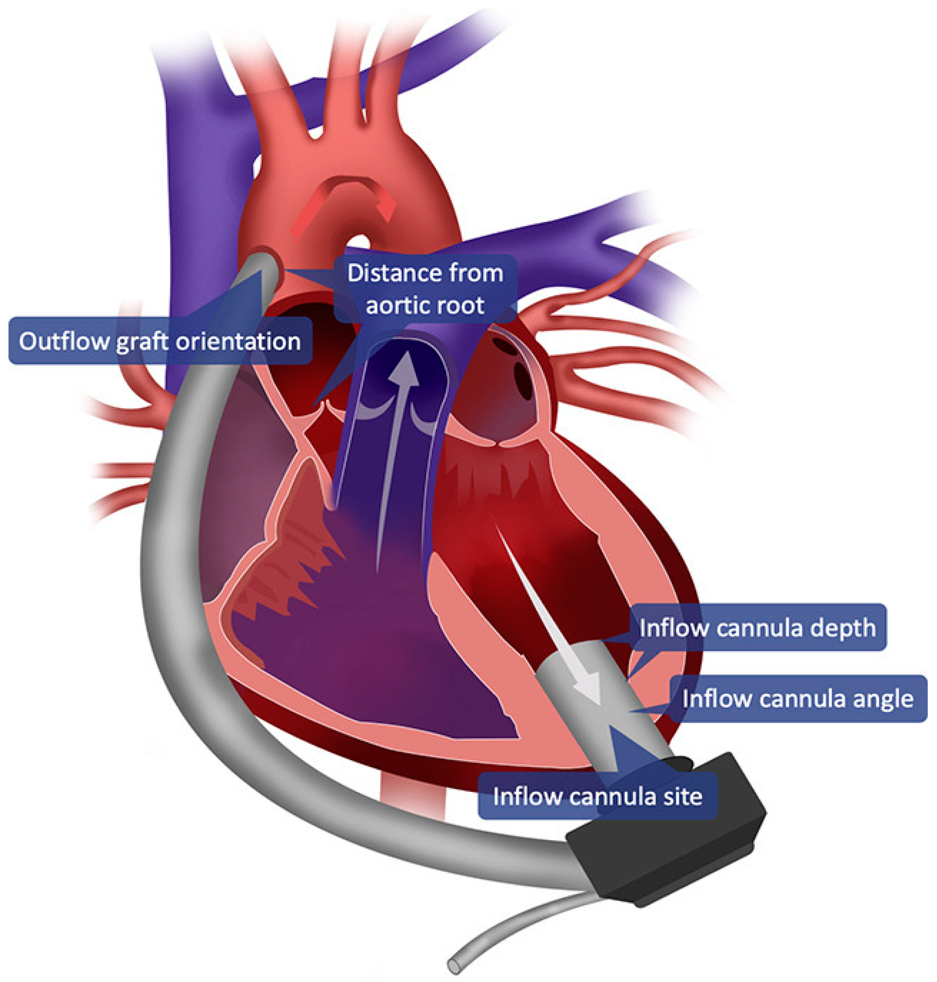

Slide 121
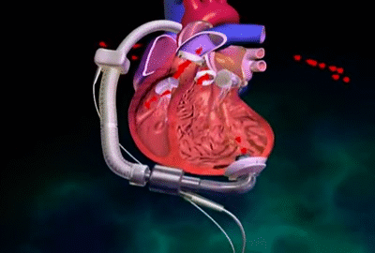

Slide 122
Where was the 1st heart transplant Performed?
On 3 December 1967, a large medical, nursing, and technical team led by the surgeon Christiaan Barnard performed the world's first human to human heart transplant, placing Groote Schuur Hospital in Cape Town, South Africa, on the international map. This led to unprecedented media coverage.

Slide 123

The landmark heart transplant performed at Stanford in 1968 ultimately led to the success of the operation around the world today. Fifty years ago, Norman Shumway, MD, PhD, a cardiothoracic surgeon at Stanford, performed the first successful human heart transplant in the United States at Stanford Hospital.

Slide 124


He has received the most acclaim amongst all of the previous inventors. In 1982, the first permanent artificial heart was transplanted into a 61-year-old patient named Barney Clark by surgeons at the University of Utah.

Slide 125

How long does a heart transplant live?
In general, though, statistics show that among all people who have a heart transplant, half are alive 11 years after transplant surgery. Of those who survive the first year, half are alive 13.5 years after a transplant.
For people with end-stage heart failure, a heart transplant is considered the "gold standard" treatment. A new study suggests that living for 15 to 20 years after a heart transplant is becoming the rule rather than the exception.
The longest surviving heart transplant patient is Harold Sokyrka (Canada, b. 16 January 1952), who has lived for 34 years and 359 days after receiving his transplant on 3 June 1986, in London, Ontario, Canada as verified on 28 May 2021.

Slide 126
Part 5: Advanced Therapies for Heart Failure

Slide 127
Stage D Heart Failure

Slide 128
Features of Stage D Heart Failure
Marked symptoms at rest or with any activity.
Despite optimal medical and device therapy.
Experience recurrent hospitalization.
Can not be discharged from the hospital without specialized interventions.
Typically these patients are “cold and wet” (low cardiac output + high filling pressures).

Slide 129
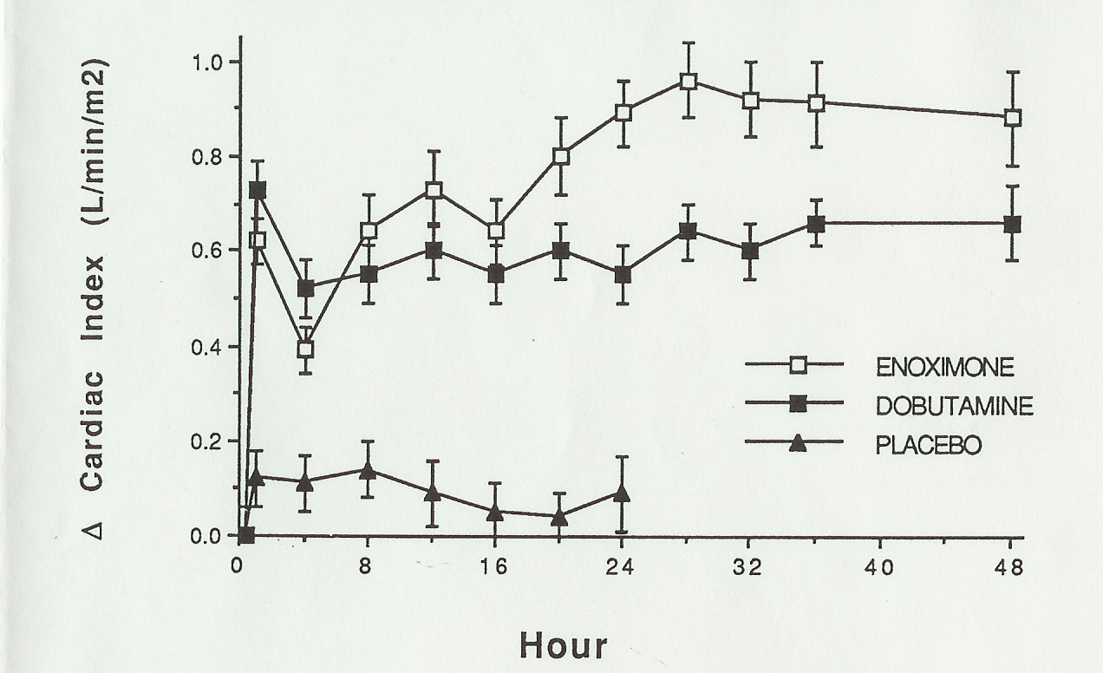
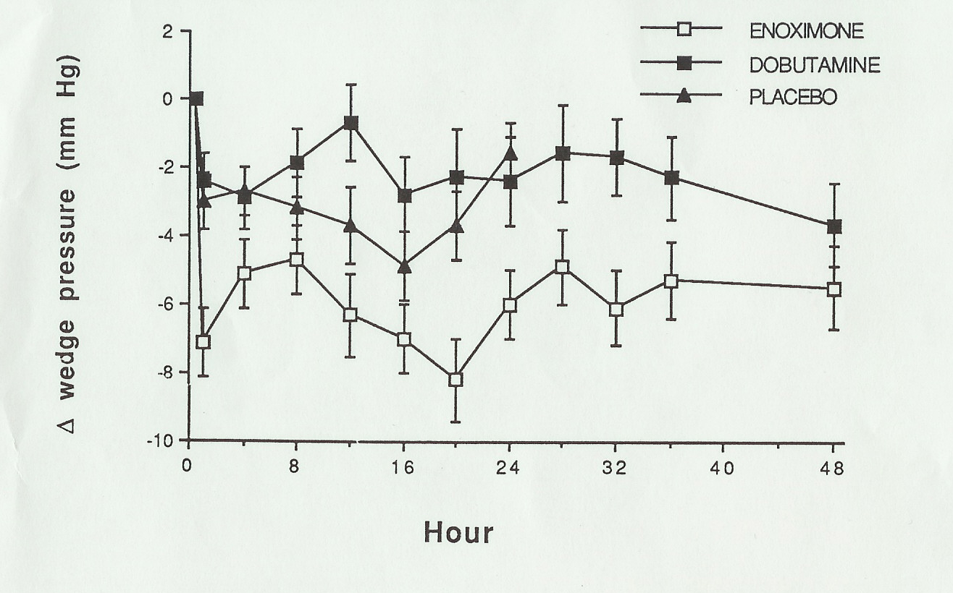
Inotropes Acutely Improve Hemodyamics
Dobutamine: β-Receptor Agonist
Enoximone: Phosdiesterase-3 Inhibitor
Bader FM, Gilbert EM et al. Congest Heart Failure, In Press.

Slide 130
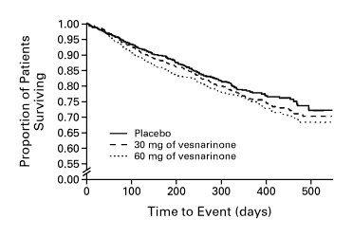
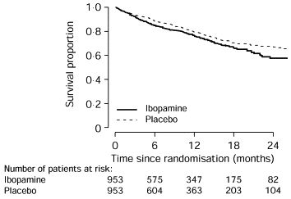
Chronic Inotrope Therapy Decreases Survival
VEST trial
PRIME II
RR = 1.21
p = 0.02
For 60 mg vs. placebo
RR = 1.26
p = 0.017
Cohn J et al. N Engl J Med 1998;339:1810-16.
Hampton JR et al. Lancet 1997;349:971-7.

Slide 131
If there is no current role for chronic inotrope therapy, then what can we do for patients with stage D heart failure?

Slide 132
Recommendation for Specialty Referral for Advanced HF
COR | LOE | Recommendation
1 | C-LD | 1. In patients with advanced HF, when consistent with the patient’s goals of care, timely refer- ral for HF specialty care is recommended to review HF management and assess suitability for advanced HF therapies (eg, LVAD, cardiac transplantation, palliative care, and palliative inotropes).^{1–6}

Slide 133
8.3. Inotropic Support
Recommendations for Inotropic Support Referenced studies that support the recommendations are summarized in the Online Data Supplements.
COR | LOE | Recommendations
2a | B-NR | 1. In patients with advanced (stage D) HF refrac- tory to GDMT and device therapy who are eligible for and awaiting MCS or cardiac trans- plantation, continuous intravenous inotropic support is reasonable as “bridge therapy.”^{1–4}
2b | B-NR | 2. In select patients with stage D HF, despite optimal GDMT and device therapy who are ineligible for either MCS or cardiac transplan- tation, continuous intravenous inotropic sup- port may be considered as palliative therapy for symptom control and improvement in func- tional status.^{5–7}
3: Harm | B-R | 3. In patients with HF, long-term use of either continuous or intermittent intravenous inotropic agents, for reasons other than palliative care or as a bridge to advanced therapies, is potentially _{harmful.}5,6,8–11

Slide 134
The evidence that cardiac transplantation provides a mortality and morbidity benefit to selected patients with stage D HF (refractory, advanced) is derived from observational cohorts. Datasets from the International Society for Heart and Lung Transplantation¹ and Unit- ed Network of Organ Sharing² document the median survival of adult transplant recipients to be now >12 years; the median survival of patients with stage D HF without advanced therapies is <2 years. For compari- son, the risk of death becomes greater than survival between 3 and 4 years on an LVAD, regardless of im- plant strategy (eg, bridge-to-transplant, bridge-to-de- cision, destination therapy).³ Improvements in pre- and posttransplant management have also increased more patients to be eligible for transplant, and treated rejec- tion rates in the first year after transplantation are now
<15%.¹ Minimizing waitlist mortality while maximizing posttransplant outcomes continues to be a priority in heart transplantation and was addressed with the re- cent changes in donor allocation policy instituted in 2018.⁵ Several analyses^{6–11} have confirmed a decrease in waitlist mortality as well as an increase in the use of temporary circulatory support devices, graft ischemic times, and distances between donor and recipient hos- pitals. The impact on posttransplant survival remains uncertain. Multiorgan transplantation remains uncom- mon and reserved for highly selected candidates. In 2018, 7% of all heart transplants involved another or- gan, in addition to the heart.¹

Slide 135
Recommendations for Evaluation and Management of Cardiogenic Shock Referenced studies that support the recommendations are summa- rized in the Online Data Supplements.
COR | LOE | Recommendations
1 | B-NR | 1. In patients with cardiogenic shock, intravenous inotropic support should be used to maintain systemic perfusion and preserve end-organ performance.1–8
2a | B-NR | 2. In patients with cardiogenic shock, temporary MCS is reasonable when end-organ function cannot be maintained by pharmacologic means to support cardiac function.9–17
2a | B-NR | 3. In patients with cardiogenic shock, manage- ment by a multidisciplinary team experienced in shock is reasonable.17–22
2b | B-NR | 4. In patients presenting with cardiogenic shock, placement of a PA line may be considered to define hemodynamic subsets and appropriate management strategies.23–27
2b | C-LD | 5. For patients who are not rapidly responding to initial shock measures, triage to centers that can provide temporary MCS may be consid- ered to optimize management.17–22

Slide 136
Does everyone with low EF need a heart transplant?

Slide 137
Case 1
52 yo male with long standing idiopathic cardiomyopathy with EF of 25%
On good max medical management and ICD
Cardiopulmonary stress test: VO2 Max of 11 (normal for him would be about 20 or greater)
Presents to clinic with continued worsening shortness of breath
https://youtu.be/ie_Ojh7FNbY

Slide 138
Case 2
32 yo male with newly diagnosed heart failure with reduced EF. His presenting symptoms to ER was “my abdomen is bloated’. Denies shortness of breath, chest pain, palpitations, syncope.
Workup negative for known etiologies (thyroid, HIV, drugs, alcohol, CAD, Chagas, hemochromotosis, viral illness)
Echo shows EF of 5-10%, no significant vavle abnormalites, no significant RV findings, no congenital defects

Slide 139
Features of Stage D Heart Failure
Marked symptoms at rest or with any activity.
Despite optimal medical and device therapy.
Experience recurrent hospitalization.
Can not be discharged from the hospital without specialized interventions.
Typically these patients are “cold and wet” (low cardiac output + high filling pressures).
Inotropes help short term but not long term

Slide 140
What else can we do for stage D heart failure?

Slide 141
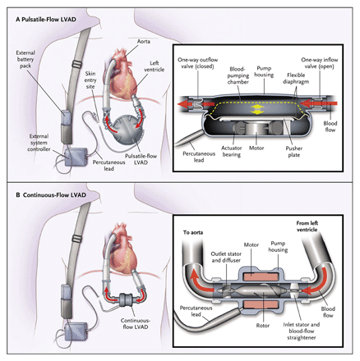
Left Ventricular Assist Devices

Slide 142
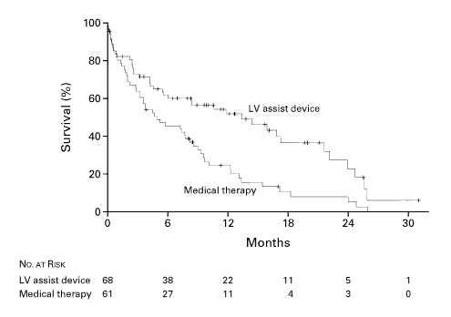
Survival in the REMATCH Trial
One Year Survival
LVAD: 52%
Medical therapy: 25%
(p = 0.002)
Two Year Survival
LVAD: 23%
Medical therapy: 8%
(p = 0.09)
LV assist device
Medical therapy
Rose EA et al. N Engl J Med 2001; 345: 1435-43.

Slide 143
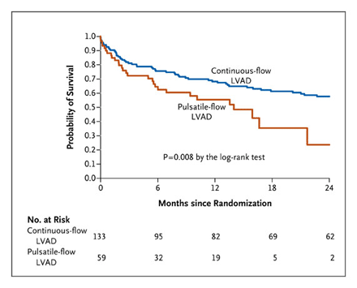
REMATCH 2 Survival
Slaughter MS et al. N Engl J Med 2009; 361:2241-51.

Slide 144
Role of Heart Transplantation in Heart Failure Management
A great option for highly selected candidates.
The number of Stage D heart failure patients who are not ready for hospice far exceeds the number of donor hearts.
Many patients are not eligible for transplantation because of other medical conditions (e.g. recent malignancy) or age.

Slide 145

NUMBER OF HEART TRANSPLANTS REPORTED BY YEAR
NOTE: This figure includes only the heart transplants that are reported to the ISHLT Transplant Registry. As such, the presented data may not mirror the changes in the number of heart transplants performed worldwide
ISHLT 2009 Update
Notes:
This figure includes only the heart transplants that are reported to the ISHLT Transplant Registry. As such, this should not be construed as evidence that the number of hearts transplanted worldwide has declined in recent years.

Slide 146
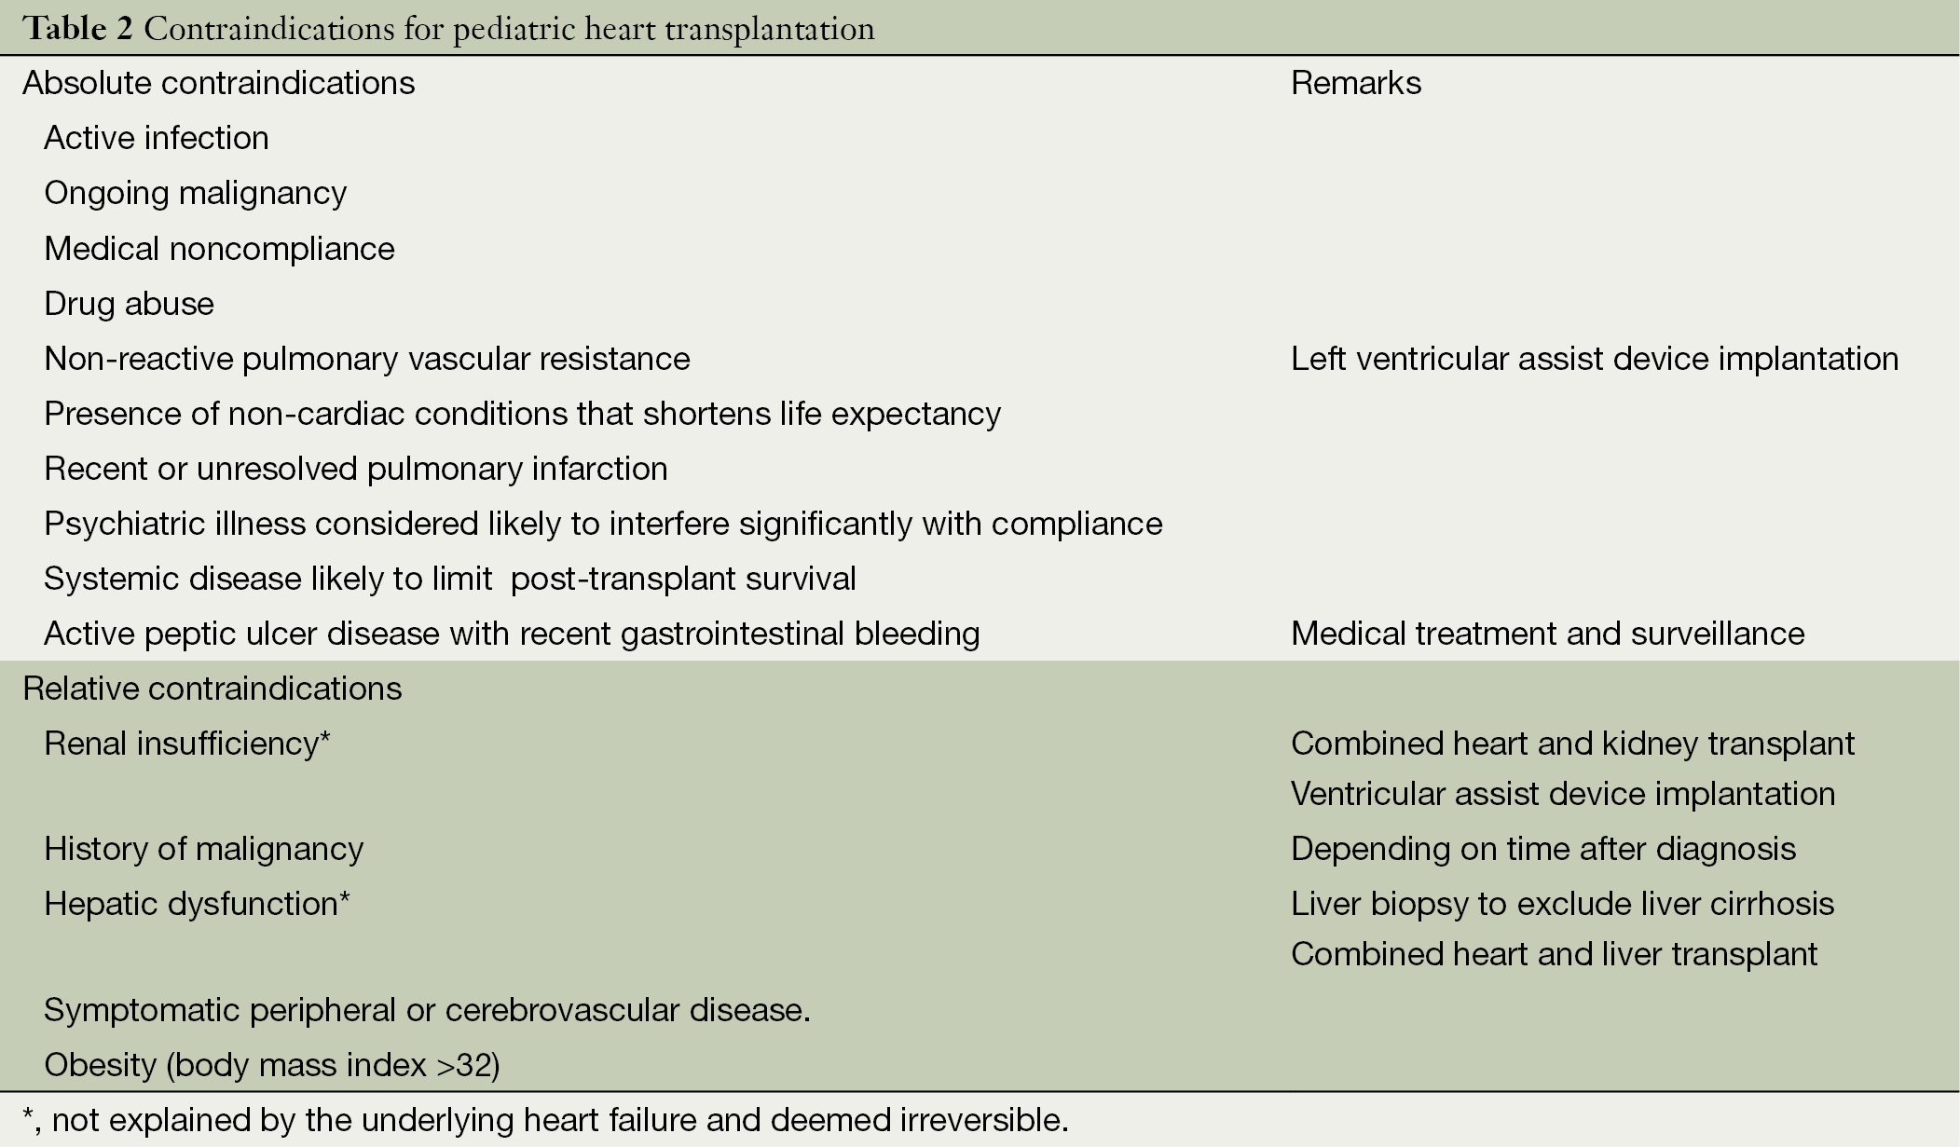

Slide 147
Proposed Statuses 1-3
Status Criteria
ECMO
Continuous Mechanical ventilation
Non-dischargeable (surgically implanted) VAD
MCSD with life-threatening ventricular arrhythmia
1
Intra-aortic balloon pump
Ventricular tachycardia/ventricular fibrillation, mechanical support not required
MCSD with device malfunction/mechanical failure
Total artificial heart
Dischargeable BiVAD or RVAD
Acute circulatory support
2
Dischargeable LVAD for up to 30 days
Multiple inotropes or single high-dose inotropes with continuous hemodynamic monitoring
MCSD with device infection
MCSD with hemolysis
MCSD with pump thrombosis
MCSD with right heart failure
MCSD with mucosal bleeding
MCSD with aortic insufficiency
3

Slide 148
Proposed Statuses 4-6
Status Criteria
Stable LVAD candidates not using 30 day discretionary period
Inotropes without hemodynamic monitoring
Diagnosis of congenital heart disease (CHD)
Diagnosis of ischemic heart disease with intractable angina
Diagnosis of hypertrophic cardiomyopathy
Diagnosis of restrictive cardiomyopathy
Diagnosis of amyloidosis
Retransplant
4
5 Combined organ transplants
6 All remaining active candidates

Slide 149
Limitations of the Current Medical
Management of Heart Failure
Many patients are still not receiving evidence based therapies.
Volume status is difficult to manage as an outpatient.
Clinically stable patients may die suddenly.
Some patients on optimal therapy will still progress to end-stage heart failure.

Slide 150
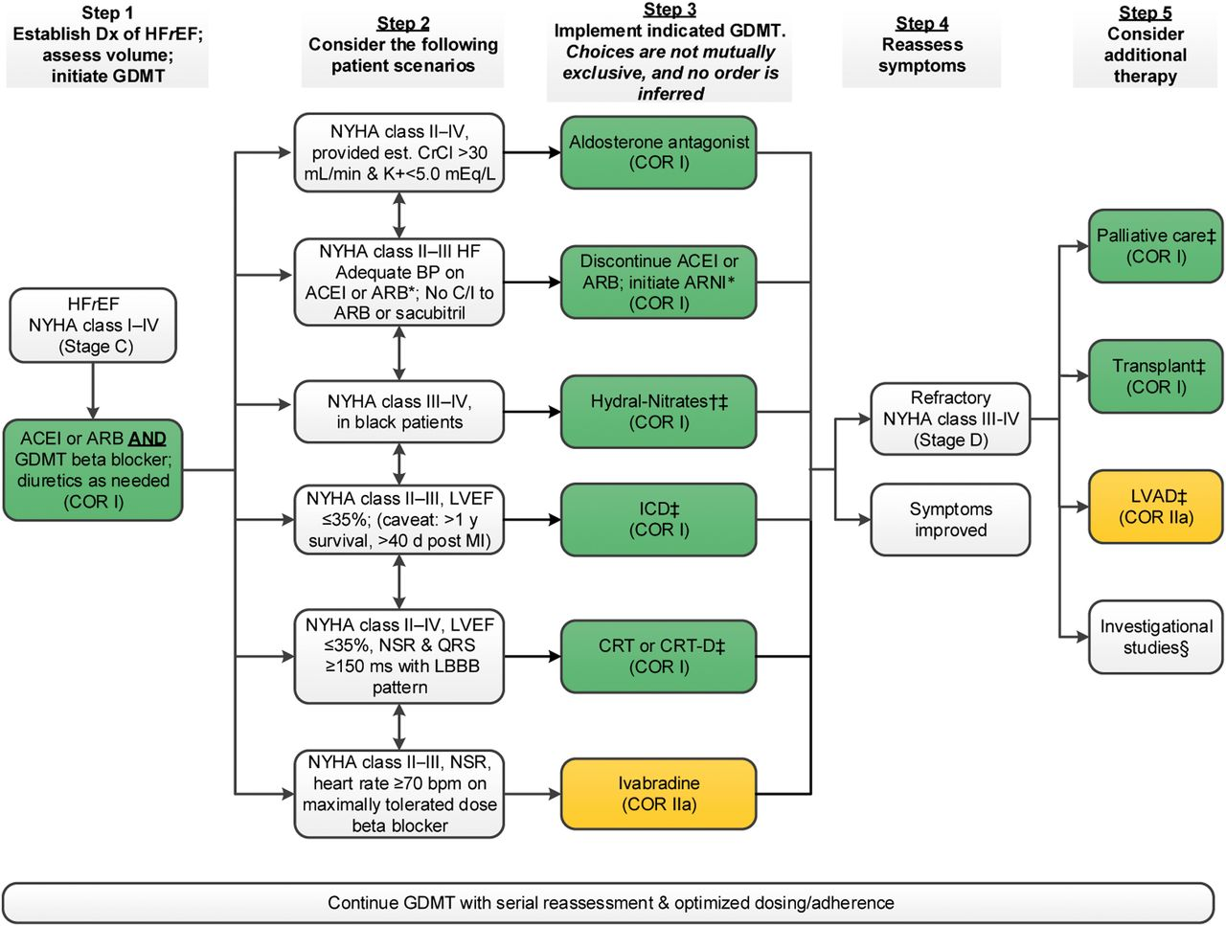

Clyde W. Yancy et al. JACC 2017;70:776-803
2017 American College of Cardiology Foundation, the American Heart Association, Inc., and the Heart Failure Society of America
Notes:
Treatment of HFrEF Stage C and D Colors correspond to COR in Table 1. For all medical therapies, dosing should be optimized and serial assessment exercised. *See text for important treatment directions. †Hydral-Nitrates green box: The combination of ISDN/HYD with ARNI has not been robustly tested. BP response should be carefully monitored. ‡See 2013 HF guideline (9). §Participation in investigational studies is also appropriate for stage C, NYHA class II and III HF. ACEI indicates angiotensin-converting enzyme inhibitor; ARB, angiotensin receptor-blocker; ARNI, angiotensin receptor-neprilysin inhibitor; BP, blood pressure; bpm, beats per minute; C/I, contraindication; COR, Class of Recommendation; CrCl, creatinine clearance; CRT-D, cardiac resynchronization therapy–device; Dx, diagnosis; GDMT, guideline-directed management and therapy; HF, heart failure; HFrEF, heart failure with reduced ejection fraction; ICD, implantable cardioverter-defibrillator; ISDN/HYD, isosorbide dinitrate hydral-nitrates; K+, potassium; LBBB, left bundle-branch block; LVAD, left ventricular assist device; LVEF, left ventricular ejection fraction; MI, myocardial infarction; NSR, normal sinus rhythm; and NYHA, New York Heart Association.

Slide 151
THANK YOU
QUESTIONS?

