Slide 1
Heart Failure Management
(2013 Guidelines)
+ 2 NEW FDA approved HF drugs and monitoring
Blake Wachter, MD, PhD
Idaho Heart Institute
Part A
February 12, 2016

Slide 2
Financial Disclosures
AMGEN, Corlanor (Ivabradine), speaker
NOVARTIS, Entresto (sacubitril/valsartan), speaker

Slide 3
Heart Failure: Significant Clinical and Economic Burden
Persons with HF in the US 5.1 million
  20% of Americans > 40yrs
Overall prevalence 2.7%
Incidence 650,000/year
Mortality in 2001 52,828
Cost $27.9 billion

Slide 4
What is heart failure?

Slide 5
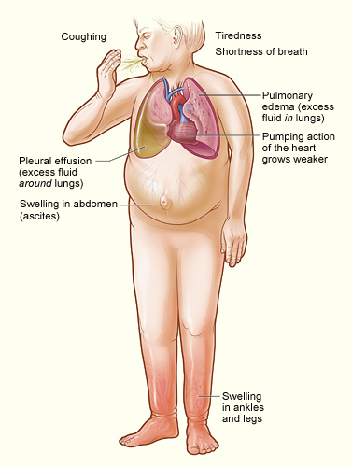
Heart Failure
Any structural or functional impairment of ventricular filling or ejection of blood
Symptoms
  Dyspnea
  Fatigue
  Decreased exercise tolerance
  Pulmonary congestion
  Splanchnic congestion
  Peripheral edema

Slide 6
Diagnosing heart failure
There is no single test or procedure to diagnosis heart failure
  Based on careful clinical history and physical exam
Heart failure is a catch all term
  Disorders of pericardium, myocardium, endocardium, heart valves, great vessels, metabolic abnormalities
  NOT synonymous for cardiomyopathy or LV dysfunction
Distinguish between reduced or normal ejection fraction
  Heart failure with reduced EF (HFrEF) < 45%
  Heart failure with preserved EF (HFpEF) > 55%

Slide 7
Diagnostic testing
Initial laboratory evaluation
  CBC
  U/A
  Basic metabolic panel with magnesium
  Fasting lipid profile
  Liver function tests
  TSH
Serial monitoring of electrolytes and renal function
ECG on first visit
Consider alcohol, drug, viral illness history

Slide 8

Looking for Zebras…
Rheumatological diseases
Amyloidosis
Pheochromocytoma
Hemochromatosis
Chagas
HIV

Slide 9
Biomarkers
BNP is useful to support HF diagnosis especially in the setting of clinical uncertainty
Measure of BNP useful for establishing prognosis or disease severity in chronic HF
Measurement of cardiac enzymes in acute decompensated patient
Can be used to guide therapy in select euvolemic patients in a well structured HF management program
Serial BNP measurements to reduce mortality or hospitalization has not been well established and is discouraged at EIRMC inpatient setting.

Slide 10
Non-invasive Cardiac Imaging
New onset or change in condition
  CXR
  Echo with Doppler
Assess goal directed medical therapy (needing an ICD?)
  Repeat echo
In the patient with known CAD with new or worsening HF (+/- symptoms) (Class IIa, level B)
  Consider non invasive imaging
Consider MRI if need to assess myocardial infiltrative processes or scar burden (Class IIa, level B)

Slide 11
Don’t routinely repeat the echo
No Benefit
  Routine repeat measurement of LV function in absence of clinical status change or treatment intervention (Class III)

Slide 12
Invasive Evaluation
Invasive monitoring with pulmonary artery catheter
  Acute decompensating patient
  Guide therapy (inotropes, vasodilators, pressors)
  Volume status is unknown
  Worsening renal failure
  Low systolic pressures
  Evaluation for mechanical circulation support (MCS) or transplant
Coronary angiogram
  In select patient if eligible for revascularization
Endomyocardial biopsy
  Select patients looking for specific diagnosis

Slide 13
AHA Classification of Heart Failure
 | Stage | Patient Description
A | High risk for developing heart failure (HF) | Hypertension CAD Diabetes mellitus Family history of cardiomyopathy
B | Asymptomatic HF | Previous MI LV systolic dysfunction Asymptomatic valvular disease
C | Symptomatic HF | Known structural heart disease Shortness of breath and fatigue Reduced exercise tolerance
D | Refractory end-stage HF | Marked symptoms at rest despite maximal medical therapy (eg, those who are recurrently hospitalized or cannot be safely discharged from the hospital without specialized interventions)
Hunt SA et al. J Am Coll Cardiol 2001;38:2101–2113.
Notes:
Stages A through D show the progressive nature of cardiovascular disease into refractory end-stage heart failure.
These patient types, especially Stage A, B, and C patients, are commonly seen by primary care physicians.

Slide 14
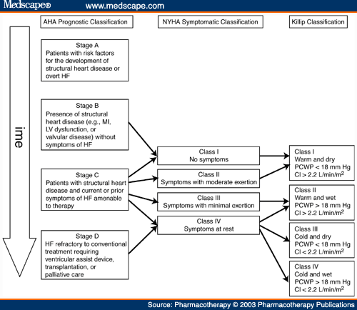

Slide 15
Treatment of chronic systolic heart failure
(HFrEF)

Slide 16
Stage A
Treat HTN
Treat lipid disorders
Address obesity
Control diabetes
Stop tobacco use
Avoid known cardiotoxic agents

Slide 17
Treatment of Stage B and C

Slide 18
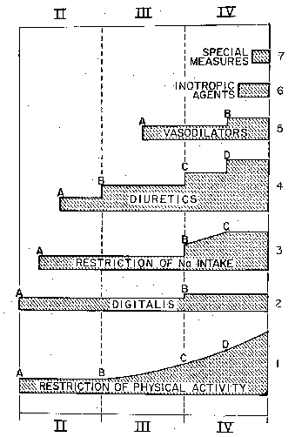
Medical Therapy of Heart Failure in 1984
Vasodilators
Diuretics
Digtalis
Restriction of Na⁺ Intake
Restriction of
Physical Activity
Functional Class
Brauwnwald E. Management of heart failure. Heart Disease 2nd ed. 1984; 503-550.

Slide 19

Diuretics

Slide 20
Diuretics and Heart Failure
No long-term studies of diuretic therapy for treatment of heart failure; its effects on morbidity and mortality are not known¹
Patients may become unresponsive to high doses of diuretic drugs if they
  consume large amounts of dietary sodium²
  Take agents that can block the effects of diuretics (e.g. NSAIDs)¹
  Have significant impairment of renal function or perfusion¹
Diuretic resistance can generally be overcome by
  IV administration of diuretics²
  using two or more diuretics in combination
¹Ravnan SL et al. Congest Heart Fail. 2002;8:80-85
² Brater DC. Drugs. 1985;30:427-443.
Notes:
Ravnan SL, Ravnan MC, Deedwania PC. Pharmacotherapy in congestive heart failure: diuretic resistance and strategies to overcome resistance in patients with congestive heart failure. Congest Heart Fail. 2002;8:80-85.
Brater DC. Resistance to loop diuretics. Why it happens and what to do about it. Drugs. 1985;30:427-443.

Slide 21
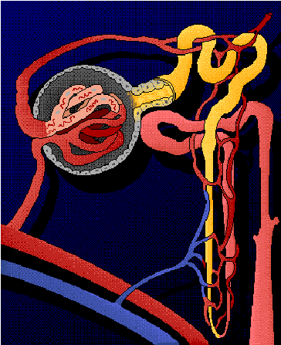
Location of Diuretic Action
Proximal Tubule
Carbonic anhydrase inhibitors
Distal Tubule
Thiazide diuretics
Collecting Duct
Vasopressin antagonists
Aldosterone antagonists
Ascending limb of Loop of Henle
Loop diuretics
Notes:
Diuretic resistance and refractoriness in heart failure patients is due to a number of factors
Avid sodium and water reabsorbtion in proximal tubule due to effects of angiotensin II (AII). Loop and thiazide diuretics work distal to proximal tubule, where majority of sodium and water has already been reabsorbed. Therefore, loop and thiazide diuretics have less substrate (tubular sodium and water) on which to exert their effects
Renal vasoconstriction mediated by norepinephrine, endothelin-1, and AII can lead to reduced GFR. As a result, ability of most diuretics to get to their site of action in renal tubules is reduced
High levels of aldosterone contribute (to a lesser extent) to sodium reabsorbtion
Weber KT. Aldosterone in congestive heart failure. N Engl J Med. 2001;345:1689-1697.
Francis GS, Goldsmith SR, Levine TB, Olivari MT, Cohn JN. The neurohumoral axis in congestive heart failure. Ann Intern Med. 1984;101:370-377.
Dzau VJ. Renal and circulatory mechanisms in congestive heart failure. Kidney Int. 1987;31:1402-1415.

Slide 22

Digoxin

Slide 23



Digitalis and the Treatment of Cardiac Dropsy
Dr. William Withering
1741 - 1799
17th Century patient
with severe dropsy
Foxglove
(Digitalis purpurea)
Withering W “An account of the foxglove and some of its medical uses;
with practical remarks on the dropsy, and some other diseases,” 1785

Slide 24
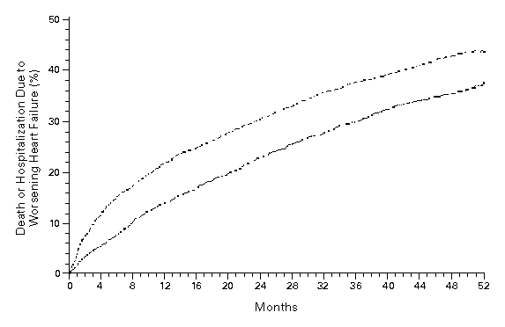
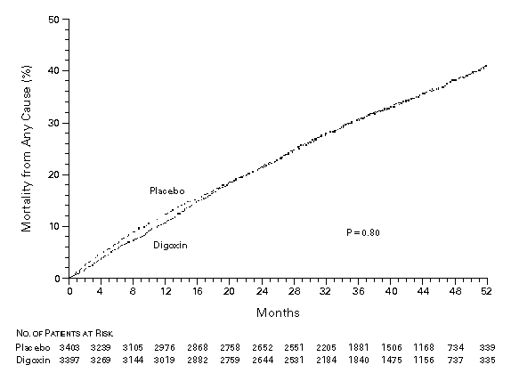
Effect of Digoxin Upon Clinical Outcomes in Subjects with Heart Failure
All Cause Mortality
Death or Hospitalization Due to HF
Placebo
Placebo
RR = 0.99
(0.91-1.07)
p = 0.80
RR = 0.85
(0.79-0.91)
p < 0.001
Digoxin
Digoxin
The Digitalis Investigator Group. N Eng J Med 1997; 336: 525-33.

Slide 25
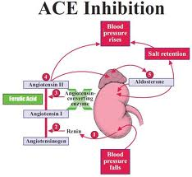
ACE Inhibitors

Slide 26
ACE Inhibition Improves Survival
SOLVD Treatment Trial
SAVE
50
30
Chronic HF
NYLVEF<35%
HA II-III
Placebo
(n=1284)
Acute MI
Asymptomatic
LV dysfunction
Placebo
(n=1116)
40
20
30
% Mortality
Enalapril
(n=1285)
Captopril
(n=1115)
20
10
10
p=0.019
P=0.0036
0
0
0
12
24
36
48
0
1
2
3
4
Months
Years
SOLVD Investigators. N Engl J Med 1991;325:293-302.
Pfeffer MA et al. N Engl J Med 1992;327:669-77.

Slide 27
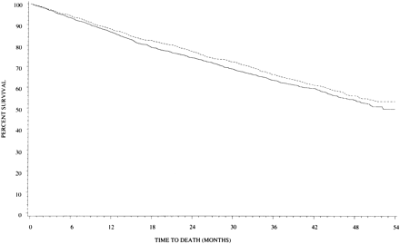
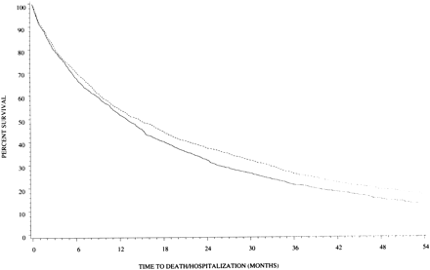
Effect of High Versus Low Dose
Lisinopril on Clinical Outcomes
ATLAS Trial
Low Dose (n = 1596): 2.5 to 5 mg daily (average = 4.5 + 1.1)
High Dose (n = 1568): 32.5 to 35 mg daily (average = 33.2 + 5.4)
All Cause Mortality
All Cause Mortality + Hospitalization
HR = 0.88 (0.82-0.96)
p = 0.002
High Dose
Low Dose
Survival (%)
Survival (%)
High Dose
HR = 0.92 (0.82-1.03)
p = 0.128
Low Dose
Follow-up (Months)
Follow-up (Months)
Follow-up (Months)
Follow-up (Months)
Packer M et al. Circulation 1999;100:2312-18.

Slide 28
ACEI is Superior to Vasodilator Therapy in Chronic Heart Failure
VHeFT II
0.75
0.54
Isosorbide +
Hydralazine
0.46
0.5
0.48
0.36
0.42
Enalapril
Mortality
0.25
0.31
0.25
0.13
RR = 28%
p = 0.016
0.18
0
0.09
0
0
0
12
24
36
48
60
Months
Cohn JN et al. N Engl J Med 1991;325:303-10.

Slide 29
ARB Improves Outcomes in ACEI Intolerant Patients
%
50
Placebo (n = 1013)
(40.0%)
40
(33.0%)
30
CV death or CHF hospitalisation
Candesartan (n = 1015)
20
10
HR 0.77 (95% CI 0.67-0.89), p=0.0004
Adjusted HR 0.70, p<0.0001
0
0
1
2
3
3.5
years
Granger CB et al. Lancet 2003;362:772-6.

Slide 30
Beta Blockers

Slide 31
Beta-Blockade Improves Survival
Advanced Heart Failure
Copernicus (n = 2289)
Post Myocardial Infarction
Capricorn (n= 1959)
100
1
90
0.95
RR=23%
P=.031
Carvedilol
0.9
80
% Survival
Placebo
0.85
Carvedilol
70
0.8
Placebo
35% ↓ in risk
P=.00013 (unadjusted)
P=.0014 (adjusted)
60
0.75
0
0.7
0
3
6
9
12
15
18
21
0
0.5
1
1.5
2
2.5
Months
Years
Packer M et al. N Engl J Med 2001;344:1651-8.
CAPRICORN Investigators. Lancet 2001;357:1385–90.

Slide 32
Major Trials of β-Blockade in Heart Failure
Trial Drug Mortality Reduction
US Carvedilol Program* carvedilol ↓ 65% (P<0.001)
1094 patients (Class II–IV)
CIBIS-II Trial HF² bisoprolol ↓ 34% (P<0.0001)
2647 patients (Class III–IV)
MERIT-HF metoprolol ↓ 34% (P=0.0062)
3991 patients (Class II–IV) succinate
BEST bucindolol ↓ 10% (P=0.109)
2708 patients (Class III–IV)
COPERNICUS carvediolol ↓ 35% (P=0.00014)
2289 patients (Class III-IV)
SENIORS* nebivolol ↓ 12% (P=0.21)
2128 patients (Class II-IV)
*Mortality not the primary efficacy endpoint in these trials

Slide 33
Effects of Metoprolol Tartrate and
Carvedilol on Mortality in Heart Failure
COMET
40
Metoprolol ( n = 1511)
30
Percent Mortality (%)
20
Carvedilol (n = 1518)
Hazard ratio 0.83,
95% CI 0.74-0.93, P = 0.0017
10
0
0
1
2
3
4
5
Time (years)
Poole-Wilson PA et al. Lancet 2003;362:7-13.

Slide 34
Impact of ACE Inhibition and β-Blockade on Annual Survival in Heart Failure
20
15.6%
Mortality
Reduced
50%!
12.4%
11.9%
Annual Mortality (%)
10
7.8%
Digoxin,
Diuretic
Digoxin,
Diuretic
+
ACEI
Digoxin,
Diuretic,
ACEI
Digoxin,
Diuretic,
ACEI
+
β-Blocker
Placebo
Active Treatment
0
SOLVD
Treatment
CIBIS-II +
MERIT-HF

Slide 35
Aldosterone antagonist

Slide 36
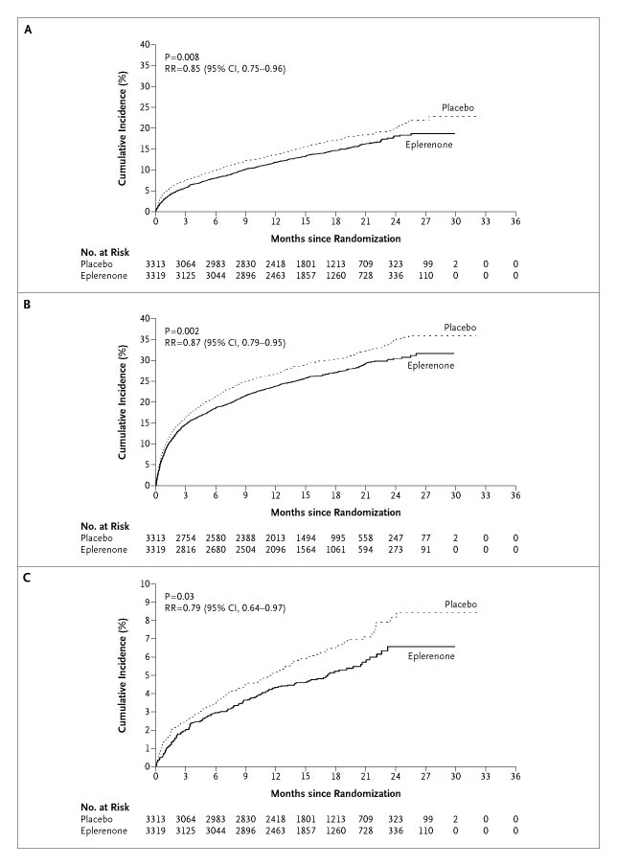
Aldosterone Antagonists Improve Survival
Advanced Heart Failure
RALES
Post Myocardial Infarction
EPHESUS
1.00
0.95
0.90
RR = 0.85 (0.75-0.96)
P = 0.008
RR = 0.85 (0.75-0.96)
P = 0.008
0.85
0.80
Placebo
0.75
Placebo
0.70
Spironolactone
0.65
0.60
Eplerenone
Eplerenone
0.55
Placebo
0.50
RR = 0.70 (0.60-0.82)
P < 0.001
0.45
0.00
0
3
6
9
12
15
18
21
24
27
30
33
36
Months Follow-up
Months Follow-up
Pitt B et al. N Engl J Med. 1999;341:709–717.
Pitt B et al. N Engl J Med 2003;348:1309-21.

Slide 37
Is there a role for aldosterone antagonists in chronic NYHA class II systolic heart failure?
Breaking News May, 2011:
EMPHASIS-HF (eplerenone verus placebo) terminated early by DSMB because of a significant reduction in the primary endpoint of cardiovascular death or heart failure hospitalization

Slide 38
Stage D Heart Failure

Slide 39
Features of Stage D Heart Failure
Marked symptoms at rest or with any activity.
Despite optimal medical and device therapy.
Experience recurrent hospitalization.
Can not be discharged from the hospital without specialized interventions.
Typically these patients are “cold and wet” (low cardiac output + high filling pressures).

Slide 40
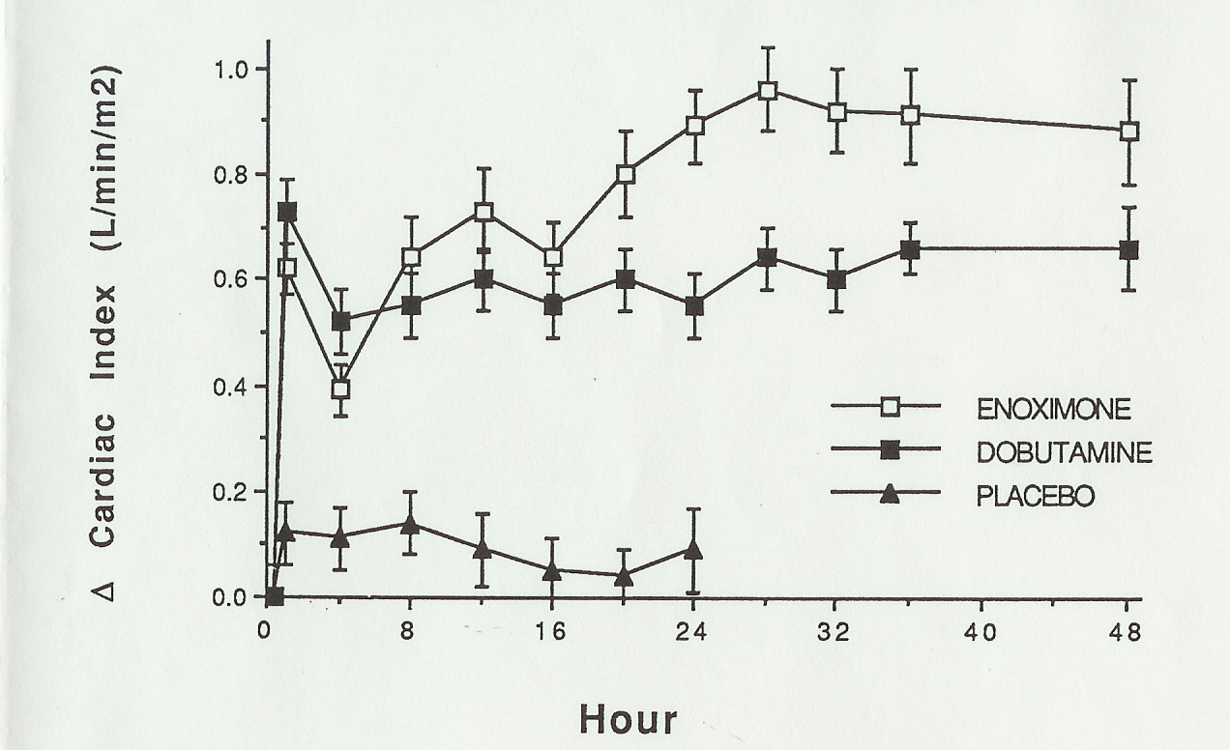
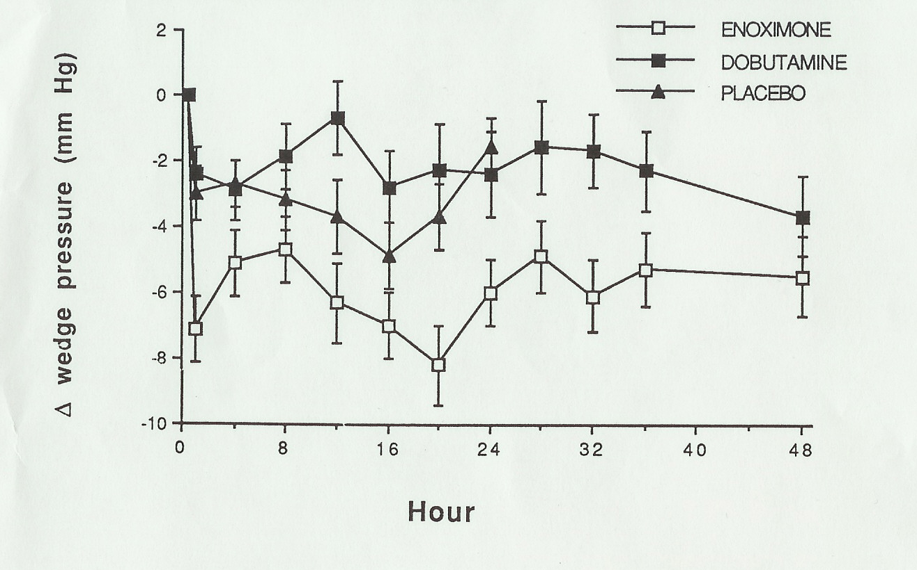
Inotropes Acutely Improve Hemodyamics
Dobutamine: β-Receptor Agonist
Enoximone: Phosdiesterase-3 Inhibitor
Bader FM, Gilbert EM et al. Congest Heart Failure, In Press.

Slide 41
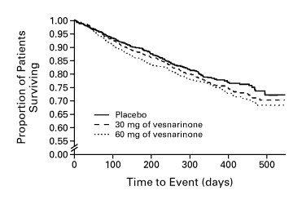
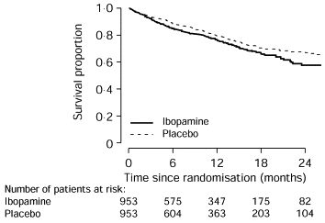
Chronic Inotrope Therapy Decreases Survival
VEST trial
PRIME II
RR = 1.21
p = 0.02
For 60 mg vs. placebo
RR = 1.26
p = 0.017
Cohn J et al. N Engl J Med 1998;339:1810-16.
Hampton JR et al. Lancet 1997;349:971-7.

Slide 42
If there is no current role for chronic inotrope therapy, then what can we do for patients with stage D heart failure?
(stay tuned for PART B)

Slide 43
Limitations of the Current Medical
Management of Heart Failure
Many patients are still not receiving evidence based therapies.
Volume status is difficult to manage as an outpatient.
Clinically stable patients may die suddenly.
Some patients on optimal therapy will still progress to end-stage heart failure.

Slide 44
NEW THERAPIES

Slide 45
IVABRADINE

Slide 46
Elevated Resting Heart Rate
Accelerates production of atherosclerosis (Int J Cardiol 2008;126:302-12)
Associated with coronary plaque disruption (Circulation 2001;126:1477-82)
Framingham Study
  progressive increase in all cause and cardiovascular mortality in relation
  to antecedent HR (Am Heart J 1987; 113:1489-94)
Continuous increase in death rates in survivors of Acute MI
starting at HR > 70 (J Am Coll Cardiol 2007;50:823-30)
Elevated HR (> 100 bpm) post heart transplant pts have worse outcomes with regard to 10-yr all cause mortality (WACHTER, et.al. Clin Transplant. 2015 Sep;29(9):829-34.)
46
Notes:
Circ journal: Heart rates greater than 80.

Slide 47
Beta Blockers (BB)
B1→ negative chronotropy and inotropy
        → AV conduction delay
        → Reduced atrial and ventricular arrythmias
B2→ Bronchoconstriction
        → Peripheral unopposed alpha constriction
        → Decrease glycogenolysis
        (contribute to hypoglycemic events)
Other → antagonize release of renin
→ reduces intraocular pressures
47
Notes:
Alpha constriction, which at least initially increases peripheral resistance, but also of potential concern in cocaine users.
Glycogenolysis, particularly in Type I diabetics
Renin, thereby altering the renin-angiotensin pathway

Slide 48
Impact of BB
Acute MI
  Norwegian Multicenter Study Group Timolol
  CAPRICORN
  ISIS-1
CHF
  COPERNICUS
  MERIT-HF
48
Notes:
Norwegion: AMI, given Timilol for up to 33 months, showing reduced mortality in the Timolol group.
CAPRICORN, AMI and EF lower than 40%→ BB reduced all cause mortality
ISIS-1, Atenolol vs placebo during hospitalization for AMI (16,000 patients). Showed reduced in-hospital mortality.
COPPERNICUS, Carvedilol in patients with EF less than 25%, reduced severity of HF and hospitalizations
MERIT-HF: Metoprolol XL vs placebo, 4000 patients with Class II-IV HF, EF of less than 40%, stopped early due to mortality benefit with Metoprolol

Slide 49
Intolerance of BB
Side effects
  Bronchoconstriction, AV delay, reduced insulin sensitivity
  Weight gain, depression, fatigue, exercise tolerance
BB may not be tolerated in high enough doses to attain
heart rates below 70 bpm
49
Notes:
Target doses for many studies are between 150 to 200mg of metoprolol daily.

Slide 50
IVABRADINE: First in class HCN channel blocker
Blocks the hyperpolarization-activated cyclic nucleotide-gated (HCN) channel responsible for the cardiac pacemaker (affects the If current)
Inward flow of positively charged ions that initiates the spontaneous diastolic depolarization phase, modulating heart rate
Lowers heart rate with NO effect on ventricular repolarization or myocardial contractility
Size of effect of ivabradine is dependent on baseline heart rate.

Slide 51
I_{f} Current
The funny current is highly expressed in spontaneously active cardiac regions, such as the sinoatrial node (SAN, the natural pacemaker region), the atrio-ventricular node (AVN) and the Purkinje fibres of conduction tissue.
Particularly unusual, the funny current is a mixed sodium-potassium current, inward and slowly activating on hyperpolarization at voltages in the diastolic range (normally from -60/-70 mV to -40 mV).
When at the end of a sinoatrial action potential the membrane repolarizes below the If threshold (about -40/-50 mV), the funny current is activated and supplies inward current, which is responsible for starting the diastolic depolarization phase (DD);
By this mechanism, the funny current controls the rate of spontaneous activity of sinoatrial myocytes, hence the cardiac rate.

Slide 52
Ivabradine
Specifically binds the (If) Funny channel
  Reduces the slope for diastolic depolarization
    Prolongs diastolic duration
Does not alter…
    Ventricular repolarization
    Myocardial contractility
    Blood pressure
52
Notes:
Because it binds to the F channel in the open position, it has greatest activity when there is greater open-close cycling of the F channel.
Hence it exhibits is greatest effect when heart rates are highest.
In that sense it has a partial self limiting capability.

Slide 53
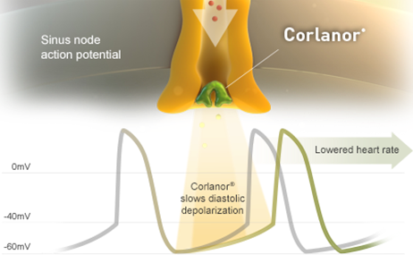
IVABRADINE
Ivabradine slows diastolic depolarization

Slide 54
Ivabradine Trials
Reduces atherosclerosis (Circ 2008;117:2377-87)
  Decreases vascular oxidative stress
  Improves endothelial function
Increases exercise tolerance and time to ischemia in
patients with > 3 months angina (Circ 2003;107:817-23)
Non-inferior to Atenolol (Eur Heart J 2005;26:2529-36)
  Exercise tolerance, time to angina or ischemia
Non-inferior to Amlodipine (Drugs 2007;67(3):393-405)
54
Notes:
Atherosclerosis, Male apolipoprotein E-deficient mice fed a high-cholesterol diet, Ivabradine decreased atherosclerotic plaque size in the ascending aorta by >70% in 6 weeks.
Exertional tolerance: Using bicycle Exercise Tolerence test, there was an increased time to ST depression and time to exercise limiting angina. NOTE, this was after a 2-7 day washout of all anti-anginals, including betablockers.
Compared to atenolol for 12 weeks of administration

Slide 55
MorBidity-mortality EvAlUation of The I _{f} inhibitor Ivabradine in patients with coronary disease and left ventricULar dysfunction
BEAUTIFUL Trial

Slide 56
BEAUTIFUL TRIAL
Clinical objective
To examine the effects of ivabradine on cardiovascular events in coronary patients with left ventricular dysfunction
Pathophysiological objective
To examine the effects of elevated HR (>70 bpm) on cardiovascular events in these coronary patients

Slide 57
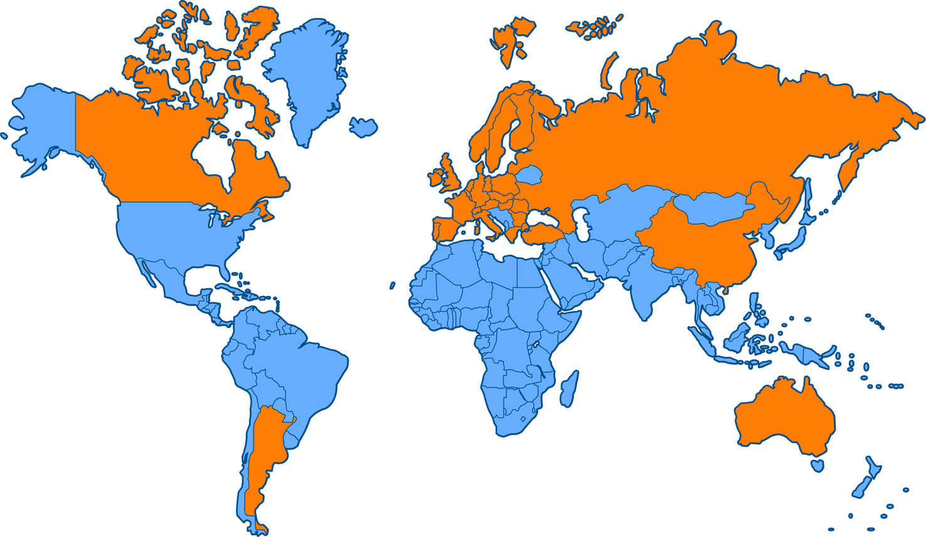
Worldwide study
10 917 participants with documented coronary artery disease
and left ventricular dysfunction
781 sites in 33 countries across 4 continents

Slide 58
Inclusion criteria
Male or female
Nondiabetic ≥55 years, diabetic ≥18 years
Documented coronary artery disease
Sinus rhythm and resting heart rate ≥60 bpm
Documented left ventricular systolic dysfunction (<40%)
Clinically stable for 3 months with regards to angina or
heart failure symptoms or both
Therapeutically stable for 1 month (appropriate or stable doses
of conventional medications)
K. Fox et al. Am Heart J. 2006;152:860-866.

Slide 59
Baseline characteristics
Placebo
Ivabradine
All
Time since CAD diagnosis
(years)
8.2 (7.1)
8.1 (7.0)
8.2 (7.0)
Previous MI (%)
89
88
88
Time since last MI (years)
6.2 (6.0)
5.9 (5.7)
6.0 (5.9)
History of diabetes (%)
37
37
37
History of hypertension (%)
71
71
71
Previous coronary
revascularization (%)
52
51
52
Values in parentheses are standard deviations
Fox K et al. Lancet. 2008;372:807-816.

Slide 60
Concomitant treatment
Placebo
Ivabradine
All
Antithrombotic agents (%)
94
94
94
Statins (%)
74
74
74
β-blockers (%)
87
87
87
Renin-angiotensin blockers (%)
90
90
90
Fox K et al. Lancet. 2008;372:807-816.

Slide 61
Heart rate above 70 bpm increases
risk of myocardial infarction by 46%
Prospective data from the BEAUTIFUL placebo arm
8
Hazard ratio = 1.46 (1.11 – 1.91)
P=0.0066
Heart rate ≥70 bpm
6
% with hospitalization for
fatal and nonfatal MI
4
Heart rate <70 bpm
2
0
0
0
0.5
1
1.5
2
Years
Fox K et al. Lancet. 2008;372:817-821.

Slide 62
Heart rate above 70 bpm increases
risk of coronary revascularization by 38%
% with coronary revascularization
6
Hazard ratio = 1.38 (1.02 – 1.86)
P=0.037
Heart rate ≥70 bpm
4
2
Heart rate <70 bpm
0
0
0.5
1
1.5
2
Years
Fox K et al. Lancet. 2008;372:817-821

Slide 63
Effect of ivabradine on primary endpoint (Overall population)
% with primary composite end point of CV death, hospitalization for acute MI, or for new-onset or worsening heart failure
25
Hazard ratio = 1.00 (0.91 – 1.10)
P=0.94
20
Ivabradine
15
Placebo
10
5
0
0
0.5
1
1.5
2
Years
Fox K et al. Lancet. 2008;372:807-816.

Slide 64
Ivabradine reduces fatal and nonfatal myocardial infarction (HR ≥70 bpm)
8
Hazard ratio = 0.64 (0.49 – 0.84)
P=0.001
Placebo
(HR >70 bpm)
RRR 36%
Hospitalization for
fatal or nonfatal MI (%)
4
Ivabradine
0
0
0.5
1
1.5
2
Years
RRR: relative risk reduction
Fox K et al. Lancet. 2008;372:807-816.

Slide 65
Ivabradine reduces the need for revascularization (HR ≥70 bpm)
8
Hazard ratio = 0.70 (0.52 – 0.93)
P=0.016
Placebo
(HR >70 bpm)
RRR 30%
Coronary revascularization (%)
4
Ivabradine
0
0
0.5
1
1.5
2
Years
RRR: relative risk reduction
Fox K et al. Lancet. 2008;372:807-816.

Slide 66
Ivabradine reduces primary end point in angina patients
Primary end point(PEP) : CV death + hospitalization for HF or MI
20
Placebo
-24%
n=1507
P=0.05
15
Cumulative incidence
for PEP* (%)
10
Ivabradine
5
0
0
0.5
1
1.5
2
Years
Fox K, Ford I, et al; BEAUTIFUL Investigators. Effect of ivabradine on cardiovascular outcomes in patients with stable coronary artery diseaseand left-ventricular systolic dysfunction with limiting angina: a subgroup analysis of the randomized, controlled BEAUTIFUL trial. Eur heart Jour On line.

Slide 67
Ivabradine reduces myocardial infarction in patients with angina
All patients with angina
Patients with angina and
heart rate >70 bpm
15
15
Hospitalization for fatal and nonfatal MI
HR (95% CI), 0.58 (0.37–0.92); P=0.021
Hospitalization for fatal and nonfatal MI
HR (95% CI), 0.27 (0.11–0.66); P=0.002
42%
73%
10
10
Event rate (%)
Placebo
Placebo
5
Event rate (%)
5
Ivabradine
Ivabradine
0
0
0
0.5
1
1.5
2
0
0.5
1
1.5
2
Years
Years
Fox K, Ford I, et al; BEAUTIFUL Investigators. Effect of ivabradine on cardiovascular outcomes in patients with stable coronary artery diseaseand left-ventricular systolic dysfunction with limiting angina: a subgroup analysis of the randomized, controlled BEAUTIFUL trial. Eur heart Jour On line.

Slide 68
BEAUTIFUL Summary
Ivabradine, the first selective and specific I_{f} inhibitor, has already demonstrated antianginal and anti-ischemic efficacy and improvement of cardiac performance
BEAUTIFUL, the first morbidity-mortality trial with ivabradine, includes 10 917 patients with documented stable coronary artery disease and left ventricular dysfunction receiving optimal guidelines-based therapy.
  In patients with coronary artery disease and left ventricular dysfunction, those with a heart rate >70 bpm have a higher risk of cardiovascular mortality, hospitalization for myocardial infarction, and heart failure.
  In patients with heart rate >70 bpm, ivabradine reduces the composite of fatal and nonfatal myocardial infarction and reduces the need for revascularisation.
  In angina patients, ivabradine reduces the primary end point of cardiovascular death, hospitalization for heart failure, or for myocardial infarction.

Slide 69
Systolic Heart failure treatment with
the If inhibitor ivabradine Trial
SHIFT Trial
http://www.lancet.com published online August 29, 2010 DOI:10.1016/S0140-6736(10)61198-1

Slide 70
Background
Elevated heart rate is associated with poor outcome in a number of cardiovascular conditions including heart failure
Heart rate remains elevated in many heart failure patients despite treatment by beta-blockers
Ivabradine is a novel heart rate-lowering agent acting by inhibiting the I_{f} current in the sino-atrial node
We hypothesized that the addition of ivabradine to recommended therapy would be beneficial in heart failure patients with elevated heart rate

Slide 71
Primary objective
To evaluate whether the I_{f} inhibitor ivabradine improves cardiovascular outcomes in patients with
1. Moderate to severe chronic heart failure
2. Left ventricular ejection fraction ≤35%
3. Heart rate ≥70 bpm and
4. Recommended therapy

Slide 72
Worldwide
Europe
Germany Portugal
Belgium Greece Spain
Denmark Ireland Sweden
Finland Italy Turkey
France The Netherlands UK
Bulgaria
Czech Republic
Estonia
Hungary
Latvia
Lithuania
Norway
Poland
Romania
Russia
Slovakia
Slovenia
Ukraine
North America
Canada
Asia
China
Hong Kong
India
South Korea
Malaysia
South America
Argentina
Brazil
Chili
Australia
6505 patients, 37 countries, 677 centres

Slide 73
Inclusion criteria
≥18 years
Class II to IV NYHA heart failure
Ischemic/non-ischemic etiology
LV systolic dysfunction (EF ≤35%)
Heart rate ≥70 bpm
Sinus rhythm
Documented hospital admission for worsening heart failure ≤12 months
Swedberg K, et al. Eur J Heart Fail. 2010;12:75-81.
Notes:
73

Slide 74
Study endpoints
Primary composite endpoint
Cardiovascular death
Hospitalization for worsening heart failure
Other endpoints
All-cause / CV / HF death
All-cause / CV / HF hospitalization
Composite of CV death, hospitalization for HF or non-fatal MI
NYHA class / Patient & Physician Global Assessment
In total population and in patients with at least 50% target dose of beta-blockers
Swedberg K, et al. Eur J Heart Fail. 2010;12:75-81.
Notes:
74

Slide 75
STUDY DESIGN
7411 screened
6558 randomized
3268 to ivabradine
3290 to placebo
5mg BID
Excluded: 27
Excluded: 26
3241 analyzed
2 lost to follow-up
3264 analyzed
1 lost to follow-up
Median study duration: 22.9 months; maximum: 41.7 months

Slide 76
Baseline characteristics
 | Ivabradine 3241 | Placebo 3264
Mean age, y | 60.7 | 60.1
Male, % | 76 | 77
Ischemic etiology, % | 68 | 67
NYHA II, % | 49 | 49
NYHA III/IV, % | 51 | 51
Previous MI, % | 56 | 56
Diabetes, % | 30 | 31
Hypertension, % | 67 | 66
Baseline EF | 29 | 29

Slide 77
Chronic HF background treatment
Patients (%)
100
91
91
89
90
90
84
83
Ivabradine
80
Placebo
70
61
59
60
50
40
30
22
22
20
10
3
4
0
Beta-blockers
ACEIs and/or
Diuretics
Aldosterone
Digitalis
ICD/CRT
ARBs
antagonists

Slide 78
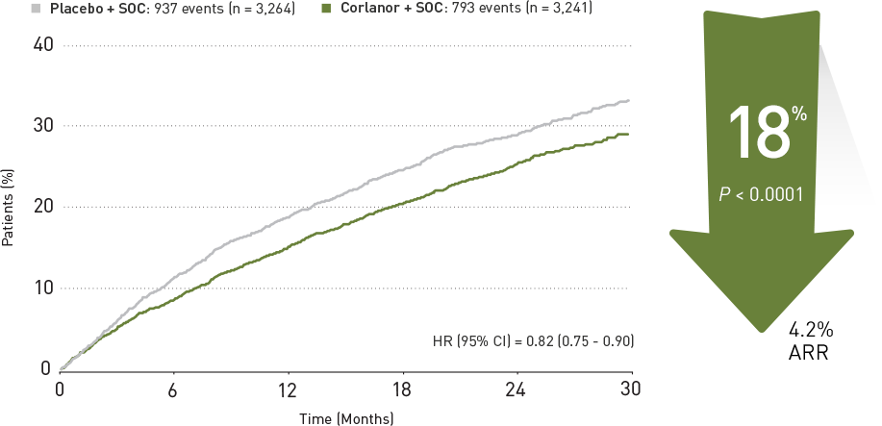
Time to first event of primary composite end point
Ivabradine
placebo
Ivabradine

Slide 79
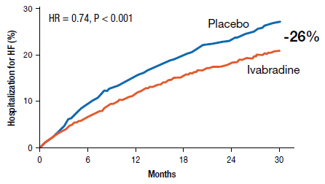
Hospitalization for heart failure
Ivabradine n=514 (9.4%PY) Placebo n=672 (12.7%PY)

Slide 80
Effect of ivabradine on outcomes
Endpoints | Hazard ratio | 95% CI | p value
Primary composite endpoint | 0.82 | [0.75;0.90] | p<0.0001
All-cause death | 0.90 | [0.80;1.02] | p=0.092
Death from HF | 0.74 | [0.58;0.94] | p=0.014
Hospital for any cause | 0.89 | [0.82;0.96] | p=0.003
Hospital for CV reason | 0.85 | [0.78;0.92] | p=0.0002
CV death/hospital for HF or non-fatal MI | 0.82 | [0.74;0.89] | p<0.0001

Slide 81
Incidence of selected adverse events (N = 6492)
 | Patients with an event
 | Ivabradine N=3232, % (n) | Placebo N=3260, % (n) | p value
All serious adverse events | 45% (1450) | 48% (1553) | 0.025
All adverse events | 75% (2439) | 74% (2423) | 0.303
Heart failure | 25% (804) | 29% (937) | 0.0005
Symptomatic bradycardia | 5% (150) | 1% (32) | <0.0001
Asymptomatic bradycardia | 6% (184) | 1% (48) | <0.0001
Atrial fibrillation | 9% (306) | 8% (251) | 0.012
Phosphenes | 3% (89) | 1% (17) | <0.0001
Blurred vision | 1% (17) | <1% (7) | 0.042

Slide 82
Conclusion
Heart failure with systolic dysfunction and elevated heart rate is associated with poor outcomes (primary composite endpoint in the placebo group is 18%/year)
Ivabradine reduced CV mortality or heart failure hospitalization by 18% (p<0.0001). The absolute risk reduction was 4.2%
This beneficial effect was mainly driven by a favourable effect on heart failure death/hospital admission (RRR 26%)
Overall, treatment with ivabradine was safe and well tolerated

Slide 83

IVABRADINE – FDA Approved in the US
Indicated to reduce the risk of hospitalization for worsening heart failure in patients with stable, symptomatic chronic heart failure with left ventricular ejection fraction < = 35% who are in sinus rhythm with resting heart rates > = 70 beats per minute and on max tolerated doses of betablockers.

Slide 84
Contraindicated in patients with…
Acute decompensated HF
Blood pressure < 90/50
Sick sinus syndrome, AV block without the protection of a PM
Resting heart rate < 60
Severe hepatic impairment
PM set to HR > 70
Concomitant use of strong P450 3A4 (CYP3A4) inhibitors

Slide 85
Side Effects
Bradycardia
Hypertension, blood pressure increased
Atrial fibrillation
Phosphenes, visual brightness
DOSING
  5mg BID, 2.5mg bid >>> 7.5mg BID

Slide 86
THANK YOU
QUESTIONS?

