Slide 1
Hypertension & Cholesterol
Blake Wachter, MD, PhD
Idaho Heart Institute

Slide 2
Epidemiology
1 billion people (26%) people of the world have HTN
As high as 69 % of men and 73% women
American Heart Association estimated the direct and indirect costs of high blood pressure in 2010 as $76.6 billion
In the US 80% of people with hypertension are aware of their condition, 71% take some antihypertensive medication, but only 48% of people aware that they have hypertension adequately control it

Slide 3
Hypertension
Systolic / Diastolic
90% are primary hypertension
10% other

Slide 4
Definitions
Normal < 120/80
Pre < 140/90
Stage 1 < 160/100
Stage II > 160/100
Urgency : DBP > 120
Emergency: acute or rapidly worsening organ damage
Malignant: HTN emergency with papilledema (retinal hemorrhages and exudates)

Slide 5
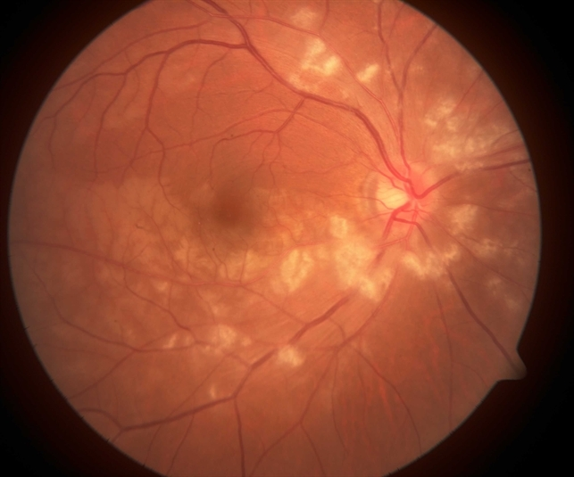

Slide 7
Other Causes of HTN
Renal disease
Pheochromocytoma
Endocrine
Acromegaly
Thyroid disease
Chronic kidney disease
Obesity
Sleep apnea
Hyperaldosteronism
Pregnancy
Alcoholism / Diet / Drugs

Slide 10
Symptoms
Headache
Vision changes
Dizziness
Tinnitus, retinopathy
Kidney failure disease
Heart failure / shortness of breath / orthopnea / edema
Chest pain

Slide 11
Workup
Urine: UA, proteinuria,
Chem 7: BUN,Cr, Potassium, Sodium, fasting blood glucose, calcium
CBC: Hct/Hgb
Other: TSH, lipid panel
ECG, Echo

Slide 12
Effects of HTN
Stroke
Kidney disease
Cardiomyopathy / Heart failure
Peripheral vascular disease
Retinopathy
Coronary artery disease
Encephalopathy
Aortic dissection

Slide 13
Pregnancy and HTN
2 measurements of > 140/90
Precursor to preeclampsia
Protein in the urine

Slide 14
Lifestyle Modifications
Exercise (30 min / day)
DASH (dietary approach to stop hypertension
BMI < 25
Sodium < 2500mg /day
Diet rich in fruit and veggies
Alcohol (3/day men, 2/day women)
Stress (minor role)

Slide 16
Treatment
Thiazide diuretics
ACE-I / ARBS
Calcium Chanel Blockers
Betablocker
Alpha blockers
Aldosterone antagonist
Avoid NSAIDS

Slide 17
Notes:
ABPM = ambulatory blood pressure monitoring; ACC = American College of Cardiology; AHA = American Heart Association; ASH = American Society of Hypertension; BP = blood pressure; CAD = coronary artery disease; CDC = Centers for Disease Control and Prevention; ESC = European Society of Cardiology; ESH = European Society of Hypertension; IHD = ischemic heart disease; JNC = Joint National Committee; NICE = National Institute for Health and Clinical Excellence; SBP = systolic blood pressure; TIA = transient ischemic attack; yr = years.

Slide 18
HTN in the Elderly
New guideline : < 150/90 (rather than <140/90)
Elderly age: > 80 (NICE and ASH/ISH)
Elderly age: > 60 (JNC 8)
5 out of 14 members of the JNC 8 writing team released a “minority report,” which protested this age-related higher BP goal
“We, the panel minority, believe that the evidence was insufficient to increase the systolic BP goal from its current level of <140 mm Hg because of concern that increasing the goal may cause harm by increasing the risk for cardiovascular disease and partially undoing the remarkable progress in reducing cardiovascular mortality in Americans older than 60 years.”

Slide 19
Renal Artery Stenosis
Atherosclerotic renal-artery stenosis is a common problem in the elderly, and is a recognized cause of secondary hypertension. Renal artery stenting for this condition is a common procedure in current clinical practice.
CORAL (Cardiovascular Outcomes in Renal Atherosclerotic Lesions)
947 patients randomized to medical therapy vs renal stenting + medical therapy
Composite end point (CV death, MI, stroke, hospitalization, renal disease)
No difference
Conclusion: medical therapy is the preferred management

Slide 20
Novel Therapies
Renal artery denervation
Catheter-based radiofrequency denervation of renal artery sympathetic nerves has recently been of great interest as a method of treating resistant hypertension, and preliminary studies were very impressive, showing systolic BP falls of 20-30 mm Hg, sustained for at least 24 months, with a very reassuring safety profile
However, the first pivotal study with sham-catheterized controls failed to meet its primary efficacy endpoint of a significant change in BP from baseline to 6 months post-randomization, and the study has been terminated.

Slide 21
Cholesterol

Slide 22
Cholesterol
The National Cholesterol Educational Panel (NCEP) has published guidelines for lipid management periodically, starting in 1988
The most current recommendations, the Adult Treatment Program III (ATP III), were published in 2001 and updated in 2004
New 2014 updates

Slide 23
LDL – primary target
For both primary and secondary prevention, LDL-C is the primary target for the majority of patients.
Major clinical trials that support LDL-C lowering to reduce cardiovascular disease events include: HPS, PROSPER, ALLHAT-LLT, ASCOT-LLA, PROVE IT-TIMI 22, VA-HIT, TNT, REVERSAL, IDEAL, and ASTERIOD.

Slide 26
Framingham Risk Score
The risk assessment tool below uses information from the Framingham Heart Study to predict a person’s chance of having a heart attack in the next 10 years. This tool is designed for adults aged 20 and older who do not have heart disease or diabetes.
Age
Sex
Total Cholesterol
HDL
Smoking
SBP (+/- medications)

Slide 27
High Risk for CAD
Known CAD
DM, PVD (aorta aneurysm), stroke, symptomatic carotid stenosis
Patients with 2+ risk factors who have a 10-year risk of CHD >20% are considered to have a CHD risk equivalent, and therefore, are at high risk.
For such patients, a goal LDL-C <100 mg/dl is reasonable.

Slide 28
Low Risk
The majority of patients with 0-1 risk factors have a low FRS (i.e., <10%).
For these low-risk adults, a goal LDL-C <160 mg/dl is considered reasonable.

Slide 29
Non-HDL Targets
Consider non-HDL targets when:
LDL target is met
Triglycerides > 200 mg/dl
Non-HDL goals are 30 mg/dl above the LDL-C goal
LDL-C goal is <100 mg/dl = non-HDL goal of <130
LDL-C goal of <70 mg/dl = non-HDL goal of <100

Slide 30
When LDL is not Primary Target
Triglyceride levels ≥500 mg/dl
Treat triglycerides first, then LDL when < 500

Slide 31
Example
Male patient at intermediate cardiovascular disease risk who has an LDL of 125 mg/dl, HDL of 30 mg/dl, and total cholesterol of 200 mg/dl.
LDL = 125 (goal < 130)
Non-HDL = 170 (goal < 160)

Slide 32
Trials
JUPITER (prevention of CVD)
17802 patients randomized to rosuvastatin vs placebo with high CRP
LDL < 130, CRP > 2
Healthy (no CVD and no DM)
Primary end point (MI, stoke, unstable angina, CV death)
Outcome: reduction of primary end point in rosuvastatin group
Conclusion: The benefits of rosuvastatin were noted for all subgroups.
The key finding of JUPITER was the benefit of statin therapy for primary prevention among patients without significant elevations of LDL-C at baseline.

Slide 35
Treatment
When patients cannot achieve their LDL goal with statin can consider combination therapies
ezetimide, bile acid sequestrants, or nicotinic acid, plant stanols/sterols
Ezetimide is also used in combination with statins for lowering LDL-C. Data for ezetimide have not been shown to reduce significant outcomes, such as MI.
NEW: AHA November
IMPROVE-IT trial proves EZETIMBE with STATIN is a benefit in reducing outcomes.

Slide 36
Treatment
Niacin: Studies have shown the combination effect of niacin to be benefical with statin. However, recent data suggests caution with niacin and statin due to increased risk of rhabdomyalysis
No flush over-the-counter preparations are ineffective for HDL raising (or LDL lowering), as they contain nicotinamide, the inactive form of the vitamin, rather than nicotinic acid.
Fibrates: Prior clinical trials with fibrates suggested a risk reduction for CHD events in patients with high triglycerides and low HDL-C, particularly among patients with diabetes.
ACCORD study do not confirm such benefits in patient with DM
Increase risk of myopathy with statins

Slide 37
Myopathies
Creatine phosphokinase (CPK) should be drawn at baseline, with repeat measures only when significant muscle aches are reported.
Statin dose should be reduced or discontinued for a CPK level >10 times normal.
Hypothyroidism can predispose patients to myopathy
Rhabdomyolysis is rare, and is associated with an increased risk of mortality (~10%).
Nonspecific muscle aches with minor or no CPK elevations are present in approximately 5% of patients which is similar to placebo
Clinical trials have found no significant side effects from very low LDL lowering

Slide 38
2014 Updates
Four statin benefit groups
Elimination of low-density lipoprotein cholesterol (LDL-C) and/or non–high-density lipoprotein cholesterol (non–HDL-C) targets.
New, pooled risk assessment.
Use of biomarkers and noninvasive tests.
Safety/monitoring recommendations.

Slide 39
Benefit Groups
Individuals with known clinical ASCVD (i.e., acute coronary syndromes or history of myocardial infarction, stable or unstable angina, coronary or other arterial revascularization, stroke, transient ischemic attack, or peripheral arterial disease of atherosclerotic origin).
Primary elevations of LDL-C >190 mg/dl (i.e., familial hypercholesterolemia).
Individuals with diabetes ages 40-75 years with LDL-C 70-189 mg/dl and without clinical ASCVD.
Individuals ages 40-75 years without known clinical ASCVD or diabetes with LDL-C 70-189 mg/dl and estimated 10-year ASCVD risk >7.5%.

Slide 41
Limitations
What do we do with patients currently on statin therapies?
Patients on intense therapy and LDL not “at goal”?
Myopathy epidemic and patient resistance?
One size fits all
Tends to over treat the elderly “lower” risk
Tends to undertreat the younger “higher” risk

Slide 42
Thank You
Questions?

