Slide 1
Elevated resting heart rate in heart transplant recipients: innocent bystander or adverse prognostic indicator?
UTAH (Utah Transplant Affiliated Hospitals) Cardiac Transplant Program
University of Utah, Intermountain Medical Center, and Salt Lake Veterans Administration Medical Center
Wachter SB, Stoddard G, Saidi A, Brunisholz K, Folsom J, Deshmukh V, Hammond L, Selzman C, Reid B, Kfoury B, Bader F, Budge D, Alharethi R, Stehlik J, Drakos S, Gilbert EM
American Transplant Congress
June 5, 2012
Notes:
Elevated resting heart rate in heart transplant recipients, an innocent bystander or adverse prognostic indicator?

Slide 2
Disclosures
none

Slide 3
Background
Elevated resting heart rate is known to be a risk factor of adverse cardiovascular outcomes in the general population
Studies in heart transplant patients with tachycardia also show adverse cardiovascular outcomes
Effects of tachycardia on mortality in a large cohort study has not previously been presented
Notes:
An elevated resting heart rate is known to be a risk factor of adverse cardiovascular outcomes in the general population.
Studies in heart transplant patients with tachycardia also show adverse cardiovascular outcomes.
However, the effects of tachycardia on mortality in a large cohort study has not previously been presented.

Slide 4
Hypothesis
In heart transplant patients sustained tachycardia increases the risk of:
All cause mortality
Cardiac allograft vasculopathy
Notes:
Our hypothesis is that in heart transplant patients, a sustained tachycardia increases the risk of all cause mortality and allograft vasculopathy.

Slide 5
Methods
Retrospective study
Adult patients with OHT from 2000 – 2011
Survived post transplant at least 3 months
In-patient and out-patient clinical records
University of Utah
Intermountain Medical Center
Salt Lake Veterans Administration Medical Center
Notes:
We retrospectively studied adult patients with orthotopic heart transplant in the years 2000 to 2011. To be included in the study, the patients had to survive at least 3 months post transplant, participate in routine outpatient clinic visits at one of our Utah cardiac transplant centers for at least 1 year.

Slide 6
Collected Data
Vital signs
ECGs
Left heart catheterizations
Cardiac biopsies
Laboratory data
Baseline clinical characteristics
Echocardiograms
Notes:
The data that was studied during the routine clinic visits included: vital signs, ECGs, left heart cath, biopsies, labs, echocardiograms, and some baseline characteristics.

Slide 7
Defining the Study Groups
Average heart rate collected by physical exam during months 3 to 12 post transplant
Study groups
Tachycardia group
Average heart rate > 100 bpm
Non Tachycardia group
Average heart rate ≤100 bpm
Notes:
To define the two study groups we first averaged the heart rates collected during the routine clinic visits from month 3 to 12 post transplant. Then the patients were assigned to either the tachycardia group with average heart rates > 100 bpm or the non tachycarida group.

Slide 8
Results
Notes:
Now I will review the results

Slide 9
Heart Rate Distribution
Non Tachycardia
HR ≤ 100 bpm
N=236 (76%)
Tachycardia
HR > 100 bpm
N=73 (24%)
bpm
Notes:
As you can see the heart rate distribution fit a normal bell shape curve. There were 73 patients (or 24%) of patients who fell into the tachcyardia group and 236 or 76% in the non tachycardia group.

Slide 10
Baseline Characteristics (pre transplant)
 | Non Tachycardia (HR ≤100) N=236 | Tachycardia (HR > 100) N = 73 | p-value
Recipient Males | 80% | 74% | 0.27
Donor Males | 71% | 69% | 0.77
Donor CMV | 66% | 65% | 0.94
Recipient Age | 49 ± 14 | 49 ± 12 | 0.98
Donor Age | 24 ± 9 | 33 ± 12 | < 0.001 *
Recipient BMI | 27 ± 5 | 25 ± 4 | 0.002 *
DM | 9% | 11% | 0.60
HTN | 13% | 25% | 0.01 *
CKD | 3% | 7% | 0.08
HLD | 17% | 26% | 0.07
Hypothyroid | 3% | 3% | 0.93
CVA | 3% | 11% | 0.01 *
Smoking | 44% | 44% | 0.99
Notes:
The baseline characteristics are similar between the two groups except for increased documentation of stroke and hypertension, a lower BMI in the tachycardia group. Interestingly, in our study, contrary to other documented studies, we found that the tachycardia group was associated with an older donor age.

Slide 11
Heart Failure Etiology
 | Non Tachycardia (HR ≤100) N = 236 | Tachycardia (HR > 100) N= 73
CAD | 46% | 41%
Idiopathic CM | 41% | 45%
Congenital CM | 3% | 8%
Valvular CM | 2% | 3%
Post partum CM | 2% | 0%
Alcoholic CM | 3% | 0%
Allograft vasculopathy | 0% | 2%
Hypertrophic CM | 1% | 0%
Hypoplastic left heart | 1% | 0%
Restrictive | 1% | 0%
Sarcoid | 1% | 0%
Giant cell myocarditis | 1% | 0%
Ischemic
46%
41 %
Non Ischemic
54%
59%
p = 0.58
Notes:
Here is the break down of the heart failure etiologies. Most were either related to coronary artery disease or idopathic. Categorizing them as ischemic vs non ischemic you can see there is no difference between the study groups

Slide 12
Clinical Changes Post Transplant (months 3-12 post transplant)
 | Non Tachcardic (HR ≤100) N = 236 | Tachcardic HR > 100 N = 73 | p-value
LDL > 100 | 7% | 4% | 0.40
TSH < 0.03 | 2% | 4% | 0.40
Hgb < 9 | 6% | 3% | 0.20
Afib by ECG | 0.0% | 1% | 0.40
Low EF < 50% | 7% | 3% | 0.08
Beta Blocker | 3% | 1% | 0.40
Ca²⁺ Channel Blocker | 3% | 0% | 0.10
ACE Inhibitor | 8% | 10% | 0.60
Synthroid | 2% | 4% | 0.40
Notes:
We also examined other possibilities of tachycardia or heart rate related therapies during our heart rate monitoring period of 3 months to 12 months post transplant. As you can see there were few documented events or therapy use and they were the similar between the two groups.

Slide 13
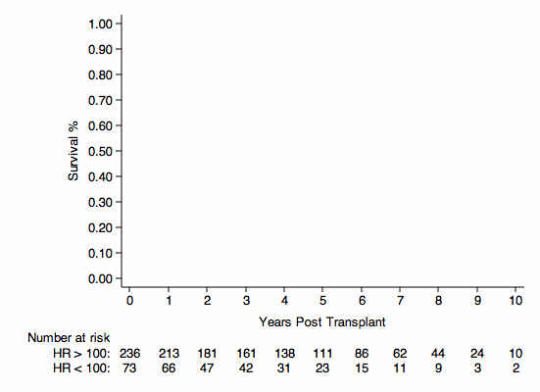
Effect of Tachycardia on All Cause Mortality
Point 0 = 3 months post transplant
Notes:
First I would like to remind the audience that on these next several graphs point 0 on the x axis represents 3 months post transplant. Also the red arrow shows the time period during which we were monitoring heart rate.

Slide 14
Effect of Tachycardia on All Cause Mortality
HR ≤ 100
HR > 100
HR 2.1 95% CI (1.3 – 3.6), p=0.004
Notes:
This is a kaplan meier curve for the effect of tachycardia on all cause mortality. The Y axis shows % survival and the X axis shows years post transplant. The blue line represents the non tachycardia group and the red line represents the tachycardia. We found that patients with tachycardia had a 2 fold increased risk of all cause mortality with a confidence interval of 1.3 to 3.6 and a p value of 0.004.

Slide 15
Effect of Tachycardia on Cardiovascular Mortality
HR ≤ 100
HR > 100
HR 2.4 95% CI (1.0 – 5.7), p=0.04
Notes:
We also found a 2.4 fold increased risk of cardiovascular mortality in patients with tachycardia post transplant with a confidence interval of 1.0 to 5.7 and p-value of 0.04.

Slide 16
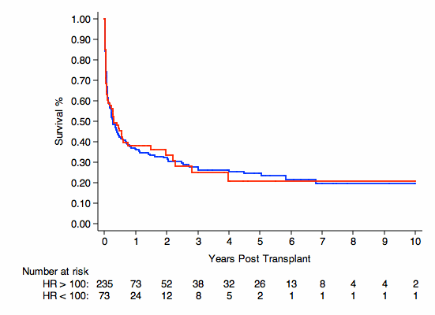
Effect of Tachycardia on Rejection
HR 1.0 95% CI (0.7 – 1.4), p=0.99
HR ≤ 100
HR > 100
Notes:
Interestingly, we did not find difference for the development of rejection between the groups.

Slide 17
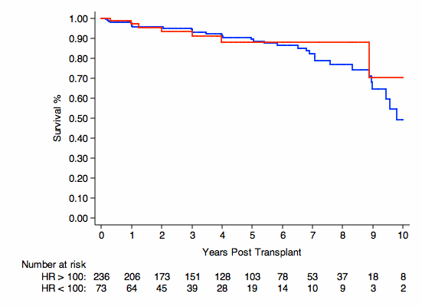
Effect of Tachycardia on Allograft Vasculopathy
HR > 100
HR ≤ 100
HR 0.8 95% CI (0.4 – 1.9), p=0.68
Notes:
And we did not find a difference for the development of allograft vasculopathy. In our study we had 22 events of vasculopathy with 11% in the tachycardia group and 8% in the non tachycardia group.

Slide 18
Multivariable Analysis of All Cause Mortality
Variable | HR (95% CI) | p-value
Recipient Age | 1.00 (0.96 – 1.04) | 0.93
Recipient Gender | 1.48 (0.50 – 4.35) | 0.48
Donor Age | 1.02 (0.98 – 1.06) | 0.32
Donor Gender | 1.08 (0.41 – 2.82) | 0.88
Etiology of Heart Failure | 0.97 (0.37 – 2.50) | 0.94
CMV | 1.20 (0.49 – 2.94) | 0.68
Recipient BMI | 0.96 (0.88 – 1.05) | 0.38
Heart rate > 100 bpm | 3.05 (1.17 – 7.94) | 0.02
Notes:
We performed a multivariable analysis with the shown variables and found that none were a significant factor including donor age.

Slide 19
Limitations
Retrospective study design
A spot measurement of heart rate does not fully reflect the circadian variability of heart rate
The data suggests a significant association but does not prove causality
Notes:
We acknowledge that a retrospective study is a limitation. Also, a spot measurement of heart rate does not fully reflect the circadian variability of heart rate. Finally, although the data suggests a significant association it does not prove causality.

Slide 20
Conclusion
Patients with tachycardia post transplant have an increased risk of all cause mortality
Patients with tachycardia post transplant have an increased risk of cardiovascular death
We did not find a difference in the rate of cardiac allograft vasculopathy or rejection between the two study groups
Notes:
In conclusion, patients with tachycardia post transplant have an increased risk of all cause mortality and cardiovascular death. We did not find a difference in the rate of allograft vasculopathy or rejection between the two study groups.

Slide 21
Thank you, Questions?

